Slide 1
Fossils and Genesis
Can a scientist believe in the Bible and still be scientific?

Slide 2
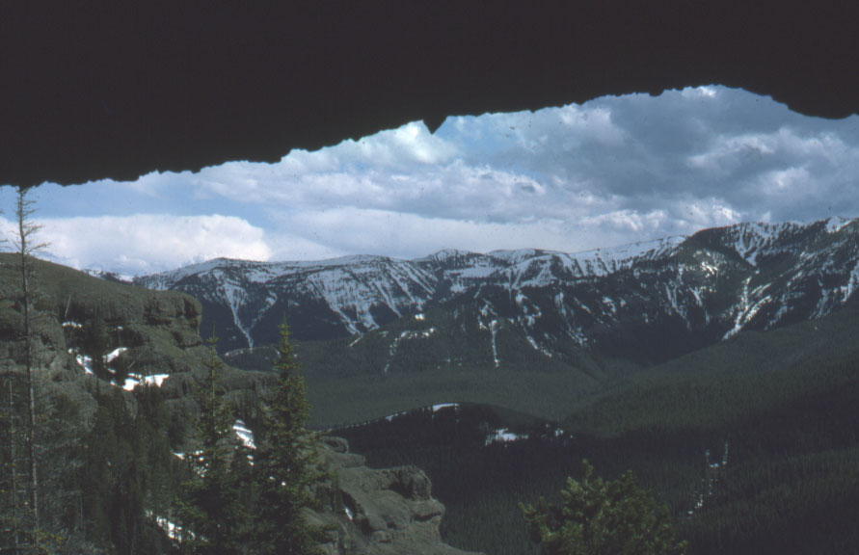
Yellowstone Fossil “Forests" – a case study

Slide 3
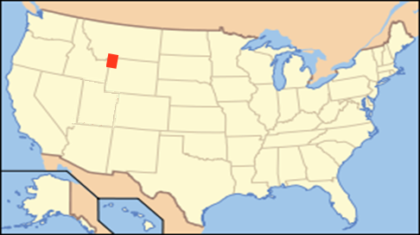
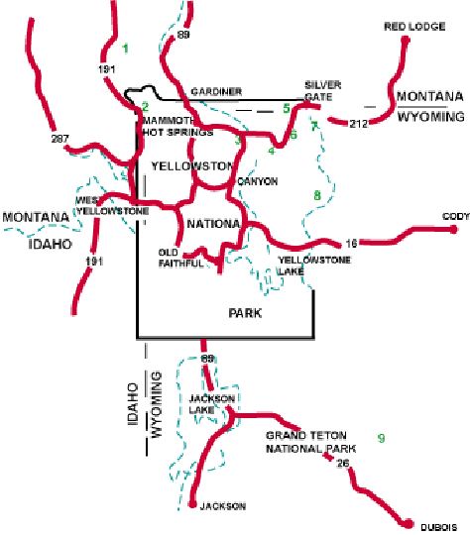

Slide 4
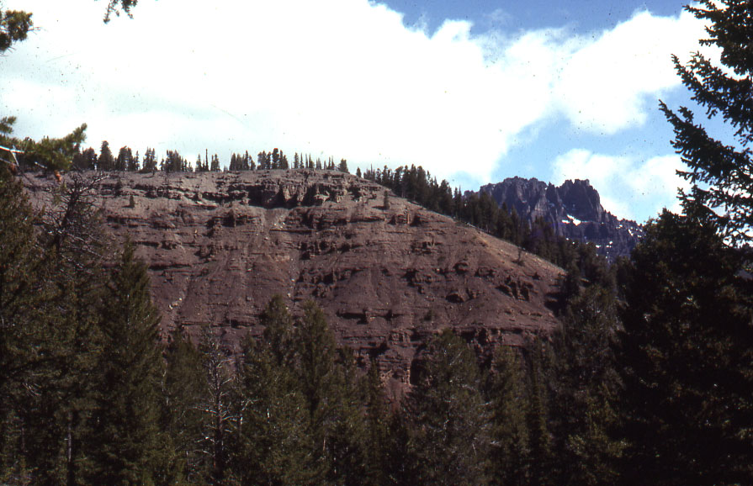

Slide 5
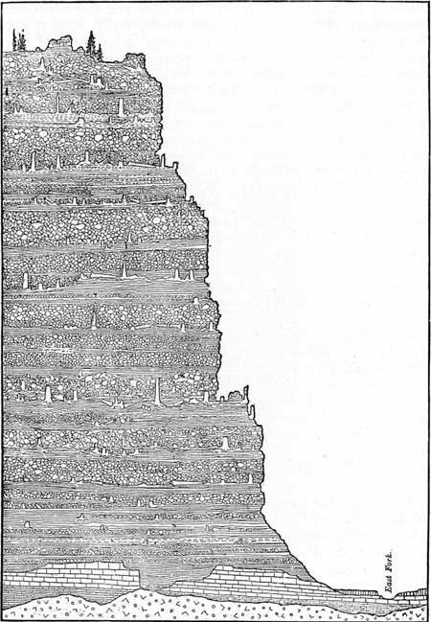

Slide 6
The Geologic Column

Slide 7
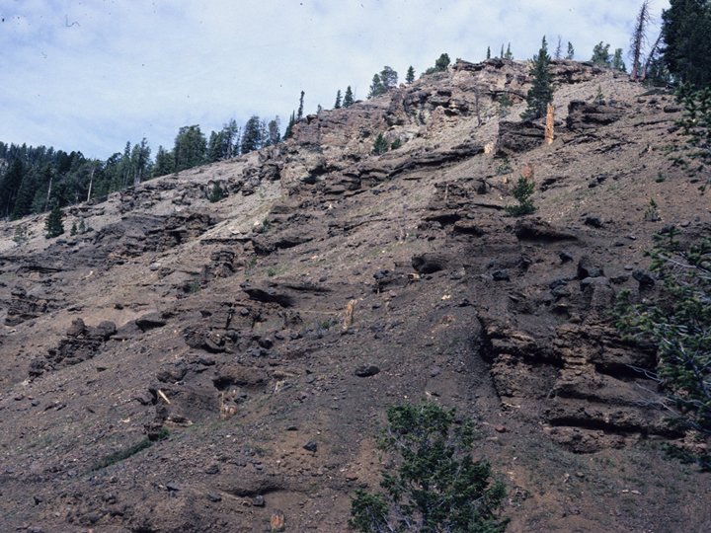

Slide 8
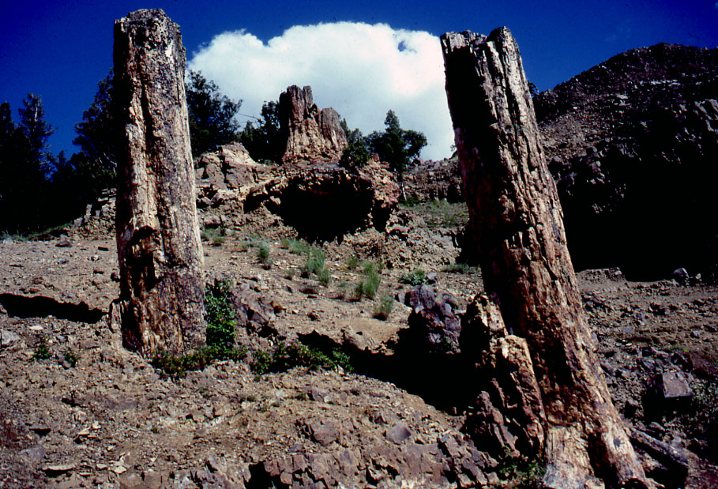

Slide 9
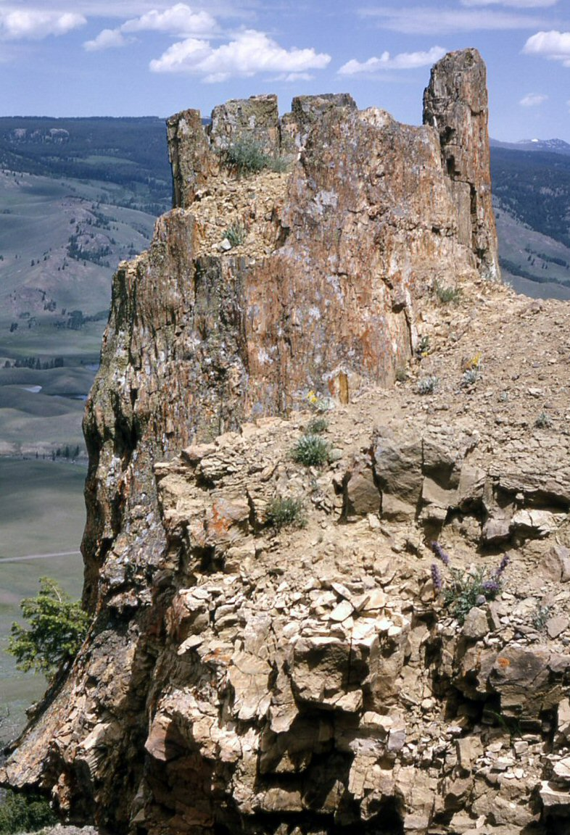

Slide 10
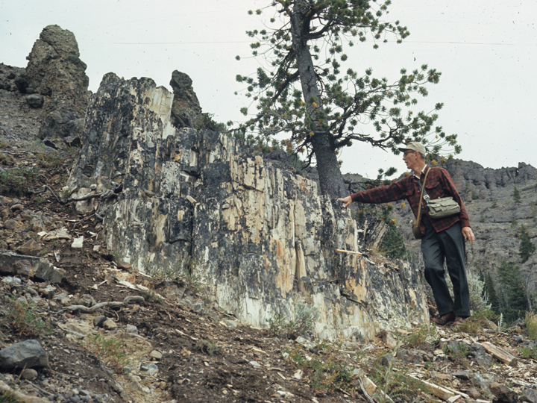
Large stumps and tall trees

Slide 11
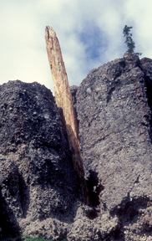

Slide 12
Challenge to Creationists
The Yellowstone "Fossil Forests" appeared to represent many layers of successive forests that grew in place and were buried by successive flows of volcanic rocks. They were presented as a serious challenge to Creationists in the 1960's, since the growth of all these forests (as many as 66 successive layers) would have required many more thousands of years than the Bible record indicates for life on earth, and this cycle of growth and burial had to have occurred before the Pleistocene glaciation (Ice Age).

Slide 13
Challenge to Creationists
The challenge was taken up by Harold Coffin and others, mostly Seventh-day Adventist scientists, who spent years studying the deposits with a mind open to other explanations. We studied the deposits from many different angles, and began to see things that suggested the forests did not grow where they are found. These data were not hidden, they were just not noticed by those who worked within the dominant paradigm. They had a different “search image.”

Slide 14
Features expected if trees buried in place
Growth rings should match within a layer, but would not match in different layers.
Reasonably good match of wood, leaves and pollen in each area.
Common soil profile, with well preserved leaves and needles on top, and decayed farther down.
Logs in various stages of decay.
Complete root systems, especially on well preserved trees.
Abundant cones, matching the nearby trees.
Random orientation of older fallen logs.

Slide 15
Features expected if trees buried in place
Growth rings should match within a layer, but would not match in different layers.
Reasonably good match of wood, leaves and pollen in each area.
Common soil profile, with well preserved leaves and needles on top, and decayed farther down.
Logs in various stages of decay.
Complete root systems, especially on well preserved trees.
Abundant cones, matching the nearby trees.
Random orientation of older fallen logs.

Slide 16
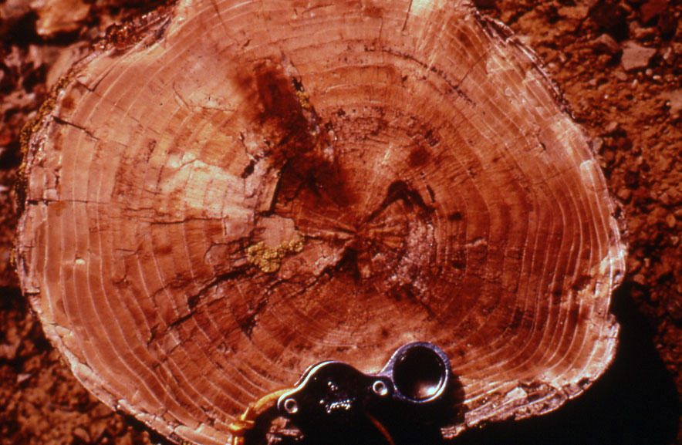
Wood usually with excellent preservation; rings can be counted and wood identified

Slide 17
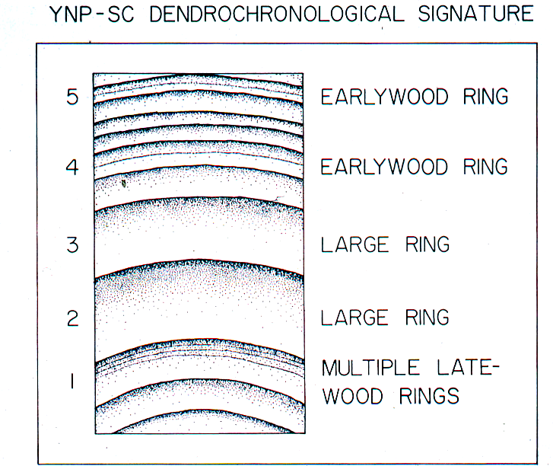

Slide 18
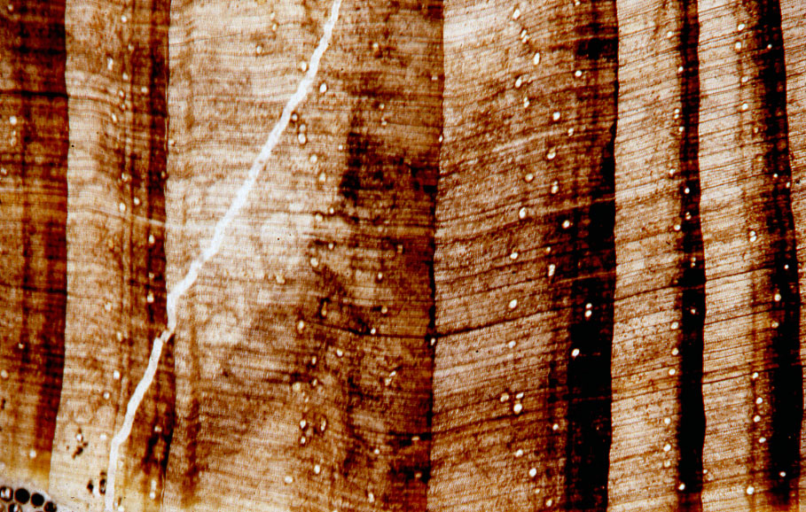

Slide 19
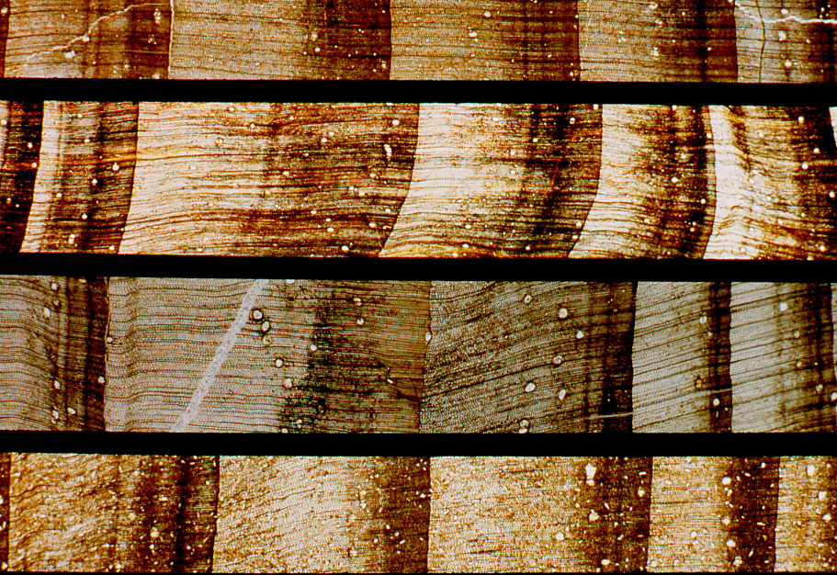

Slide 20
Features expected if trees buried in place
Growth rings match within a layer, but not between layers.
Reasonably good match of wood, leaves and pollen in each area.
Common soil profile, with well preserved leaves and needles on top, and decayed farther down.
Logs in various stages of decay.
Complete root systems, especially on well preserved trees.
Abundant cones, matching the nearby trees.
Random orientation of older fallen logs.

Slide 21
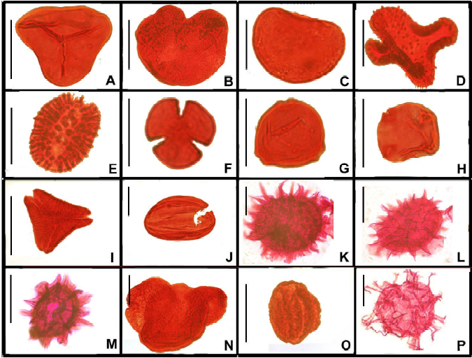
Features as seen in outcrops
Fossil pollen abundance and identity can be compared with identified wood: Do they match?

Slide 22
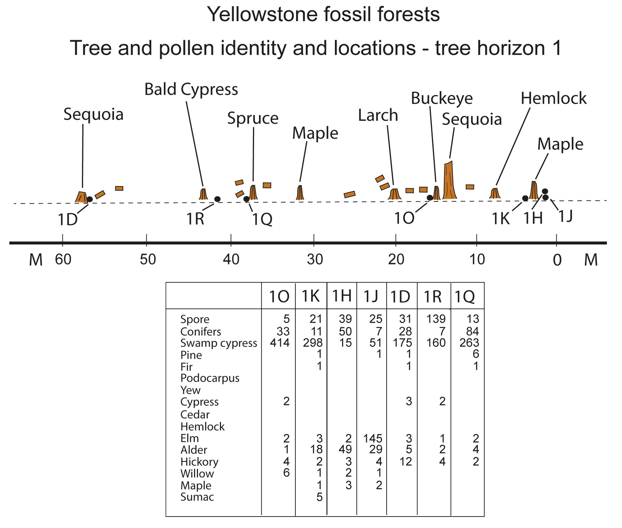

Slide 23
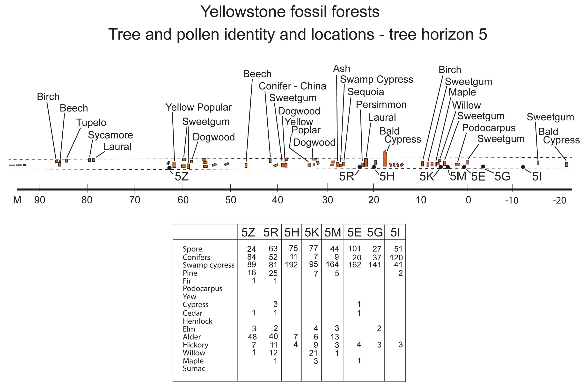

Slide 24
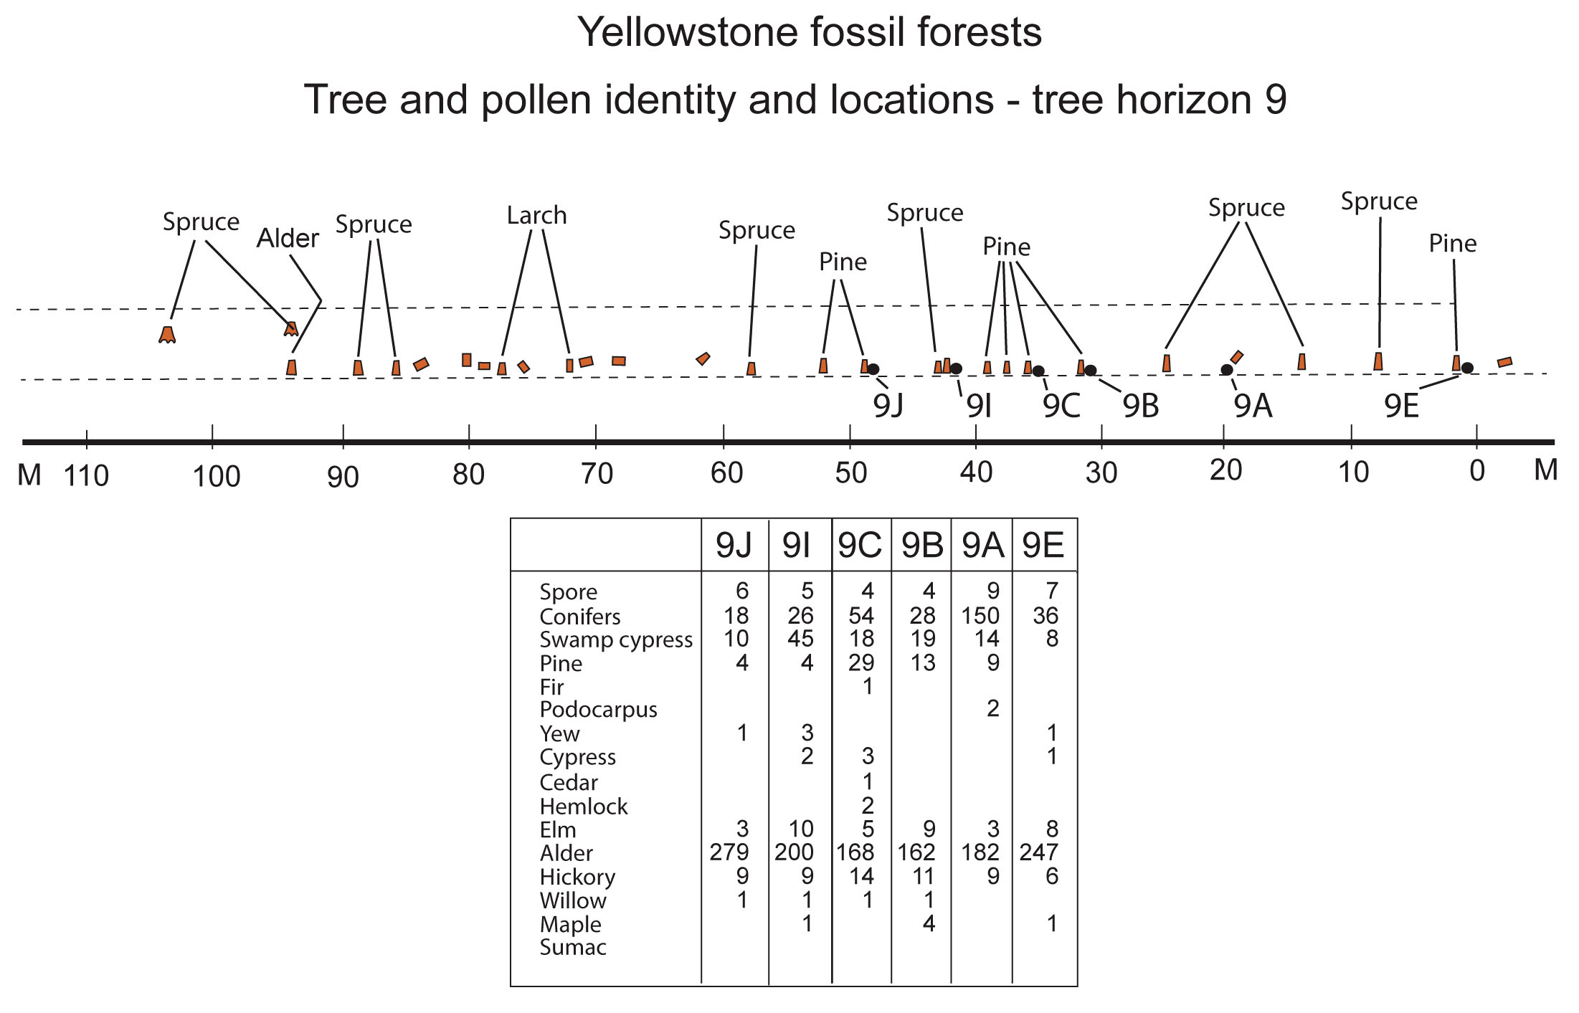

Slide 25
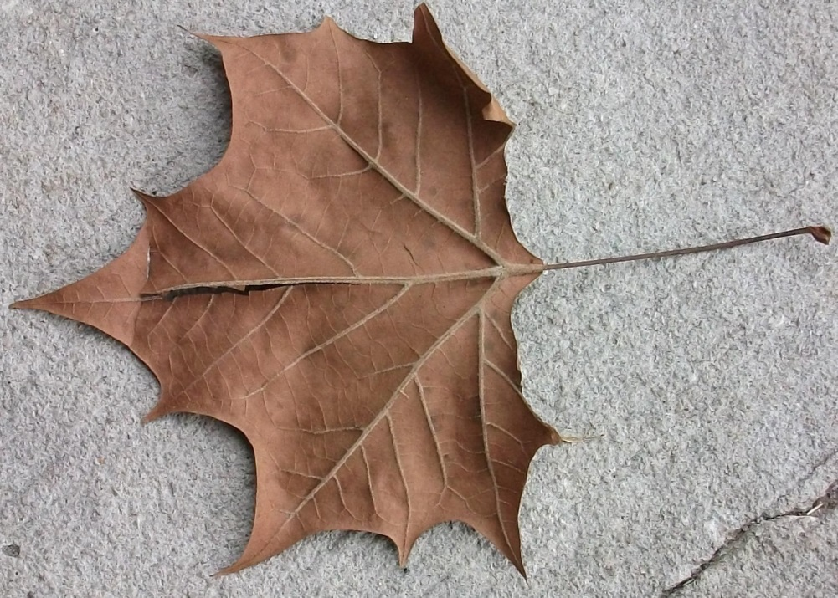
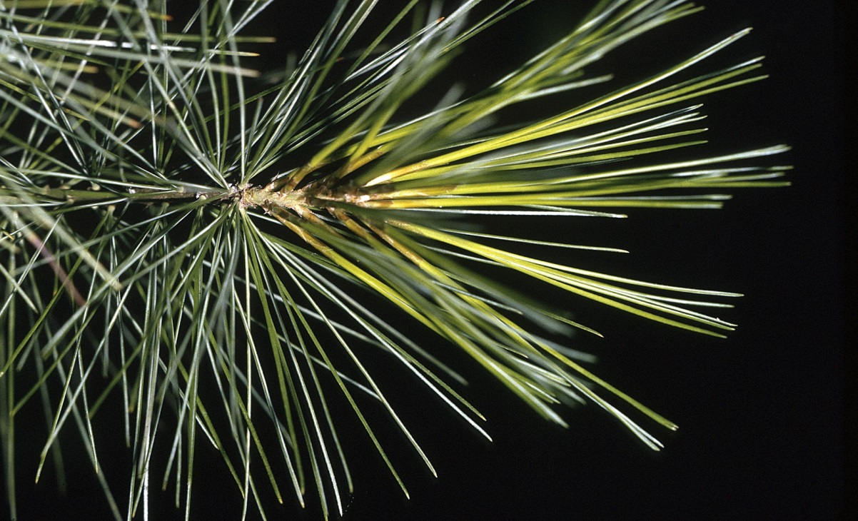
Features as seen in outcrops
Fossil leaves are predominantly broad leaves.
Overall, logs and stumps are predominantly conifers.
There is a poor match between wood, leaves, and pollen.
Broadleaf
Conifer needles

Slide 26
Features expected if trees buried in place
Growth rings match within a layer, but not between layers.
Reasonably good match of wood, leaves and pollen in each area.
Common soil profile, with well preserved leaves and needles on top, and decayed farther down.
Logs in various stages of decay.
Complete root systems, especially on well preserved trees.
Abundant cones, matching the nearby trees.
Random orientation of older fallen logs.

Slide 27
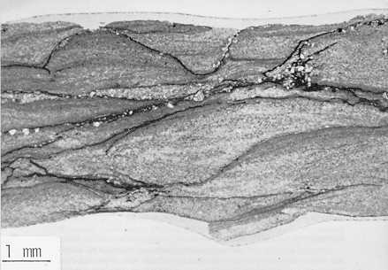
Soil features as seen in thin section
“Organic zones” not like soil.
Thin, and often missing.
Leaves not decayed – well preserved and separated by pure, graded sediment layers.

Slide 28
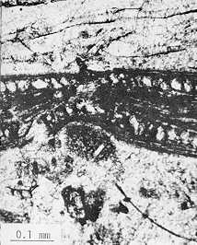
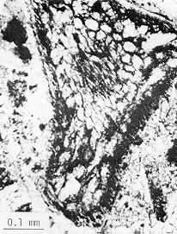
Features as seen in outcrops
Fossil leaves in “soil” horizon are well preserved
Cells of palisade layer of fossil broadleaf well preserved
Likewise for cells of less common coniferous needle

Slide 29
Features expected if trees buried in place
Rings match within a layer, but not between layers.
Reasonably good match of wood, leaves and pollen in each area.
Common soil profile, with well preserved leaves and needles on top, and decayed farther down.
Logs in various stages of decay.
Complete root systems, especially on well preserved trees.
Abundant cones, matching the nearby trees.
Random orientation of older fallen logs.

Slide 30
Features as seen in outcrops
Fossil wood is uniformly well preserved
Roots are often truncated or absent
Cells of palisade layer of fossil broadleaf well preserved

Slide 31
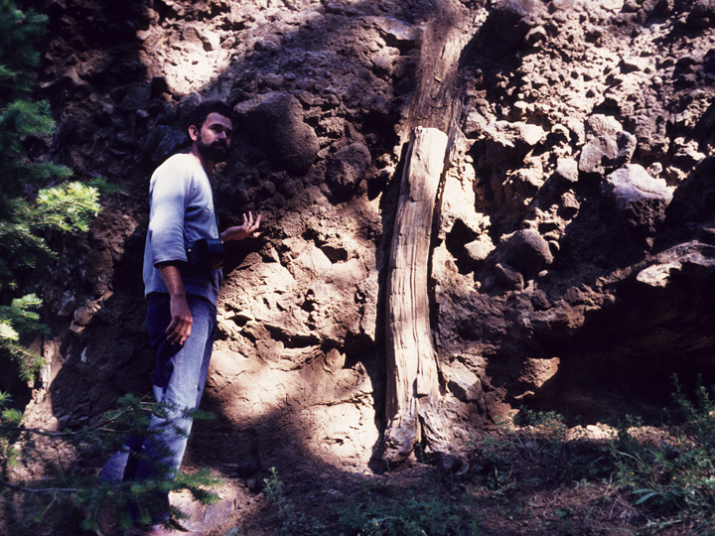
Roots generally broken off close to stumps

Slide 32
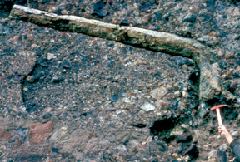
One example of green-stick fracture
Roots also broken off

Slide 33
Features expected if trees buried in place
Growth rings match within a layer, but not between layers.
Reasonably good match of wood, leaves and pollen in each area.
Common soil profile, with well preserved leaves and needles on top, and decayed farther down.
Logs in various stages of decay.
Complete root systems, especially on well preserved trees.
Abundant cones, matching the nearby trees.
Random orientation of older fallen logs.

Slide 34
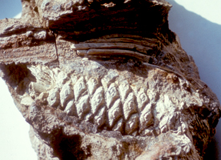
Features as seen in outcrops
Conifer cones, including sequoia, are very rare

Slide 35
Features expected if trees buried in place
Growth rings match within a layer, but not between layers.
Reasonably good match of wood, leaves and pollen in each area.
Common soil profile, with well preserved leaves and needles on top, and decayed farther down.
Logs in various stages of decay.
Complete root systems, especially on well preserved trees.
Abundant cones, matching the nearby trees.
Random orientation of older fallen logs.

Slide 36
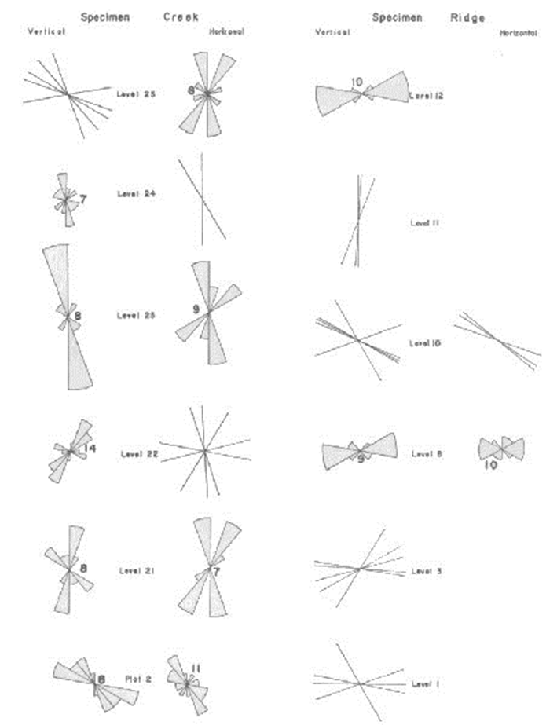
Features as seen in outcrops
Both vertical and horizontal fossil logs and stumps are well oriented,

Slide 37
Summary of Features as seen in outcrop
Tree growth line patterns match across several forest levels.
Poor match between wood, leaves, and pollen.
“Organic zones” not like soil.
Thin, and often missing.
Leaves not decayed – well preserved and separated. by pure, graded sediment layers.
Trees excellently preserved – very little decay.
Larger roots broken off, some small roots near trunk.
Cones rare, but well preserved.
Trunks and stumps with similar alignment.
Wide variety of life zones represented – tropical to high elevation forests.

Slide 38
Summary of Features as seen in outcrop
Not a single example of an animal fossil has ever been collected from the “Fossil Forest” deposits in Yellowstone National Park.

Slide 39
If not actual forests, what are these deposits?
How then can we explain all of the features we have described?

Slide 40
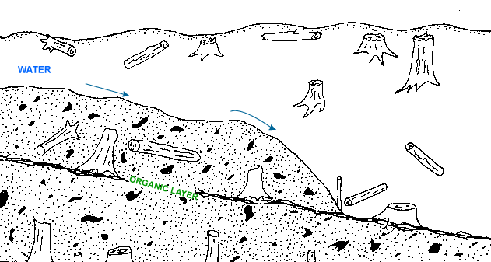
A model for depositing upright trees

Slide 41
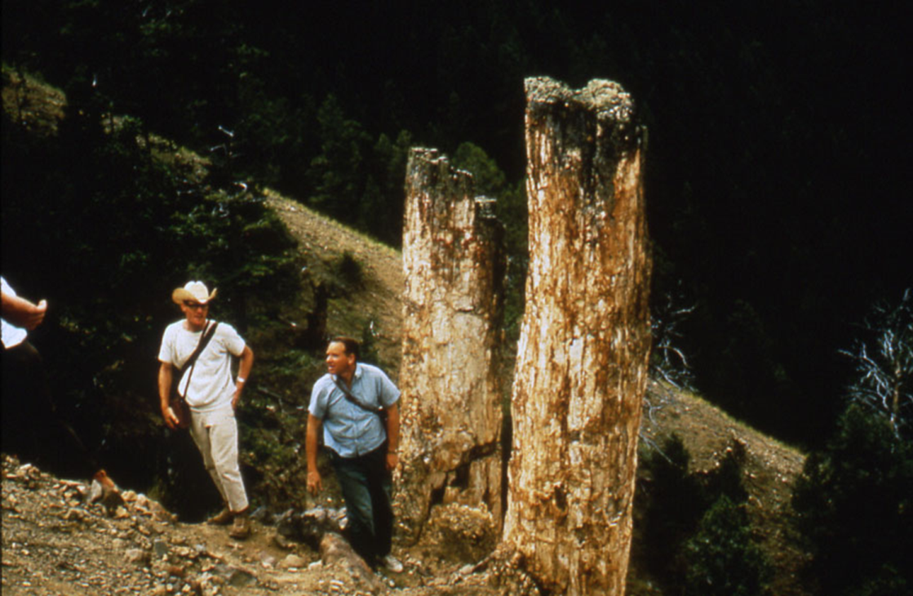
Is there a modern analogue for this model?
Can transported trunks and stumps really be preserved upright?
On May 18, 1980, and the period following, we had the answer to this and other questions regarding the Yellowstone “Fossil” Forests.

Slide 42
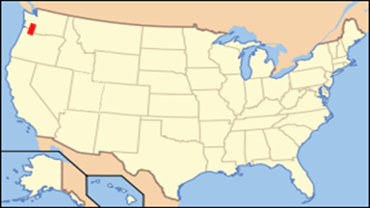
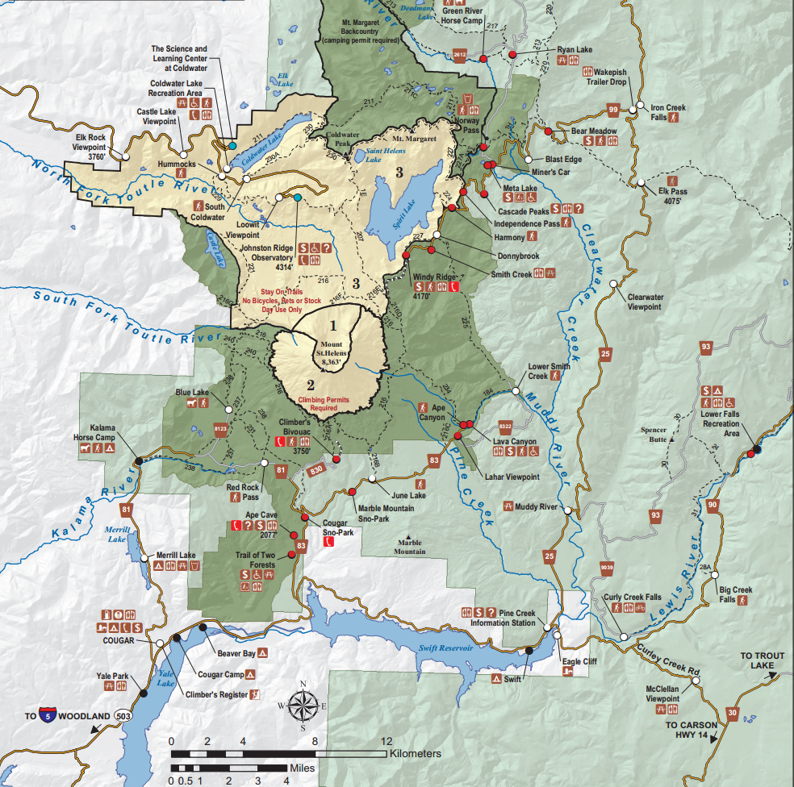
Mt. St. Helens

Slide 43
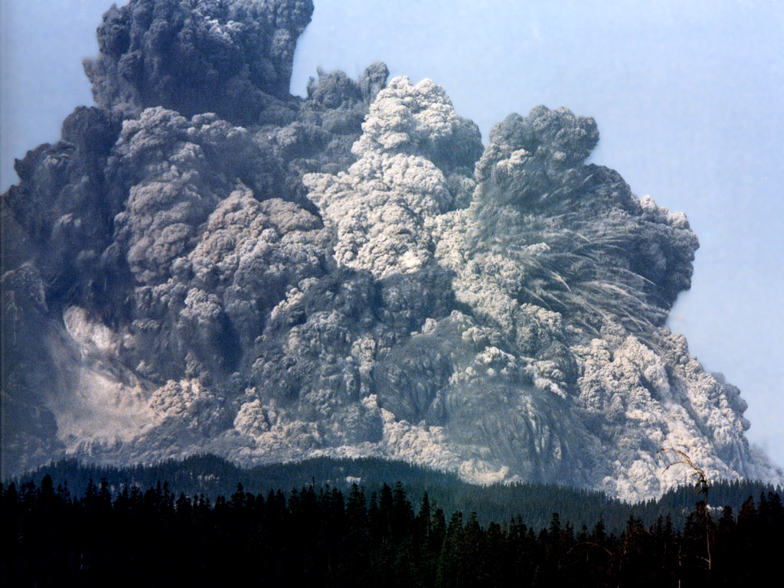

Slide 44
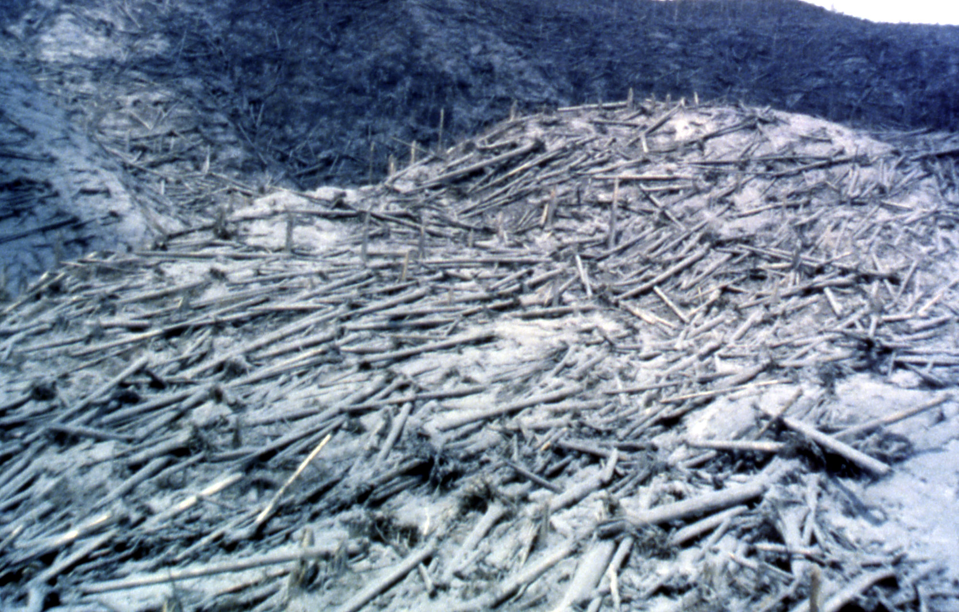

Slide 45
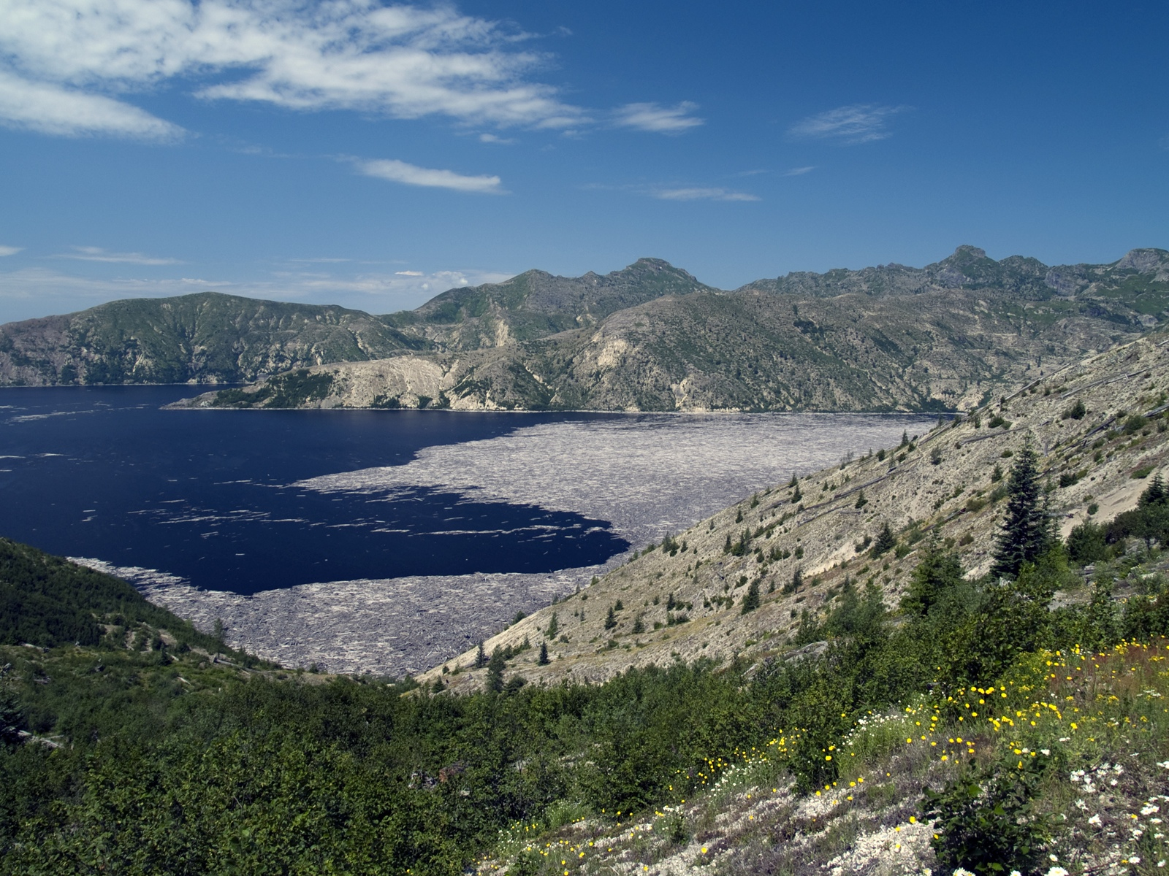
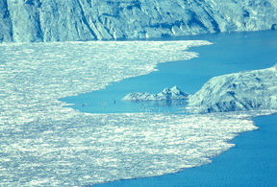
Is there a modern analogue for this model?
Spirit Lake, after 1980 eruption of Mt. St. Helens

Slide 46
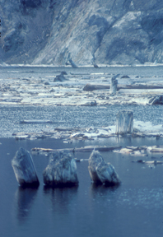
Upright floating stumps in Spirit Lake

Slide 47
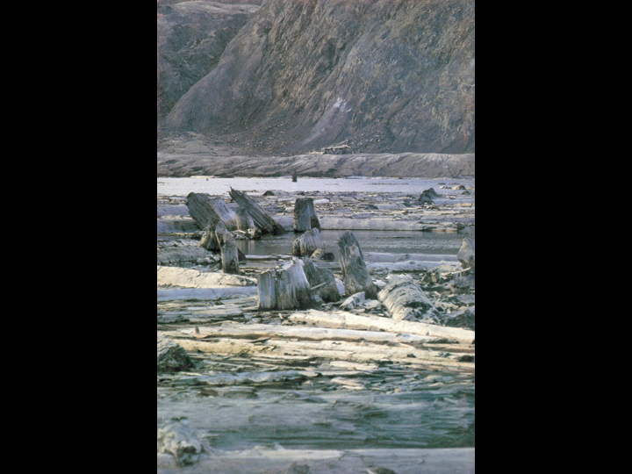
Upright stumps deposited on sandbar in Toutle River

Slide 48
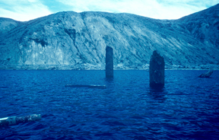
Upright floating stumps in Spirit Lake

Slide 49
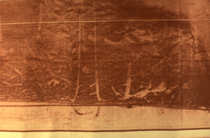
Sidescan sonar image of bottom of Spirit Lake
Upright stumps on bottom of Spirit Lake

Slide 50
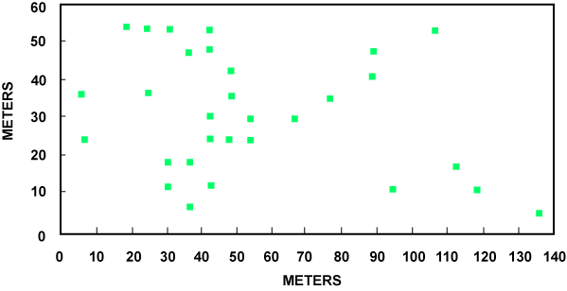
Distribution of upright stumps on bottom of Spirit Lake
Distribution Field of Upright Logs in Spirit Lake

Slide 51
Challenge to Creationists
Our approach paid off and by the early 1980's, aided by the catastrophic eruption of Mt. St Helens, not only had the National Park Service removed the signs describing them as fossil forests, but National Geographic Magazine produced a map of the Park in which they identified the deposits of fossil trees as catastrophic emplacements. This was all the result of scientific research published by scientists who took Genesis seriously and their students.

Slide 52
Selected Bibliography from Adventist Authors
H. G. Coffin, “Orientation of Trees in the Yellowstone Petrified Forests,” Journal of Paleontology 50 (1976): 539-543
H. G. Coffin, “The Organic Levels of the Yellowstone Petrified Forests,” Origins 6, no. 2 (1979): 71-82
Yamamoto, T. and A.V. Chadwick. Identification of fossil wood from the Specimen Creek area of the Gallatin Petrified Forest, Yellowstone National Park. Part I Gymnosperms. J. San-iku Gakuin J C. 10 (1982):25-42.
H. G. Coffin, “Erect Floating Stumps in Spirit Lake, Washington,” Geology 11 (1983): 298-299
H. G. Coffin, “Erect Floating Stumps in Spirit Lake, Washington: Reply,” Geology 11 (1983): 734
Yamamoto, T. and A.V. Chadwick. Identification of fossil wood from the Specimen Creek area of the Gallatin Petrified Forest, Yellowstone National Park. Part II Angiosperms. J. San-iku Gakuin J C. 11 (1983):49-66.
A. V. Chadwick, and T. Yamamoto, “A Paleoecological Analysis of the Petrified Trees in the Specimen Creek Area of Yellowstone National Park, Montana, USA,” Palaeogeography, Palaeoclimatology, Palaeoecology 45 (1984): 39-48.

Slide 53
Why were creationists the ones who found the evidence for a transported forest, and carried out the research?
The general appearance was of in-situ forests.
Naturalistic scientists had no motivation to dig deeper with more detailed research.
Bible-believers saw past the surface and were motivated to examine more closely.
Those who write anti-creation literature have no understanding of how educated creationists think.
Creationist scientists have the opportunity to be well aware of both theories, and to seek ways to test between them

Slide 54
Challenge to Creationists
What would have happened had an individual listened to the adherents of the in situ model and abandoned their faith?

Slide 55
Challenge to Creationists
Early on this story was used to influence other people to leave behind the biblical model of origins. When a proponent of the in situ model, made a presentation to a group of students at Berkeley in the late 1960's Ron Numbers, a graduate history major there became convinced that the fossil forests could not be accommodated by the biblical model. Although the model that influenced Ron Numbers to give up his biblical faith was subsequently shown to be incorrect, Numbers persists in his views.

Slide 56
Challenge to Creationists
This sad example illustrates what the results of failing to have an abiding confidence in the Bible and its Author can be.

