Slide 1
The Biblical Foundation for Adventist Education
Adventist
Education
By E. Edward Zinke
Illustrations by David Zinke
and Carol Raney
Motivation by Doug Zinke
and by Seven Grandchildren
Notes:
*

Slide 2
The Authority of the Bible in the History of Theology
Reformation - Present

Slide 3
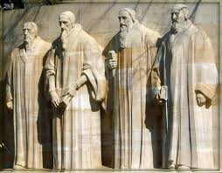
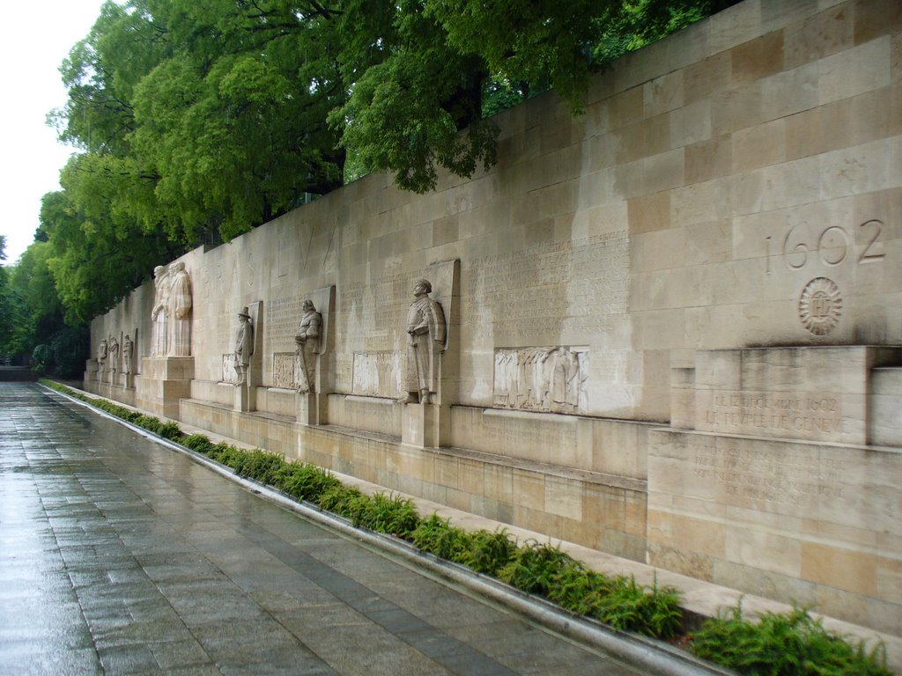
Reformation
Early Church | Middle Ages Dark Ages 500s-1500s | Renaissance 1300s-1600s Reformation 1500s | Enlightenment Age of Reason 1600s-1700s | Modernism Post-Modernism
The Bible ALONE
Notes:
The reformation era responded to the scholastic synthesis of the middle ages with the Bible and the Bible alone as the foundation and guide to life.
The scholastic synthesis put the Bible and reason, philosophy, etc on the same level
Names: the main four--Theodore Beza, John Calvin, William Farel, John Knox
Others in facing displays: William the Silent, Gaspard de Coligny, Frederick William of Brandenburg, Robert Williams, Oliver Cromwell, Stpehen Bocskay

Slide 4
Notes:
The slogan “the Bible ALONE” did not rule out other methods of knowing. However, it asserted that the Bible ALONE was the foundation for all other knowledge. This meant that the Bible was not to be interpreted by alien philosophies world views or methods (as happened with Origin and Aquinas). Rather, it was to provide the world view, the philosophical context for its own interpretation.
*

Slide 5
William of Ockham
God could not be conclusively demonstrated rationally.
Acceptance of God’s existence and attributes must rest upon Scripture.
Notes:
Ockham concluded that neither the characteristics nor the existence of God could be conclusively demonstrated rationally.
Ockham insisted that the acceptance of God’s existence and acquaintance with His attributes must rest upon Scripture.
*

Slide 6
William of Ockham
Ockham opened the door to the acceptance of Scripture alone.
Literal word of scripture as norm
Notes:
By regarding revelation as a given, Ockham opened the door to the acceptance of Scripture alone, appealing solely to the literal word of Scripture as the norm by which doctrine could be acknowledged as universal and necessary for salvation.
*

Slide 7
Sola Scriptura
Affirmed the foundational role of Scripture
Notes:
The principle of sola Scripture, the Bible alone, affirmed not only the foundational role of Scripture in the church and tradition, but also foundational role over all philosophies and methods of obtaining knowledge.
*

Slide 8
Sola Scriptura
The world view (philosophy) must come from Scripture itself.
The method for the study of the Scripture must arise out of Scripture itself.
Scripture must be its own interpreter-compare text with text.
Notes:
The principle of sola Scripture meant that the method for the study of Scripture must arise out of Scripture itself.
*

Slide 9
Sola Scripture
Did not deny that God could speak through other channels
Scripture provides the sole foundation for accepting and the basis for interpreting God’s revelation in other areas.
Notes:
The sola Scripture concept did not deny that God could speak through other channels. It affirmed that scripture provides the foundation for accepting and the basis for interpreting God’s revelation in other areas.
*

Slide 10
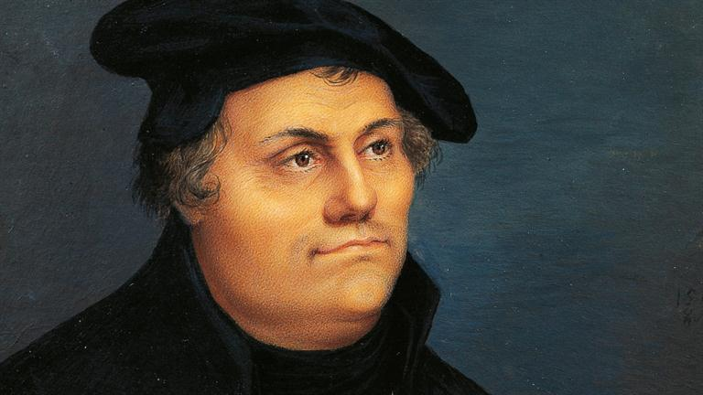
Martin Luther
Early Church | Middle Ages Dark Ages 500s-1500s | Renaissance 1300s-1600s Reformation 1500s | Enlightenment Age of Reason 1600s-1700s | Modernism Post-Modernism

Slide 11
Basis of the Great Controversy
“Fearlessly did Luther defend the gospel from the attacks which came from every quarter. The Word of God proved itself a weapon mighty in every conflict. With that word he warred against the usurped authority of the pope, and the rationalistic philosophy of the schoolmen, while he stood firm as a rock against the fanaticism that sought to ally itself with the reformation.

Slide 12
Basis of the Great Controversy
Each of these opposing elements was in its own way setting aside the Holy Scriptures and exalting human wisdom as the source of religious truth and knowledge. Rationalism idolizes reason and makes this the criterion for religion. Romanism, claiming for her sovereign pontiff an inspiration descended in unbroken line from the apostles, and unchangeable through all time, gives ample opportunity for every species of extravagance and corruption to be concealed under the sanctity of the apostolic commission.

Slide 13
Basis of the Great Controversy
The inspiration claimed by Munster and his associates proceeded from no higher source than the vagaries of the imagination, and its influence was subversive of all authority, human or divine. True Christianity receives the word of God as the great treasure house of inspired truth and the test of inspiration.” --Great Controversy, p. 193
Notes:
Though each of these opposing sources of authority are radically different, they are all the same – they put authority in human kind.

Slide 14
The protest of the princes at the Diet of Spires also upheld the authority of Scripture. “’There is no sure doctrine but such as is conformable to the word of God. . . . The Lord forbids the teaching of any other doctrine. . . . The Holy Scriptures ought to be explained by other and clearer texts. . . . this Holy Book is, in all things necessary for the Christian, easy of understanding, and calculated to scatter the darkness. We are resolved, with the grace of God, to maintain the pure and exclusive preaching of His only word, such as it is contained in the biblical books of the Old and New Testaments, without adding anything thereto that may be contrary to it. This word is the only truth; it is the sure rule of all doctrine and of all life, and can never fail or deceive us. He who builds on this foundation shall stand against all the powers of hell, while all the human vanities that are set up against it shall fall before the face of God.’ . . . ‘The principles contained in this celebrated Protest . . . constitute the very essence of Protestantism.’”—Great Controversy, p. 203.
Notes:
Put a picture of Zwingli in the next slide (done)
*

Slide 15
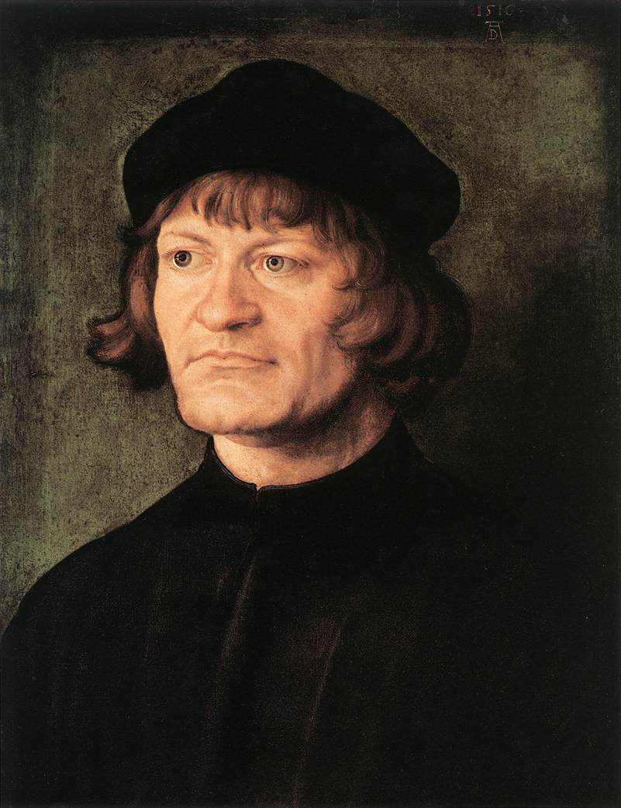
Zwingli
Word of God = only infallible authority
No new method, but the old method employed by the church in earlier and purer times
Notes:
Zwingli also presented the Word of God as the only infallible authority. He declared that he was introducing no new method but the old method employed by the church in earlier and purer times.
School of Antioch was careful not to impose alien philosophies on scripture.
*

Slide 16
“The more he searched the Scriptures, the clearer appeared the contrast between their truths and the heresies of Rome. He submitted himself to the Bible as the Word of God, the only sufficient, infallible rule. He saw that it must be its own interpreter. He dared not attempt to explain Scripture to sustain a preconceived theory or doctrine, but held it his duty to learn what is its direct and obvious teaching. He sought to avail himself of every help to obtain a full and correct understanding of its meaning, and he invoked the aid of the Holy Spirit, which would, he declared, reveal it to all who sought it in sincerity and with prayer.

Slide 17
“’The Scriptures,’ said Zwingli, ‘come from God, not from man, and even that God who enlightens will give thee to understand that the speech comes from God. The Word of God . . . cannot fail; it is bright, it teaches itself, it discloses itself, it illumines the soul with all salvation and grace, comforts it in God, humbles it, so that it loses and even forfeits itself, and embraces God.’ The truth of these words Zwingli himself had proved. Speaking of his experience at this time, he afterward wrote: ‘When . . . I began to give myself wholly up to the Holy Scriptures, philosophy and theology (scholastic) would always keep suggesting quarrels to me. At last I came to this, that I thought, “Thou must let all that lie, and learn the meaning of God purely out of His own simple word.” Then I began to ask God for His light, and the Scriptures began to be much easier to me.’”—Great Controversy, pp. 173-74

Slide 18
Notes:
*
Ed: I really like what David has done with these slides. They look great! I think I remember seeing a note somewhere asking him to replace “Medieval World” with some other wording. Does this matter?
Should really be Early Church and Medieval World – but not a big deal.

Slide 19
Notes:
*

Slide 20
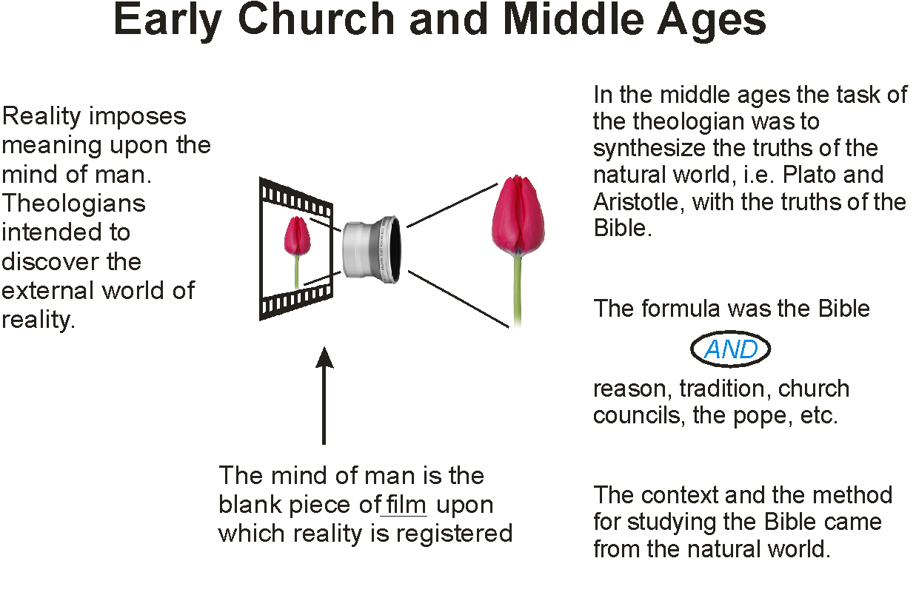
Notes:
Can we use a larger font? Ed: If I could get just the tulip/lens/film graphic by itself I could make a series of slides with a larger font. David – see note above. Or if you can, increase the sizes.
Ed: David sent me several graphics, but not this one. Shall we just leave this slide as is or ask him for the graphic?
Yes – leave if we don’t get from Him. You could send this to him by itself to see if he handles it.
*

Slide 21
The Bible
Alone
Alone
Alone
Alone
Alone

Slide 22
The Bible
Alone
Alone
Alone

Slide 23
The Bible
Alone
Alone
Alone
Alone
Alone

Slide 24
Protestant Reformation
The Bible
ALONE
Is the lens (philosophy) through which the natural world is understood
Notes:
The Biblical worldview is the context for studying the Bible itself, and the basis for understanding the rest of the world.

Slide 25
The
Bible Alone
Notes:
The reformation brought a major change in epistemology and world view. Rather than founding theology and world view in the Bible & the natural world, the Bible alone was the foundation for all study.

Slide 27
Protestant Scholasticism
Early Church | Middle Ages Dark Ages 500s-1500s | Renaissance 1300s-1600s Reformation 1500s | Enlightenment Age of Reason 1600s-1700s | Modernism Post-Modernism
Used the same rationalistic methods for theology as the middle ages
Notes:
The period called “Protestant Scholasticism” immediately followed the reformation. This system relied upon the same rationalistic methods that were used in the theology of the middle ages.

Slide 28
Scholasticism
Tradition was the authority
Church tradition
Particularly the Philosophical tradition of Aristotle
Cosmology of Ptolemy
Notes:
At the time of the Counter Reformation, there was a resurgence of Aristotelian scholasticism within both in Catholicism and Protestantism. Tradition was the authority—not simply church tradition, but particularly the philosophical tradition stemming from Aristotle. The cosmology of Ptolemy reigned supreme. It was obviously true because it coincided best with the Aristotelian scholastic synthesis that so perceptively described the nature of reality.
It is instructive how quickly this can happen in the Christian world.
*

Slide 29
Aristotelian Scholasticism
Scripture and nature were to be understood by:
Authority of the past
Traditions of the church
Intellectual traditions of the scholastics - Aristotelianism

Slide 30
Aristotelian Scholasticism
Things were categorized by their degrees of perfections
There were two distinct worlds
Reality
Immutable things
of the heavens
Mutable things of earth
A shadow of Reality
Notes:
Things were categorized by their degrees of perfections, which defined a great chain of being which allowed one to know contemplatively the value of all things. (click) The scale of perfections placed God at the top. (click) There was a divide between the mutable things of the earth (click) and the immutable things of the heavens. (click)
*

Slide 31
Aristotelian Scholasticism
Things were categorized by their degrees of perfections
There were two distinct worlds
Reality
Immutable things
of the heavens
Mutable things of earth
A shadow of Reality
Notes:
Is there anything we can do to add the feature of the earlier slide where arrows move in both directions, shadowy near the bottom,
Let’s see what David does in first set.
*

Slide 32
Center of the Universe
Earth was at the center of the universe: why
Not because the earth was the center of God’s activity, but because:
Mutable things fall to the earth
Divine things rise to the heavens
Notes:
The earth was at the center of the universe, not because it was at the center of God’s activity, but because mutable things fall to the earth, while divine things rise to the heavens. The heavenly bodies were higher on the scale of perfection and therefore operated by different laws than earthly objects, which were imperfect.
*

Slide 33
Enlightenment
Early Church | Middle Ages Dark Ages 500s-1500s | Renaissance 1300s-1600s Reformation 1500s | Enlightenment Age of Reason 1600s-1700s | Modernism Post-Modernism
Freedoms opened up by the Reformation
Reaction to the authority of tradition and the rigidity of scholasticism
Notes:
The Era of the Enlightenment took place within the context of the freedoms opened up by the Reformation on the one hand, and as a reaction to the authority and rigidity of scholastic philosophy on the other
Freedom of the reformation – from the imposition of the church,
Freedom to read and interpret the Bible apart from tradition, to take responsibility for oneself, and to have direct access and responsibility to God

Slide 34
Enlightenment
Early Church | Middle Ages Dark Ages 500s-1500s | Renaissance 1300s-1600s Reformation 1500s | Enlightenment Age of Reason 1600s-1700s | Modernism Post-Modernism
Development of modern science
New philosophical understandings
Notes:
This new freedom opened the world to the development of modern science and new philosophical understandings.
Science has performed many wonderful things. But it has also become God, the basis of our understanding of the natural world, and even of God.

Slide 35
Scientific Revolution
New cosmology: Copernicus, Kepler, Galileo, Newton
Earth was not the center of the universe
Earth was in orbit around the sun
Notes:
A series of observations made by Copernicus, Kepler, Galileo, and Newton brought an entirely new understanding of cosmology. The earth was not the center of the universe with all planetary bodies revolving around it. Rather, the earth was itself a planet in orbit with the other planets around the sun.
*

Slide 36
Scholastic Tradition Was Questioned
Planetary orbits were elliptical
New stars were discovered
The moon had mountains
The sun had spots
Objects fell because of gravity, not because of their rightful place in the universe.
Notes:
This new understanding brought into question the entire scholastic tradition. The planetary movements were discovered to be elliptical rather than the implied perfection of circular motion. Stars were discovered that had not been seen by Aristotle. The moon had mountains (and therefore was not perfectly circular, i.e. divine), and the sun had spots (and thus did not partake of divine perfection). Thus, these bodies were not the incorruptible and immutable heavenly objects of Aristotelian-Ptolemaic philosophy. Objects fell to the ground because of gravity, not because they were trying to find their natural and rightful place in the universe. Therefore, circular motion was not natural to heavenly bodies, for they would move in a straight line if it were not for the pull of gravity upon them.
*

Slide 37
Dichotomy Broken
Planets remained in orbit by the same laws that caused rocks to fall to the ground.
The same laws that applied on earth also applied to the heavens.

Slide 38
Dichotomy Broken
The heavens were composed of material substances as on earth, and their movements were impelled by natural mechanical forces according to mathematical laws.

Slide 39
Dichotomy Broken
The dichotomy between the celestial and terrestrial realms was broken
Immutable things
of the heavens
(Celestial)
Mutable things of earth
(Terrestrial)
Notes:
(click for separating line to disappear)
*

Slide 40
Tradition Questioned
The absolute authority of Aristotelian Tradition and its attending scholasticism was called into question.

Slide 41
Scholastic Synthesis The Integrationist Model
Notes:
Scholasticism had sought a synthesis, and integration between nature and religion. When scholasticism fell…
*

Slide 42
Scholastic Synthesis
Notes:
a schism developed between science and religion.
*

Slide 43
GREEK philosophy
Notes:
The Bible had been so fully reinterpreted by Greek philosophy that it also was caught in the undertow.
Cosmology of Ptolomy
*

Slide 44
Notes:
The Bible had been so fully reinterpreted by Greek philosophy that it also was caught in the undertow.
Cosmology of Ptolomy
The Bible could not see apart from Greek philosophy. It could only be seen through the grasses of Greek philosophy.
The encrustations that came from Greek philosophy were attributed to the Bible itself. Thus when scholasticism fell, the Bible fell as well.
*

Slide 45
The Loss of Biblical Authority
Science was now autonomous not only from human tradition but also from Biblical guidance.

Slide 46
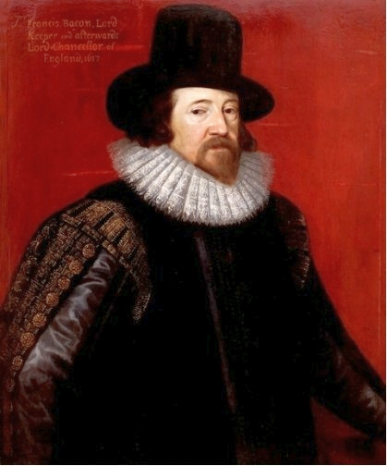
Francis Bacon
Early Church | Middle Ages Dark Ages 500s-1500s | Renaissance 1300s-1600s Reformation 1500s | Enlightenment Age of Reason 1600s-1700s | Modernism Post-Modernism
16th century

Slide 47
Francis Bacon
Knowledge of the natural world comes from experience and experimentation (empiricism) ALONE.
Spiritual and natural realms operate by their own SEPARATE AND independent laws.
In summary - Science ALONE
Notes:
Experience and experimentation was the only legitimate method to arrive at knowledge of the natural world. The true basis of knowledge was the natural world and the information it provided through the human senses. The Bible had no value for understanding the natural world. The spiritual and the natural realm operated by their own independent laws.
*

Slide 48
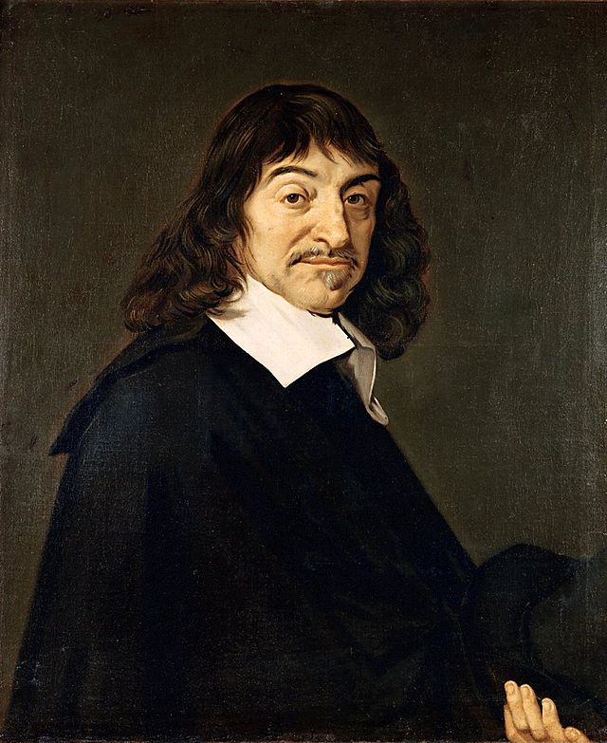
Rene Descartes
Early Church | Middle Ages Dark Ages 500s-1500s | Renaissance 1300s-1600s Reformation 1500s | Enlightenment Age of Reason 1600s-1700s | Modernism Post-Modernism
17th century

Slide 49
Descartes
Response to skepticism about the possibility of certain knowledge
Systematically doubted everything
Existence of physical world
Existence of own body, ect.
Certainty of self-awareness
I doubt, therefore I am
Popularized as I think, therefore I am
Notes:
The crumbling fortification of the scholastic synthesis produced a new skepticism about the possibility of certain knowledge. Descartes set about to solve this problem of skepticism by systematically doubting everything including the existence of the physical world and his own body. At the end of this exercise, there was one thing that could not be doubted – the certainty of his self-awareness – I think, therefore I am.
*

Slide 50
Descartes
Analytical reason ALONE (as contrasted with reason that was guided by the Bible) was the basis for understanding the natural world
Human reason was enthroned as supreme authority
Notes:
Analytic reason alone was the basis for understanding the natural world. Descartes enthroned human reason as the supreme authority in matters of knowledge.
*

Slide 51
Authority
Notes:
Foundational authority, (click) once ascribed only to Holy Scripture or the supreme pontiff, was now transferred to human reason itself.
Speed the animation just a little. (done)
*

Slide 52
The universe was understood mechanistically rather than sustained by God.
Whereas Luther’s foundational certainty was his faith in God’s revelation in the Bible, Descartes’ foundational certainty was his faith in the procedural clarities of mathematical reasoning applied to the thinking self.

Slide 53
Descartes separated the material world from its long association with religious belief, declaring the autonomy of science to develop its analysis of that world… unconstrained by the authority of scripture. The study of the natural world was now seen as autonomous from the Bible.
Notes:
Moreover, by his assertion of the essential dichotomy between thinking substance and extended substance, Descartes helped emancipate the material world from its long association with religious belief, freeing science to develop its analysis of that world in terms uncontaminated by spiritual or human qualities and unconstrained by the theological dogma.
Both the human mind and the natural world now stood autonomously as never before, separated from God and from each other.
*

Slide 54
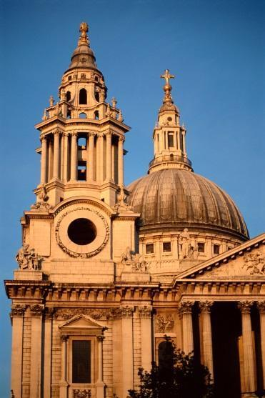
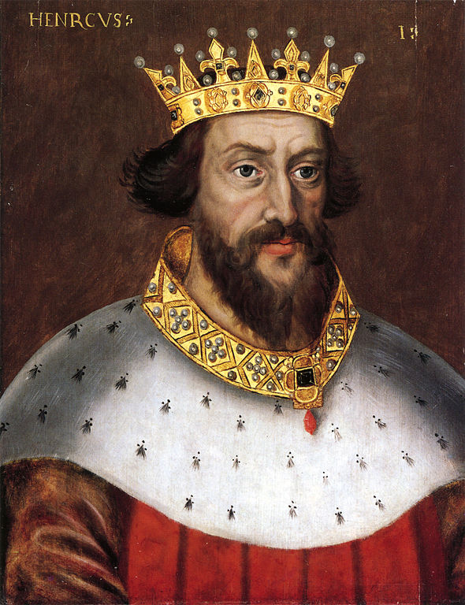
Mankind was now free not only from the dictates of the natural world, tradition, church, and king, but also from Scripture.

Slide 55
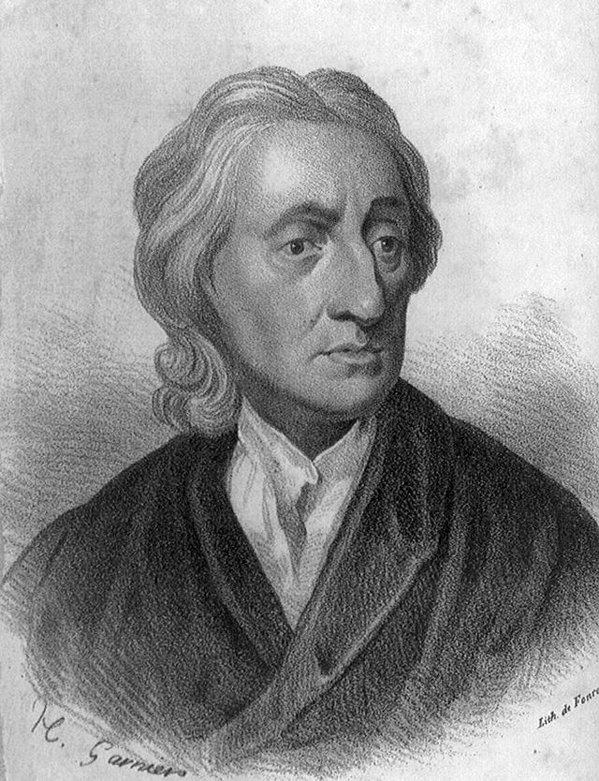
John Locke
Early Church | Middle Ages Dark Ages 500s-1500s | Renaissance 1300s-1600s Reformation 1500s | Enlightenment Age of Reason 1600s-1700s | Modernism Post-Modernism
17th century

Slide 56
John Locke
Ideas are not innate
The mind is a blank slate to be written upon by our experiences
Experience ALONE (not intuition, reason, or Scripture) is the foundation for understanding
Notes:
Locke was the reigning epistemological authority in Europe during the seventeenth century. He provided the epistemological foundations for its scientific achievements. For Lock, ideas are not innate, as with Descartes, but rather our mind is a tabula rasa, a blank slate to be written upon by our sense experience of the world. We know because our experience of the world is imprinted upon our own mind by the senses and reflection. We cannot know apart from our experience. The authority of experience alone over against intuition, reason and the Bible is the source of our knowledge both of the external and internal world.
*

Slide 57
New View of God--Deism
Divine architect who set the universe in motion
NOT the Man of Calvary
NOT active in history, not the man of the exodus, nor will He coming again in a second coming
Notes:
The new epistemology brought a new view of God. God was now the divine architect who set the universe in motion, but he was not the Man of Calvary who is active in history and who will return in a literal manner a second time.
*

Slide 58
Deism
The universe was to be explained on mechanical and mathematical principles
Observation and analysis
NOT scholastic ideas
NOT divine revelation or God’s action
Notes:
The universe was to be explained on mechanical and mathematical principles. These principles were to be sought through observation and analysis, not by scholastic ideas or divine revelation.
*

Slide 59
Deism
God was active in the design and creation of universe
God’s revelation is universal in nature
God was not active in historical events
God did not reveal Himself in the Bible to a particular people at a particular time
Notes:
Providence and God’s love was now reinterpreted to mean God’s action in the creation and design of the ordered universe, but not His action with particular individuals or specific historical events. God did not reveal Himself to a particular people at a particular time; His revelation of Himself is universal through nature.
*

Slide 60
Deism
Faith is based upon empirical evidence and reason.
Faith is not based on the gift of God through the Bible, not on God’s revelation of Himself.
Notes:
Faith is based upon evidence and reason, not the gift of God.
*

Slide 61
Enlightenment Results
The nature and source of knowledge of the natural world is not to be determined by special revelation.
It is to be discovered by some aspect of humanity, primarily by empirical science

Slide 62
Enlightenment Results
Doubt was integral to the process of acquisition of knowledge. Everything was to be questioned until one arrived at an absolute starting point.
Doubt is still central to education today
Notes:
Ed Develop some Bible and EGW quotes on doubt.

Slide 63
Enlightenment Results
“Faith”--if it had any meaning at all--was founded upon and harmonious with the results of the scientific process
Faith was not based upon God’s word, but rather in human intellect

Slide 64
Enlightenment Results
Notes:
In general, there was a radical separation of theology and natural inquiry. If there was a relationship between science and theology, the foundation was scientific. The Bible could not be used as a starting point for the study of the natural world.
*

Slide 65
Enlightenment Results
Theology
Science
Notes:
If there was a relationship between science and theology, the foundation was scientific. (click) Special revelation could not be used as a starting point for the study of the natural world.
*

Slide 66
Science was King
“The greatest achievement of Newtonian science must ever be the first full explanation of the universe on mechanical principles. One set of axioms and laws of universal gravitation applied to matter everywhere on earth as it did in the heavens. Who, after studying the contribution to thought, could deny that pure science (italics supplied) exemplifies this creative accomplishment of the human spirit at its pinnacle?
Notes:
The historian of science, Bernard Cohen, put it in almost religious terms…
*

Slide 67
Science was King
What an exalted view of science. What a transforming view Newton gave to all humans. In all different endeavors the optimistic view that humans could deduce the order of the natural world had a significant trickle down effect in other human endeavors.”

Slide 68
Science had become the way, the truth, and the life.
Freedom was absolute. Humanity was no longer under the bondage of Greek metaphysics, scholastic theology, the church, tradition, or the authority of the Bible.

Slide 69
As Tarnas summarizes it: While the classical Greek world view had emphasized the goal of human intellectual and spiritual activity as the essential unification (or reunification) of man with the cosmos and its divine intelligence, and while the Christian goal was to reunite man and the world with God…

Slide 70
…the modern goal was to create the greatest possible freedom for man—from nature; from oppressive political, social, or economic structures; from restrictive metaphysical or religious beliefs; from the Church; from the Judeo-Christian God; from the static and finite Aristotelian-Christian cosmos; from medieval Scholasticism; from the ancient Greek authorities; from all primitive conceptions of the world.

Slide 71
Leaving behind tradition generally for the power of the autonomous human intellect, modern man set out on his own, determined to discover the working principles of his new universe, to explore and further expand its new dimensions, and to realize his secular fulfillment.⁴

Slide 72
Coming of Age
No need for God to tell us how to live or what to believe
We have come of Age
Neither God nor His Word is necessary to understand the universe
God, if He exists, must conform to whatever we discover to be true in the natural world.
Notes:
Humanity had come of age. There was no need for God to look over our shoulder telling us how to live or what to believe. The tutelage of God our Father was not necessary to understand the universe. That can be done on our own for we are autonomous from God and His Word. Whoever or whatever God is, if he exists at all – we will decide that -- He must conform to whatever we discover to be true in the natural world.
*

Slide 73
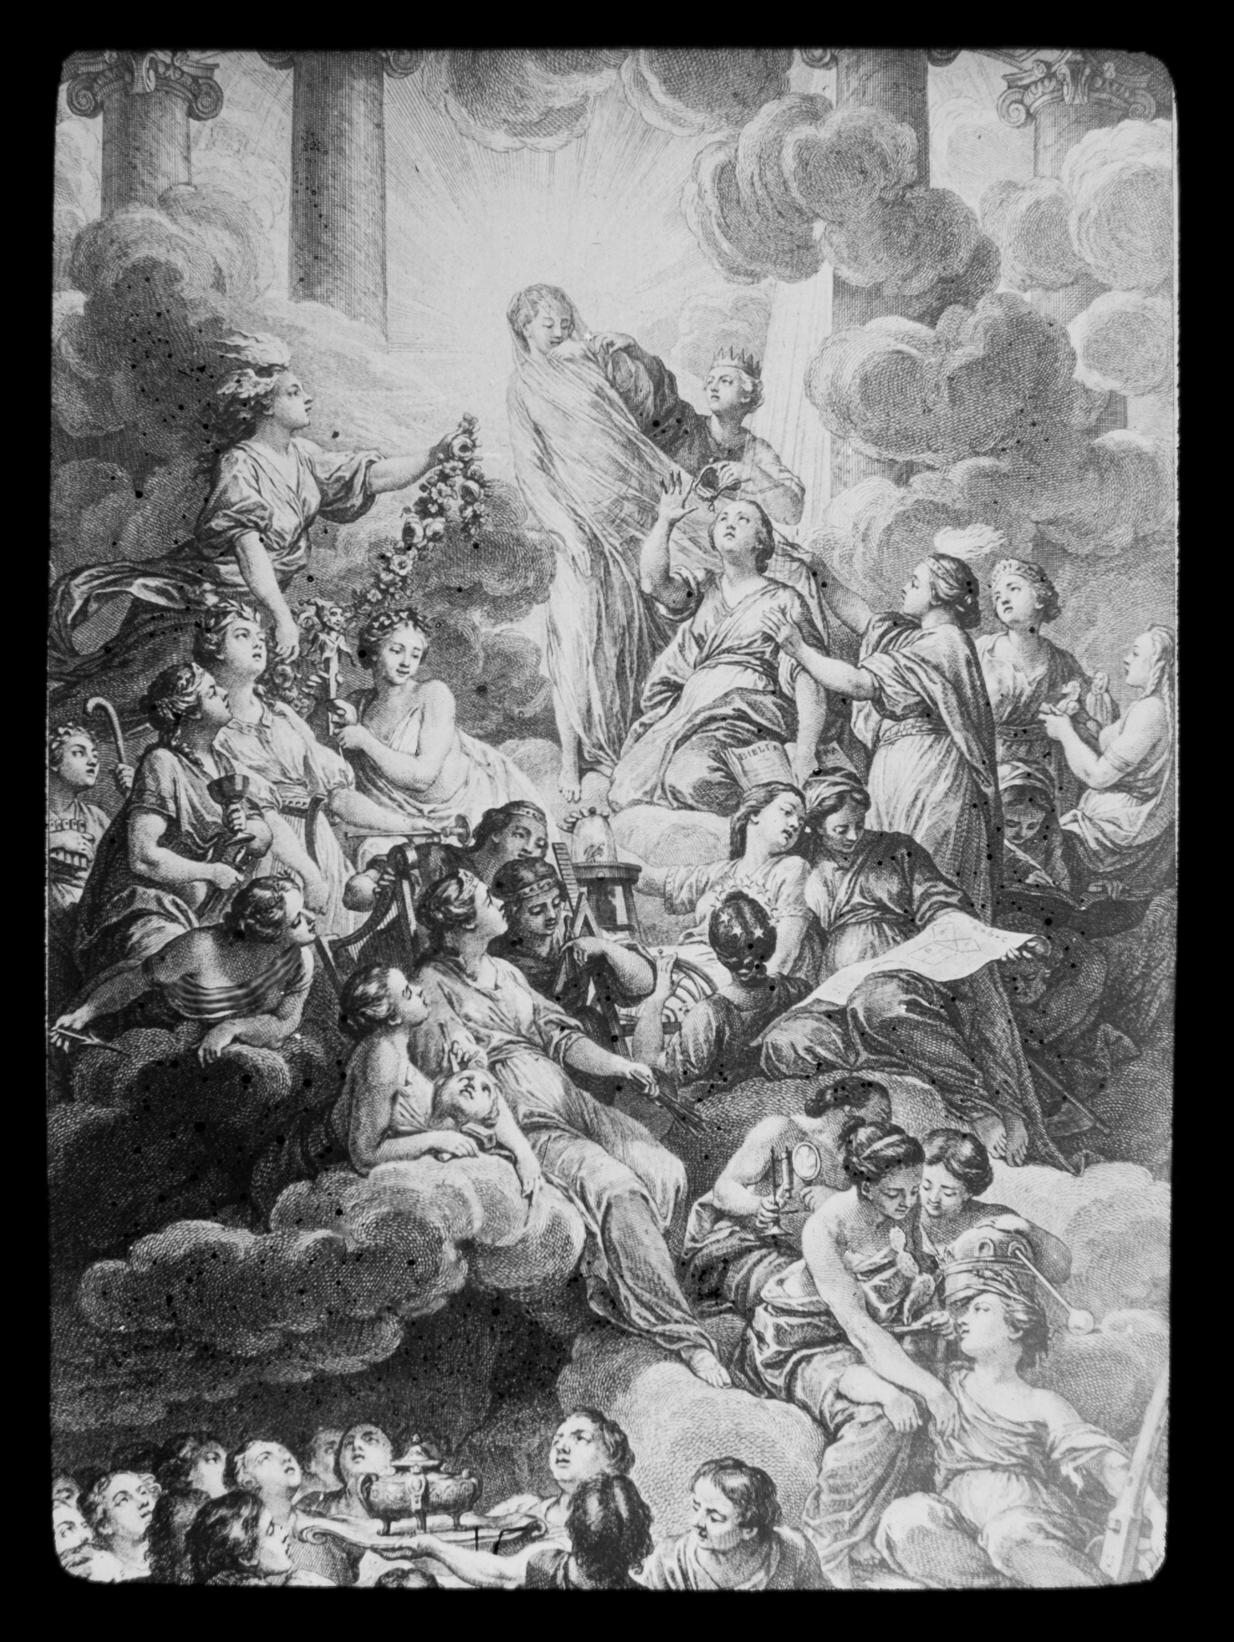
Notes:
Ed – work on
http://search.aol.com/aol/image?q=encyclopedie+frontispiece&s_chn=wm_t19&v_t=webmail-searchbox
This is the frontispiece of the enclyclopedie of Demis Diderot.
Cover for the first extensive Encyclopedia – produced in France.
The Cover piece represented light proceeding from a woman (truth) to all other disciplines. At her right – reason and philosophy unveiling her attended by the sciences, to her left, the arts adorning her.
Down below were the theologians who would not look at the “light” because they expected light from above.
This art depicts the absolute reversal of authorities (which were often implied in prior methods, but not verbalized so strongly). God and His Word, the Bible were dethroned. Progress could only be made in the light of human reason.

Slide 74
18th & 19th Century
Early Church | Middle Ages Dark Ages 500s-1500s | Renaissance 1300s-1600s Reformation 1500s | Enlightenment Age of Reason 1600s-1700s | Modernism Post-Modernism
Eighteenth and nineteenth century theology stepped into the epistemological shoes that were developed in the era of the Enlightenment.

Slide 75
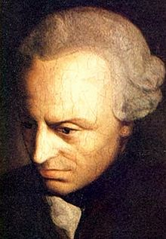
Immanuel Kant
Early Church | Middle Ages Dark Ages 500s-1500s | Renaissance 1300s-1600s Reformation 1500s | Enlightenment Age of Reason 1600s-1700s | Modernism Post-Modernism
18th century

Slide 76
Kant
Denied that a mind is simply an empty vessel (tabula rasa)
The mind itself determines the character of knowledge
Questioned the theoretical arguments for the existence of God
Notes:
Immanuel Kant revolutionized man’s concept of the thought processes themselves and thereby provided the context for contemporary theology.
He denied that the mind of man is a tabula rasa, an empty vessel, which simply receives impressions from the exterior world. He insisted that the mind of man itself determines the character of knowledge.
Kant questioned the possibility of theoretical arguments for the existence of God, stating that objects or things in themselves cannot be known except in relation to the experience of the knowing subject.
*

Slide 77
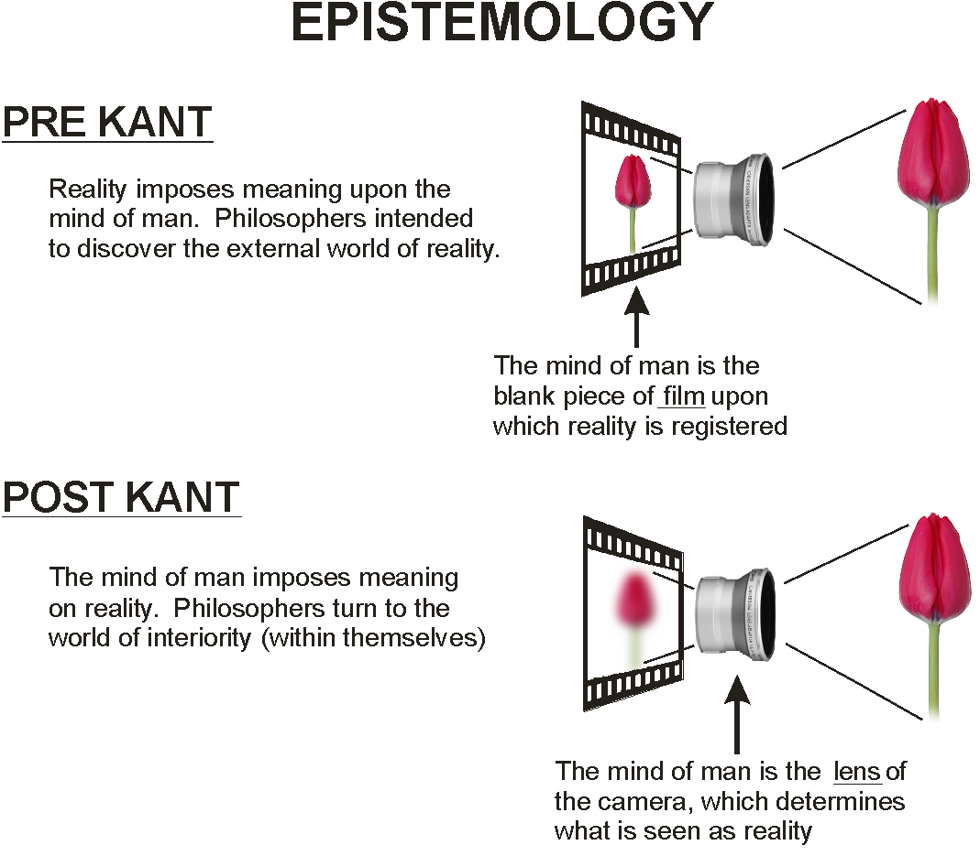

Slide 78
Kant’s New Appeal
Man is structured a priori to live under certain moral imperatives
Man has an insatiable desire for happiness
Man is driven toward the supreme good—the ideal union of moral perfection and complete happiness
Notes:
Kant made a new appeal for the existence of God which rested not on speculative thought but on practical reason in relation to responsible human action.
*

Slide 79
Kant
The supreme good in man cannot be fulfilled in this life
There must be a life beyond
Only God is capable of bringing about a moral order within eternity
Notes:
The supreme good (which is a priori within man himself) cannot be fulfilled in this life. Therefore, there must be a life beyond in which man can fulfill the moral requirements of his being. Furthermore, living a moral life throughout eternity would not necessarily bring about happiness. Therefore Kant postulated a God who is capable of bringing about such an order of things within eternity. Only thus, argued Kant, could the a priori within man find fulfillment.
*

Slide 80
Kant
This argument is not objective, valid proof of God’s existence
Simply justification for the concept of a perfect and infinite God if we want to live in harmony with the nature of our being.
Notes:
Kant stated that the status of this argument is not objective valid proof but simply justification for the concept of a perfect and infinite God
*

Slide 81
Kant
Scripture was interpreted morally
From moral foundations to theology
Not from the Bible to morals
Notes:
Kant turned from Scripture to the moral law written in the heart as the basis for his theology. This meant that Scripture was interpreted morally. The movement was from morals to theology rather than from the Bible to morals.
*

Slide 82
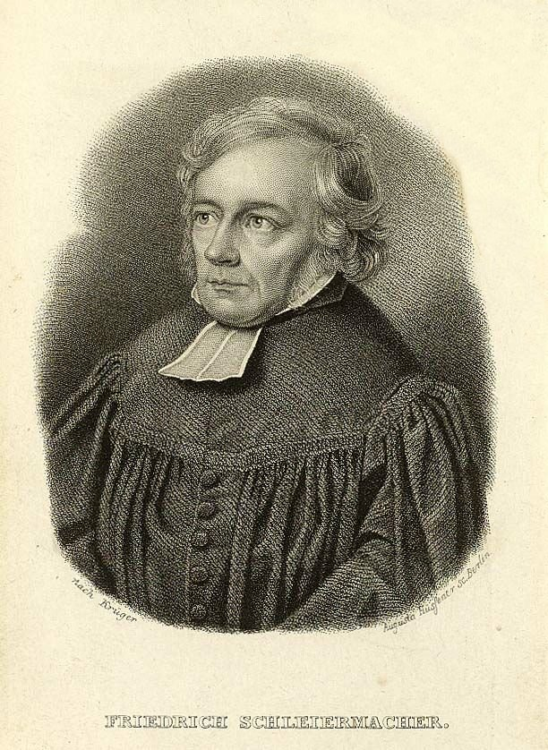
Friedrich Schleiermacher
Early Church | Middle Ages Dark Ages 500s-1500s | Renaissance 1300s-1600s Reformation 1500s | Enlightenment Age of Reason 1600s-1700s | Modernism Post-Modernism
18th – 19th centuries

Slide 83
Friedrich Schleiermacher
Father of “contemporary theology”
Agreed with Kant’s turn to the human subject
Notes:
Friedrich Schleiermacher, the father of “contemporary theology,” illustrates the kind of theology that has been done since Kant. The basic turn to the human subject presented a way of doing theology which is dominant in both Protestant and Catholic theology.
*

Slide 84
Friedrich Schleiermacher
The Foundation of Religion
NOT metaphysics (like Kant)
NOT a sacred book (like Kant)
NOT a moral life (unlike Kant)
Notes:
As with Kant, Schleiermacher stated that religion is not found in metaphysics nor in some sacred book. But he also disagreed with Kant’s idea that it is found in the moral life.
*

Slide 85
Friedrich Schleiermacher
Mental life is composed of
Perception (knowledge)
Activity (moral life)
Feeling (religious life)
Notes:
By contrast, Schleiermacher stated that mental life is composed of perception, activity, and feeling. Perception and activity deal with knowledge and moral life whereas feeling issues in religious life.
*

Slide 86
Friedrich Schleiermacher
Religion was the creation of the apriori self-consciousness
Not scientific
Not moral
Centered in feeling
Consciousness of religious truth was immediate self-consciousness
Notes:
Religion for Schleiermacher was grounded in the structure of human existence. It was the creation of the a priori self-consciousness which was neither scientific nor moral, but centered in feeling. Consciousness of religious truth was immediate self-consciousness.
*

Slide 87
Friedrich Schleiermacher
Religious truth was based upon a feeling that our being and living was being and living in and through God. It was a feeling or consciousness of ourselves as absolutely dependent.

Slide 88
Friedrich Schleiermacher
By placing the basis of religion within feeling, Schleiermacher broke down the distinction between the natural and the supernatural. The immanence of God in man and the world became the basis for theology.

Slide 89
Friedrich Schleiermacher
Christian doctrines are formulated relative to feeling, not Scripture
Revelation did not communicate knowledge, but rather, religious experience
Notes:
The theology of Schleiermacher became a description of the content of conversion. Christian doctrines are formulations in language or objectifications of the prior Christian feeling. Consciousness of truth is the objectification of self-consciousness, and doctrine was defined relative to self-consciousness rather than to Scripture.
The given was a priori experience rather than Scripture.
Revelation did not stand at the center of Schleiermacher’s theology for revelation was not considered to communicate knowledge; rather it gave the ability for the rise of a new religious experience.
*

Slide 90
19th Century
Protestant Liberalism
Notes:
Nineteenth century Protestant liberalism developed within the general milieu of the inception of the present scientific age which stressed the absolute autonomy of humanity. Religion was studied in the same way as were other disciples – from a human foundation.
*

Slide 91
Object Subject
The new paradigm was a switch from the object, the world outside of humanity, to the subject, the world inside of mankind.
Outside Inside
Notes:
In philosophy this is called the turn to the human subject.
*

Slide 92
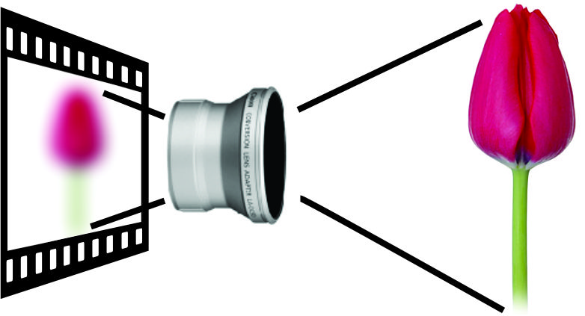

Slide 93
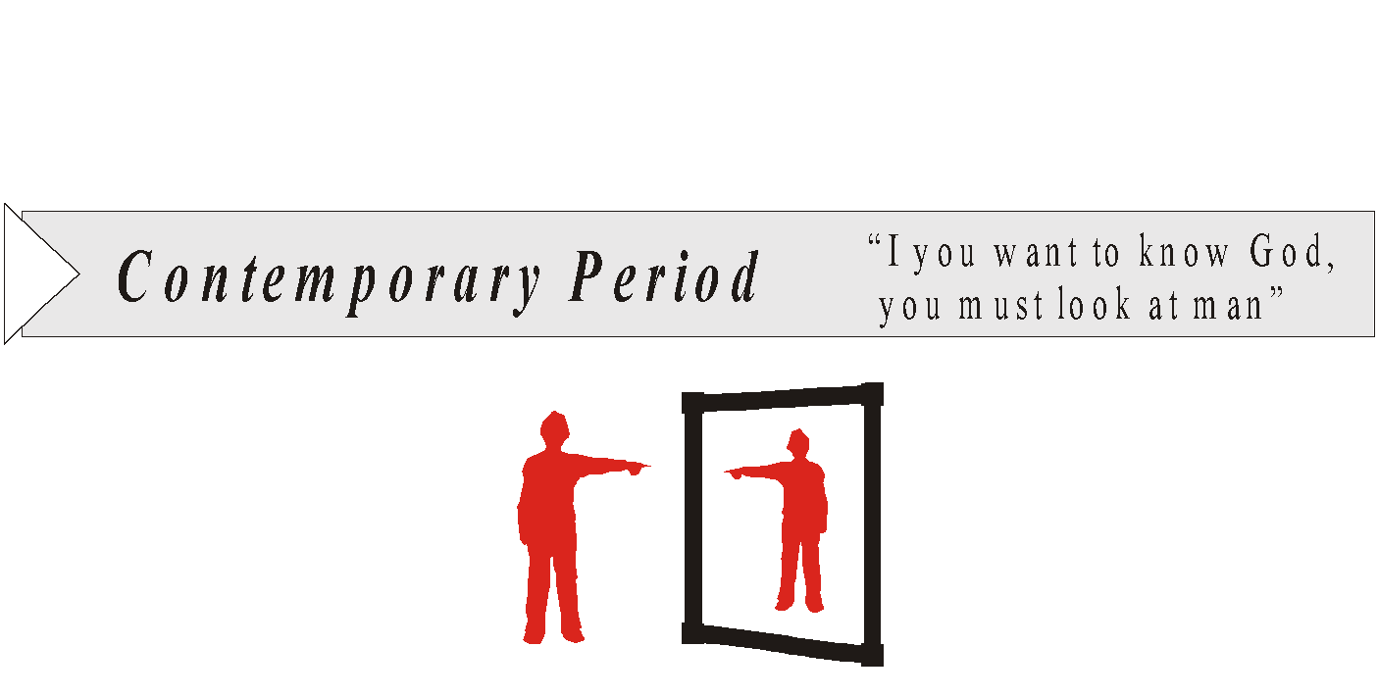
Notes:
*

Slide 94
Common Characteristics of Theology Early Church to Enlightenment (Except the Reformation)
Natural continuity between the natural world and the world of religion
We are capable of determining the nature of reality as the basis of our theology apart from scripture
Criteria other than Scripture form the foundation for theology and our understanding the natural world.
Notes:
Nineteenth century Protestant liberalism developed within the general milieu of the inception of the present scientific age which stressed the autonomy of humankind. With the exception of the Reformation, the theologies we have reviewed have had the following in common: A natural continuity is assumed between the natural world, in which mankind exercises his reason and acquires knowledge, and the world of religion.
It is also assumed that we are capable of determining either the nature of reality or the nature of humankind as the basis for our theological systems.
Each of these systems in its final analysis posits criteria other than Scripture for the foundation for theology.
See if you can find a way to simplify the title. It includes all theologies studied expect the reformation. Ed: does this work?
*

Slide 95
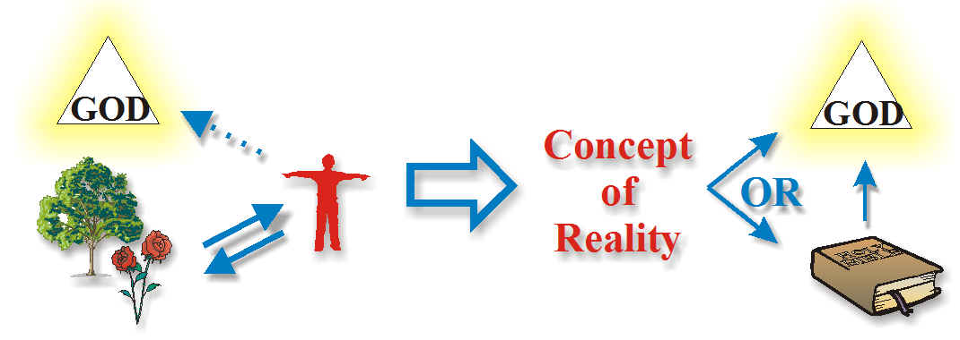
Paths to Knowledge of God
Medieval
Period
“Look at Reality”
Reformation
“Rely on God’s
Self-revelation”
Contemporary
Period
“Look at man”
Notes:
*

Slide 96
Theology

Slide 97
Notes:
The Bible was stripped of its authority and replaced by human authority of one kind or another. It is within this context that the theory of Evolution became predominant.

