Slide 1
Origins & By Design Resources
http://www.southern.edu/academics/academic-sites/faithandscience/Origins-Curriculum-Resources/
A handout will be distributed after Dr. King’s talk this evening.

Slide 2
No Middle Ground: Why Theistic Evolution and Biblical Creation Are Mutually Exclusive (with Some Thoughts on the Implications for Biblical Doctrine)

Slide 3
Affirming Creation Conference St. George, Utah
presented by
Greg A. King, Ph.D.
Dean, School of Religion
Southern Adventist University
July 12, 2017

Slide 4
Key OT Verse
“The grass withers, the flower fades;
But the word of our God
stands forever.”
Isa. 40:8, NKJV

Slide 5
Key NT Verse
“Your word is truth.” John 17:17, NKJV

Slide 6
Outline of Presentation:
Introduction
Reasons Why Biblical History Matters
Contrasts between Theistic Evolution and Biblical Creation
Theological/Doctrinal Implications of Theistic Evolution
Conclusion

Slide 7
Introduction:
Sometimes people want to have it both ways. Such as when Mother asks at Thanksgiving dinner, “Do you want pumpkin pie or apple pie?”
Some people are dual citizens and carry passports from two different countries. Australia, Canada, the United States, and Switzerland are among the countries that allow for this.

Slide 8
Introduction:
Likewise, some people say that it is possible to have a high view of Scripture and also accept macro-evolution, to be a Bible-believing Christian even while embracing deep time and universal common ancestry
Is a peaceful coexistence possible between these two viewpoints?

Slide 9
Introduction:
Some people say Yes:
“Science and religion are not in conflict, for their teachings occupy distinctly different domains. Evolution is entirely compatible with Christian belief.” Stephen J. Gould, “Nonoverlapping Magisteria,” 16

Slide 10
Introduction:
But consider other quotes from Gould--
“Biology took away our status as paragons created in the image of God.”
“Before Darwin, we thought that a benevolent God had created us.”
“Why do humans exist? I do not think that any ‘higher’ answer can be given.

Slide 11
Introduction:
“We are the offspring of history and must establish our own paths in this most diverse and interesting of conceivable universes---one indifferent to our suffering, and therefore offering us maximal freedom to thrive, or to fail, in our own chosen way.” Stephen J. Gould, Wonderful Life, 322-323

Slide 12
Introduction:
“I believe that God is in charge and that evolution is the way he chose to carry out his creation. If life emerged from a primeval soup, then God was the Master Chef.” Colin Humphreys, “Can Science and Christianity Both Be True?” in Real Science, Real Faith, ed. R. J. Berry, pp. 124-125

Slide 13
Introduction:
But can one be a good Christian/SDA and also embrace a non-biblical view like theistic evolution? Or are these positions mutually exclusive?

Slide 14
Reasons Why Biblical History Matters:
God has revealed Himself in history
According to Scripture, history is the arena of God’s redemptive activity.
This is a major difference between the biblical teaching about God and what other ancient cultures said about the nature gods.
This is a possible implication of the name of God, “I AM WHO I AM.”

Slide 15
Reasons Why Biblical History Matters:
History is moving towards a goal
Other ancient cultures tended to have a cyclical view of the activity of the gods
The Bible is teleological, not cyclical
The goal to which it is moving: The restoration of all that was lost through sin

Slide 16
Reasons Why Biblical History Matters:
The theological message of Scripture is grounded in historical events
“I am the Lord your God, who brought you out of the land of Egypt.” Exod. 20:2
“I am the bread of life.” John 6:35
“I am the resurrection and the life.” John 11:25
If the historical event is removed, the theological message has no basis.

Slide 17
Summary of Reasons Why Biblical History Matters:
God has revealed Himself in history
History is moving towards a goal, namely, the restoration of all that has been lost through sin
The theological message of Scripture is grounded in historical events; without the historical events, the theology has no basis on which to stand

Slide 18
How Theistic Evolution Contradicts Biblical Creation:
Theistic Evolution—The view that God, keeping discretely in the background, used the process of macroevolution to create every living thing. That is, God somehow directed the process of evolution from simple life to complex life over millions of years.

Slide 19
How Theistic Evolution Contradicts Biblical Creation:
No literal creation week
Perhaps a week of God’s revelatory activity
Possibly each day represents a lengthy, indeterminate period of time
But no literal week of God’s creative activity

Slide 20
How Theistic Evolution Contradicts Biblical Creation:
No special creation of humans
At some point God placed a soul within early apelike hominids
At some time God gave a sense of morality to a chosen pair of human ancestors
But no literal Adam and Eve who were the ancestor of all humans

Slide 21
How Theistic Evolution Contradicts Biblical Creation:
No personal involvement of God in creation
Natural selection is viewed in basically the same terms as for naturalistic evolution
The personal Creator God of Genesis nearly vanishes from the scene
God becomes something like a life-giving principle

Slide 22
How Theistic Evolution Contradicts Biblical Creation:
No causal linkage between sin and death
Animal death, predatory activity, “nature, red in tooth and claw” had been occurring for millions of years prior to the earliest humans
A key biblical connection (Rom. 5:12) is broken: The nexus between sin and death

Slide 23
How Theistic Evolution Contradicts Biblical Creation:
No Sabbath grounded in creation
The Sabbath came along much later, possibly when workers in early Israel desired a day of rest
Perhaps the Sabbath was based on a non-working day from some other culture
It is no longer a creation institution

Slide 24
How Theistic Evolution Contradicts Biblical Creation:
No global flood
Ignores the perspective of Jesus who understood the flood narrative literally (Matt. 24:38-39)
Denies God’s major worldwide judgment in the past (2 Pet. 3:5-7)

Slide 25
Summary of How Theistic Evolution Contradicts Biblical Creation:
No literal creation week
No special creation of humans
No personal involvement of God in creation
No causal linkage between sin and death
No Sabbath grounded in creation
No global flood

Slide 26
Implications of Theistic Evolution for Theology/Biblical Doctrines
Doctrine—the unfolding of what Scripture says about God
It tells us about God
It tells us about mankind
It tells us how we should relate to God and to one another

Slide 27
Theological Implication #1
Doctrine of Scripture

Slide 28
Theological Implication #2
Doctrine of God (His character, attributes, and sovereignty)

Slide 29
Theological Implication #3
Doctrine of Salvation

Slide 30
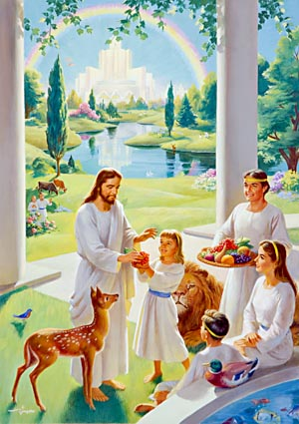
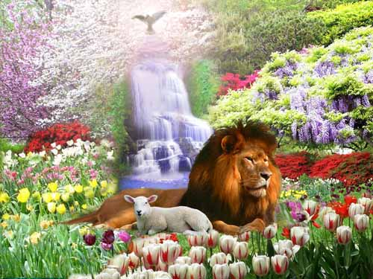
Theological Implication #4
Doctrine of the New Earth/Restoration

Slide 31
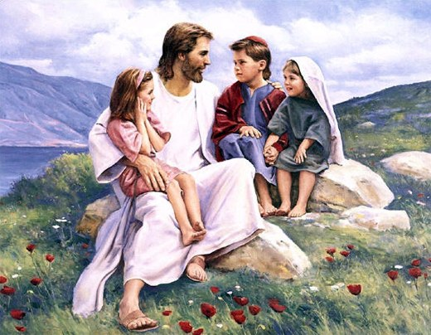
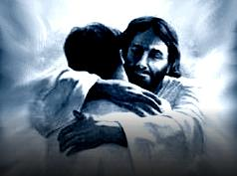
Theological Implication #5
Doctrine of Man (Worth and Significance of Humans)

Slide 32
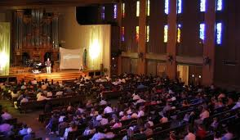
Theological Implication #6
Doctrine of the Sabbath

Slide 33
Theological Implication #7
Doctrine of Marriage

Slide 34
Summary of Implications of Theistic Evolution for Theology/Biblical Doctrines
Doctrine of Scripture
Doctrine of God
Doctrine of Salvation
Doctrine of the New Earth/Restoration
Doctrine of Man
Doctrine of the Sabbath
Doctrine of Marriage

Slide 35
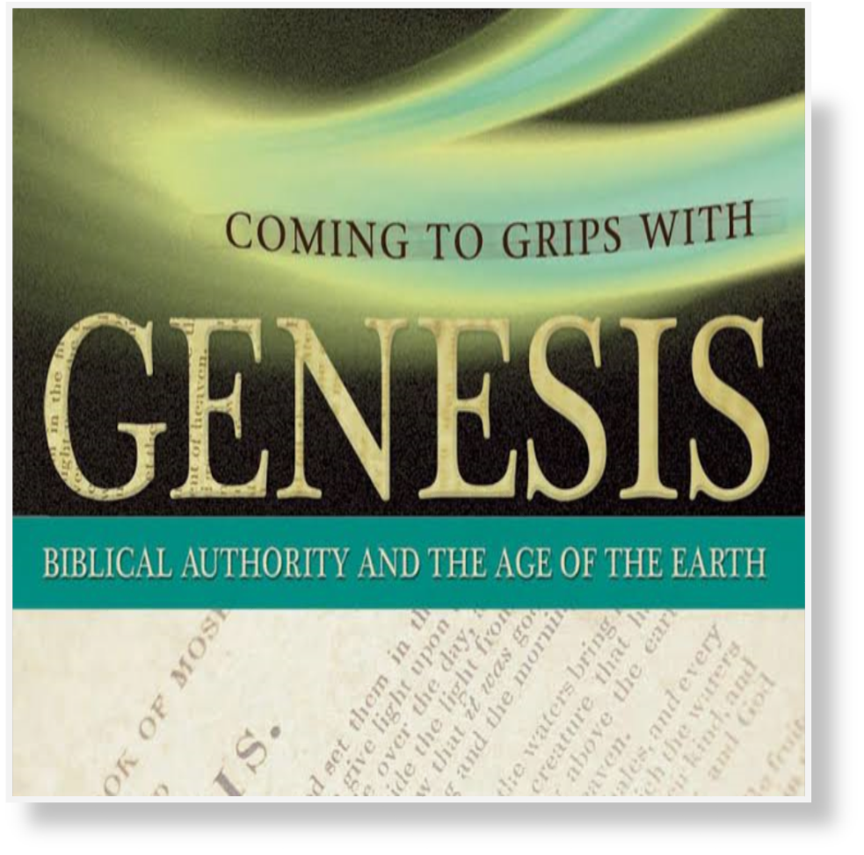
Recommended Reading from Evangelical Christian Scholars
Coming to Grips with Genesis, Terry Mortensen and Thane Ury, eds.

Slide 36
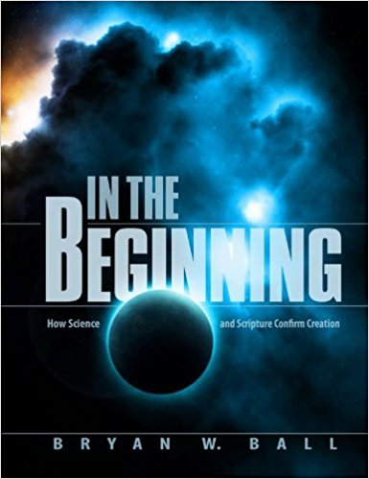
Recommended Reading from Adventist Scholars
In the Beginning: Science and Scripture Confirm Creation, Bryan Ball, ed.

Slide 37
A Concluding Quote
“And so, here is our first answer to the question, ‘Who am I?’ The Babylonian myth would answer, ’You are a product of the gods to make their life easier.’ Modern myth would assert, ‘You are a product of random chance in a purposeless universe.’ The Bible says, ‘You are a personal creation of Yahweh, who cares for you,

Slide 38
A Concluding Quote (cont.)
“has created you male and female, and has placed you in an orderly and good creation as his representative ruler.’ This knowledge of God’s order and created relationships is considered obsolete by many today. As a result, our age suffers the anxiety of enjoying no secure place or significance in the world.” Albert Baylis, From Creation to the Cross, 42

Slide 39
Concluding Exhortation
It is time for all Adventists to “join other members of our church in proclaiming and teaching the biblical doctrine of creation, living in its light, rejoicing in our status as sons and daughters of God, and praising our Lord Jesus Christ—our Creator and Redeemer.” (from the SAU statement on creation)

Slide 40
Biblical Creation is Present Truth!

