Slide 1
Serving the Seventh-day Adventist Church www.grisda.org

Slide 2
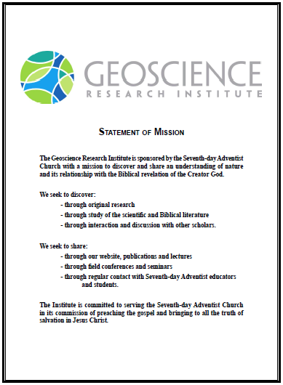
GRI Mission Statement

Slide 3
The Most Difficult Lesson
Apart from Christ we are still incapable of interpreting rightly the language of nature. The most difficult and humiliating lesson that man has to learn is . . .
is his own inefficiency in depending upon human wisdom, and the sure failure of his efforts to read nature correctly.
8 T 257:1

Slide 4
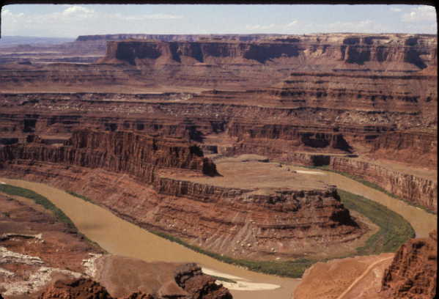
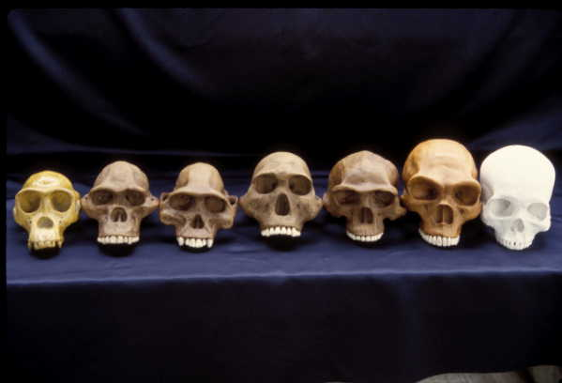
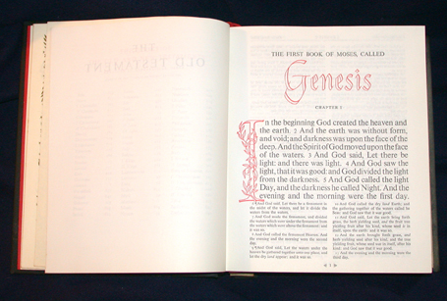
“In the light shining from the cross, we can rightly interpret nature's teaching.” MH 462 8T 324
Notes:
We have been told that human reason is not reliable in interpreting nature, unless illuminated by the gospel. Thus it is important that Biblical teaching be included in our efforts to interpret nature. This is what makes the Geoscience Research Institute necessary, and why it is unique.

Slide 5
OUTLINE
Who We Are
How We Seek to Discover
How We Seek to Share

Slide 6
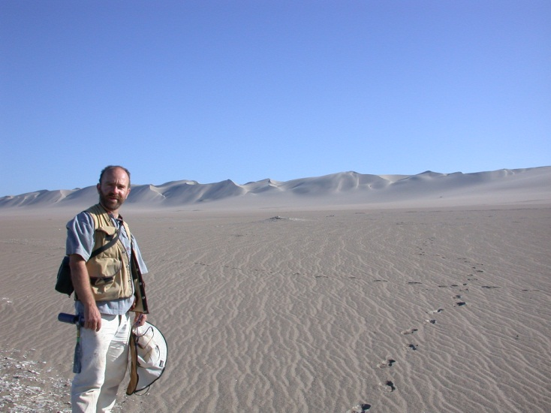
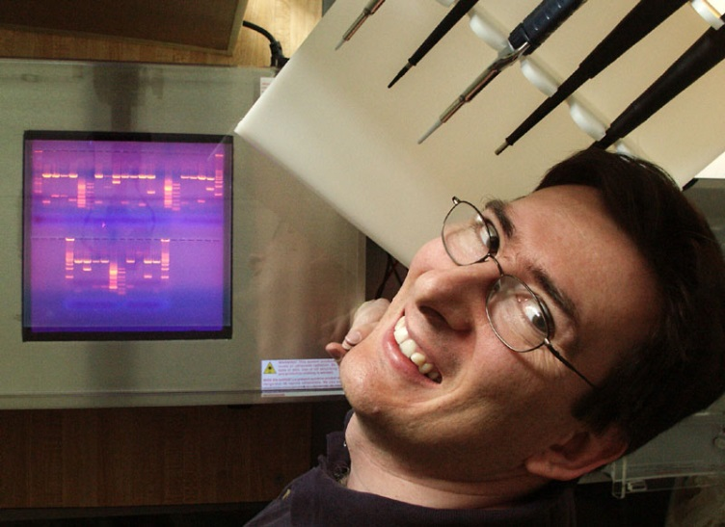
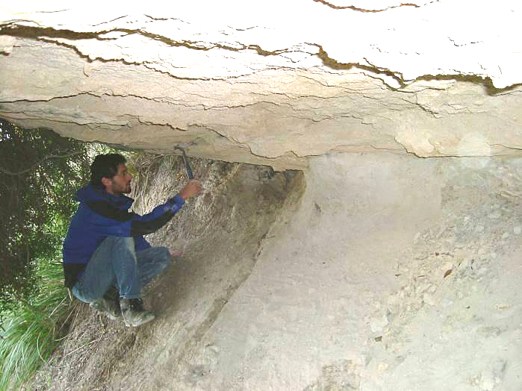
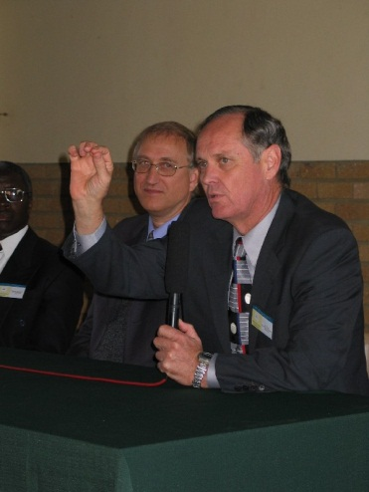
GRI STAFF
Raúl Esperante
Ben Clausen
Tim Standish
Research
Staff Research
Extramural Grants
Education
Publishing
Seminars and Lectures
Field Conferences
Ronny Nalin
Jim Gibson
Notes:
The work of the Institute includes both research and education. Let me introduce the staff.

Slide 7
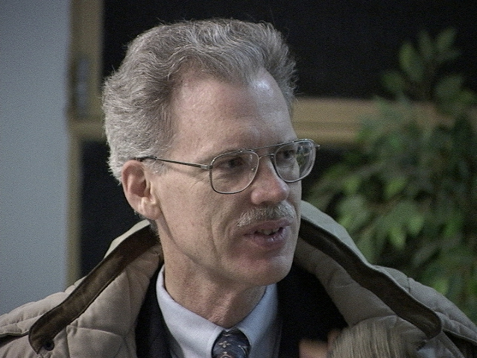
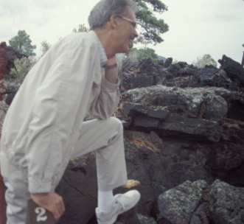
GRI Staff Ben Clausen, PhD
Research Interests:
Nuclear physics shell modeling
Radioisotope dating
Igneous petrology
Notes:
Ben Clausen has a Master’s degree in geology and a PhD in nuclear physics. His current research is in geochemical trends in the Southern California batholith, a large mass of granitic rocks underlying much of Southern California. Ben manages the web site for the Institute, and leads in the meetings of BRISCO, the Biblical Research Institute Science Council.

Slide 8
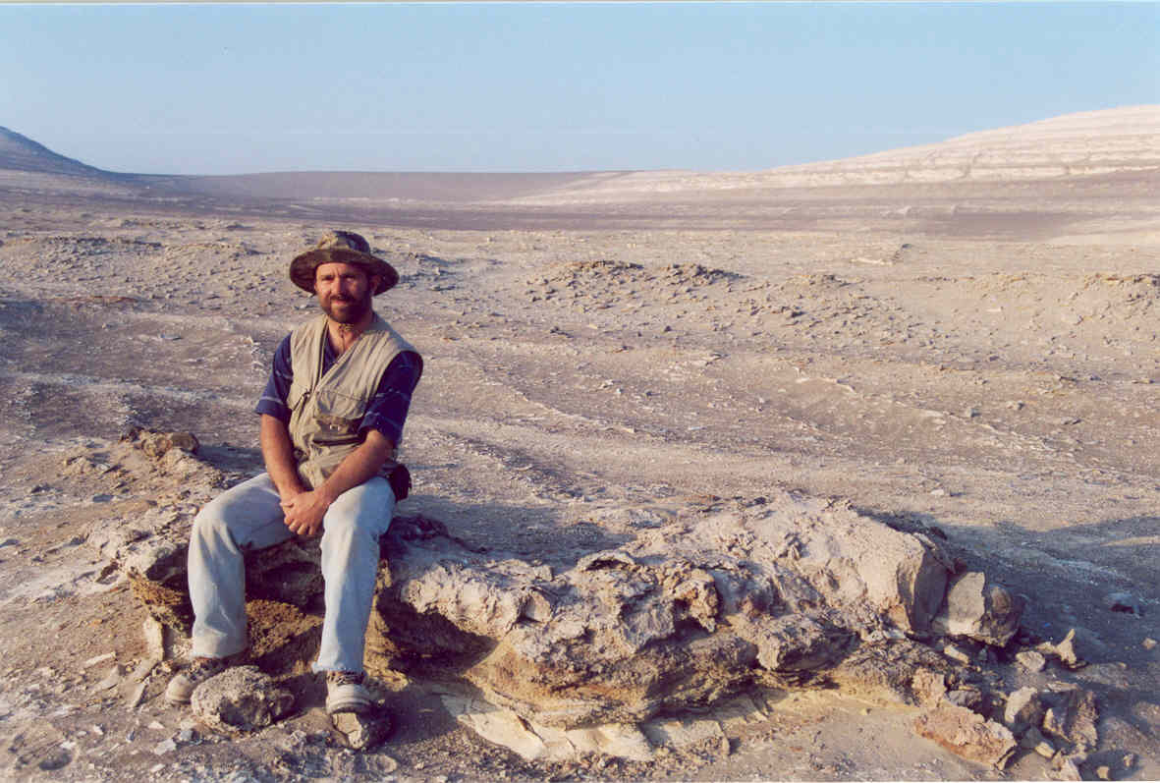
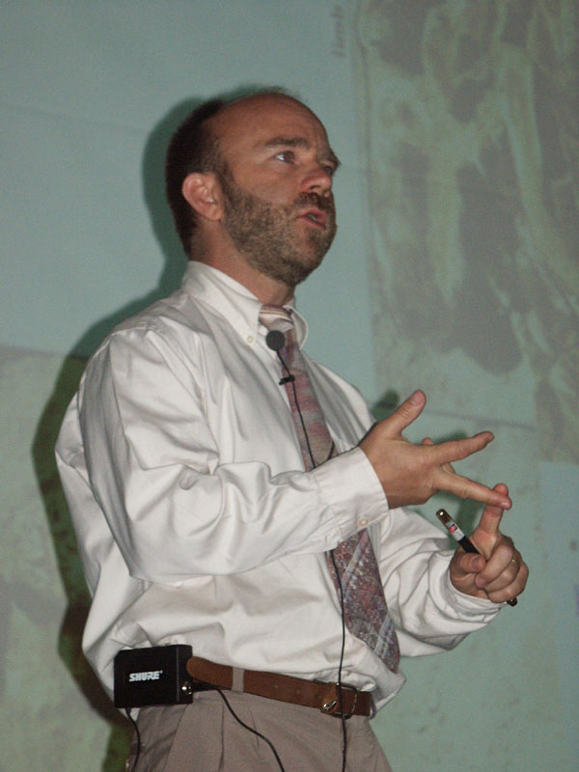
GRI Staff: Raul Esperante, PhD
Research Interests:
Processes of fossilization
Whale fossils in Peru
Whale fossils in Spain
Notes:
Raul Esperante has a PhD in biology with an emphasis in paleontology. His current research is a study of fossil whales preserved in deposits of diatomaceous earth in Peru. Raul is bilingual, which is a great asset to the Institute. Raul is assuming the editorship of our Spanish language magazine, Ciencia de los Origines.

Slide 9
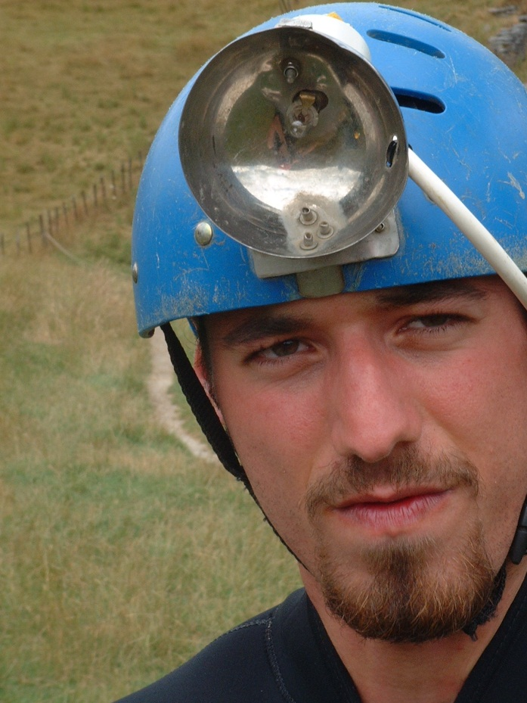
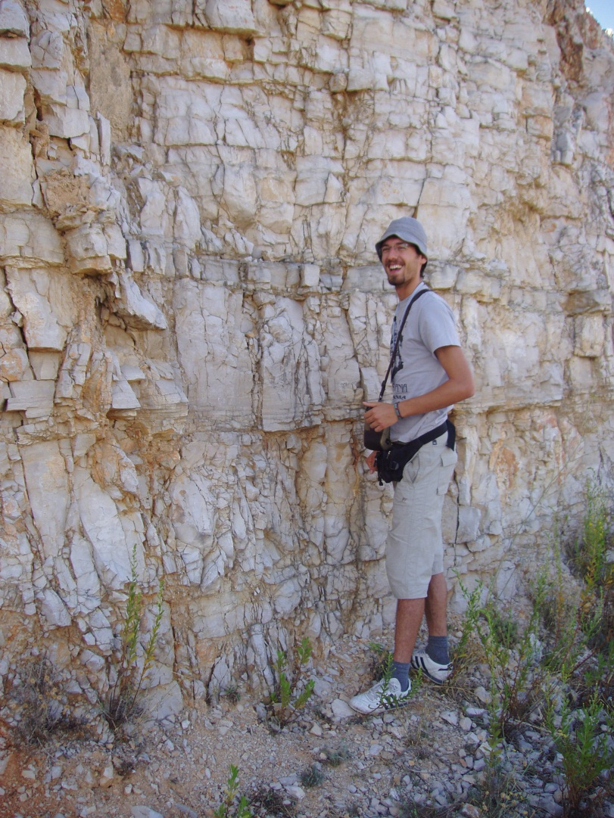
GRI Staff: Ronny Nalin, PhD
Research Interests:
Sedimentology
Non-tropical carbonates
Sequence stratigraphy
Notes:
Raul Esperante has a PhD in biology with an emphasis in paleontology. His current research is a study of fossil whales preserved in deposits of diatomaceous earth in Peru. Raul is bilingual, which is a great asset to the Institute. Raul is assuming the editorship of our Spanish language magazine, Ciencia de los Origines.

Slide 10
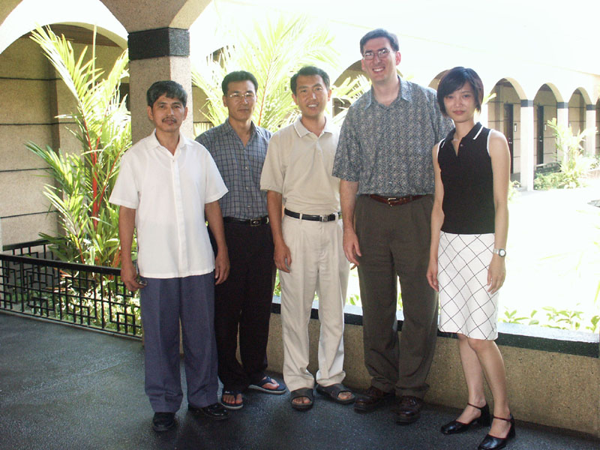
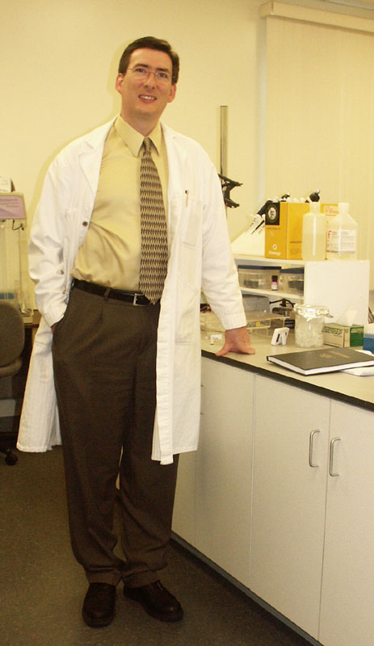
GRI Staff: Tim Standish, PhD
AIIAS
Tim Standish
Molecular genetics
DNA differences
between nematode species
Notes:
Tim Standish is a molecular biologist. His current research project is studying DNA differences between different species of nematodes (roundworms).

Slide 11
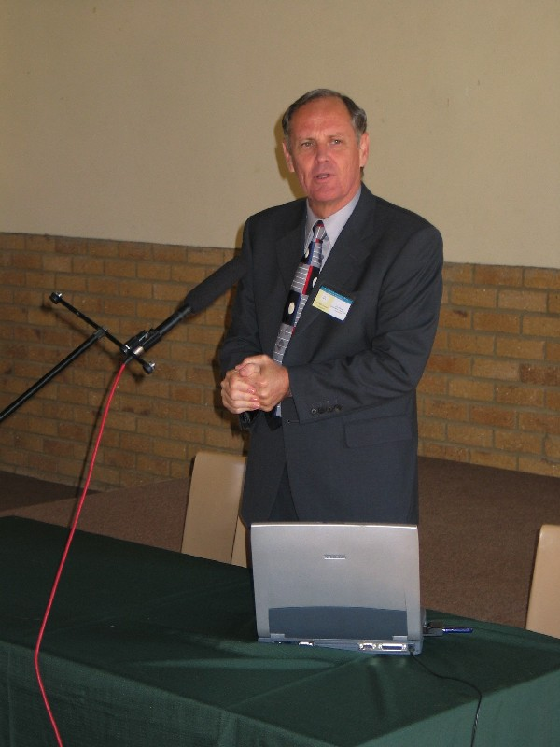
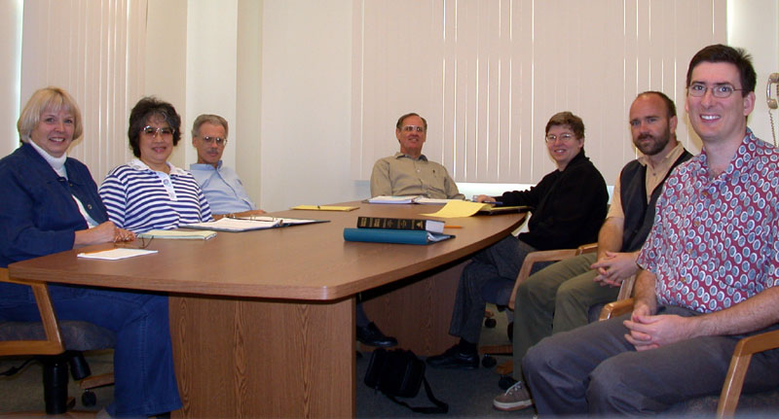
GRI Staff: Jim Gibson, PhD
Research Interests:
Vertebrate biogeography and speciation
Notes:
Jim Gibson has been the Director of the Institute since 1994. Most of my time seems to be taken with administrative duties and lecturing. My research interests are in the distribution of vertebrates (biogeography). I am also the editor of Origins, a scholarly journal published once or twice a year, dealing with issues in origins.

Slide 12
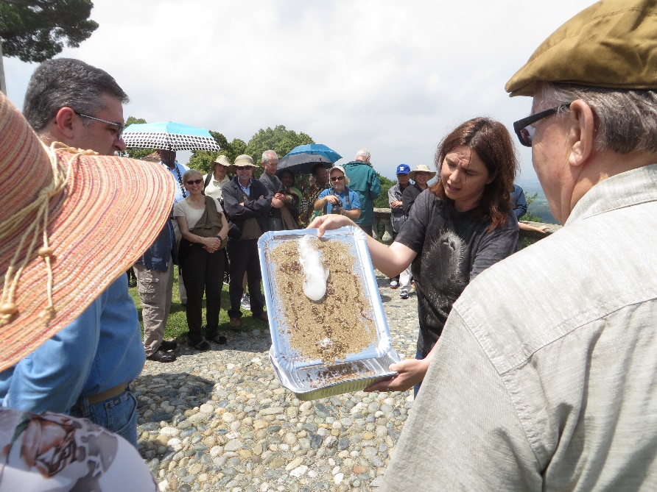
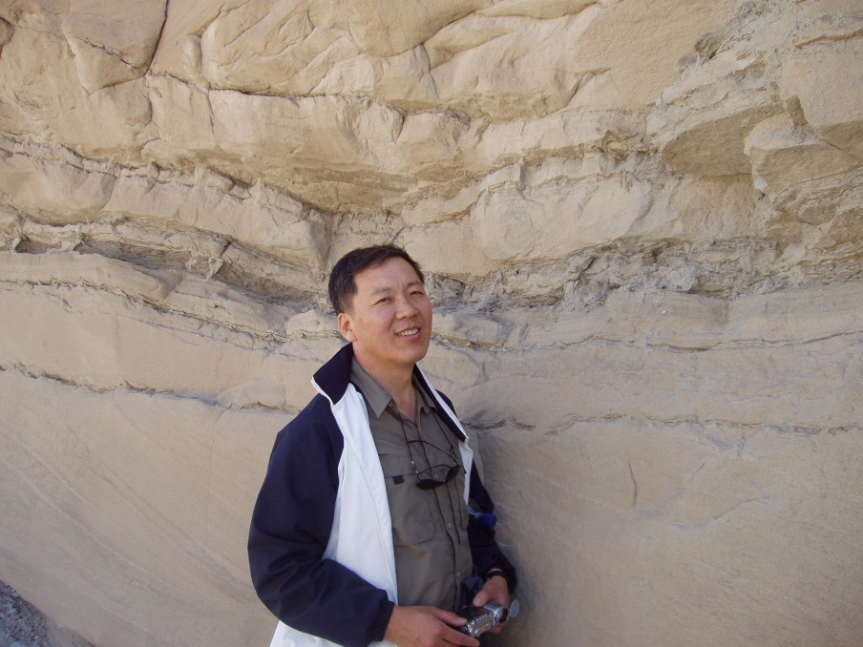
GRI Branch Offices
Noemi Duran Royo, PhD Europe (Spain)
Choi Chong Geol (John), PhD
Asia (Korea)
Notes:
Jacques Sauvagnat is the director of our branch office in France. His research interests are in the study of fossil ostracodes (a kind of tiny arthropod). He also edits a magazine, Science et Origines, published twice a year, and teaches a class in science and religion.
Antonio Cremades directs our branch office in South America. His research is in the area of biometrics, especially of the human hand.

Slide 13
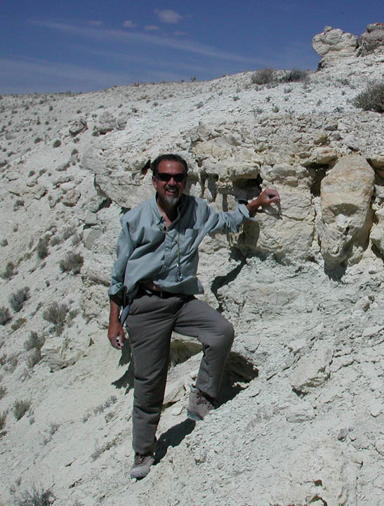
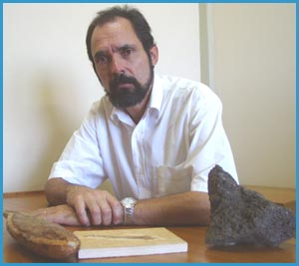
GRI Branch Offices
Nahor Neves, PhD
South America, Portuguese
(Brazil)
Roberto Biaggi, PhD
South America, Spanish (Argentina)
(Pending)
Luciano Gonzalez Interamerican Division, Mexico

Slide 14
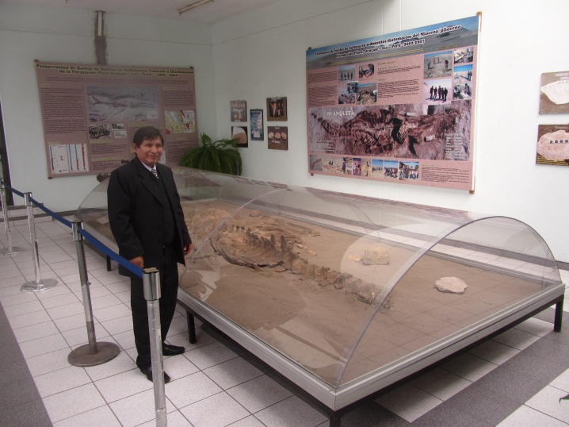
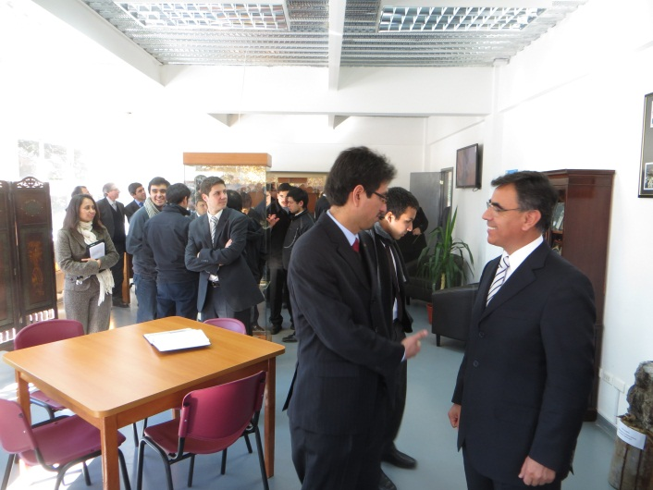
GRI Resource Centers
Peru Adventist University
Chile Adventist University

Slide 15
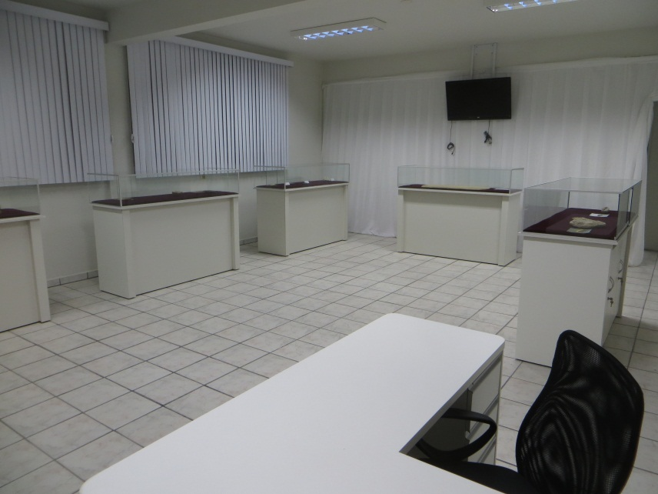
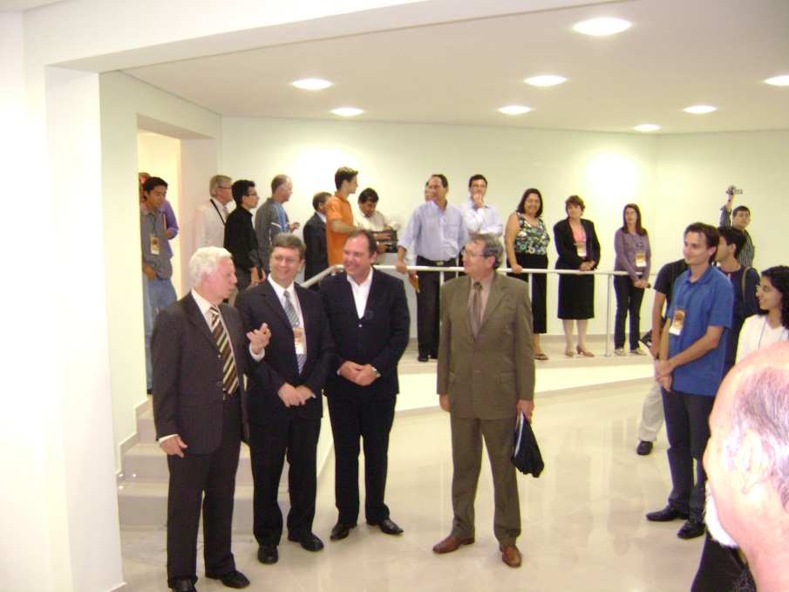
GRI Resource Centers
Northeast Brazil Adventist University
UNASP (Brazil Adventist University College

Slide 16
OUTLINE
Who We Are
How We Seek to Discover
How We Seek to Share

Slide 17
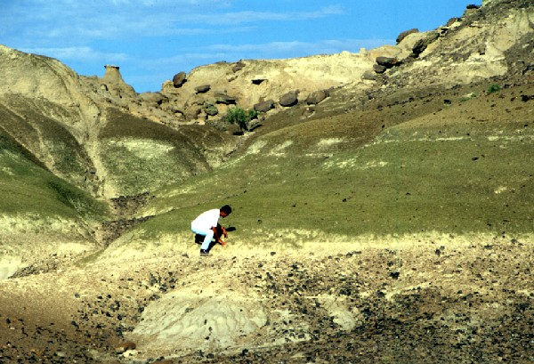
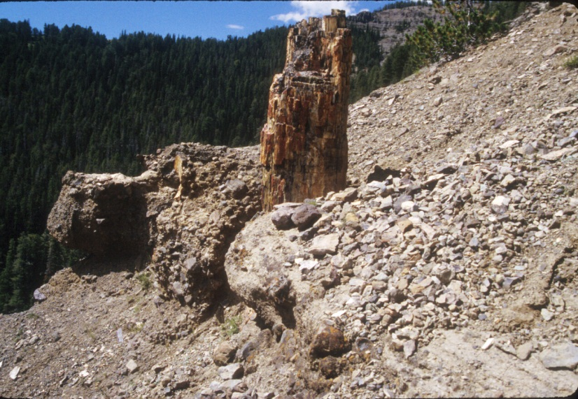
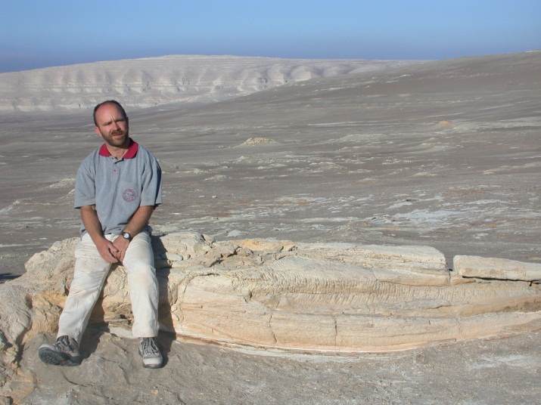
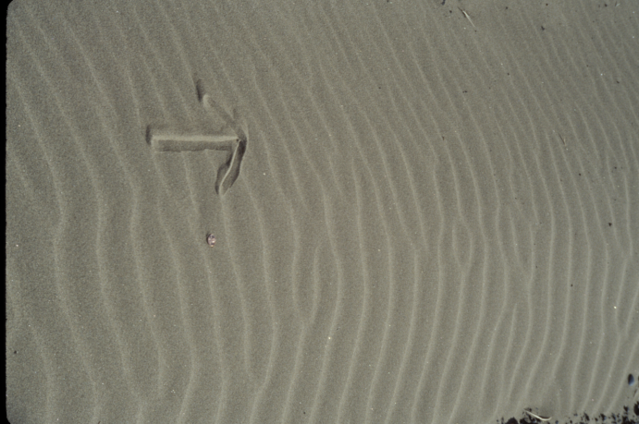
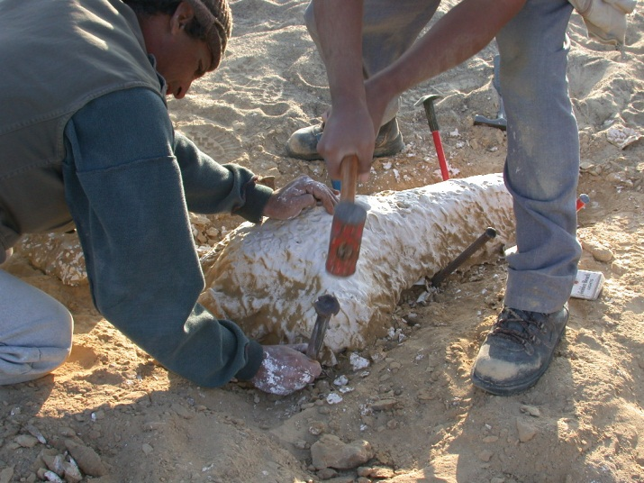
GRI Sponsored Research
Staff research projects
Research grants for SDA researchers
Notes:
Research is one of the major activities of the Institute. In addition to research by staff members, we have a very modest research grant program that provides seed money for research to Adventist researchers investigating questions of interest to the Institute.

Slide 18
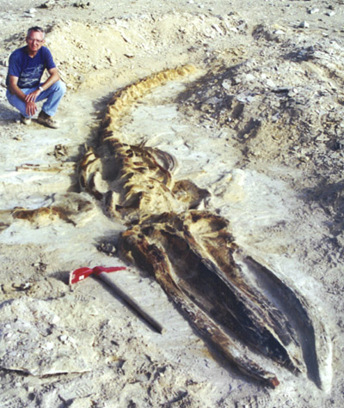
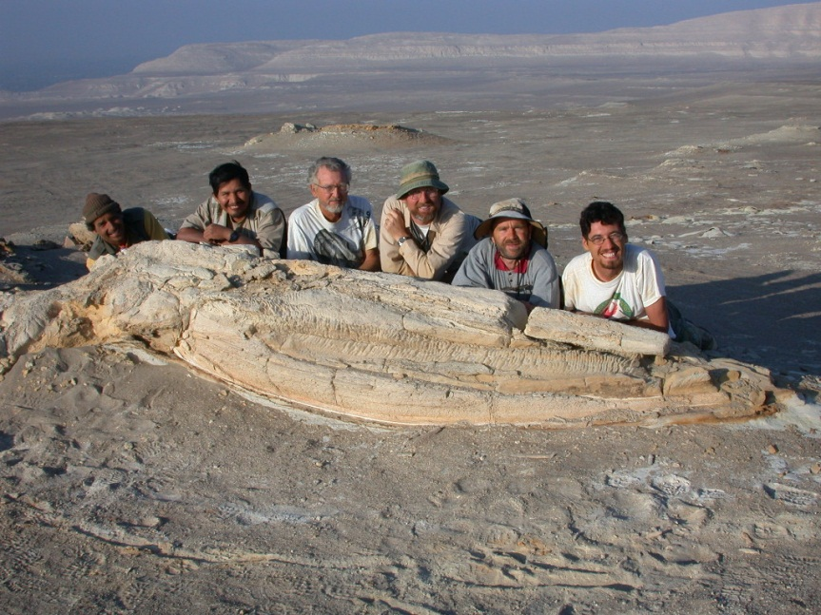
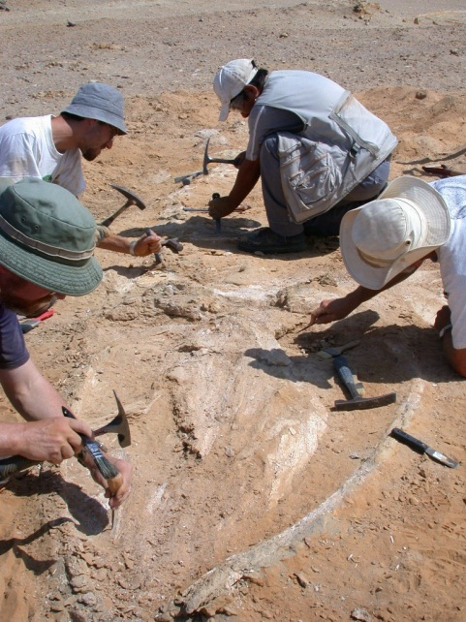
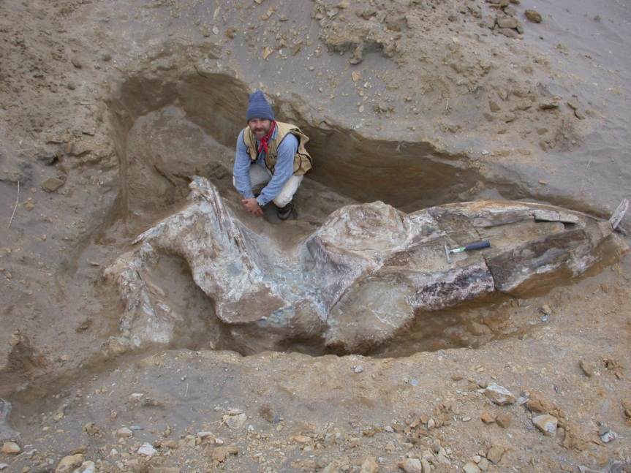
Fossil Whales, Pisco Formation, Peru
Once thought to represent a long period of time, now known as rapid catastrophic preservation of fossil whales
Leonard Brand, LLU
Research Team
Excavating
Raul Esperante, GRI
Notes:
Hundreds of fossil whales are found in the Pisco Formation of Peru. The standard interpretation was that several hundred thousand years were involved in the deposition of this deposit. Research sponsored in part by the Institute has shown that the fossil whales are well preserved, and must have been buried rapidly.

Slide 19
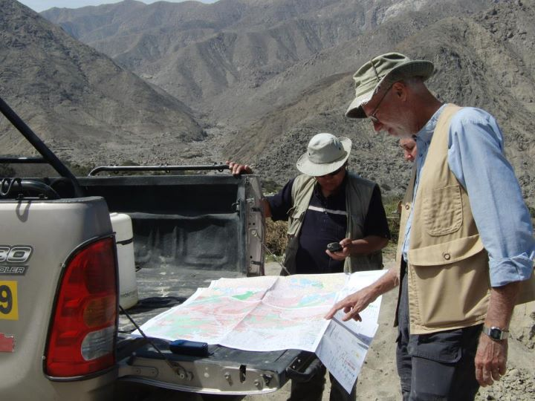
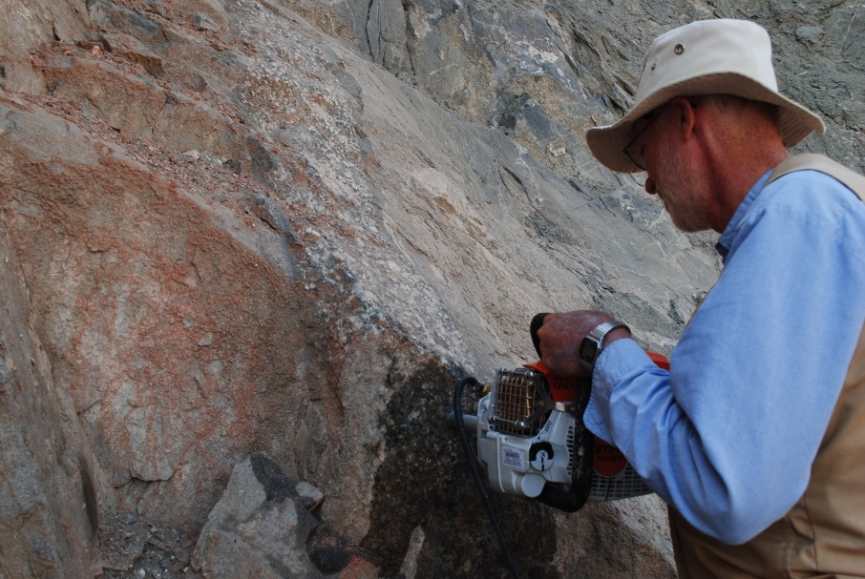
Geochemistry of Granites
Directed by Dr. Ben Clausen
Including Luciano Gonzalez and Ana Martinez

Slide 20
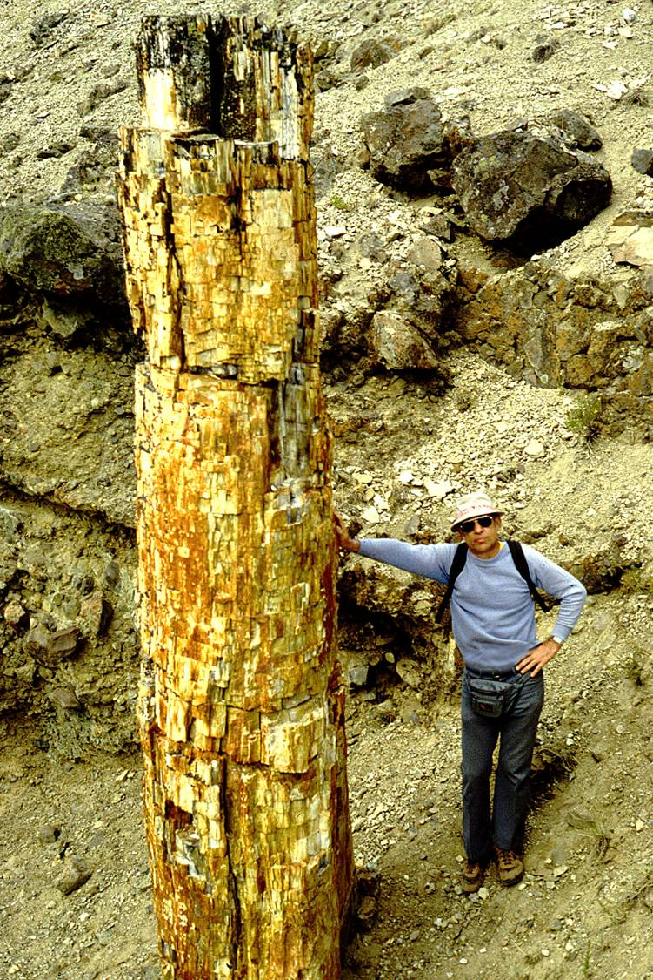
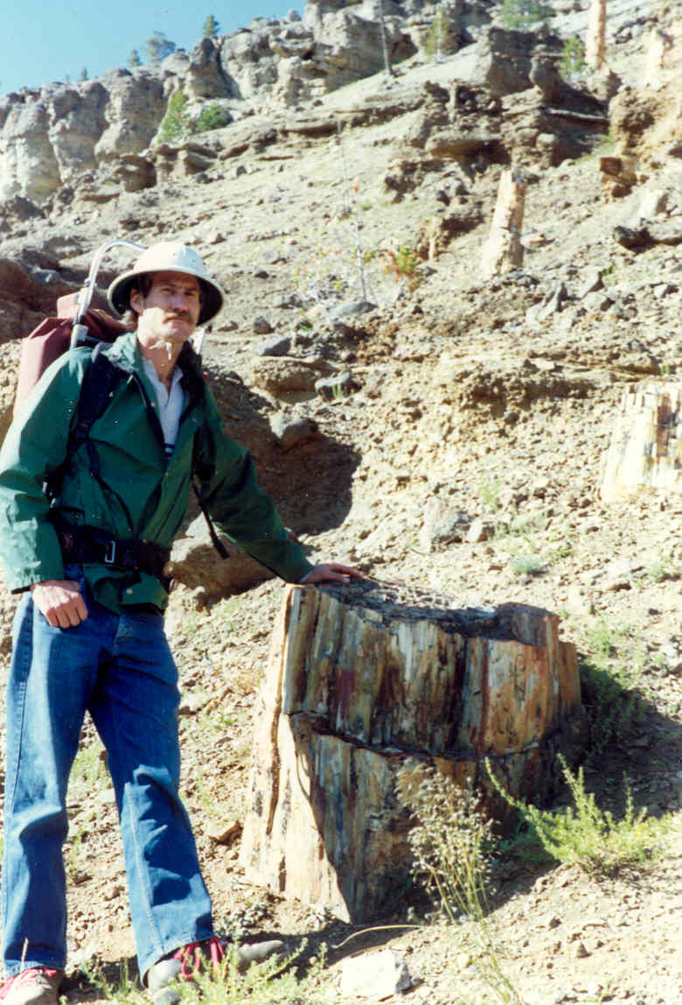
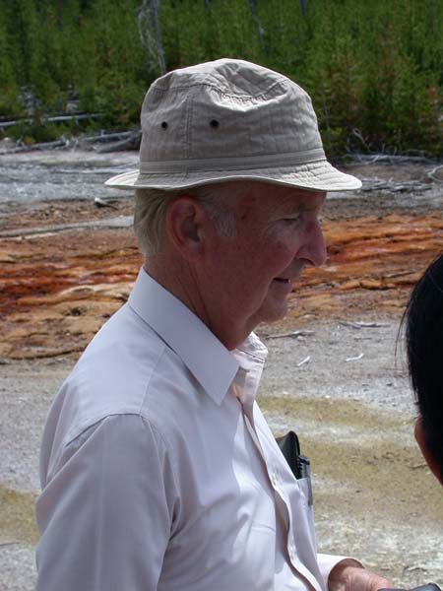
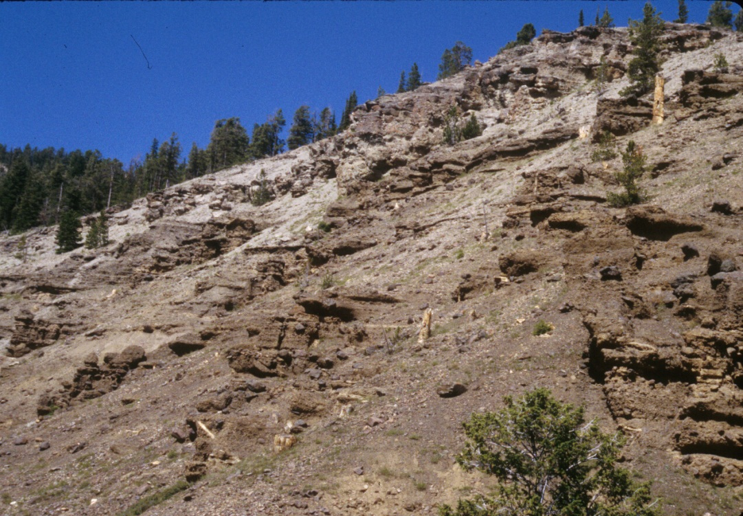
Yellowstone Fossil Forest
Clyde Webster
Once thought to require hundreds of thousands of years, but now believed to have been deposited catastrophically
Many layers of upright fossil trees.
Harold Coffin
Mike Arct
Notes:
The Yellowstone fossil forest is a sequence of 70 or more successive layers of fossil trees, interspersed with layers of volcanic ash and leaves. It was long interpreted as representing long periods of time when trees grew in place, were buried by volcanic eruptions, and replaced by new forests. Research sponsored by the Geoscience Research Institute has revealed that these trees were probably transported into their present position, and did not grow there. The deposit appears the be deposited catastrophically rather than representing hundreds of thousands of years.

Slide 21
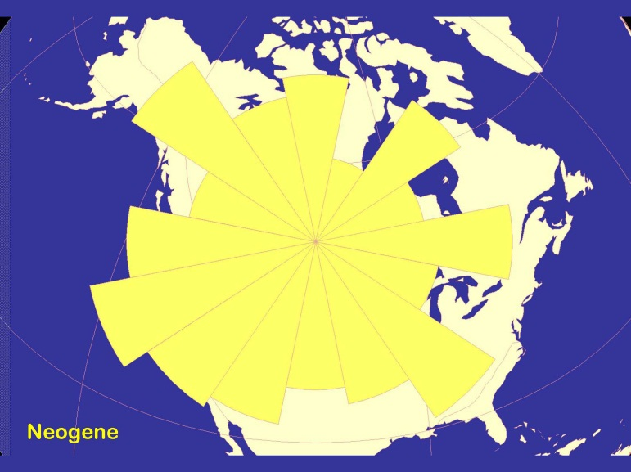
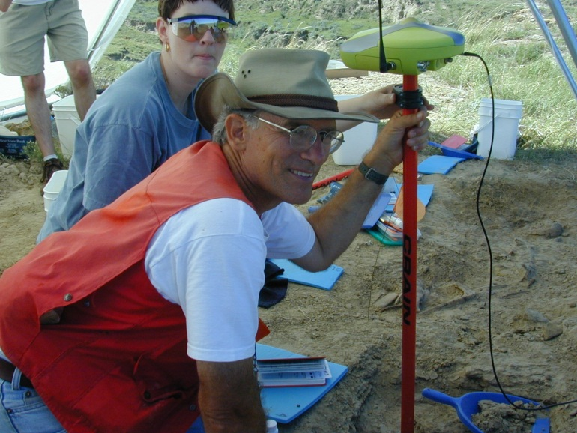
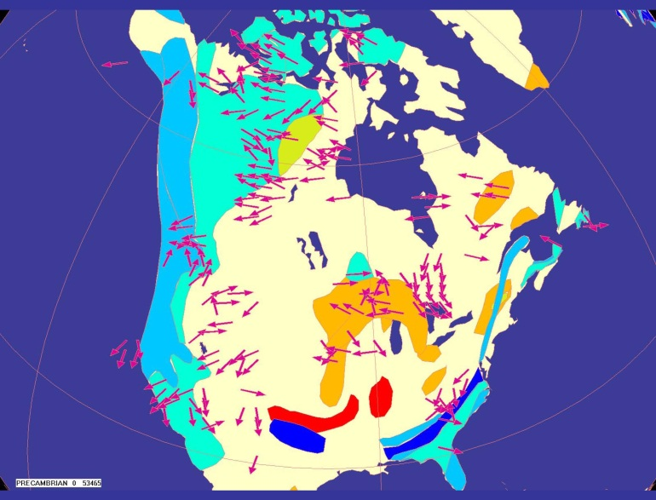
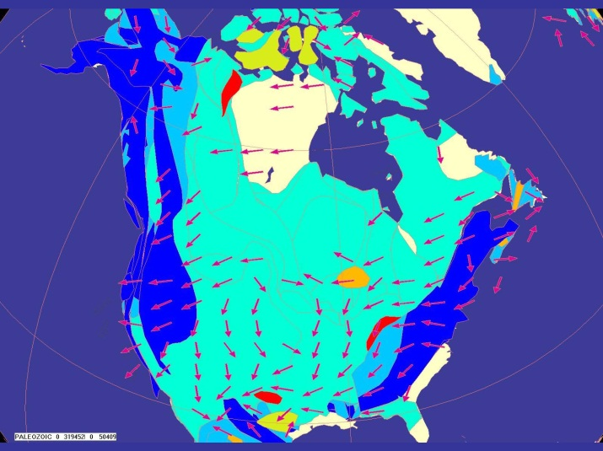
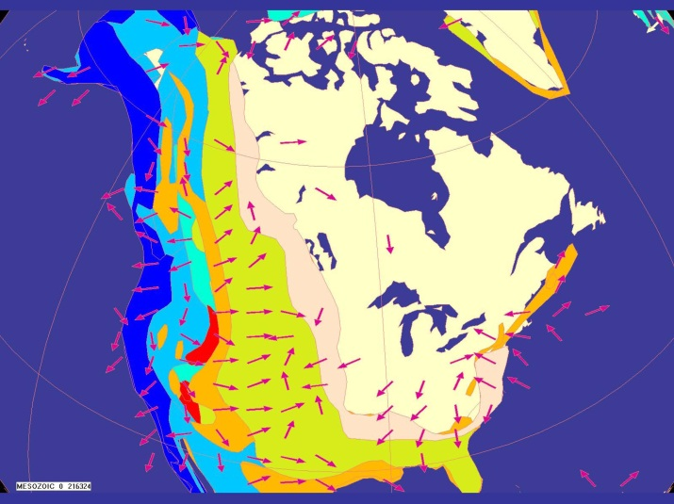
Global Paleocurrents:
Mesozoic
Neogene
Arthur Chadwick SWAU
Paleozoic
Fossilized current indicators unexpectedly show global patterns in Paleozoic sediments
Precambrian
Notes:
Water currents produce evidence that indicates the direction of flow. This evidence is often preserved in the geological record. Ordinarily, currents flow into basins from all directions. This is the pattern seen at the top of the geological column, but deeper in the column there is evidence for global patterns in the paleocurrents. This indicates processes on a wider scale than local basins.

Slide 22
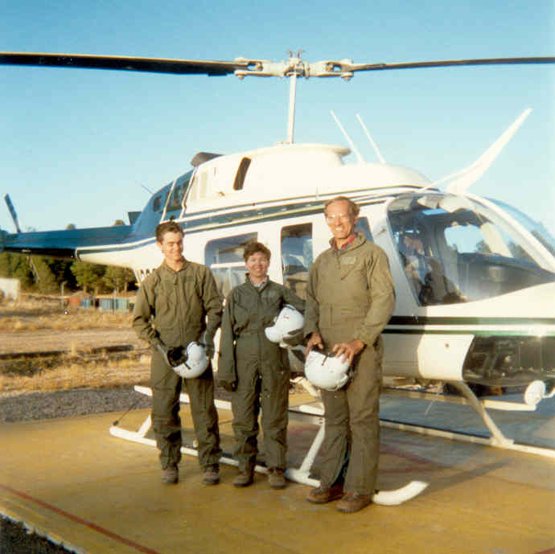
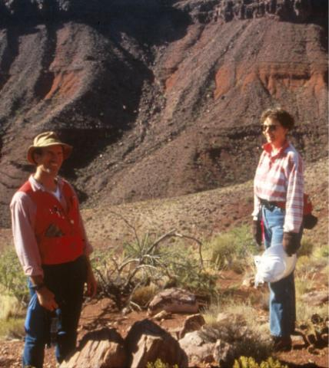
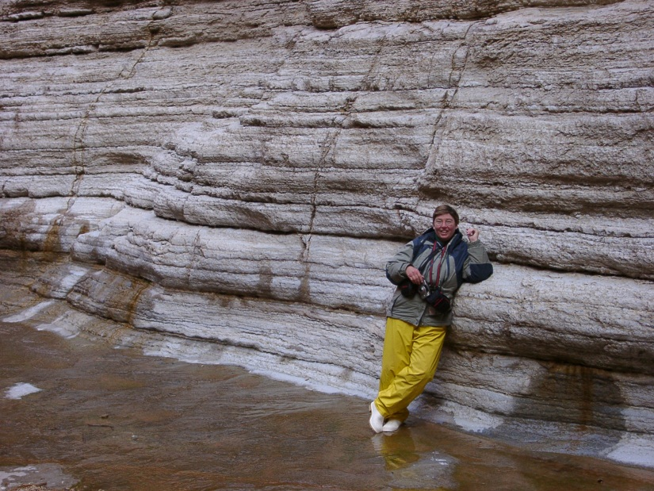
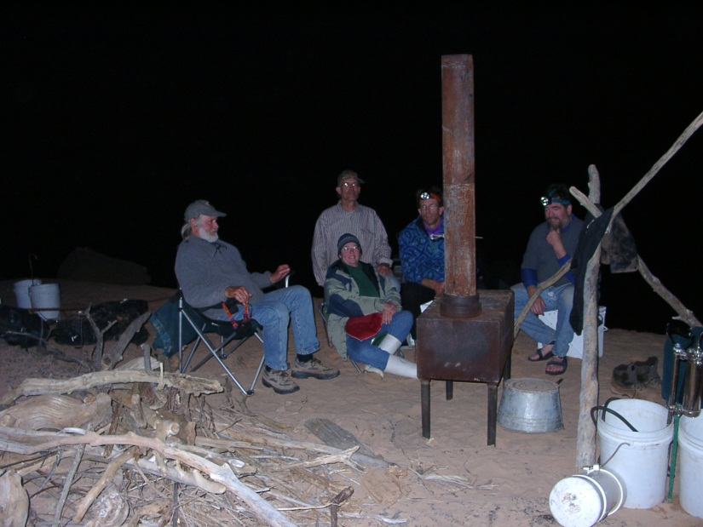
Tapeats Sandstone, Grand Canyon
Shown to have been deposited catastrophically in deep water
Access by helicopter
Elaine Kennedy, Arthur Chadwick and others
Research Team
Elaine Kennedy, GRI
Notes:
The Tapeats Sandstone is a Cambrian deposit which has been interpreted as deposited in shallow water as the rising sea gradually encroached upon the land. Research sponsored by GRI has shown that it was deposited in deeper water, probably rapidly.

Slide 23
OUTLINE
Who We Are
How We Seek to Discover
How We Seek to Share

Slide 24
Seminars, Lectures
SID
SSD
SUD
ESD
TED
WAD
SAD
NSD
IAD
Notes:
Members of the Institute travel widely, by invitation, to all parts of the world to present seminars and lectures on science and faith. The Institute has been represented at most of the Faith and Learning Seminars sponsored by the GC Department of Education. In addition, we have held numerous creation seminars at our universities in South America and elsewhere. Occasionally, we teach courses in Issues in Origins.

Slide 25
Field Conferences
Church Leaders
Wyoming
SPD Workers
South Pacific
NAD Teachers
Mt St Helens
Korean Teachers Grand Canyon
Church Leaders
Europe
Notes:
Field Conference represent one of the major projects of the Geoscience Research Institute. Most Field Conferences are offered in North America, due to the accessibility of geological features, ease of transportation, and availability of lodging. We have also held Field Conferences in Europe and in Australia – New Zealand. Field Conferences are conducted in response to requests from Divisions or Unions.

Slide 26
GRI Activities Web Publications

Slide 27
GRISDA.ORG

Slide 28
Ciencia de los Orígenes

Slide 29
GRI Outreach Products Audio-Visual Products
SPD Media Center
Newbold College Church
Illustra Media
ANN
SPD Media Center

Slide 30
Fulfilling the GRI Mission
DISCOVERY
Research: projects in Italy, Spain, Peru, Utah.
Literature study: continual and ongoing.
Interaction: university meetings, GRICO,
professional meetings.
SHARING
Web redesign; blog; Facebook; FAQs;
church articles; newsletters; book Entrusted; helped with Flight DVD; TV and radio appearances.
Seminars and similar events in all Divisions.
Visit universities; Workers’ meetings
Off-campus meetings for students, or local churches.

Slide 31
The End

