Slide 1
The Creator of Nature and the Nature of the Creator
L. J. Gibson
Geoscience Research Institute
www.grisda.org

Slide 2
Three Points
Nature reveals both good and evil, producing a dilemma for “natural theology” by pointing to the Creator as the source of evil.
Jesus revealed to us the true nature of the Creator.
The Creator is truthful, compassionate, a healer.
The Creator acts in nature with absolute power, but preserves freedom of choice.
The Creator is the God of life, while the devil is the god of death.
The life and teachings of Jesus falsify origins theories, such as evolutionary creation, that are based on death.

Slide 3
The Creator of Nature Creation Through God the Son
God, who at various times and in various ways spoke in time past to the fathers by the prophets, ² has in these last days spoken to us by His Son, whom He has appointed heir of all things, through whom also He made the worlds;
Hebrews 1:1-2

Slide 4
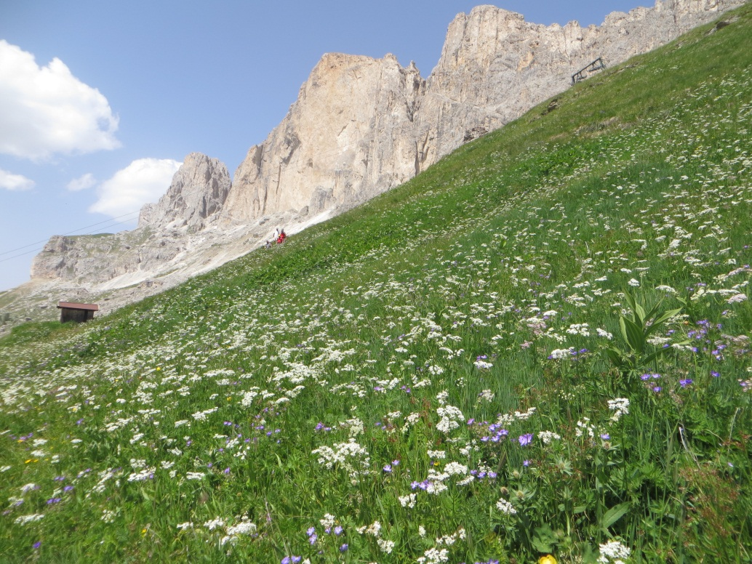
The Creator of Nature
What can we learn about God from observing nature?
For since the creation of the world His invisible attributes are clearly seen, being understood by the things that are made, even His eternal power and Godhead . . .
Romans 1:20
He did not leave Himself without witness, in that He did good, gave us rain from heaven and fruitful seasons, filling our hearts with food and gladness.
Acts 14:15
(Sermon at Lystra)
Wildflowers in the Dolomites of Italy
Notes:
And God said, let there be light, and there was light. So the evening and morning were the first day. Genesis 1:3, 5, NKJV.

Slide 5
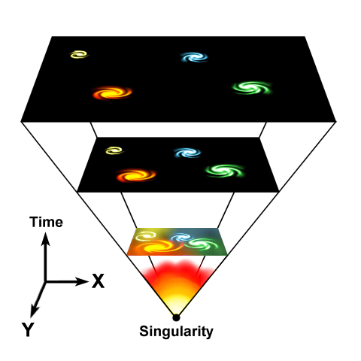
Eternal Creator
Seen In The Creation
In the beginning God created the heavens and the earth.
Genesis 1:1
Before the mountains were brought forth . . . From everlasting to everlasting, you are God.
Psalm 90:2
Universe Expansion.
By Fredrik, Public Domain

Slide 6
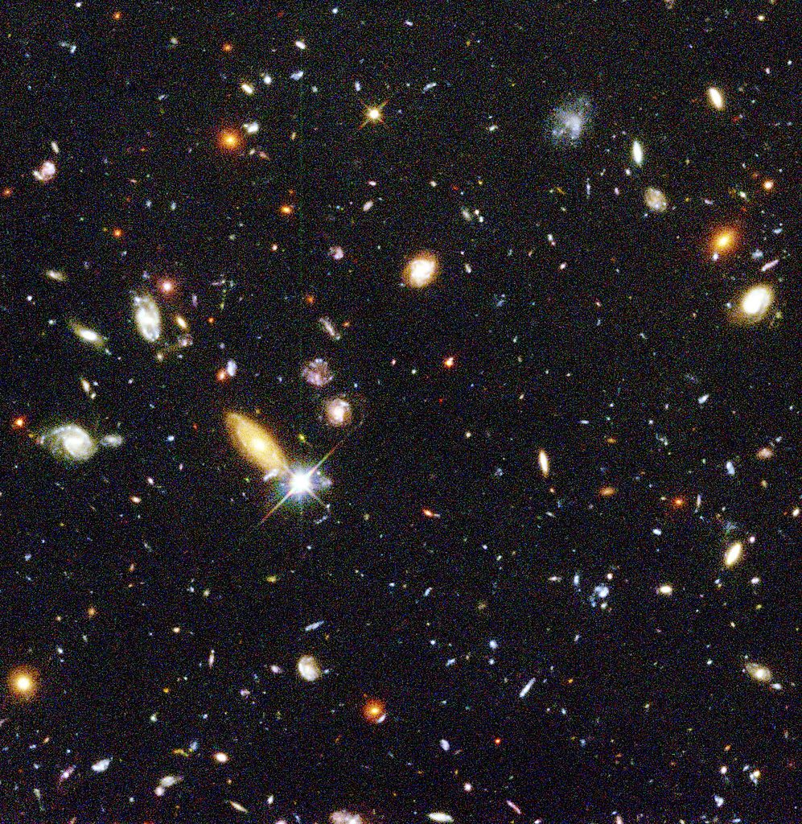
Powerful Creator
Seen In The Creation
Ah! Lord God! You have made the heavens and the earth by Your great power and outstretched arm. There is nothing too hard for You.
Jeremiah 32:17
Who stretches out the heavens like a curtain, and spreads them out like a tent to dwell in.
Isaiah 40:12
Hubble Deep Field. NASA.

Slide 7
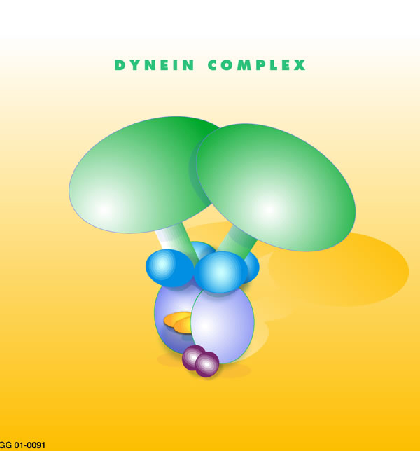
Supernatural Creator
Seen In The Creation
Oh Lord, how manifold are Your works! In wisdom You have made them all. The earth is full of your possessions.
Psalm 104:24
By faith we understand that the worlds were framed by the word of God, so that the things which are seen were not made of things which are visible.
Hebrews 11:3 NKJV
Photos (in Public Domain)
Cartwheel Galaxy.
Dynein Molecule Model.
From US gov.

Slide 8
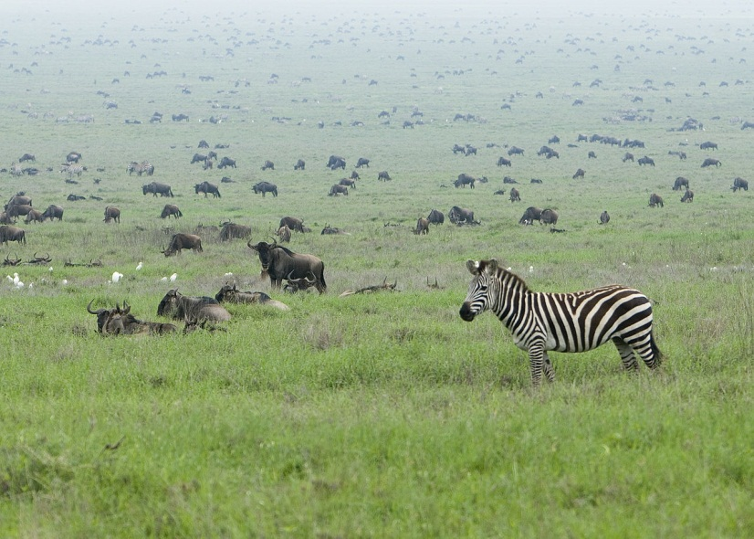
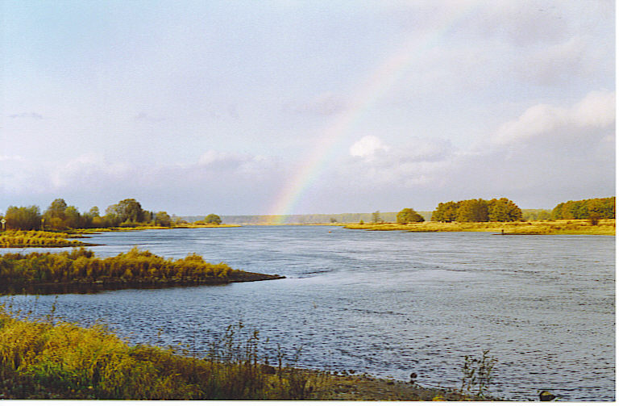
Provident Creator
Seen In The Creation
Also to every beast of the earth, to every bird of the air, and to everything that creeps on the earth, in which there is life, I have given every green herb for food.
Genesis 1:30
. . . He makes His sun rise on the evil and on the good, and sends rain on the just and on the unjust.
Matthew 5:45
Serengeti migration. Copyright David Dennis.
Used by permission under Creative Commons Attribution Share 2.0
Rainbow over Oder River in Europe. Boerkevitz. Public.

Slide 9
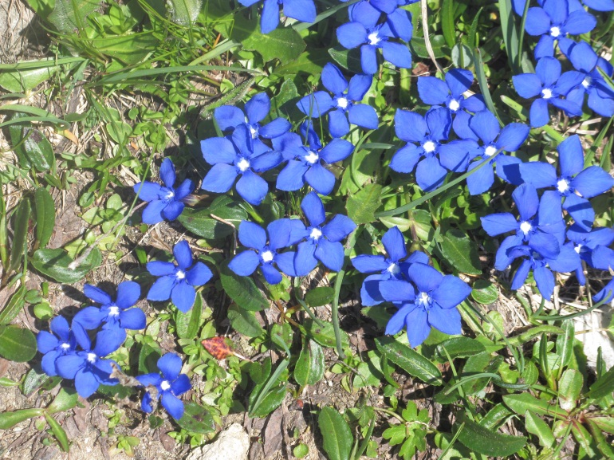
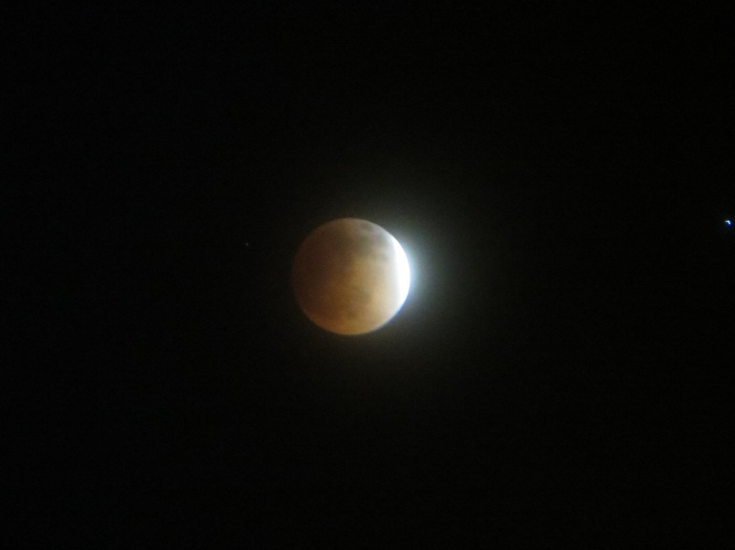
The Creator of Nature
Summary: What We Can See in the Creation
For since the creation of the world His invisible attributes are clearly seen, being understood by the things that are made, even His eternal power and Godhead . . .
Romans 1:20
He did not leave Himself without witness, in that He did good, gave us rain from heaven and fruitful seasons, filling our hearts with food and gladness.
Acts 14:15
Photos: GRI

Slide 10
Beauty in Nature “Consider the Lilies”
Troupial
Andreas Trepte. CCA4.0
www.photo-natur.de
Dahlia Flower.
Ragesoss. Commons.
GNU Free Doc.

Slide 11
The Dark Side of Nature Violence, Suffering, Death
Wolves eating a deer. Photo by Ipuser, CCA2.0, Commons

Slide 12
The Creator of Nature
What Kind of Creator from Natural Theology?
“What a book a Devil’s Chaplain might write on the clumsy, wasteful, blundering low and horridly cruel works of nature.”
Charles Darwin. Letter to Joseph Hooker, July 13, 1856.
“But I own that I cannot see as plainly as others do, and as I should wish to do, evidence of design and beneficence on all sides of us. There seems to me too much misery in the world.”
Charles Darwin. Letter to Asa Gray. May 22, 1860.
“What kind of God can one infer from the sort of phenomena epitomized by the species on Darwin’s Galapagos Islands? . . . The God of the Galapagos is careless, wasteful, indifferent, almost diabolical. He is certainly not the sort of God to whom anyone would be inclined to pray.”
David Hull. The God of the Galapagos. Nature 353:485-486 (1991).

Slide 13
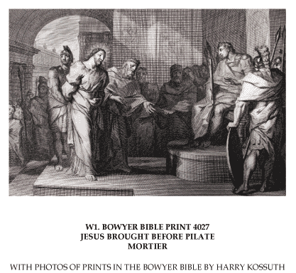
The Truthful Creator
I am the way, the truth, and the life. No one comes to the Father except through Me.
John 14:6
For this cause I was born, and for this cause I have come into the world, that I should bear witness to the truth. Everyone who is of the truth hears My voice.
John 18:37

Slide 14
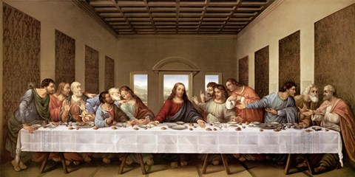
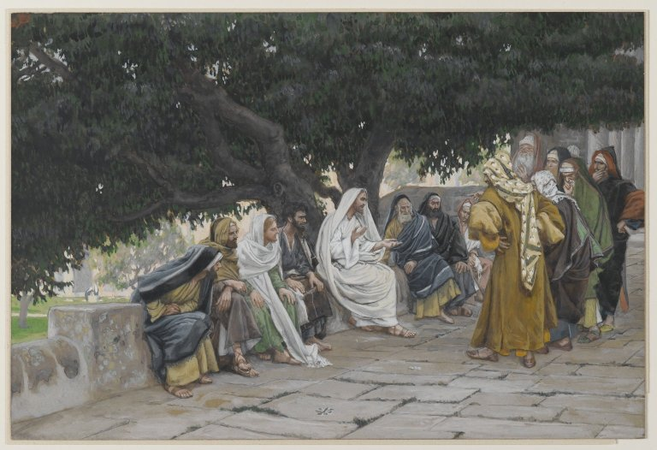
Jesus’ Words Are True
If it were not so, I would have told you.
John 14:2
Leonardo da Vinci. 1498
If you abide in My word, you are My disciples indeed. And you shall know the truth, and the truth shall make you free.
John 8:31-32
James Tissot. 1886-1894.

Slide 15
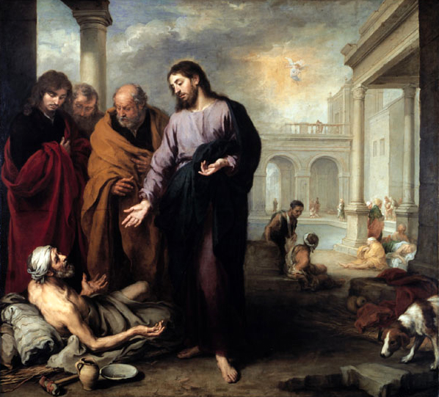
The Compassionate Healing Creator
Now a certain man was there who had an infirmity thirty-eight years. . . .
Jesus said to him “Rise, take up your bed and walk.”
John 5:5, 8
The Spirit of the Lord is upon Me, Because He has anointed Me to preach the gospel to the poor. He has sent Me to heal the brokenhearted . . .
Luke 4:18
Bartolomé Esteban Murillo.
1670.

Slide 16
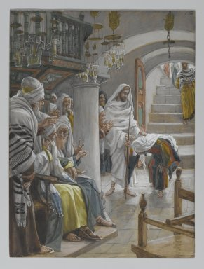
Jesus Treated the Weak With Compassion and Favor
So ought not this woman, being a daughter of Abraham, whom Satan has bound – think of it – for eighteen years, be loosed from this bond on the Sabbath?
Luke 13:16
James Tissot.
1886-1896

Slide 17
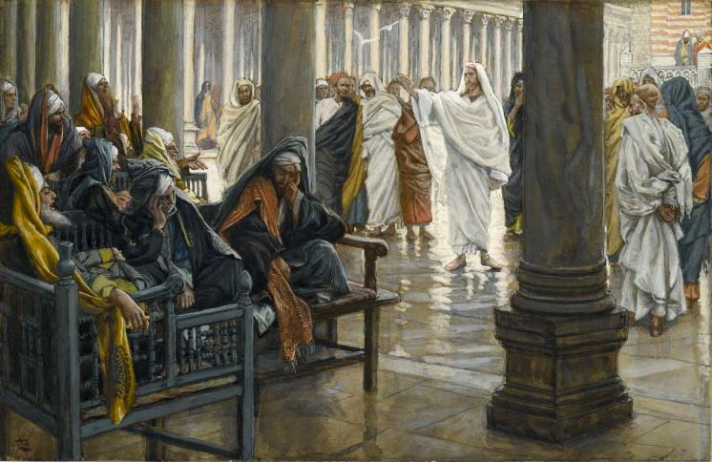
Jesus Believed Scripture
But he said to him “If they do not hear Moses and the prophets, neither will they be persuaded though one rise from the dead.”
Luke 16:31
James Tissot. 1886-1894.
Jesus answered and said to them,
You are mistaken, not knowing the Scriptures nor the power of God.
Matt 22:29

Slide 18
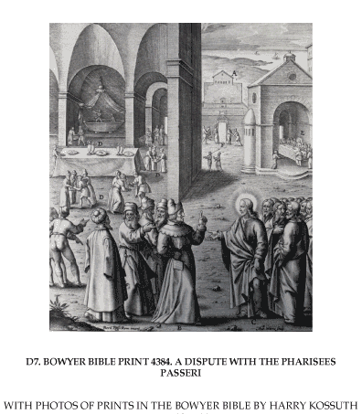
Jesus Believed in Genesis
And He answered and said to them, “Have you not read that He who made them at the beginning made them male and female, and said, For this reason a man shall leave his father and mother and be joined to his wife, and the two shall become one flesh?
Matthew 19:4-5

Slide 19
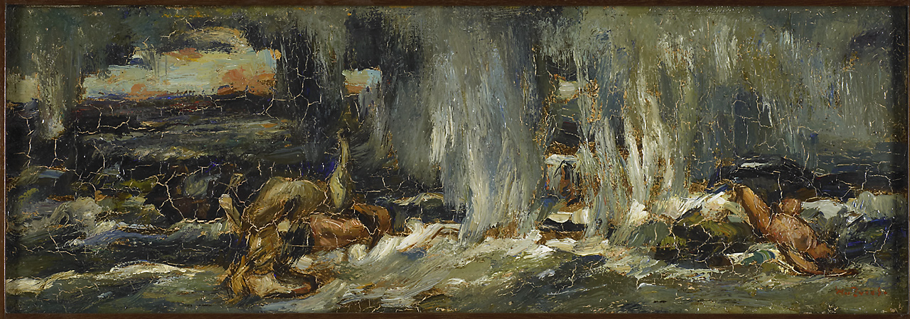
Jesus’ Disciples Believed in Creation and the Flood
But as the days of Noah were, so also will the coming of the Son of Man be.
Matthew 24:37
. . . By the word of God the heavens were of old, and the earth standing out of water and in the water,
By which the world that then existed perished, being flooded with water. 2 Peter 3:5,6
Willem de Zwart. 1900-1031.

Slide 20
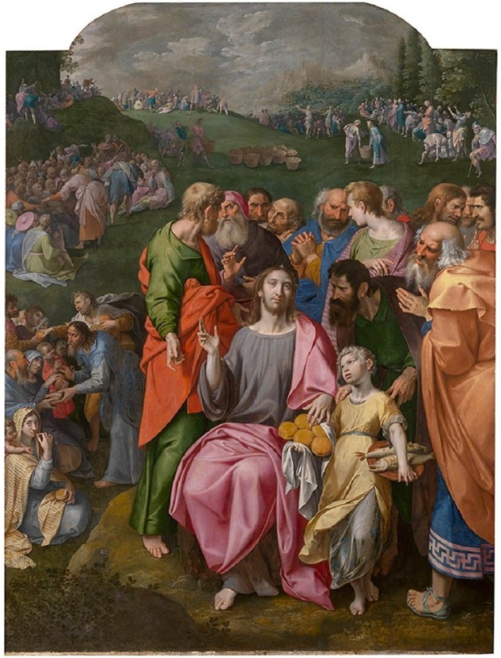
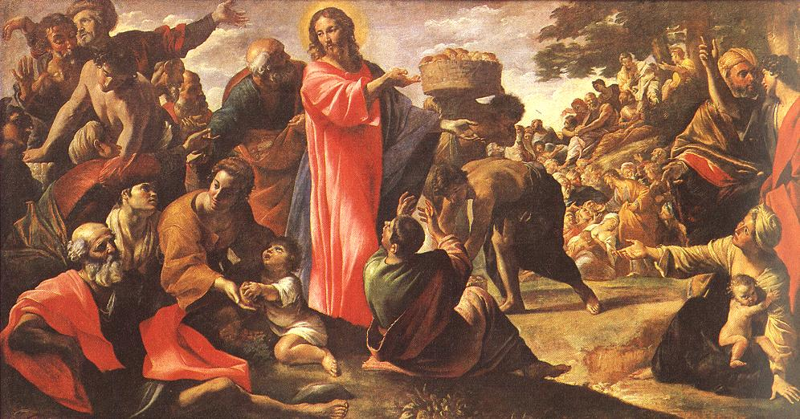
Jesus Demonstrated Creation by Fiat
And Jesus took the loaves, and when He had given thanks He distributed them to the disciples, and the disciples to those sitting down; and likewise of the fish, as much as they wanted.
John 6:11
Ambrosius Franck.
c1544
Giovanni Lanfranco.
1620-1623

Slide 21
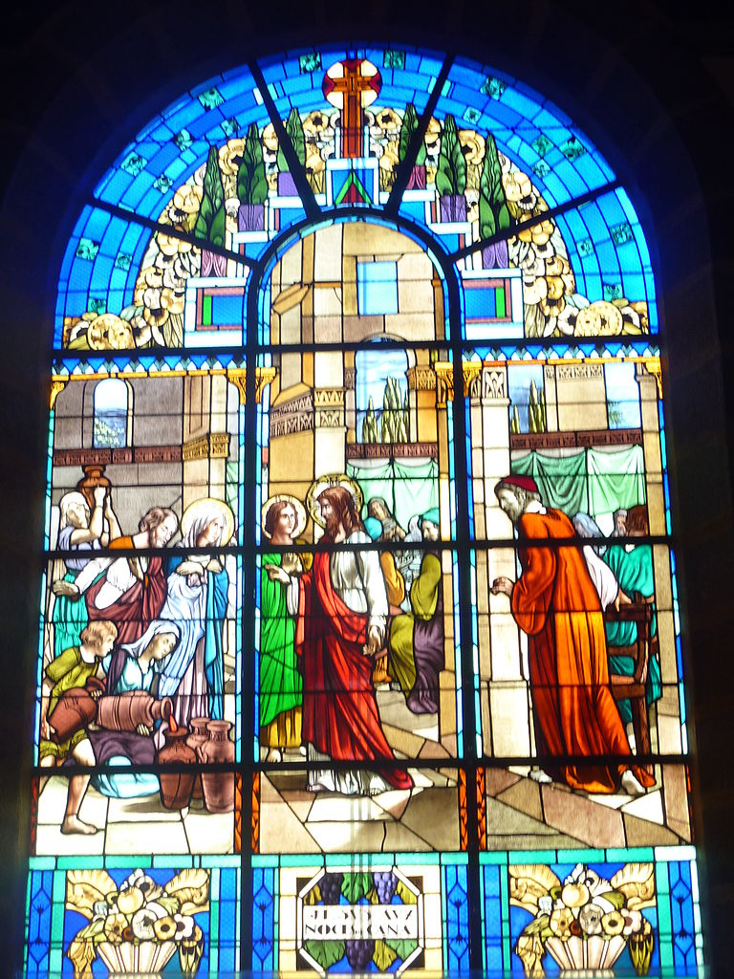
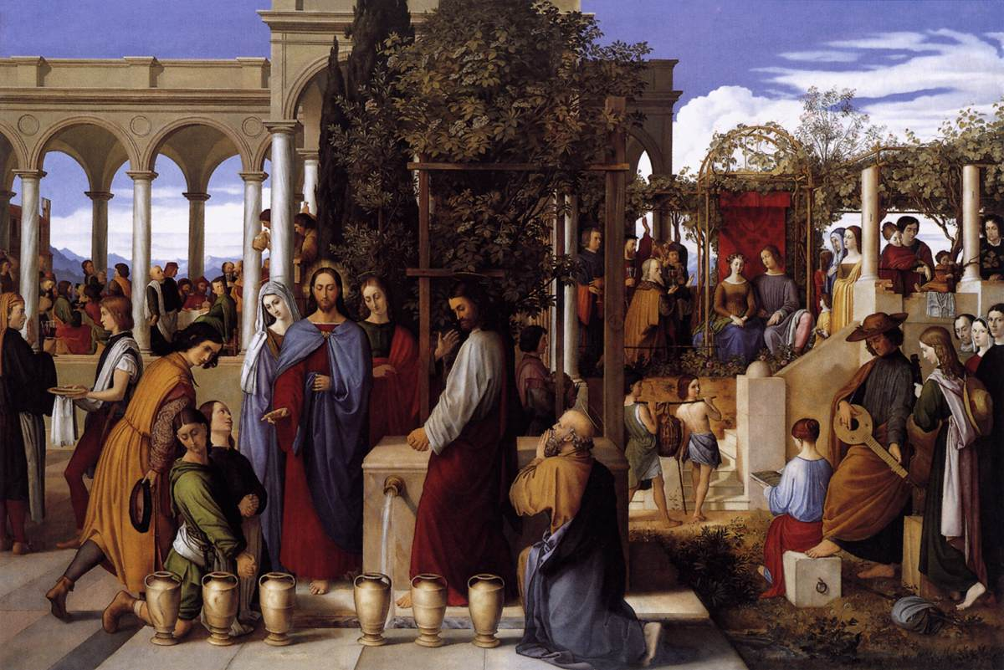
Fiat Creation: Wine From Water
Jesus said, “Fill the waterpots with water” . . . “Draw some out now, and take it to the master of the feast.”
John2:7,8
Church of St Peter. Milizac, France.
Copyright Moreau.henri.
Creative Commons Attribution-Share Alike 3.0 Unported license.
Julius Schnorr von Carolsfeld. 1819.

Slide 22
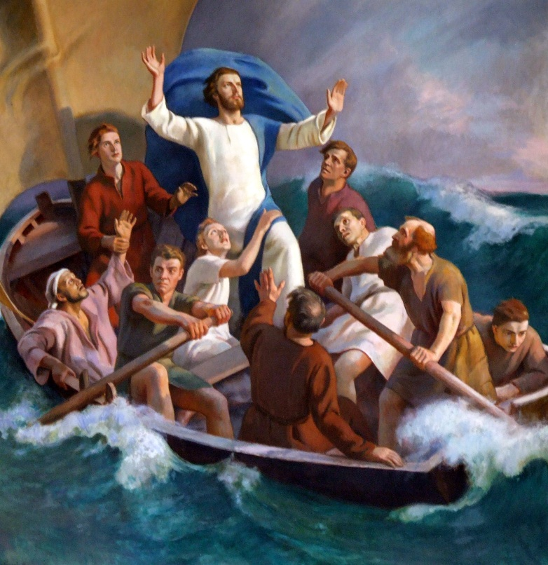
Jesus Demonstrated Power Over Nature by Fiat
Then He arose and rebuked the wind, and said to the sea, “Peace, be still!” And the wind ceased and there was a great calm.
Mark 4:39
Jarnefelt Eero. 1926.
Rembrandt.
1633.

Slide 23
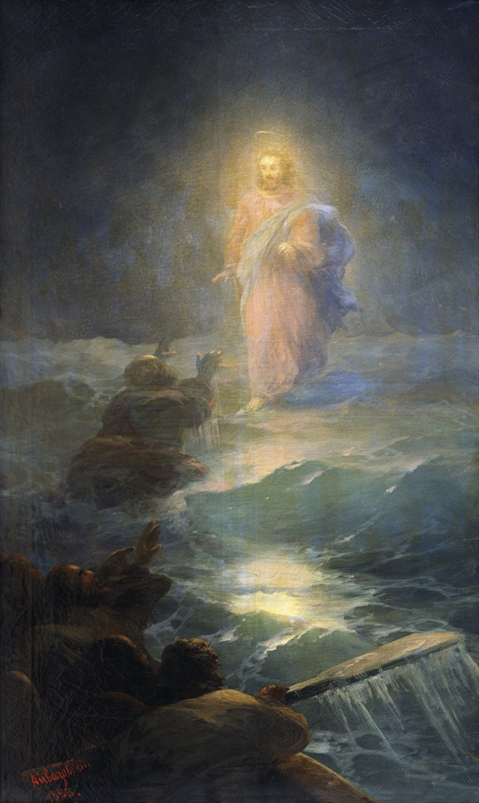
Fiat Power Over Nature: Walking On Water
And about the fourth watch of the night He came to them, walking on the sea, and would have passed them by.
Mark 6:48
Paul Bril. 1590’s.
Po Vodem. 1888.

Slide 24
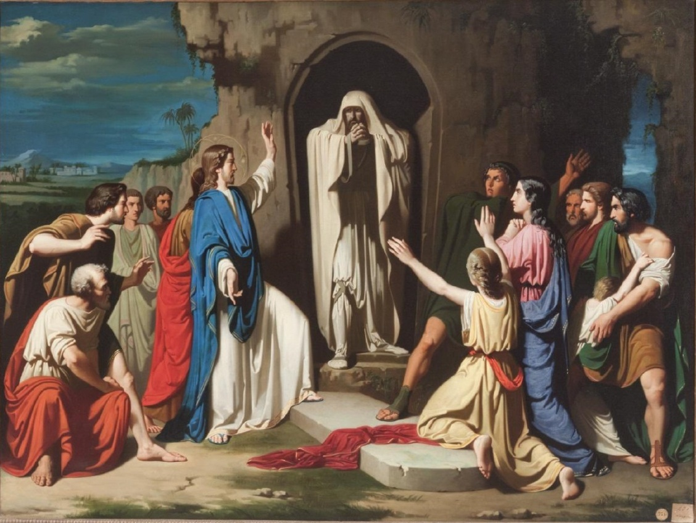
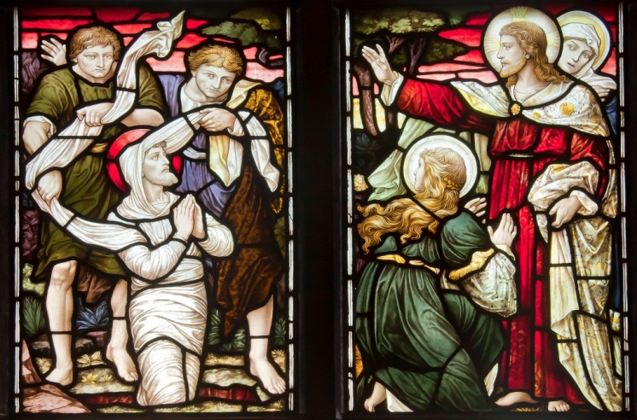
Jesus Demonstrated Fiat Power Over Death
Jesus said to her, “I am the resurrection and the life. . . .
He cried with a loud voice, “Lazarus, come forth!”
John 11:25, 43.
Jose Casado del Alisal. 1855.
Church of St Nicolai. Örebro, Sweden. 1860-1899.

Slide 25
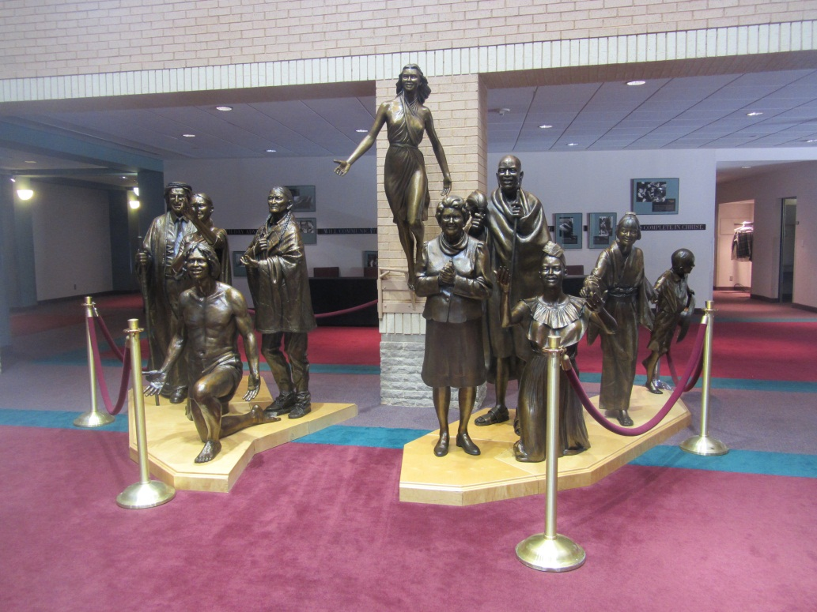
The God of Life
God is not the God of the dead, but of the living.
Matthew 22:32
He Himself likewise shared in the same, that through death He might destroy him who had the power of death, that is, the devil.
Hebrews 2:14
I am the resurrection and the life.
John 11:25
The Resurrection of the Saved
Lobby, General Conference Building
Silver Spring, MD

Slide 26
So Why a Mixed Message?
“An enemy has done this.” Matthew 13:24-30
Then the Lord said to Satan, “Behold, all that he has is in your power, only do not put forth your hand on him.” So Satan departed from the presence of the Lord. Job 1:12
The results: fire from heaven; great wind; boils; violent attacks by humans.
“Now the ruler of this world will be cast out.” John 12:31
“I will not speak much more with you, for the ruler of the world is coming, and he has nothing in Me.” John 14:30
“according to the prince of the power of the air, of the spirit that is now working in the sons of disobedience.” Eph 2:2
“that through death He might render powerless him who had the power of death, that is, the devil.” Hebrews 2:14

Slide 27
Contrasting Principles
Biblical Creation Evolutionary “Creation”
(or “Theistic Evolution”)
- Based on the Bible, - Based on natural theology,
divine revelation human discovery
- Death an enemy caused by sin - Death an agent of progress
- Principle of compassion - Principle of elimination
for the weak of the weak
- Principle of truthfulness - Principle of pragmatism
- Righteousness by faith - Progressive improvement
- Based on life - Based on death
Fits the characteristics Jesus Fits the characteristics of
demonstrated (John 10:10) Satan (Hebrews 2:14)

Slide 28
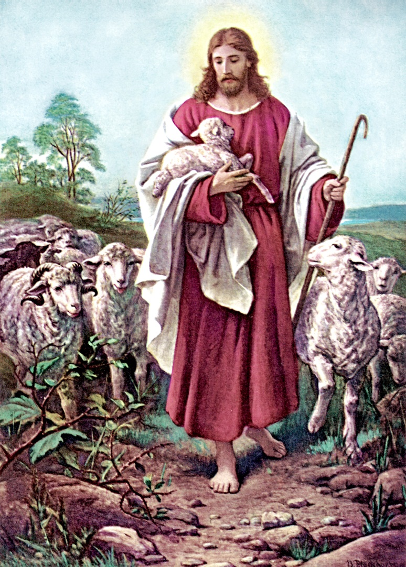
Conclusion
The biblical creation story recorded in Genesis and alluded to through Scripture is the only story of origins that is consistent with the life and teachings of Jesus Christ.
From Nature:
Eternal
Power
Supernatural
Provident
From Scripture:
Truth
Compassion
Fiat Power
Life
Faith
Bernhard Plockhorst. d1907.

