Slide 1
WHAT IS REAL ABOUT Evolution?
What Aspects of Evolutionary Theory Fit With Creation Theory?
L.J. Gibson
Geoscience Research Institute
www.grisda.org

Slide 2
Purpose of This Talk
To attempt to develop a creationist view of speciation and change in species.
To review and critique the evolutionary theory of universal common ancestry (TUCA).
To distinguish ideas in evolutionary theory that are well supported from those that are not.

Slide 3
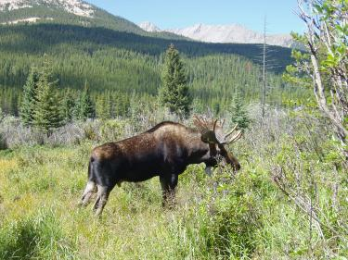
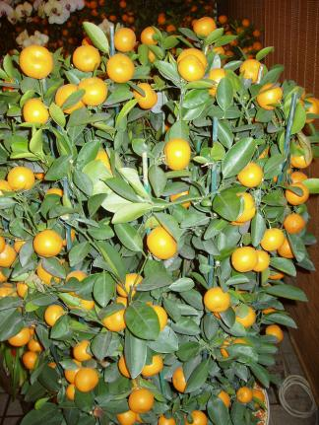
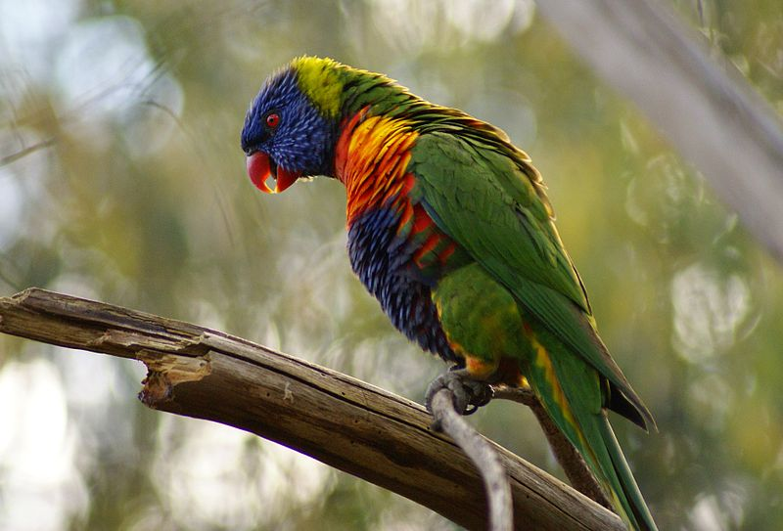
The Original Creation Was “Very Good”
Then God saw everything that He had made, and indeed it was very good. Genesis 1:31a
Goodness can still be seen in the creation:
God provided green plants for food. Genesis 1:30.
Photo: GRI
Beauty is there for us to appreciate.
Photo: Jacopo Montano. License GNU.
Photo: GRI

Slide 4
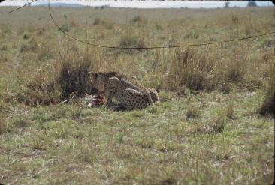
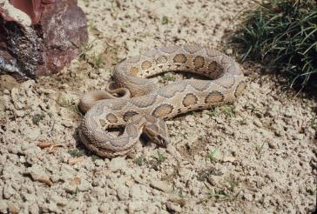
But Not All In Nature Is “Very Good”
VIOLENCE
DEGENERATION
EVIL DESIGN
This species of (Australian) skink has lost the ability to develop limbs.
Predation is a form of violence. Cheetah and gazelle, Masai Mara, Kenya.
Russell’s Viper (India) has a finely designed system for delivering venom, causing pain and death.
Photos: GRI

Slide 5
How Does Change in Species Fit Into Creation Theory?
How much of evolutionary theory is real?

Slide 6
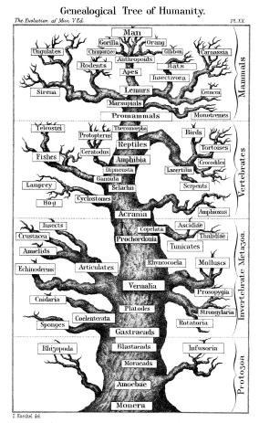
What Is “Evolution” ?
“Evolution” is used with a variety of meanings, of differing empirical status and philosophical underpinnings.
For most scientists “Evolution” means:
(TUCA) All living species have descended with modification from one (or a few) common ancestor,
2. through natural processes
still in operation today.
Ernst Haeckel 1879

Slide 7
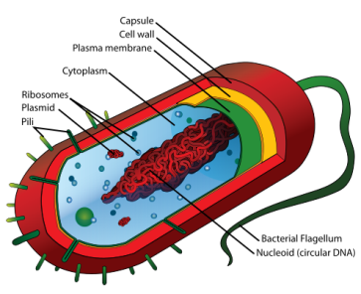
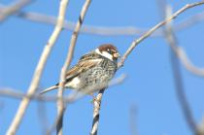
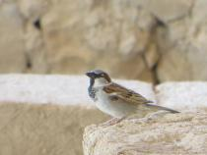
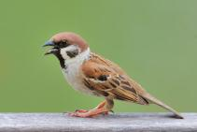
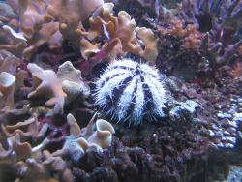
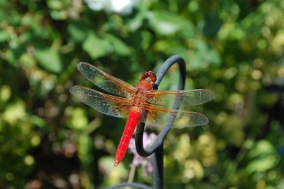
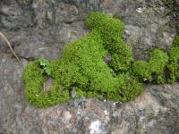
Requirements for TUCA
1. An ancestral living cell;
2. A genetic system with heritable variation;
3. Adaptation to diverse local environments.
4. through cumulative heritable change;
5. Speciation and lineage formation;
6. Innovation of new organs and body plans.
LadyofHats.
PublicDomain
Pikiwiki Israel
GRI
Yiwenyiwen. License GNU
Examples of different body plans and different organs.
GRI
GRI
Mathboy48. License GNU

Slide 8
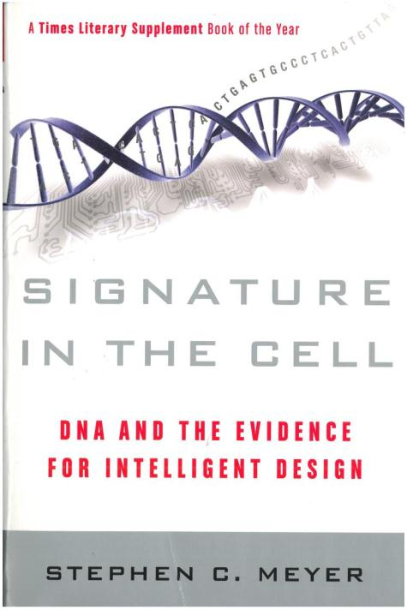
1. The Chemical Evolution of Life: Is It Real?
No. There is no plausible naturalistic explanation for the origin of life.
Creation is the only successful explanation.
Chemical evolution of life is not empirically based, but a logical necessity of materialism.
Recommended Reading

Slide 9
2. Heritable Variation: Is It Real?
Yes. Heritable variation is observed in all species, and the probable mechanism is fairly well understood.
House of Romanov Family Tree.
Basilio. PublicDomain

Slide 10
3. Local Adaptation: Is It Real?
Yes. Species generally show minor differences in different environments. These differences often appear to be adaptive, although this is difficult to test.
Pikiwiki Israel
Yiwenyiwen. License GNU
GRI
Three closely related species of sparrows.

Slide 11
4. Cumulative Heritable Change? Is It Real?
Yes? Conventional neodarwinian theory proposes that species differences are due to accumulation of mutations, which produces creative potential.
But mutations are rarely beneficial, and slightly harmful mutations tend to accumulate faster than helpful mutations, leading to genetic deterioration.
Accumulation of mistakes (mutations) is not a likely mechanism for producing adaptation.

Slide 12
4. Cumulative Heritable Change? Is It Real?
No? It is now known that genetic information can be turned on and off in response to environmental stresses.
Genes may be turned off by attachment of a small molecule (methyl group) and turned on again by removal of the molecule. There is no need for change in DNA sequence.
This mechanism allows rapid local adaptation without waiting for helpful mutations, but does not provide a means of creation by cumulative changes. (Think “genomic piano.”)

Slide 13
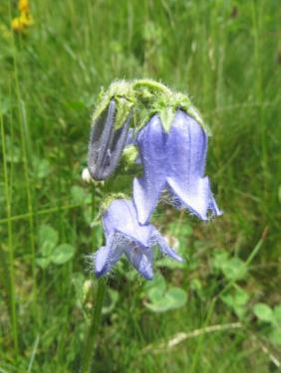
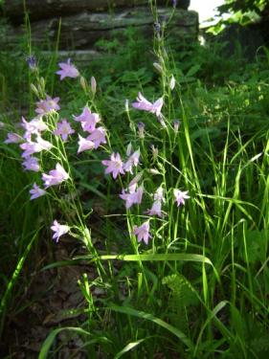
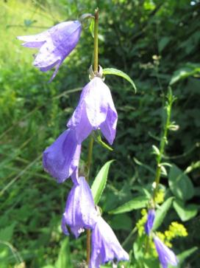
5. Speciation and Lineage Formation Is It Real?
Yes. Although not directly observed, speciation is readily inferred and can be explained using mechanisms currently observed in operation.
Three species in the genus Campanula.
Photos: GRI

Slide 14
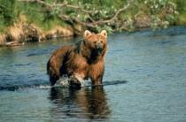
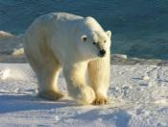
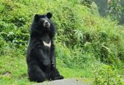
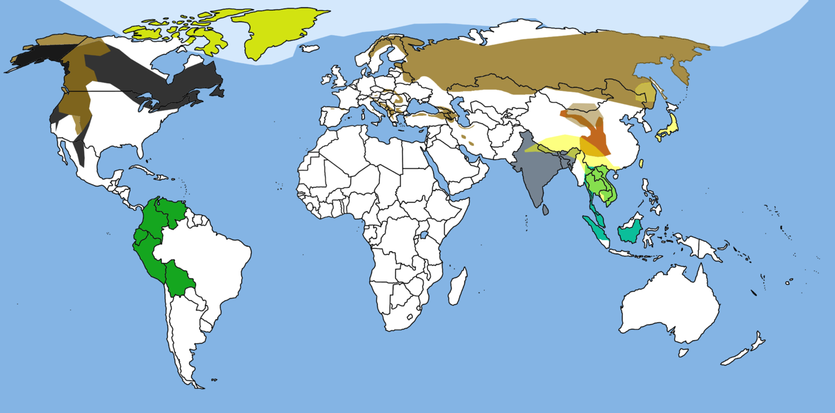
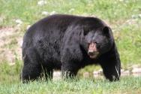
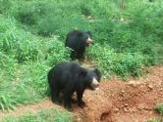
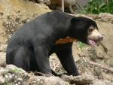
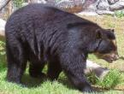
Bears: A Proposed Example of a Lineage Formed By Speciation
Red lines indicate reported hybrids.
USFWS
Ansgar Walk. License GNU
Joydeep. License CCA3.0.
Jeff Kubina. PublicDomain
Cephas. License CCA3.0.
PeterHalasz. License
CCA2.5
Osoandino.
Public Domain
Adityamadhav83. License CCA3.0
Map courtesy of Tbjornstad. Commons. Public Domain.
?

Slide 15
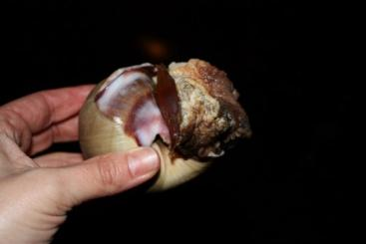
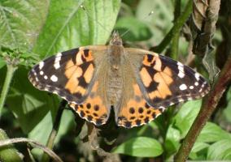
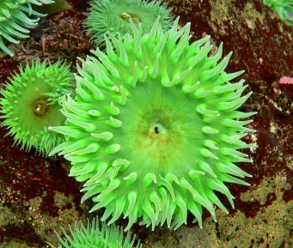
6. Innovation – Formation of New Organs and Body Plans: Is It Real?
Echinoderm Tube Feet. GRI.
No. The empirical evidence does not support the evolution of new morphological structure.
Creation theory is consistent with the evidence, but opposed by scientists committed to materialistic philosophy.
Cnidarian Stinging Cells
Stan Shebs. License GNU1.2.
Molluscan Foot.
LeslieSeaton. License CCA2.0.
Insect Wings. GRI.

Slide 16
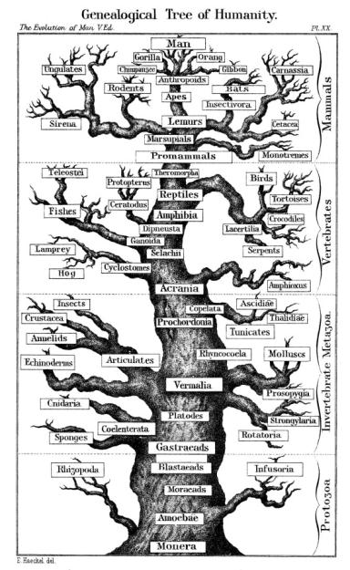
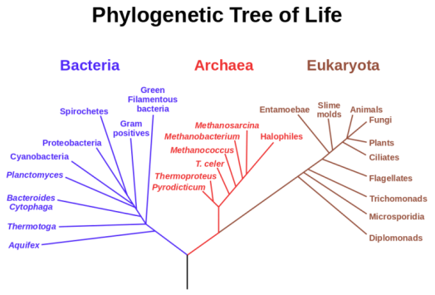
Summary What Is Real About Evolution?
Creation of innovations, morphological “disparity.”
Evolution of locally adapted species and varieties.
PhylogeneticTree. Woese 1990. by Maulucioni. Public Domain.
Haeckel, 1879.
The Evolution of Man.
Public Domain
Creation of original life

Slide 17
A Creationist Theory: The Origin of Life
Life has never been observed to arise from non-living materials.
Living organisms easily change to non-living materials, but not the reverse.
The complexity of the simplest form of life strongly points to creation.

Slide 18
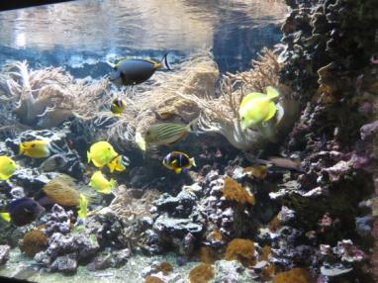
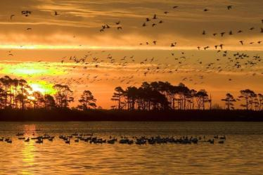
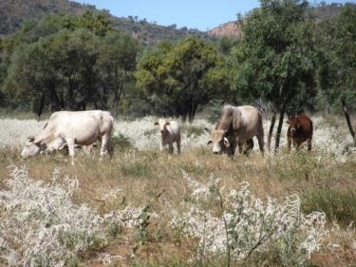
A Creationist Theory: Morphological Novelties Created
a
Original created diversity (Gen 1): Polyphyly – in sea, air and land.
The origins of organs and body plans do not need to be explained by descent with modification, but are explained by creation.
There never was an ancestral living cell, but multiple types of living organisms were created simultaneously.
b
c
Photo Credits: a. GRI; b. USFWS; c. GRI

Slide 19
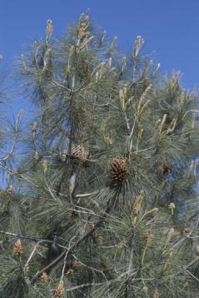
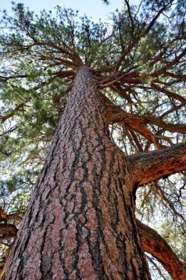
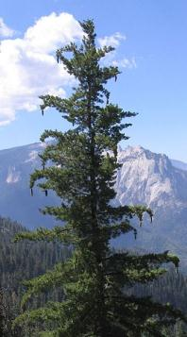
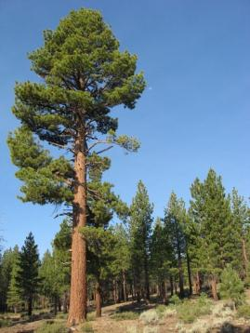
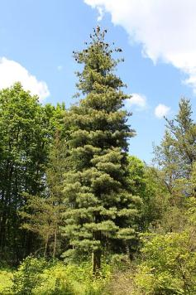
A Creationist Theory: Change in Species
A created genetic system, programmed to produce variation and local adaptation, such as through gene recombination and epigenetic effects.
Digger Pine Credit: Eric in SF
License CCA3.0
Ponderosa Pine Credit: USFS, Coconino NF
Sugar Pine
Public Domain, Commons
Jeffrey Pine
Public Domain, Commons
Western White Pine Credit: Cruiser. License GNU1.2

Slide 20
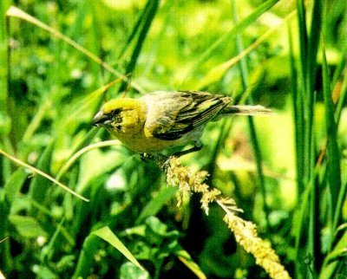
A Creationist Theory
Rates of Change
Genetic recombination and epigenetic effects facilitate rapid change and local adaptation.
African green monkeys introduced on St Kitts 300 years ago are now morphologically distinctive.
Laysan finches introduced to Southeast Island in 1967 had changes in bill shape by 1986.
Notes:
Photos are not mine

Slide 21
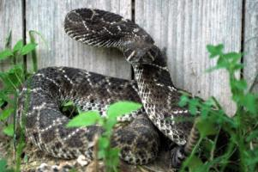
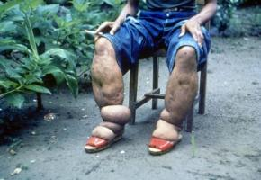
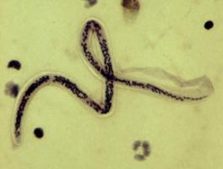
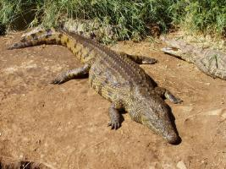
A Creationist Theory: Change in Species
Adam’s sin introduced satanic influence and brought curses, perhaps bringing change through random deleterious mutations and resource shortages leading to competition and natural selection.
These produce structural modification, but not structural innovation.
Western Diamondback
Clinton, Charles Robertson
License CCA2.0
Elephantiasis
CDC Public Domain
Wuchereria bancrofti. CDC
Nile Crocodile
Kruger NP. GRI

Slide 22
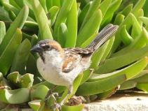
A Creationist Theory: Speciation and Lineage Formation
Filling the Earth (Gen 1:22, 9:1)
Process:
Dispersal to different environments, or climate change,
Natural selection for different traits in different environments,
Incompatible genetic changes in different populations produces reproductive isolation, which is speciation,
This could be repeated in numerous different environments to produce a lineage of related species.
Passer iagoensis male (top).
Ivo Antusek. Public Domain.
Passer hispaniolensis (below).
Commons. PikiWiki Israel 4291.
Passer domesticus (above)
Israel. GRI.
Passer montanus (below)
Yiwenyiwen. License GNU1.2

Slide 23
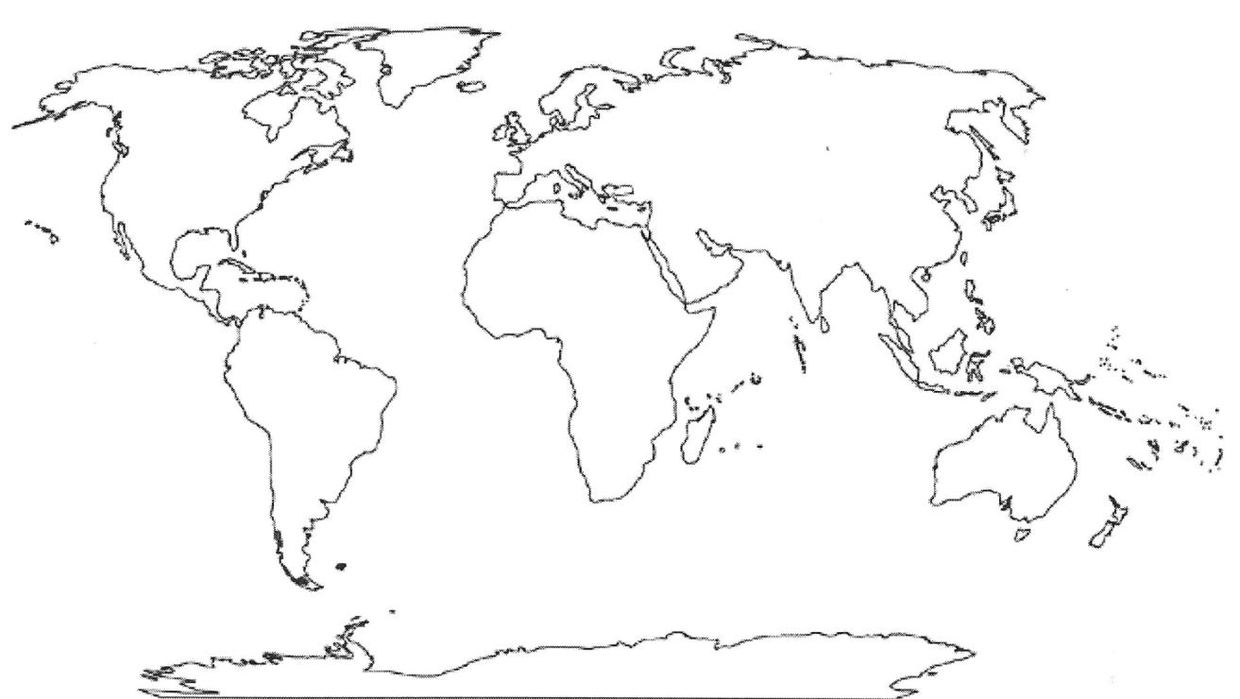
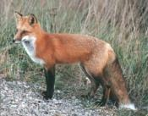
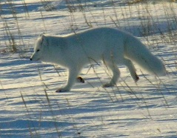
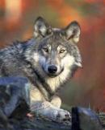
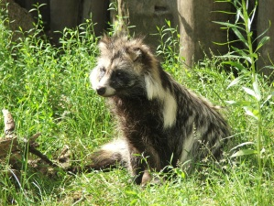
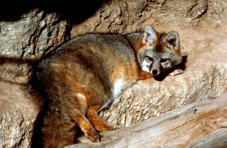
Canidae: A Lineage Descended From A Created Ancestor
Self-learner. GNU1.2
AnsgarWalk. GNU1.2
Gary Kramer, USFWS, CCA2
GMStolz, USFWS. Public
SuNeko. CCA2
DGERobertson
GNU1.2
Pkuczynski. GNU1.2
TAHermann. Public
Dhole. CCA3.
YSKrishnappa.
Karelj. CCA3
BKSwanson. GNU1.2
Quartl. CCA3
Birdphotos.com Commons.CCA3
SageRoss. GNU1.2
Notes:
Photos are not mine

Slide 24
Camelidae: A Lineage Descended From A Created Ancestor
(Extinct) Fossil Camel from USA
GRI
Bactrian Camels Dltl2010. License CCA3.0
Arabian Camels. Bernard Gagnon. License CCA3.0
Guanacos.
Alex Proimos. License CCA2.0
Llamas
GRI
(Feral) Camels in Australia.
Mark Marathon. License CCA3.0
Reported Hybrids
Notes:
Some photos not mine

Slide 25
A Creationist Theory Multiple Lineages from Independently-Created Ancestors
A creationist might represent biodiversity as a forest (or an orchard) of independent trees, each representing a lineage descended from a created ancestor.
Understanding Creation. Pacific Press.
Creationist Orchard
Philip Barnes. License GNU1.2

Slide 26
A Creationist Theory: Innovation Implies Design
Experimental selection always reaches limits.
Observed processes do not create new organs or body plans.
Known natural mechanisms of change are inadequate to produce innovations.
Personal intelligence is the only known method for creating innovation.
Photo credits:
Plane – Public Domain. Others - GRI

Slide 27
A Creationist Theory: Hints of Common Ancestry
Gene flow
Hybridization
Vicariant Species
Zorse.
Kumana@WildEquinesLicense CCA2.0
Zeedonk.
Colchester Zoo, UK Ondrejk. License GNU
“Liger”
By Restle. Novosibersk Zoo.
Public Domain
“Lepjag”
GRI
“Pumapard”
Sarah Hartwell.
Museum at Tring, UK
License GNU1.2

Slide 28
A Creationist Theory: Hints of Independent Ancestry
Different organs
Different body plans
“Orfan” genes – genes unique to a taxon
Different developmental trajectories
Humans have about 200 identified genes not found in chimps or other species (“orfan genes”).
Chimp Mother and Young. Gombe Stream NP.
Ikiwaner. License GNU1.2
Buzz Aldrin, Apollo 11. NASA. Public Domain.

Slide 29
Conclusions
Creation explains the origin of life and the origin of innovation.
Evolutionary theory explains local adaptation, speciation and lineage formation.
Creation explains the origin of the genetic system that enables species to adapt and survive in different habitats.
a
b
c
d
Photo Credits: c- Yiwenyiwen. License GNU1.2; a, b, d: GRI.

Slide 30
A Creationist Forest

