Slide 1
Fuzzy, with a chance of feathers Taking a fresh look at dinosaurs and birds
Marcus R. Ross, Ph.D.
Professor of Geology
Director, Center for Creation Studies
Liberty University

Slide 2
At issue:
Views of dinos have changed over time
1830s→1940s→1980s→Today
Change is good (understanding now is actually better)
Change is challenging (evolutionary predictions change or are often correct)
Creationist understandings are good, and getting better

Slide 3
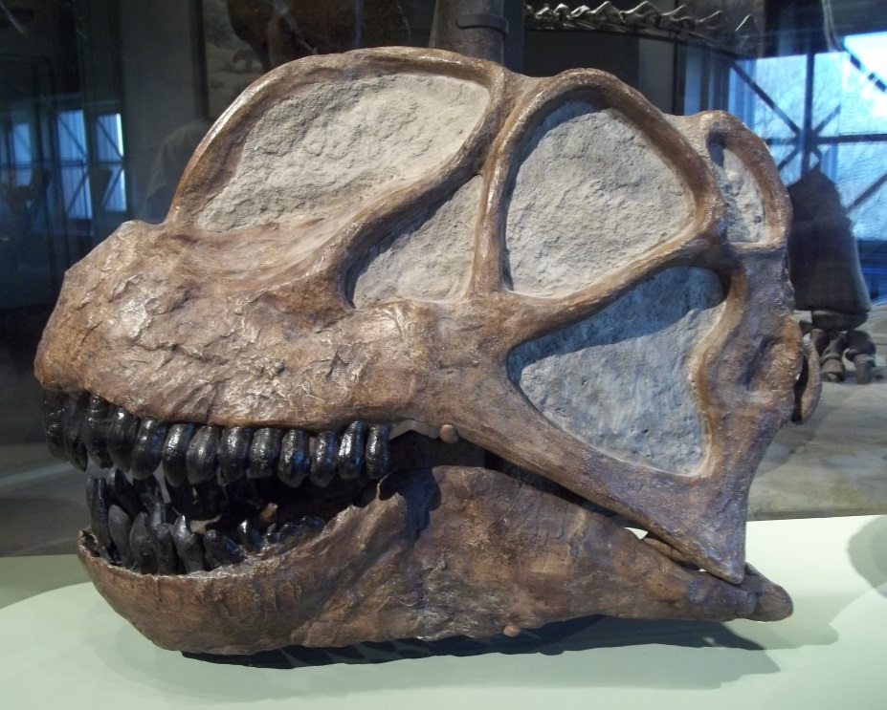
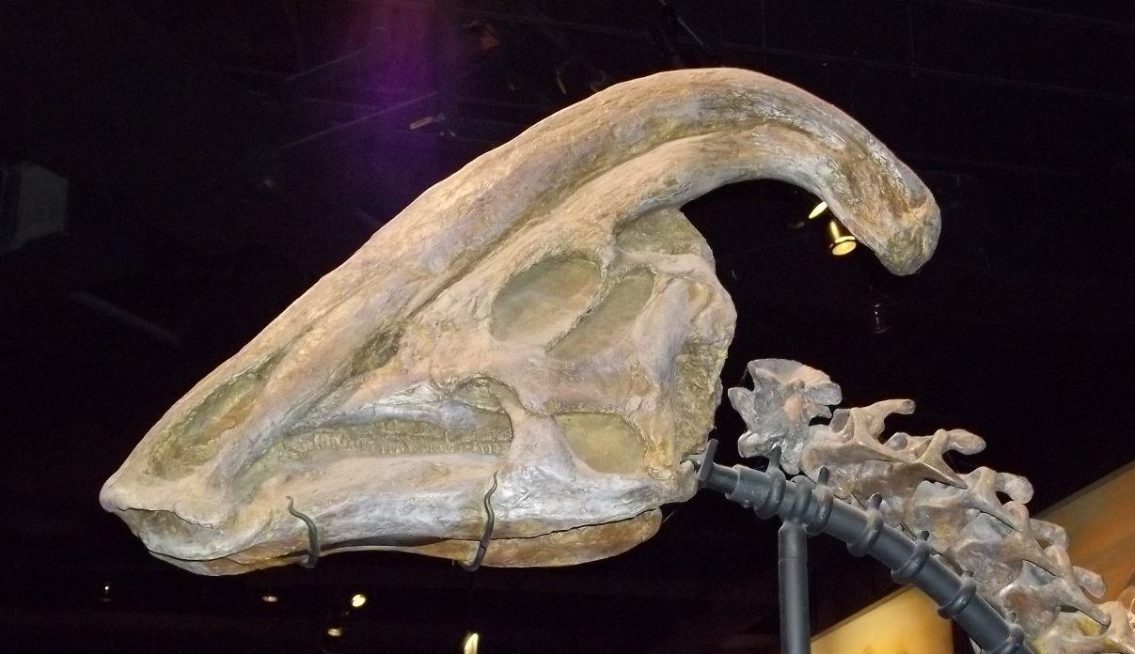

Slide 4
Biblical Context: Creation Week
Dinosaurs were Day 6 creations
Land-dwelling
Air-breathers
“Beasts of the earth”

Slide 5
Dinosaurs’ Geological Context
Cenozoic
Biblical Context: Noah’s Flood
Mesozoic
Flood Rocks
Paleozoic
Proterozoic

Slide 6
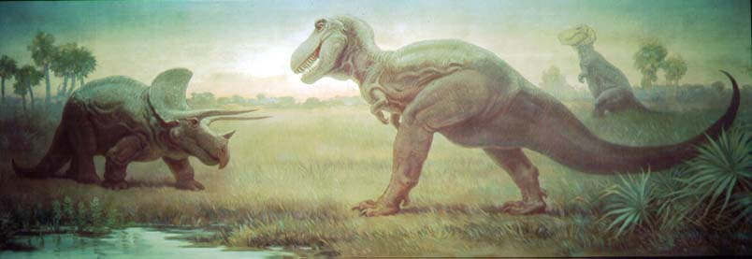
Our Mental Image of Dinosaurs?

Slide 7
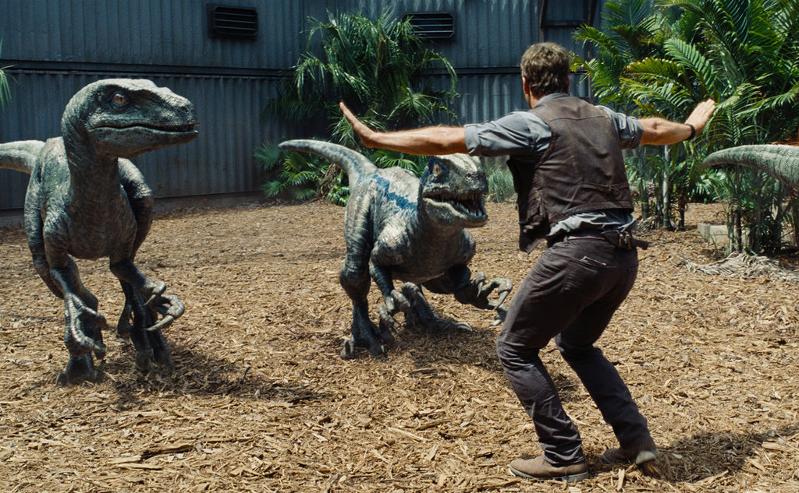
Ahhhhh…much better ☺

Slide 8
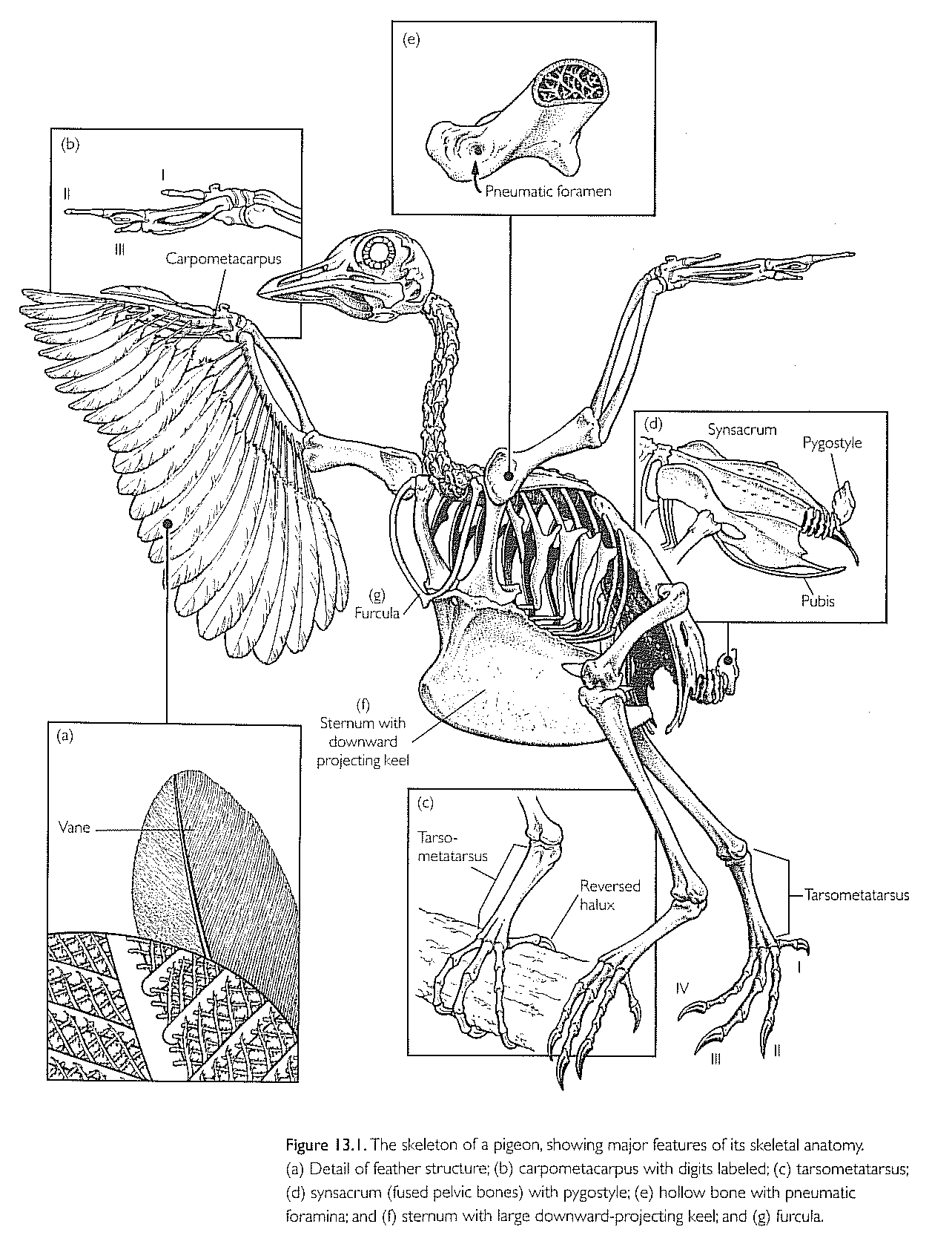
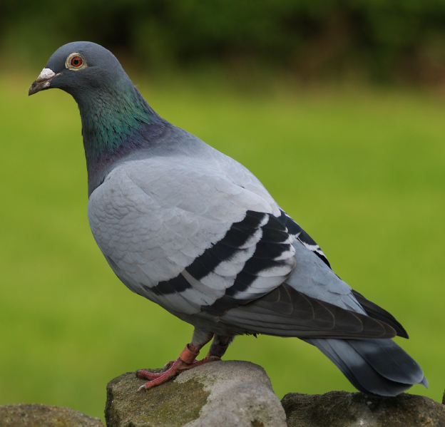
But…birds are dinosaurs?
Not exactly, but it’s complicated.

Slide 9
Dinosaurs and Feathers
The key players
Maniraptorans
Archaeopteryx

Slide 10
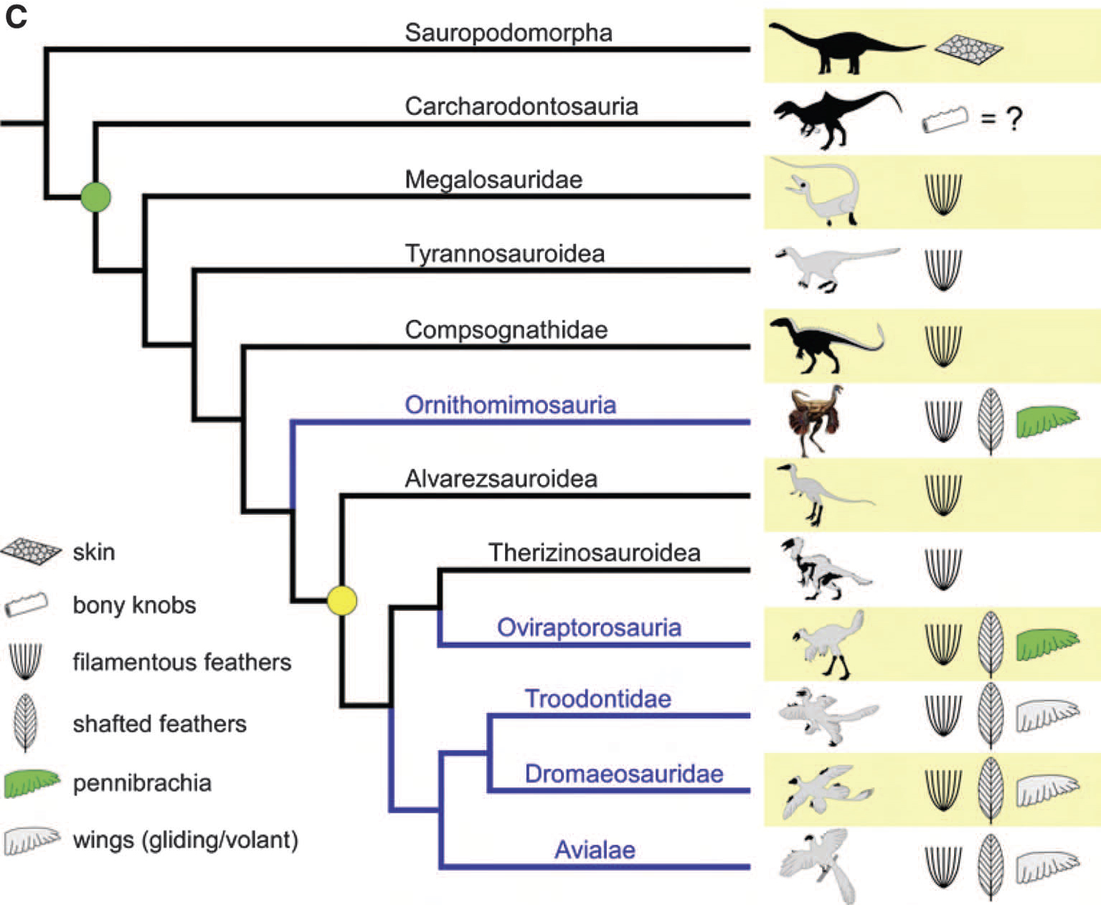

Slide 11
Dinosaurs with feathers
Ornithomimus—ornithomimid
Caudipteryx—oviraptorid
Similcaudipteryx—oviraptorid
Anchiornis—troodontid
Eosinopteryx—troodontid
Microraptor gui—dromaeosaurid
Velociraptor—dromaeosaurid
Each possessed shafted feathers, not fluff or fuzz

Slide 12
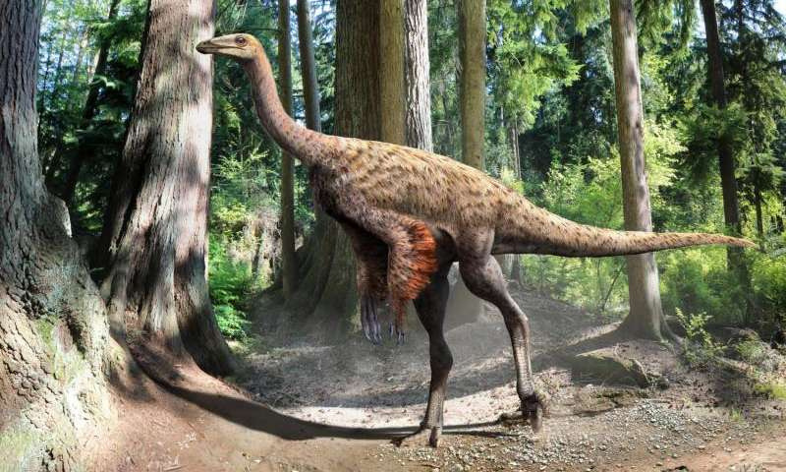

Slide 13
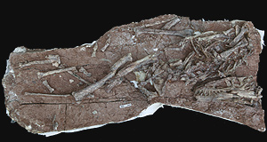
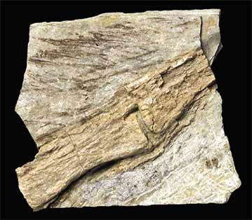
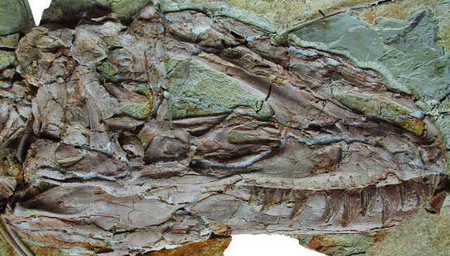
The tyrannosauroids Dilong and Yutyrannus, from China

Slide 14
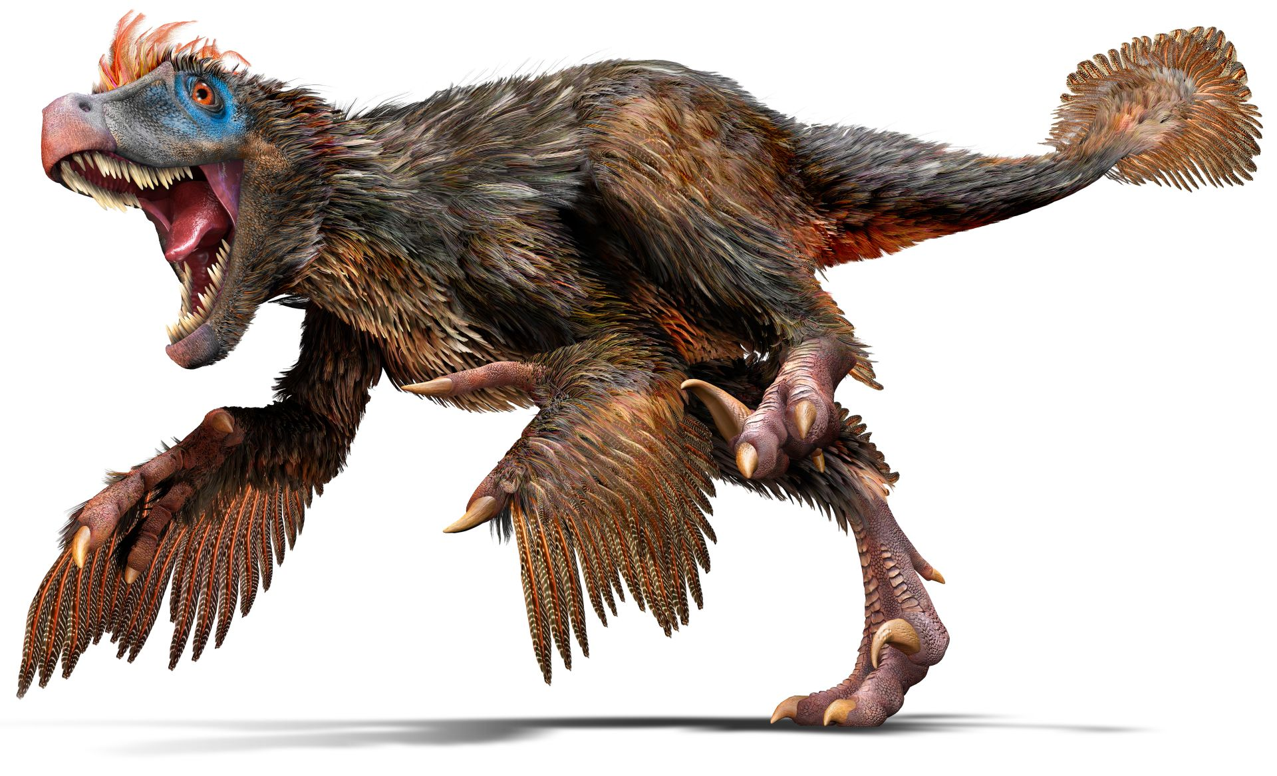
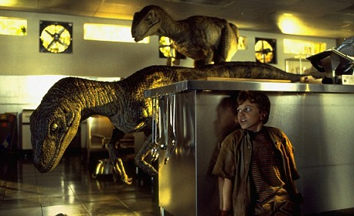
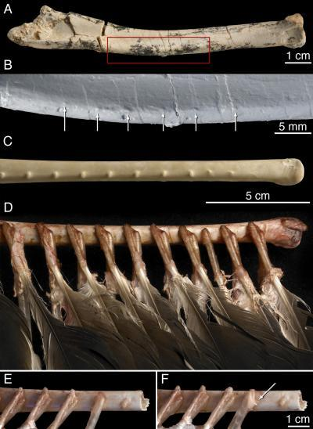
Maniraptorans
Velociraptor (Upper Cretaceous)

Slide 15
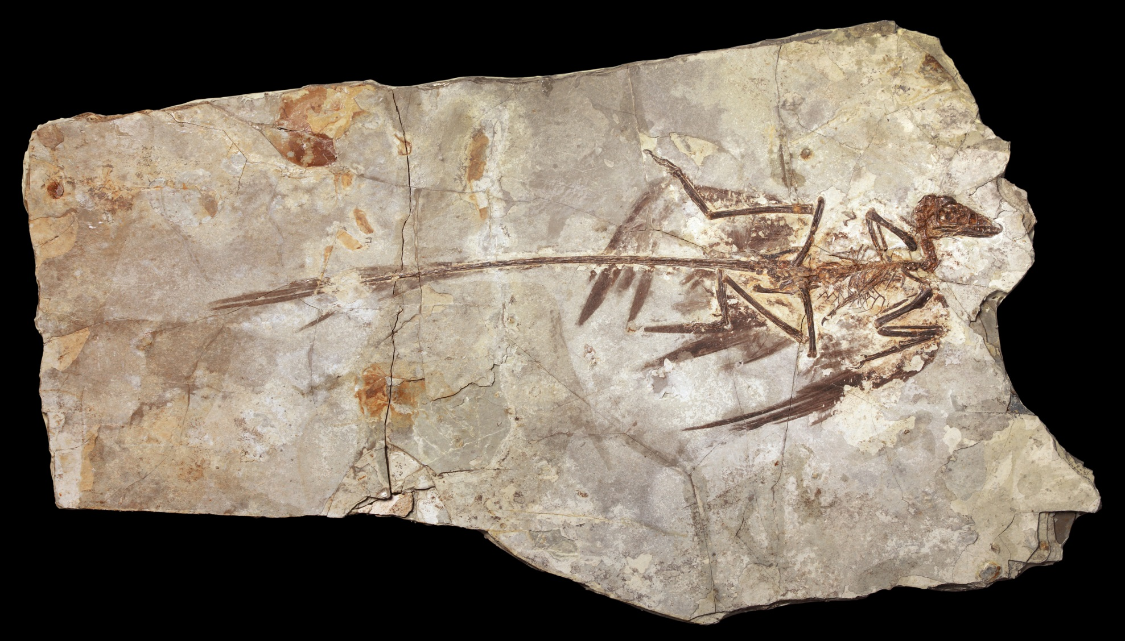
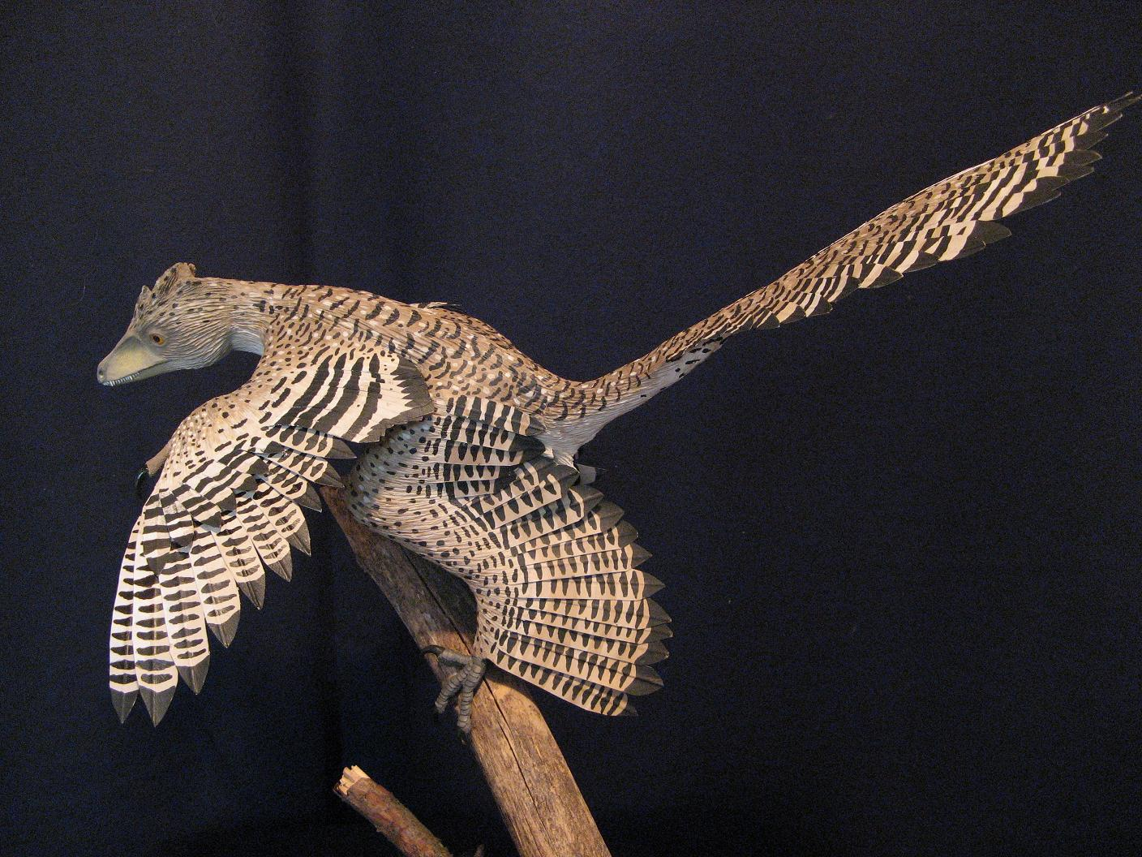
Microraptor gui (Lower Cretaceous)

Slide 16
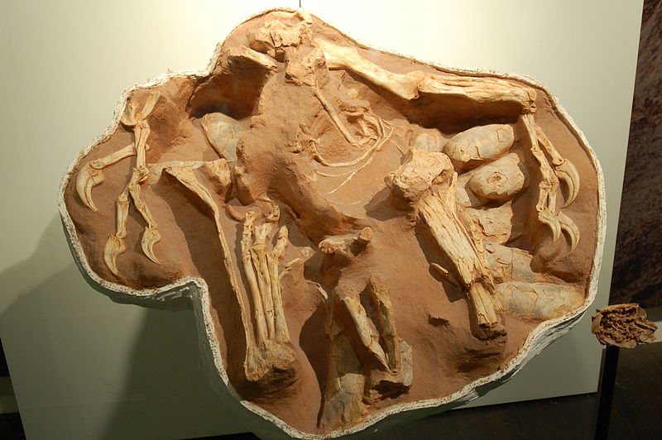
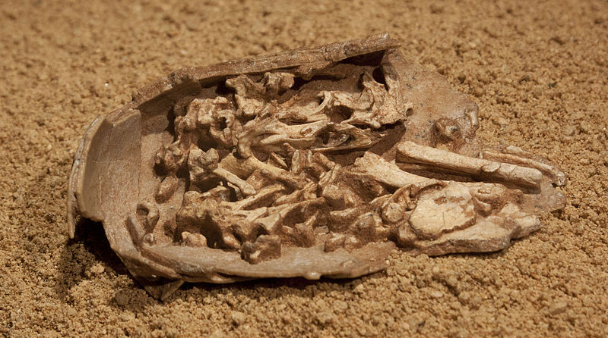
And fossilized embryos in the eggs!
Citipati, an oviraptorid dinosaur. This specimen (“Big Mama”) is sitting over a clutch of eggs with limbs stretched around them, similar to a brooding posture.

Slide 17
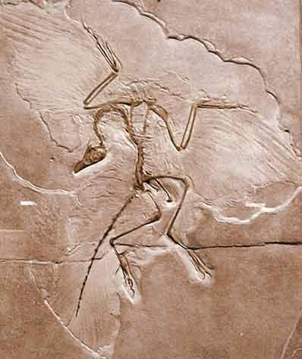
So what is Archaeopteryx?
The Berlin specimen of Archaeopteryx. One of 12 known skeletal specimens.

Slide 18
So what is Archaeopteryx?
Bird
Feathers
Wings
Perching claw
Mobile quadrate
Flow-through lung
Flight
Hollow bones & air sacs
Brain
Keeled sternum (small)
Dinosaur (Maniraptoran)
Dinosaur (Maniraptoran)
Skull construction
Teeth
Tail
Brain
Hands/claws
Semi-lunate carpal
Enlarged first toe claw
Pubis orientation
Ankle bones

Slide 19
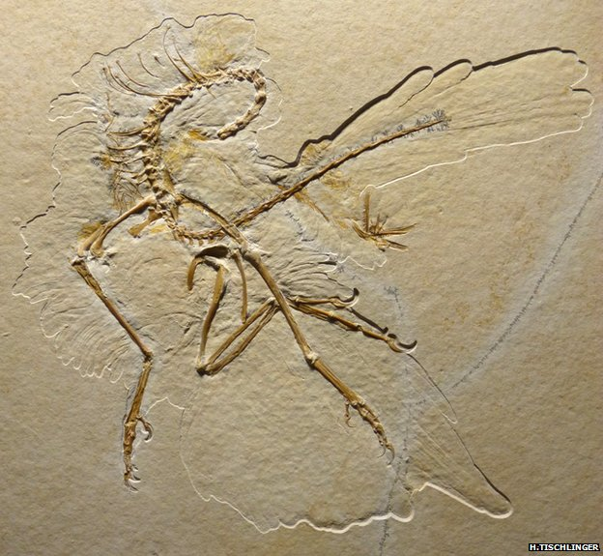
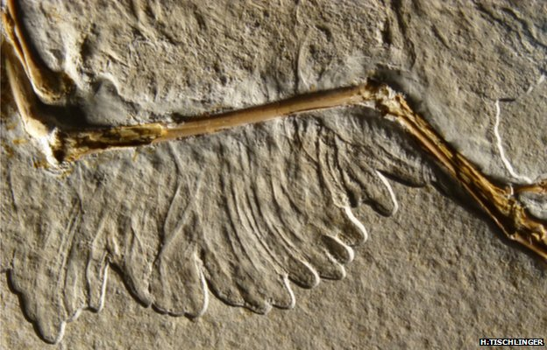
11th Archaeopteryx skeleton

Slide 20
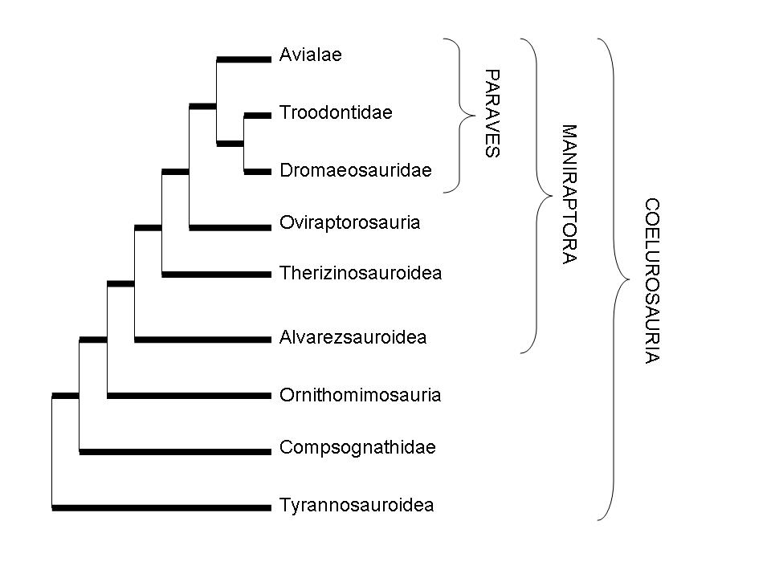
Many dinosarus had feathers or “fuzz”

Slide 21
But what is a creationist view?
Our own models must deal with the data
Our models should be robust
Our models should be adaptable
Our models are tentative

Slide 22
Baraminology: A Creationist Approach
Baraminology
Character-based
Biblical references incorporated
Assumes both continuity and discontinuity of life

Slide 23
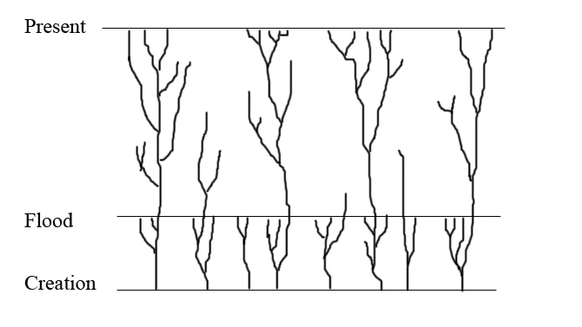
An “orchard of life”. From Answers in Genesis.

Slide 24
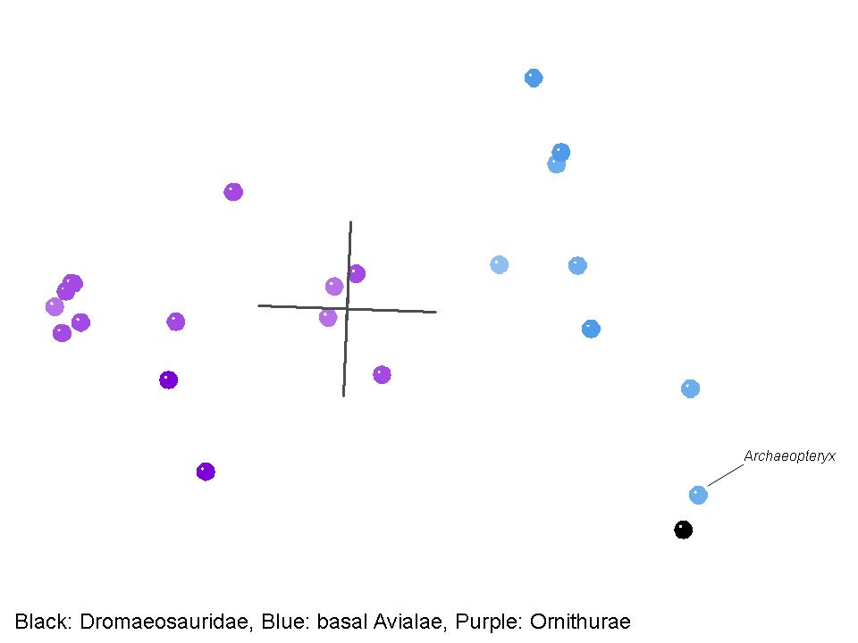
Dromaeosauridae

Slide 25
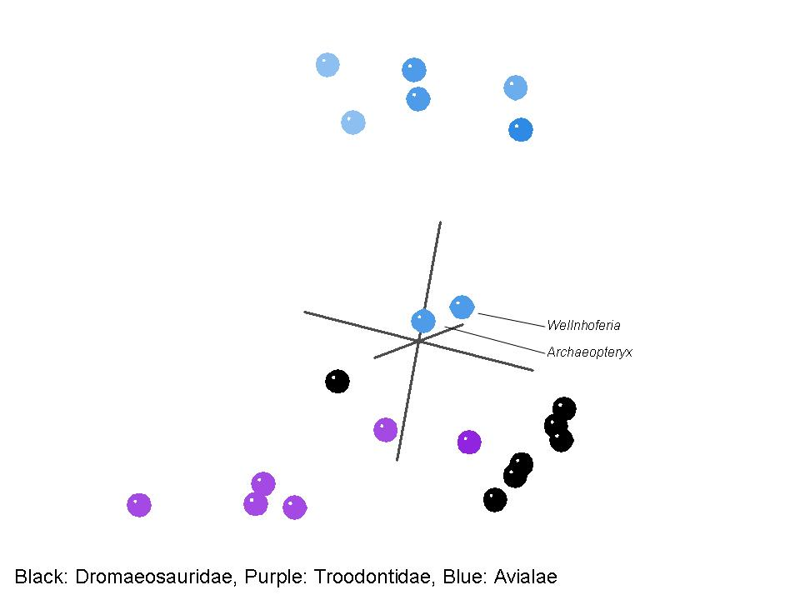

Slide 26
So what IS Archaeopteryx?
Well…
Day 5 creation
“Bird”
But…
More “dinosaur” than “bird”
Dromaeosaur, like Velociraptor and Microraptor

Slide 27
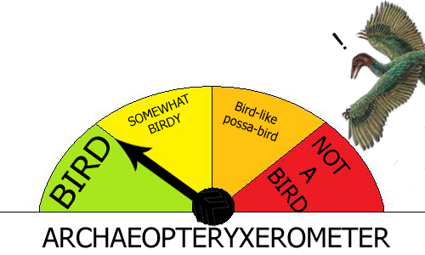
?

Slide 28
Feathers, feathers, everywhere
Many theropods have feathers or filamentous structures
Some ornithischians have feathers and filamentous structures
Filamentous structures may be common to many, many different kinds of dinosaurs.
WOW!!!

Slide 29
Feathers, feathers, everywhere
These new discoveries are not to be feared, avoided, or quickly dismissed
God’s creation is bountiful and beautiful (more than we know!)
Dinosaurs show many traits like birds, and many other traits unique to each species and their bigger “kinds”

Slide 31
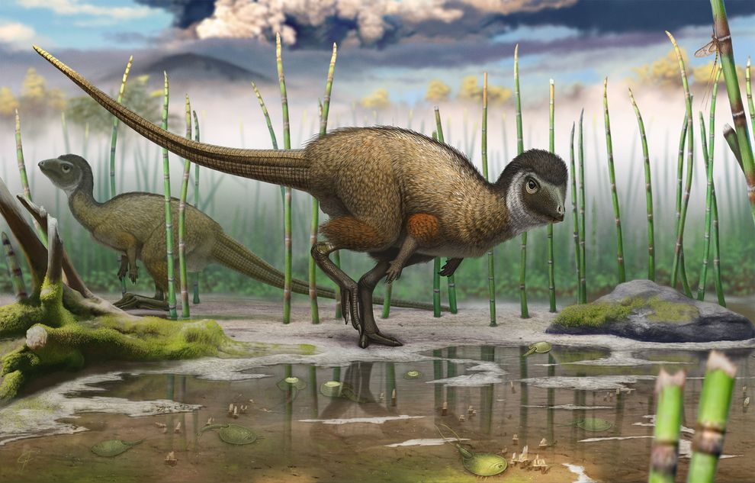
But wait, there’s more!
Kulindadromeus zabaikalicus, from the Jurassic of Siberia

Slide 32
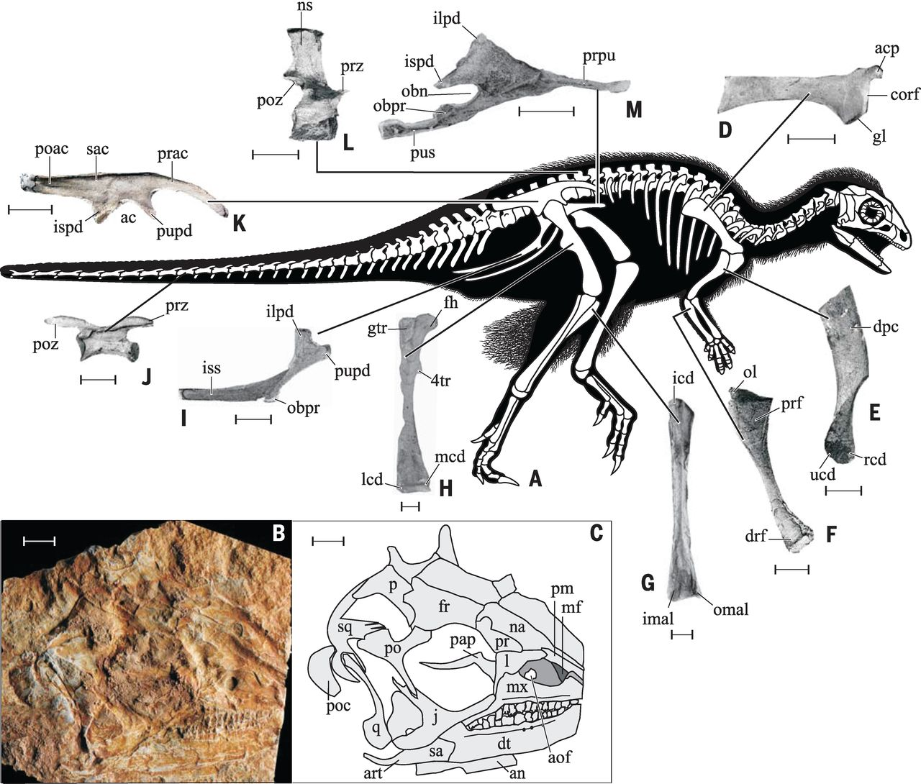
Fig. 1 Skeletal anatomy of Kulindadromeus zabaikalicus.(A) Composite skeletal reconstruction; photograph (B) and line drawing (C) of the holotype skull (INREC K3/109) in right lateral view; (D) proximal portion of right scapula (INREC K3/204) in lateral view; (E) right scapula (INREC K3/134) in caudolateral view; (F) left ulna (INREC K3/205) in medial view; (G) right tibia (INREC K3/207) in caudal view; (H) right femur (INREC K3/206) in cranial view; (I) right ischium (INREC K3/124) in lateral view; (J) distal caudal vertebra (INREC K3/202) in right lateral view; (K) mirror image of left ilium (INREC K3/113) in lateral view; (L) dorsal vertebra (INREC 3/112) in right lateral view; (M) mirror image of left pubis (INREC K3/114) in lateral view.
P Godefroit et al. Science 2014;345:451-455
Published by AAAS
Notes:
Skeletal anatomy of Kulindadromeus zabaikalicus.(A) Composite skeletal reconstruction; photograph (B) and line drawing (C) of the holotype skull (INREC K3/109) in right lateral view; (D) proximal portion of right scapula (INREC K3/204) in lateral view; (E) right scapula (INREC K3/134) in caudolateral view; (F) left ulna (INREC K3/205) in medial view; (G) right tibia (INREC K3/207) in caudal view; (H) right femur (INREC K3/206) in cranial view; (I) right ischium (INREC K3/124) in lateral view; (J) distal caudal vertebra (INREC K3/202) in right lateral view; (K) mirror image of left ilium (INREC K3/113) in lateral view; (L) dorsal vertebra (INREC 3/112) in right lateral view; (M) mirror image of left pubis (INREC K3/114) in lateral view. Scale bars, 10 mm. Abbreviations: ac, acetabulum; acp, acromial process; an, angular; aof, antorbital fossa; art, articular; cor, coracoid facet; dpc, deltopectoral crest; drf, distal radial facet; dt, dentary; fh, femoral head; fr, frontal; gl, glenoid; ilpd, iliac peduncle; imal, inner malleolus; ispd, ischial peduncle; iss, ischial shaft; j, jugal; l, lacrimal; lcd, lateral condyle; mcd, medial condyle; mf, maxillary fenestra; mx, maxilla; na, nasal; obn, obturator notch; obpr, obturator process; ns, neural spine; ol, olecranon process; omal, outer malleolus; p, parietal; pap, palpebral; pm, premaxilla; po, postorbital; poac, postacetabular process; poc, paroccipital process; poz, postzygapophysis; pr, prefrontal; prac, preacetabular process; prf, proximal radial facet; prpu, prepubic process; prz, prezygapophysis; pupd, pubic peduncle; pus, pubic shaft; q, quadrate; qj, quadratojugal; rap, rostral ascending process; rcd, radial condyle; sa, surangular; sac, supraacetabular crest; sq, squamosal; ucd, ulnar condyle; 4tr, fourth trochanter.

Slide 33
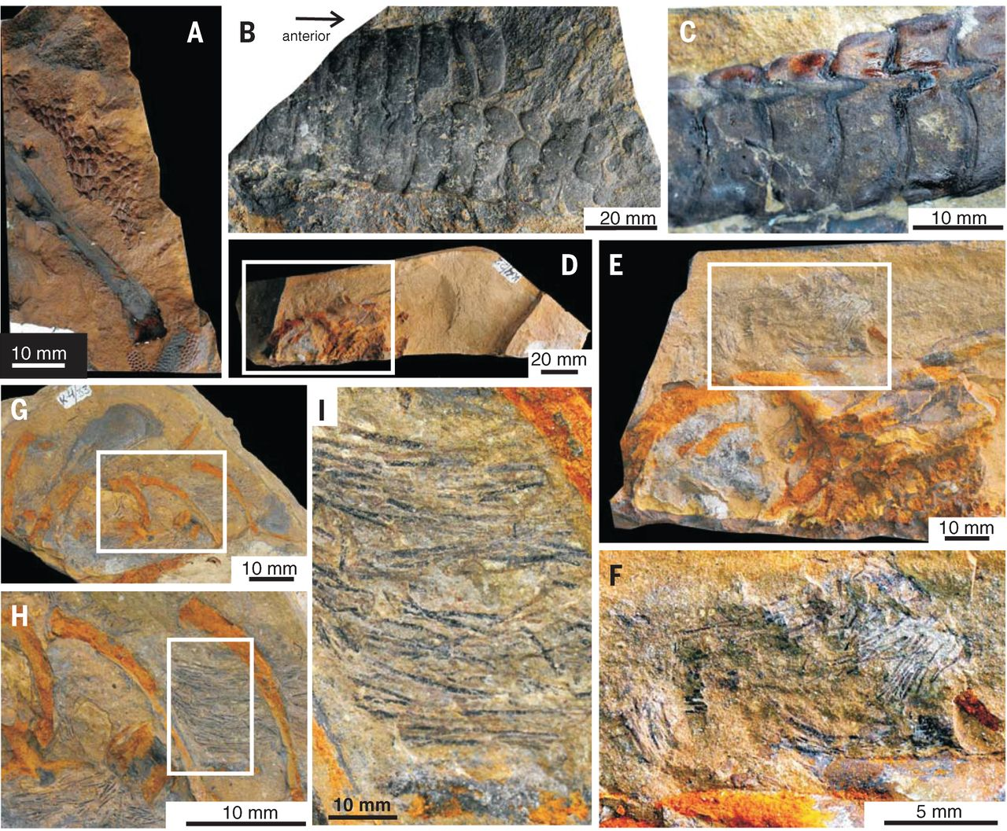
Fig. 2 Epidermal scales and featherlike structures of Kulindadromeus zabaikalicus.(A) Scales around the distal tibia and the tarsus (INREC K4/57); (B) double row of scales above the proximal part of the tail (INREC K4/94) in dorsal view; (C) close-up of the left row of caudal scales (INREC K4/117) in dorsal view; (D) partial skull (INREC K4/22) in right lateral view, with (E and F) detail of areas indicated in (D) and (E) showing filamentous structures; (G) left part of ribcage (INREC K4/33), with (H and I) detail of areas indicated in (G) and (H) showing filamentous structures.
P Godefroit et al. Science 2014;345:451-455
Published by AAAS
Notes:
Epidermal scales and featherlike structures of Kulindadromeus zabaikalicus.(A) Scales around the distal tibia and the tarsus (INREC K4/57); (B) double row of scales above the proximal part of the tail (INREC K4/94) in dorsal view; (C) close-up of the left row of caudal scales (INREC K4/117) in dorsal view; (D) partial skull (INREC K4/22) in right lateral view, with (E and F) detail of areas indicated in (D) and (E) showing filamentous structures; (G) left part of ribcage (INREC K4/33), with (H and I) detail of areas indicated in (G) and (H) showing filamentous structures.

Slide 34
Psittacosaurus mongoliensis, from the Cretaceous of Mongolia.

