Slide 1
The Cambrian Explosion and the Flood
Matthew McLain
The Master’s University

Slide 2
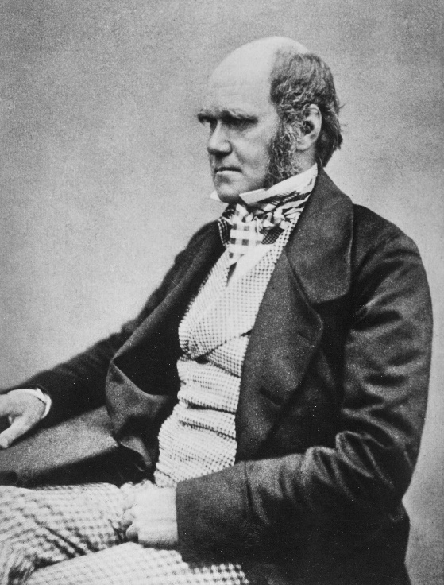
Darwin’s Dilemma
“There is another and allied difficulty, which is much more serious. I allude to the manner in which species belonging to several of the main divisions of the animal kingdom suddenly appear in the lowest known fossiliferous rocks…
“Consequently, if the theory be true, it is indisputable that before the lowest Cambrian stratum was deposited long periods elapsed… To the question why we do not find rich fossiliferous deposits belonging to these assumed earliest periods prior to the Cambrian system, I can give no satisfactory answer…
“The case at present must remain inexplicable; and may be truly urged as a valid argument against the views here entertained.”
Charles Darwin, On the Origin of Species, Modern Library Paperbacks, pp. 437-440.

Slide 3
The Geologic Column
Quaternary
Cenozoic
Neogene
Paleogene
Cretaceous
Mesozoic
Jurassic
Why would animal fossils just suddenly appear in the fossil record if evolution were a gradual process occurring over millions of years?
Triassic
Phanerozoic
Permian
Carboniferous
Devonian
Paleozoic
Silurian
Ordovician
Cambrian
Precambrian
Ediacaran
Images from http://phylopic.org.

Slide 4
The Missing Trunk
Time
Diversity

Slide 5
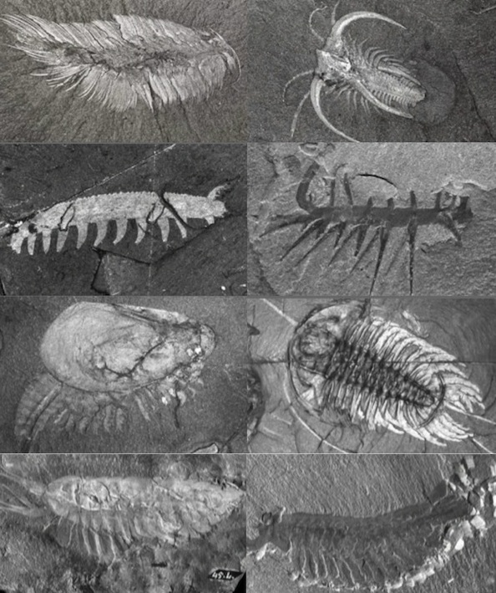
The Burgess shale
Hundreds of species known.
Representing many phyla and classes.
Complex eyes
Exoskeletons
Jointed legs
Complex feeding structures
Complex defensive structures
Various Burgess Shale fossils from https://cdn-assets.answersingenesis.org/img/articles/2013/11/burgess-shale.jpg

Slide 6
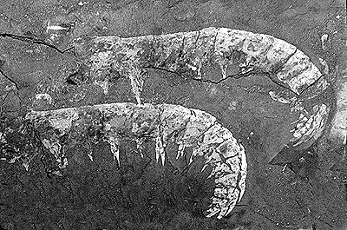
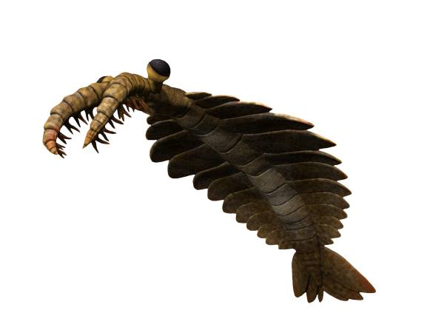
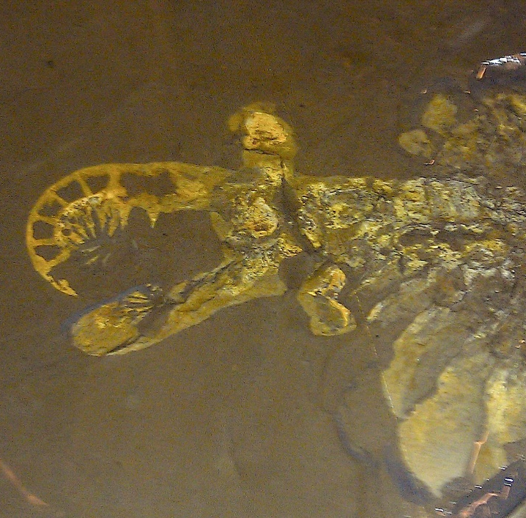
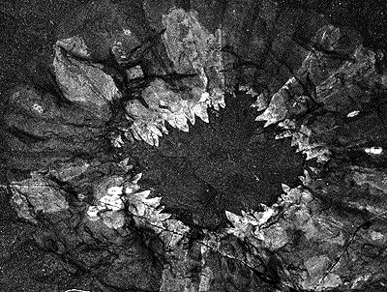
The Weird creatures of the cambrian
Photo by Tyler Irving.
Image by Nobu Tamura CC BY-SA 4.0.
Anomalocaris images obtained from the website of the Smithsonian http://paleobiology.si.edu/burgess/anomalocaris.html

Slide 7
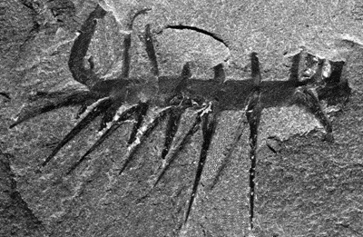
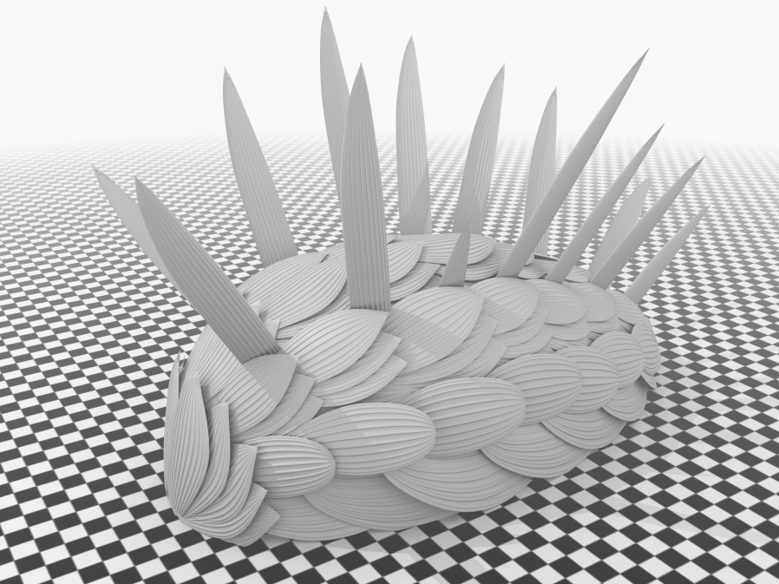
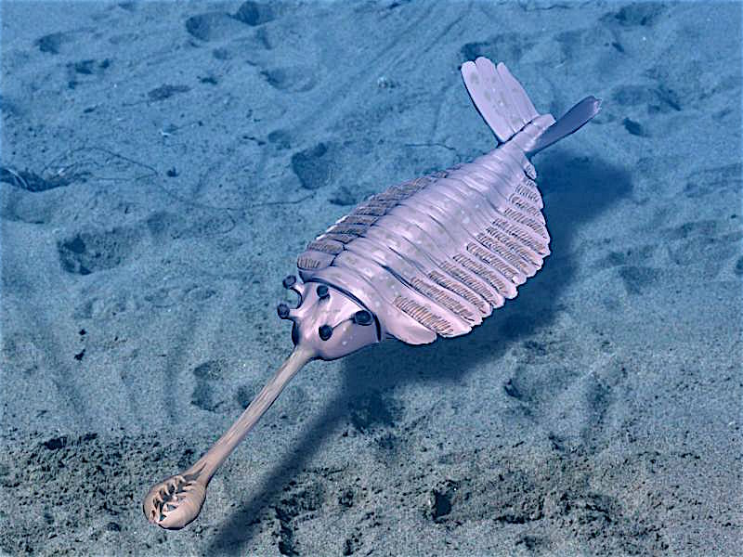
Even more weird creatures
Hallucigenia image from the Smithsonian website http://paleobiology.si.edu/burgess/hallucigenia.html.
Wiwaxia by Martin R. Smith.
Opabinia by Nobu Tamura CC BY 3.0.

Slide 8
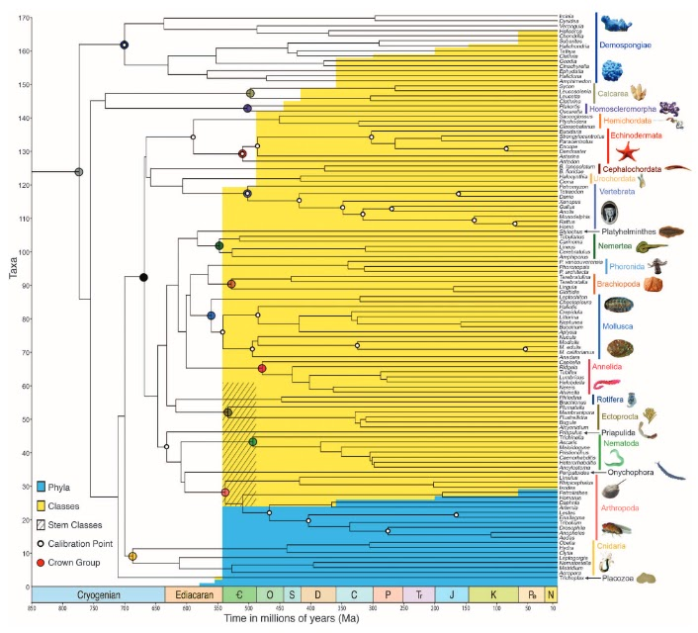
But Not just weird creatures…
Almost every phylum is known to be present in the Cambrian.
Almost every class is known to be present in the Cambrian.
All of these appear suddenly without obvious ancestry.
Erwin, et al. 2011. The Cambrian conundrum: Early divergence and later ecological success in the early history of animals. Science 334(6059):1091-1097.
Notes:
Note that this is from an evolutionary paper entitled “The Cambrian Conundrum”.
There are two diagrams layered on top of each other here. In the background is a phylogeny showing the range of organisms and when they show up. We’re not going to focus on that for now. Instead, I want you to look at four things here: the number of taxa, the time, and the blue and yellow areas…

Slide 9
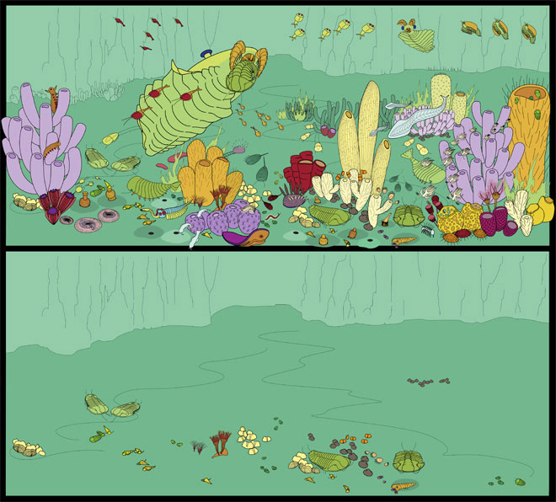
Explanations for the explosion
Lack of fossils
Poor soft-bodied preservation potential
Real, rapid, evolutionary event
Image by Marianne Collins from Royal Ontario Museum http://burgess-shale.rom.on.ca/en/science/burgess-shale/03-fossils.php.

Slide 10
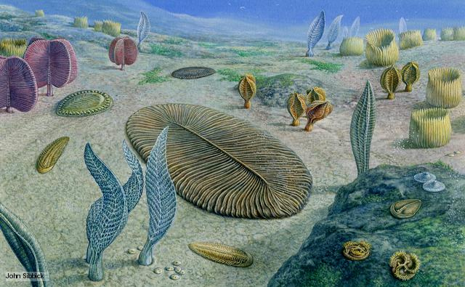
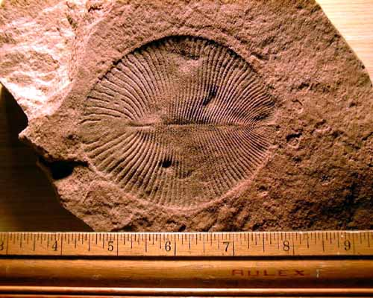
Lack of fossils?
We now have abundant Precambrian fossils
Ediacara biota
Dickinsonia image from UCMP Berkeley.

Slide 11
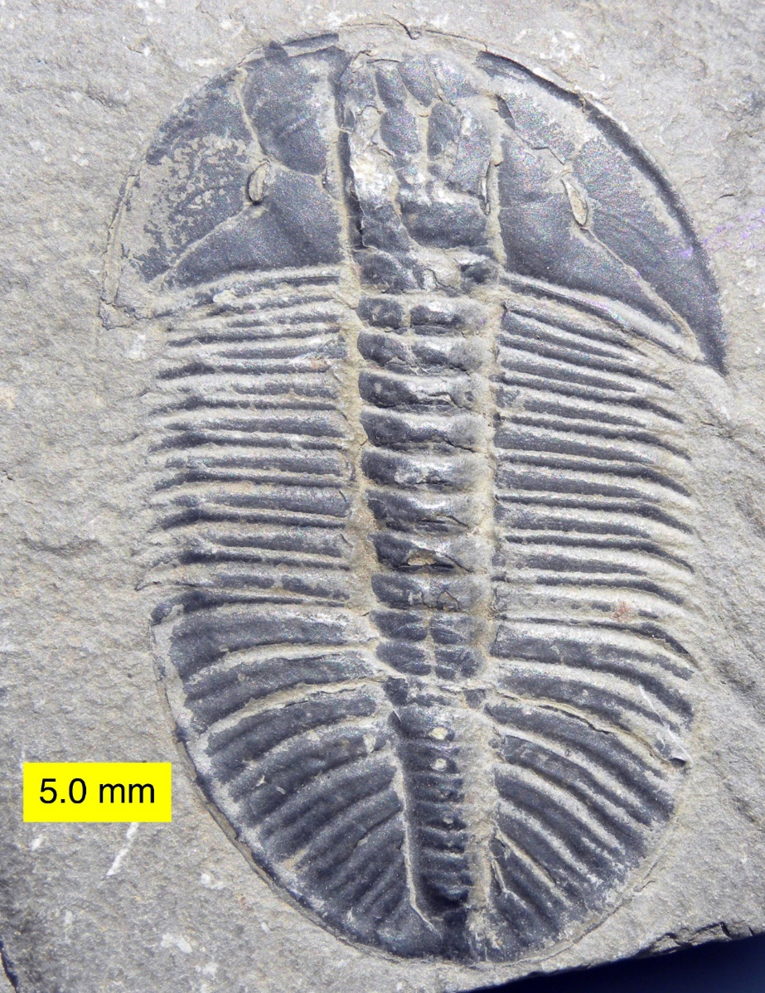
Poor preservation potential?
We have abundant soft-bodied Precambrian and Cambrian organisms.
Many Cambrian organisms have hard parts. Even if we did have poor preservation for soft-bodied animals, that wouldn’t explain why we don’t get the preservation of these ancestral hard parts.
Spriggina image by Merikanto CC BY 2.5.
Olenoides serratus image by Wilson44691.

Slide 12
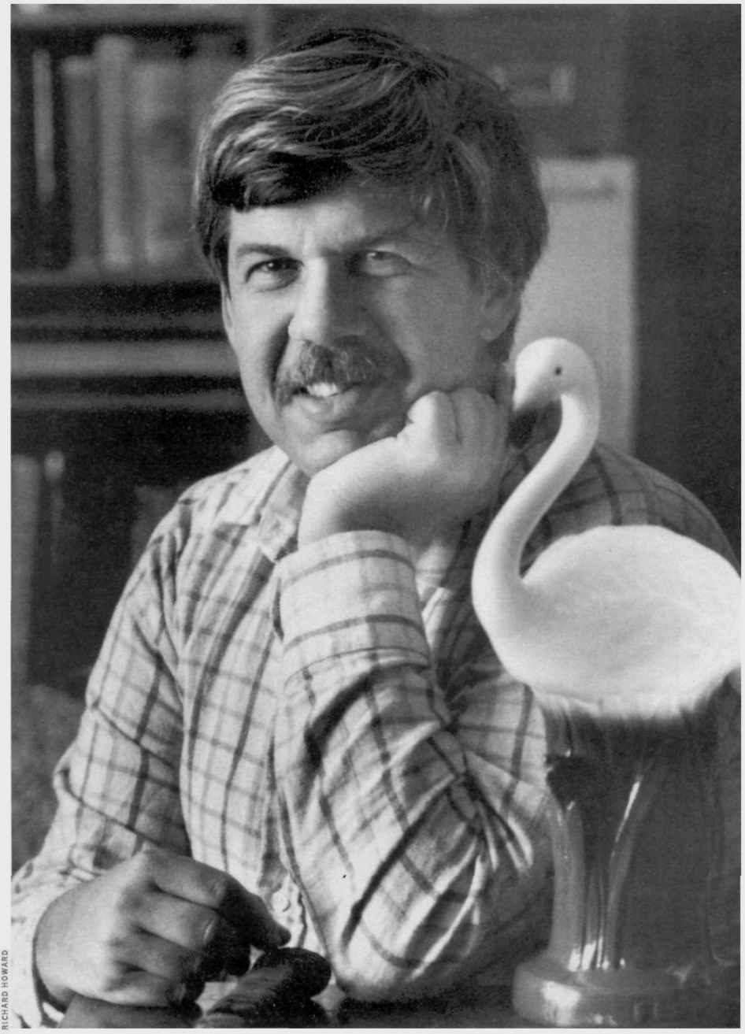
Real Evolutionary event
This is now the dominant opinion.
It is thought that almost all of the animal phyla appeared in a rapid burst of evolution.
Oxygen?
Calcium carbonate addition?
Peters and Gaines (2012) explained the Cambrian Explosion through the Great Unconformity.
Stephen Jay Gould – CC BY-SA 4.0.
Notes:
Stephen Jay Gould’s main book introducing the Cambrian Explosion is called Wonderful Life.
Peters and Gaines (2012) linked abundant addition of calcium and bicarbonate to the ocean to the formation of calcified skeletons in Cambrian animals.

Slide 13
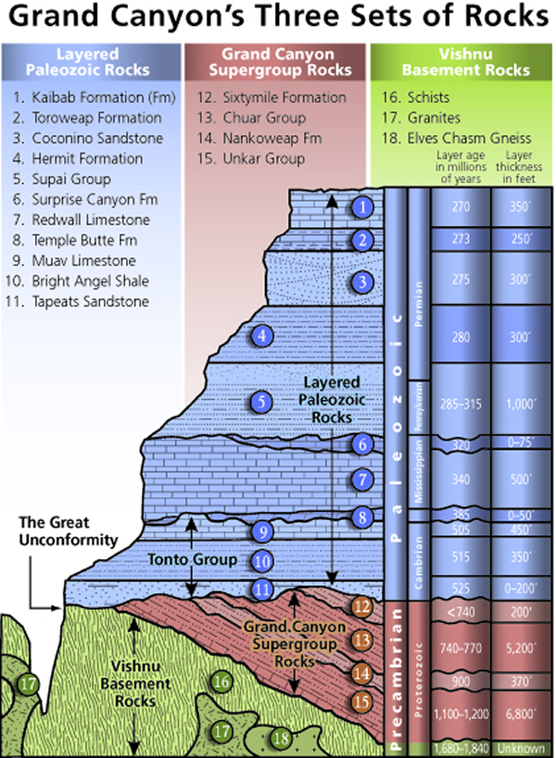
The great unconformity
The Great Unconformity is a worldwide erosional contact between Cambrian layers and underlying Precambrian rock.
Peters and Gaines (2012) proposed that calcium, bicarbonate, and other ions were added to the ocean because of this intense scouring of the continents.
They proposed that these ions could have been used by organisms in the production of hard parts.
NPS

Slide 14
Many Explosions?
Quaternary
Cenozoic
Neogene
Paleogene
Cretaceous
Is the Cambrian Explosion a one-time deal?
We’ll look at 3 other “taxic explosions” in the fossil record:
Permian Therapsids
Paleogene Mammals
Paleogene Birds
Mesozoic
Jurassic
Triassic
Phanerozoic
Permian
Carboniferous
Devonian
Paleozoic
Silurian
Ordovician
Cambrian
Precambrian
Ediacaran
Notes:
If this were a one time thing, sure – it would be weird, but it would be kind of like the Big Bang – a one-time freak accident. However, when we study the fossil record, we find multiple similar “taxic explosions”.

Slide 15
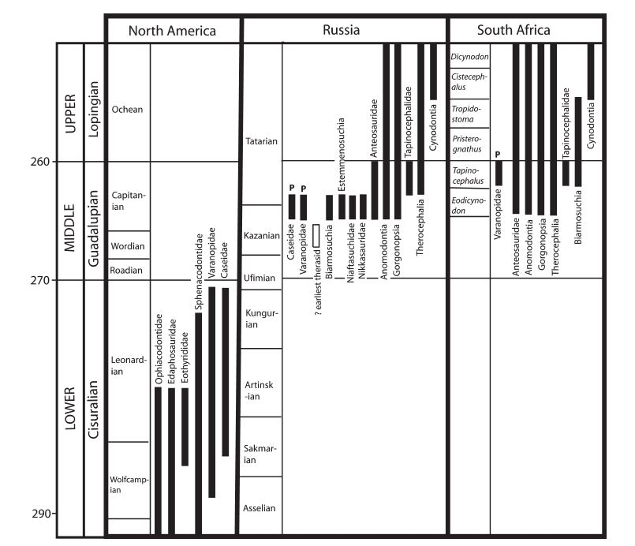
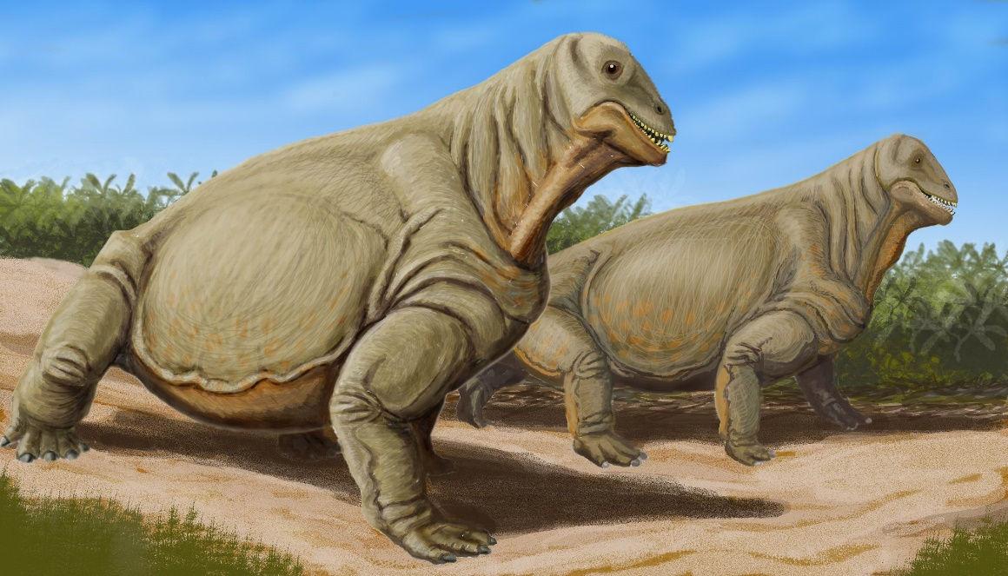
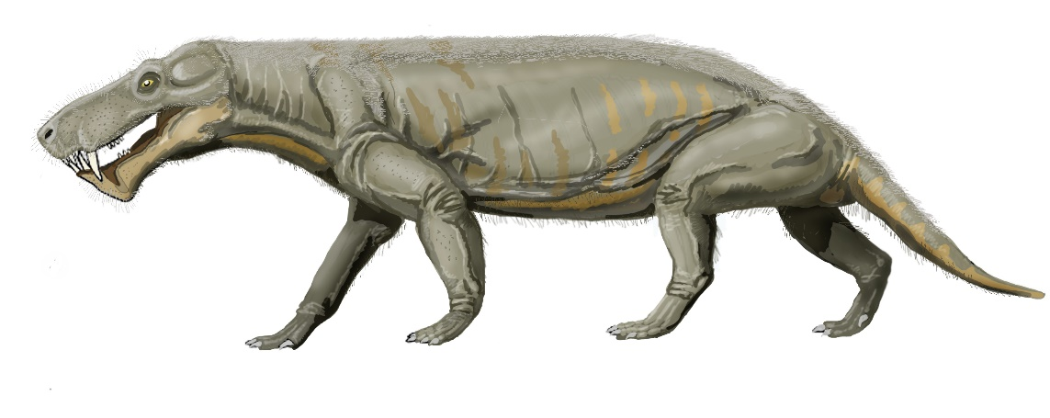
Permian therapsid explosion
Moschops (above) and Gorgonops (below) by Dmitry Bogdanov CC BY 3.0.
Kemp, 2009. Phylogenetic interrelationships and pattern of evolution of the therapsids: testing for polytomy. Palaeontologia Africana 44:1-12.
Notes:
Kemp compares the therapsid explosion in the Middle Permian to the Cambrian explosion and the Paleogene mammal explosion!

Slide 16
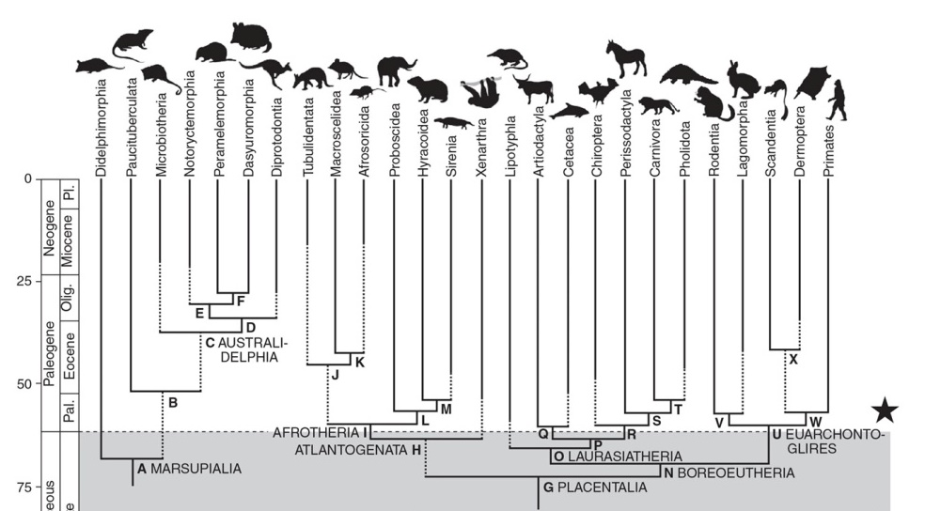
Paleogene mammal explosion
Paleogene
Cretaceous

Slide 17
Paleogene BIRD explosion
Paleogene
Cretaceous

Slide 18
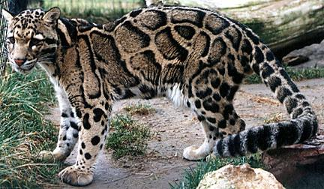
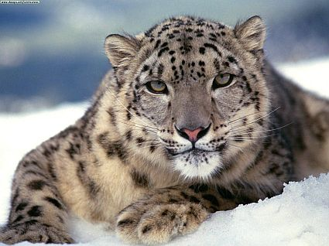
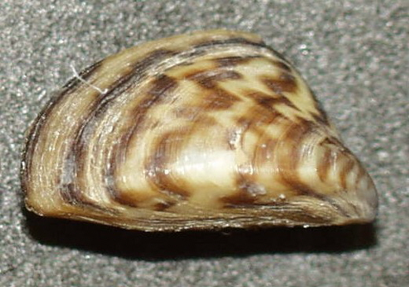
Why is everything exploding?
The sudden appearance of drastically different body plans is unexpected from a naturalistic evolutionary paradigm.
Time
Diversity
Diversity Precedes Disparity
Little changes over a long time lead to big changes
Notes:
What is this, a Michael Bay movie?

Slide 19
An alternative explanation
These explosions are showing us disparity preceding diversity.
Time
Diversity

Slide 20
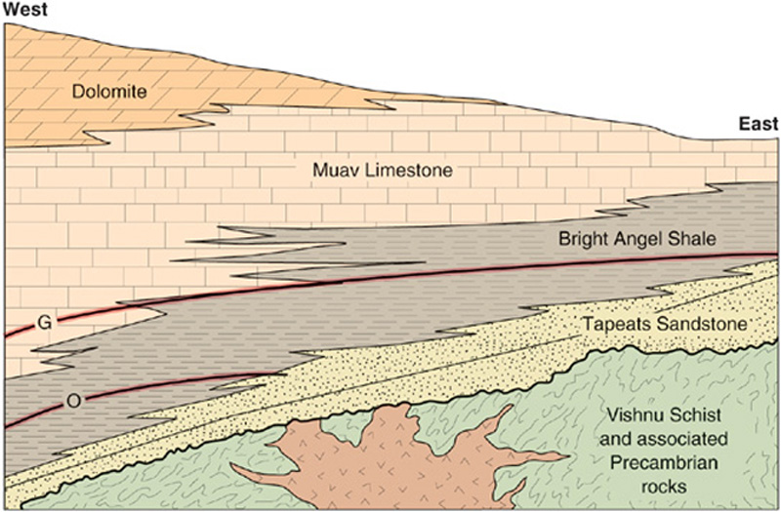
The Cambrian explosion and the flood
The transgressive Sauk sequence in the Grand Canyon. Image by Harold L. Levin.
The Cambrian Explosion represents some of the first organisms killed by the Flood.
Beneath the Cambrian Explosion is a worldwide erosional surface called the Great Unconformity.
Above the Great Unconformity is a transgressive sequence.
Notes:
Many creationists put the pre-Flood/Flood boundary at or near the Great Unconformity. The actual pre-Flood/Flood boundary may be a little lower in the Proterozoic, including the Ediacaran biota.

Slide 21
Making sense of explosions
Post-Flood
Quaternary
Cenozoic
Neogene
Paleogene
Cretaceous
Mesozoic
Jurassic
Sudden appearances of disparity in the fossil record makes sense from a creationist viewpoint as different environments are being preserved at different times.
Initial burial of different environments in the Flood would give the appearance of explosions.
The first deposits immediately after the Flood would give a similar picture.
Triassic
Phanerozoic
Flood
Permian
Carboniferous
Devonian
Paleozoic
Silurian
Ordovician
Cambrian
Precambrian
Ediacaran

Slide 22
Conclusions
The Cambrian Explosion, the simultaneous, sudden appearance of almost every phylum in the Cambrian, presents a large problem for naturalistic evolution.
The Cambrian Explosion, although unique, is not the only “taxic explosion” in the fossil record.
From a creationist perspective, we would expect the fossil record to have such punctuated bursts of disparity.
Although this pattern fits our prediction, we must be diligent to study the fossil record if we are to accurately understand earth history.

Slide 23
References
Benton, M.J. 2015. Vertebrate Palaeontology, 4th Edition. John Wiley & Sons, Ltd.
Darwin C. 1859. On the Origin of Species. Modern Library Paperbacks.
Erwin, et al. 2011. The Cambrian conundrum: Early divergence and later ecological success in the early history of animals. Science 334(6059):1091-1097.
Kemp, T.S. 2009. Phylogenetic interrelationships and pattern of evolution of the therapsids: testing for polytomy. Palaeontologia Africana 44:1-12.
Peters, S.E. and Gaines, R.R. 2012. Formation of the ‘Great Unconformity’ as a trigger for the Cambrian explosion. Nature 484:363-366.

