Slide 1
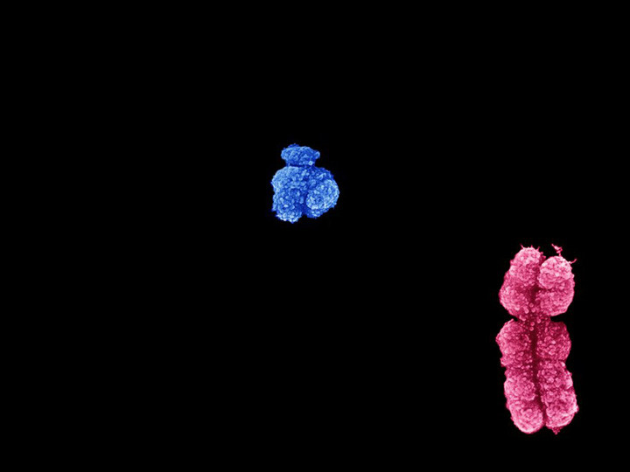
Y Chromosomes
in Chimps and Humans
are Horrendously Different
Paul Giem
Loma Linda, CA

Slide 2
Y Chromosomes in Chimps and Humans
The common chimp (Pan troglodytes) and human Y chromosomes are "horrendously different from each other", says David Page of the Whitehead Institute for Biomedical Research in Cambridge, Massachusetts
The fickle Y chromosome: Chimp genome reveals rapid rate of change.
http://www.nature.com/news/2010/100113/full/463149a.html

Slide 3
Y Chromosomes in Chimps and Humans
A paper in Nature
Hughes JF et al., 2010. Chimpanzee and human Y chromosomes are remarkably divergent in structure and gene content. Nature 463(7280): 536-539.
http://www.nature.com/nature/journal/v463/n7280/full/nature08700.html
http://hdl.handle.net/1721.1/59332

Slide 4
Talk Outline
Evolutionary expectations for the Y chromosome (similarity)
The data (that shows the two species’ Y chromosomes to be “horrendously different”)
The fact that intra-human variance is less than expected
The failure of evolution to predict the facts
Research opportunities for creation science

Slide 5
Y Chromosomes in Chimps and Humans
Expectations
The rest of the genome is 99% similar
<70 to 99.75% (see The Genetic Similarity Between Chimps and Humans, 2011)
Many reptiles are sexed by heat
The Y chromosome and the X chromosome supposedly originated from a standard chromosome; the Y is a degenerate X

Slide 6
Y Chromosomes in Chimps and Humans
Since the Y chromosome cannot cross over (except for very small parts at the ends) with any other chromosome, there is no way of “correcting” it
Bad genes or deletions “hitchhike” on good genes
Assuming common ancestry, the Y chromosome has grown smaller

Slide 8
Science News
http://news.sciencemag.org/evolution/2010/01/y-chromosome-evolving-rapidly
The Y chromosome has long been thought of as a stagnant part of the genome, where genes are slowly decaying in males of all species.
For almost a century, researchers have thought that the Y chromosome, with far fewer genes than the X, was decaying. Both sex chromosomes evolved from an ordinary pair of chromosomes more than 200 million years ago (Science, 29 October, 1999, p. 964).

Slide 9
Science News
But since then, the Y has steadily lost genes as well as its ability to recombine and swap genes with the X chromosome. This suggested that the Y has long been an isolated chromosome with little left to lose--just a couple of hundred genes, at most, whose job is to produce sperm and determine the sex of offspring. As a result, researchers predicted that the Y chromosome should be nearly identical in humans and chimpanzees, like the rest of the genome.

Slide 10
Forbes
http://www.forbes.com/sites/jasperhamill/2014/04/23/genetic-researchers-strike-men-off-the-endangered-species-list/
He [Page] found that the human Y chromosome contains only 19 of the 600 genes it once shared with the X chromosome.

Slide 11
Nature News
The common chimp (Pan troglodytes) and human Y chromosomes are "horrendously different from each other", says David Page of the Whitehead Institute for Biomedical Research in Cambridge, Massachusetts, who led the work. "It looks like there's been a dramatic renovation or reinvention of the Y chromosome in the chimpanzee and human lineages.”

Slide 12
Nature Article
Our laboratories previously demonstrated that the human MSY [male-specific Y] euchromatin [chromosome material] is largely comprised of two sequence classes: ampliconic and X-degenerate¹³. We find that the same two sequence classes dominate the chimpanzee MSY euchromatin (Fig. 1A, B), and thus the same was likely true in the common ancestor.

Slide 13
Nature Article
The ampliconic segments are composed of large, nearly identical repeat units, most often arrayed as palindromes, [or stretches of DNA that read the same both ways] and they harbor multi-copy gene families expressed predominantly or exclusively in the testis¹³ (Supplementary Fig. 6 and 7). By contrast, the X-degenerate segments are dotted with single-copy homologs of X-linked genes [or stretches of DNA that can be aligned with genes on the X chromosome]. These single-copy MSY genes, most of which are expressed ubiquitously, are surviving relics of ancient autosomes [or chromosomes that are not sex chromosomes] from which the X and Y chromosomes evolved².

Slide 14
Nature Article
Together, the ampliconic and X-degenerate sequences comprise the bulk of the MSY euchromatin [or chromosome material] in both chimpanzee and human (Fig. 1B). A third sequence class in the human MSY euchromatin – the X-transposed sequences [defined below] – has no counterpart in the chimpanzee MSY. The presence of these sequences in the human MSY is the result of an X-to-Y transposition that occurred in the human lineage after its divergence from the chimpanzee lineage¹⁴.
…

Slide 15
Nature Article
Given that primate sex chromosomes are hundreds of millions of years old², theories of decelerating decay would predict that the chimpanzee and human MSYs should have changed little since the separation of these two lineages just six million years ago. To test this prediction, we aligned and compared the nucleotide sequences of the chimpanzee and human MSYs (Supplementary File 3). As expected, we found that the degree of similarity between orthologous [comparable or alignable] chimpanzee and human MSY sequences (98.3% nucleotide identity) differs only modestly from that reported when comparing the rest of the chimpanzee and human genomes (98.8%)¹⁵.

Slide 16
Nature Article
Surprisingly, however, > 30% of chimpanzee MSY sequence has no homologous, alignable counterpart in the human MSY, and vice versa (Supplementary Fig. 8 and Supplementary Note 3). In this respect the MSY differs radically from the remainder of the genome, where < 2% of chimpanzee euchromatic sequence lacks an homologous, alignable counterpart in humans, and vice versa¹⁵. We conclude that, since the separation of the chimpanzee and human lineages, sequence gain and loss have been far more concentrated in the MSY than in the balance of the genome.

Slide 17
Nature Article
… … …
… Indeed, at six million years of separation, the difference in MSY gene content in chimpanzee and human is more comparable to the difference in autosomal [non-sex chromosome] gene content in chicken and human, at 310 million years of separation²⁶.

Slide 18
Nature Article
We have conducted the first comprehensive comparison of Y chromosomes from two species, providing empirical insight into Y-chromosome evolution and a test of decelerating-decay theories. These theories elegantly account for the degeneration observed in neo-Y chromosomes recently evolved from autosomes³⁻⁸. However, they did not predict and cannot account for the rapid divergence of the older, highly evolved chimpanzee and human MSYs described here. Instead, remodelling and regeneration have dominated chimpanzee and human MSY evolution during the past six million years.

Slide 19
Nature Article
We suggest that this renovation, involving both architecture and genetic repertoire, was propelled by a combination of factors acting in synergy. Three of these factors distinguished the evolving hominid MSY from the bulk of the genome: 1) the highly disproportionate role of MSY genes – especially ampliconic gene families – in sperm production¹³, 2) the brisk kinetics of ectopic recombination and resultant structural change in ampliconic regions¹⁸, and 3) the absence of crossing over with a homolog, which creates the opportunity for a single advantageous mutation to dictate the MSY’s evolutionary fate (“genetic hitchhiking”)^{1,3}.

Slide 20
Nature Article
… In the future, complete Y chromosome sequences from additional species will shed further light on these hypotheses.

Slide 21
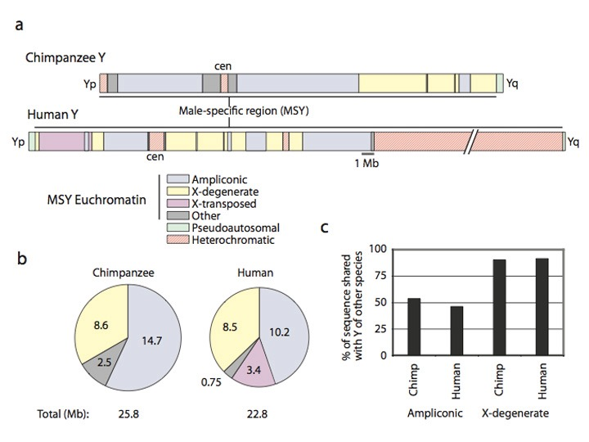
Hughes et al., Nature 2010

Slide 22
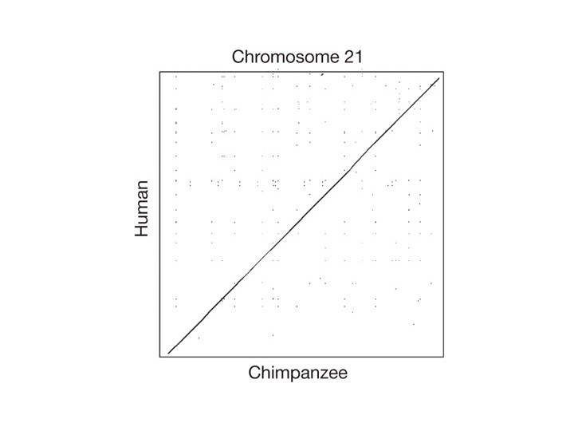
Hughes et al., Nature 2010
3´?
5´?
5´?
3´?

Slide 23
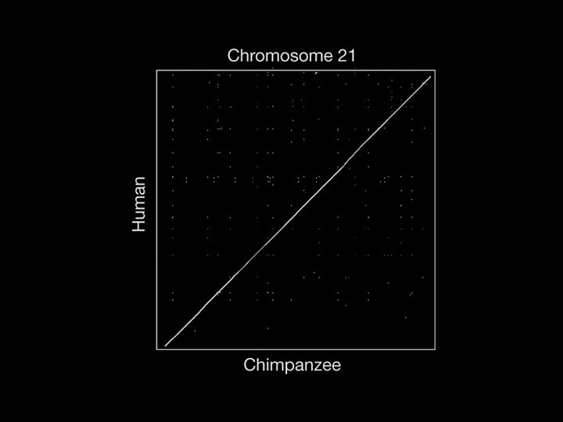
Hughes et al., Nature 2010

Slide 24
Hughes et al., Nature 2010

Slide 25
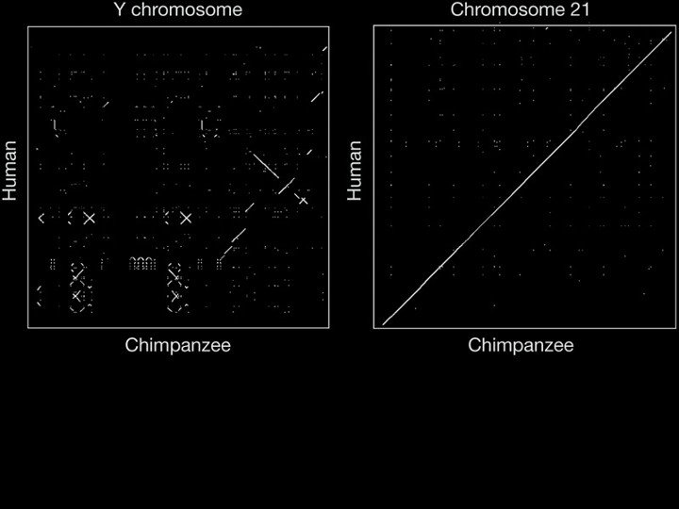
Each dot represents 100% chimpanzee–human identity within a 200-base-pair (bp) window. In the Y-chromosome plot, the human chromosome is oriented with short arm to top and long arm to bottom, and the chimpanzee chromosome is oriented with short arm to left and long arm to right. For chromosome 21, which is acrocentric, the plot represents only the long arm.
Hughes et al., Nature 2010

Slide 26
Nature News
Even the portions that do line up have undergone erratic relocation. In the only other chromosome to have been sequenced to the same degree of completeness in both species, chromosome 21, the authors found much less rearrangement.
"If you're marching along the human chromosome 21, you might as well be marching along the chimp chromosome 21. It's like an unbroken piece of glass," says Page. "But the relationship between the human and chimp Y chromosomes has been blown to pieces."

Slide 27
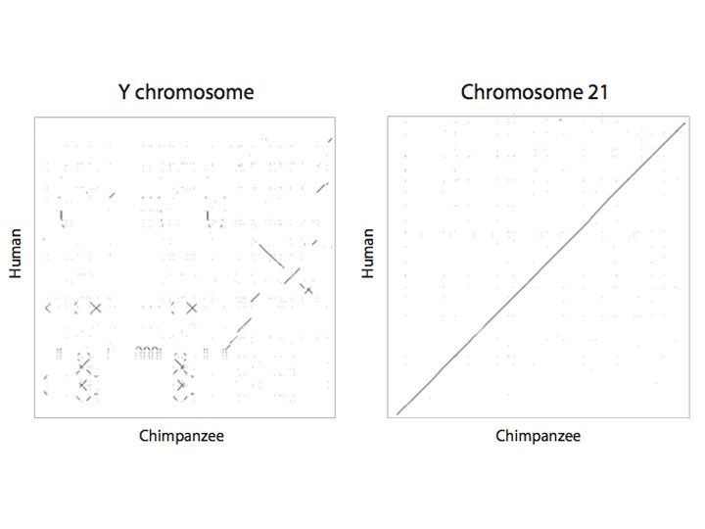
Hughes et al., Nature 2010

Slide 28
Subsequent Data
Rhesus Macaque monkey
Hughes JF et al., 2012. Strict evolutionary conservation followed rapid gene loss on human and rhesus Y chromosomes. Nature 483(7387): 82–86
https://www.nature.com/nature/journal/v483/n7387/abs/nature10843.html
https://www.ncbi.nlm.nih.gov/pmc/articles/PMC3292678/?tool

Slide 29
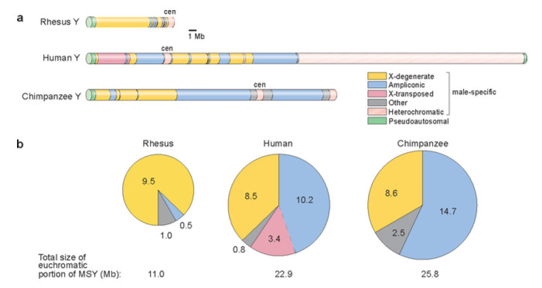
Hughes et al., Nature 2012

Slide 30
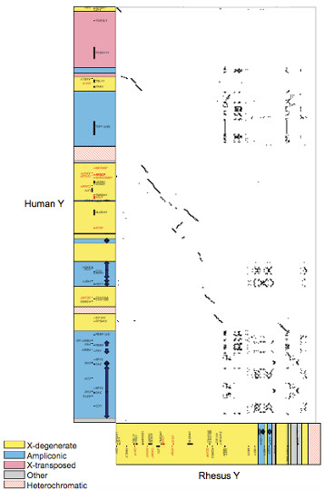
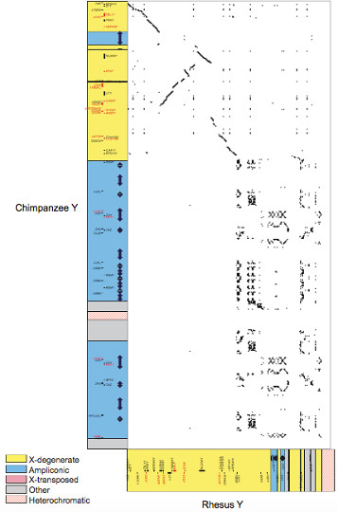
Hughes et al., Nature 2010

Slide 31
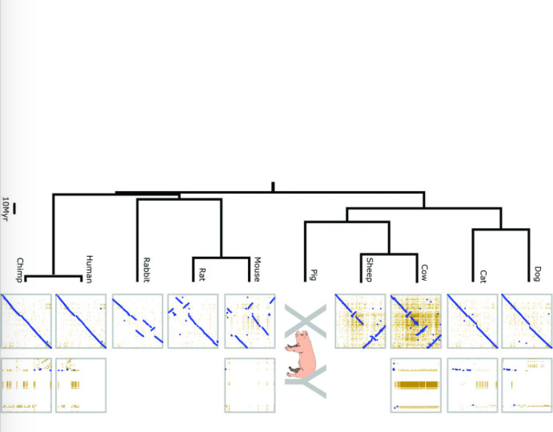
Skinner BM et al. 2016. The pig X and Y Chromosomes: structure, sequence, and evolution. Genome Res 26: 130–139
http://genome.cshlp.org/content/26/4/530.full

Slide 32
PLoS Article
Evolutionary theory might expect that with this much evolution between chimpanzee and human Y chromosomes, that human Y chromosomes would be markedly different from each other, much more than other chromosomes
This expectation is incorrect
Wilson Sayres MA, Lohmuller KE, Nielsen R, 2014. Natural Selection Reduced Diversity on Human Y Chromosomes. PLoS Genet 10(1): e1004064. doi:10.1371/journal.pgen.1004064
http://www.plosgenetics.org/article/info%3Adoi%2F10.1371%2Fjournal.pgen.1004064

Slide 33
PLoS Article
… Under simple neutral models with constant and equal male and female population sizes, diversity is expected to be proportional to the relative number of each chromosome in the population: X diversity is expected to be three-quarters autosomal diversity (because there are three X chromosomes for every four autosomes) and both the Y and mtDNA diversity are expected to be one-quarter autosomal diversity [6].

Slide 34
PLoS Article
… … …
Here, using genome-wide analyses of X, Y, autosomal and mitochondrial DNA, in combination with extensive population genetic simulations, we show that low observed Y chromosome variability is not consistent with a purely neutral model. …

Slide 35
PLoS Article
… chromosome-wide Y diversity is an order of magnitude lower than the equilibrium neutral expectation of one-quarter the autosomal level of diversity (Figure 1). Conversely, mitochondrial diversity is not reduced compared to expectations under neutrality (Figure 1).

Slide 36
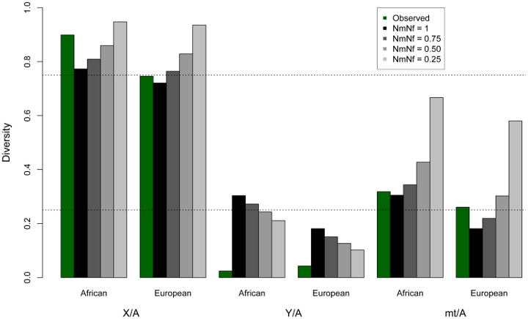
Sayres et al., PLoS 2014

Slide 37
PLoS Article
No comments about the tension between lower rates of mutation in humans and higher rates of divergence between chimpanzees and humans
Same is true for Wikipedia
You’ve probably never heard of this problem for a common ancestry of chimpanzees and humans

Slide 38
Creationist Reactions
Creationist articles note the difficulties raised by the Y chromosome
http://creation.com/y-chromosome-shock
http://www.godandscience.org/evolution/human_y_chromosome.html
http://www.icr.org/article/new-chromosome-research-undermines/
https://answersingenesis.org/answers/research-journal/v6/comprehensive-analysis-of-chimpanzee-and-human-chromosomes/

Slide 39
Creationist Reactions
Answers Research Journal
Comprehensive Analysis of Chimpanzee and Human Chromosomes Reveals Average DNA Similarity of 70%
by Jeffrey Tomkins on February 20, 2013

Slide 40
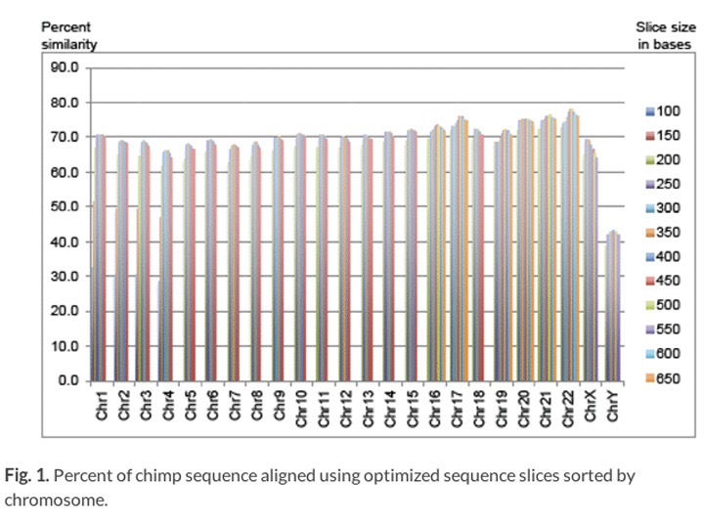
Tompkins, Answers Research Journal 2013

Slide 41
My Take
From a naturalistic perspective, chimpanzee and human Y chromosomes are “horrendously different”.
The difference does not make sense when compared to the slow evolution of human Y chromosomes
Perhaps the difference is designed

Slide 42
Talk Outline
Evolutionary expectations for the Y chromosome (similarity)
The data (that shows the two species’ Y chromosomes to be “horrendously different”)
The fact that intra-human variance is less than expected
The failure of evolution to predict the facts
Research opportunities for creation science

Slide 43
My Take
Predictions that could be made
Bonobos and chimps will have very much less change in their Y chromosomes
It will be interesting to check the intraspecies variation in chimps—Low again?
Gorillas and chimps might have low variation in Y chromosomes, and this might create additional difficulties in naturalistic explanations for the chimp-human difference
It would be interesting to check on horses, zebras, and donkeys, or wolves and foxes

Slide 44
Questions and Comments

