Slide 1
Bible “Scientists”
History of Individuals Challenged with Data that Contradicted the Word of God
Eve
Noah

Slide 2
“Junk DNA”
Humans are estimated to have approximately 20,000 protein-coding genes which account for only about 1.5% of DNA in the human genome. The primary goal of the encode project is to determine the role of the remaining component of the genome, much of which was traditionally regarded as "junk" (i.e. DNA that is not [used to make protein]).

Slide 3
Richard Dawkins on “Junk DNA”
Before ENCODE: “Pseudogenes are genes that once did something useful but have now been sidelined and are never transcribed or translated. They might as well not exist, as far as the animal's welfare is concerned. But as far as the scientist is concerned they very much exist, and they are exactly what we need for an evolutionary clock. .. . . What pseudogenes are useful for is embarrassing creationists. It stretches even their creative ingenuity to make up a convincing reason why an intelligent designer should have created a pseudogene --a gene that does absolutely nothing and gives every appearance of being a superannuated version of a gene that used to do something, unless he was deliberately setting out to fool us." Dawkins then continues: "Leaving pseudogenes aside, it is a remarkable fact that the greater part (95 percent in the case of humans) of the genome might as well not be there, for all the difference it makes." The Greatest Show on Earth, 2009, pp 332-333.

Slide 4
“Junk DNA”
The encyclopedia of DNA elements (ENCODE) is a public research project launched by the US national human genome research institute (NHGRI) in September 2003, (including over 400 scientists). One main accomplishment described by the ENCODE consortium has been that 80% of the human genome is now "associated with at least one biochemical function.” (2012) Much of this functional non-coding DNA is involved in the regulation of the expression of coding genes. furthermore the expression of each coding gene is controlled by multiple regulatory sites located both near and distant from the gene. these results demonstrate that gene regulation is far more complex than was previously believed.

Slide 5
Richard Dawkins on “Junk DNA”
After ENCODE: "I know there are some creationists who have jumped on it because they think it is awkward for Darwinism. Quite the contrary, of course. It is exactly what a Darwinist would hope for -- is to find usefulness in the living world.“

Slide 6
“Pseudogenes are not pseudo any more”
“The study of functional pseudogenes is just at the beginning. There remain many questions to be addressed, such as the regulatory elements controlling the cell or tissue specific expression of pseudogenes. But, definitely, the so-called pseudogenes are really functional, not to be considered any more as just “junk” or “fossil” DNA. Surely, many functional pseudogenes and novel regulatory mechanisms remain to be discovered and explored in diverse organisms.”
Wen et al, RNA Biology 9:27-32. Jan 2012

Slide 7
There Are Issues That Challenge the concept of a fiat creation
Radiometric dating
Other dating methods
Fossil record
Orderly fossil record
Hominid record
Etc.

Slide 8
There Are Issues That support the concept of a fiat creation
Origin of life
Fossil record
Sudden appearances
General absence of intermediate forms
Sedimentology and Catastrophism
Evidence of extraordinary events.
General lack of evidence for time.
Molecular biology

Slide 9
What Science Tells Us:
Evolution
Creation

Slide 10
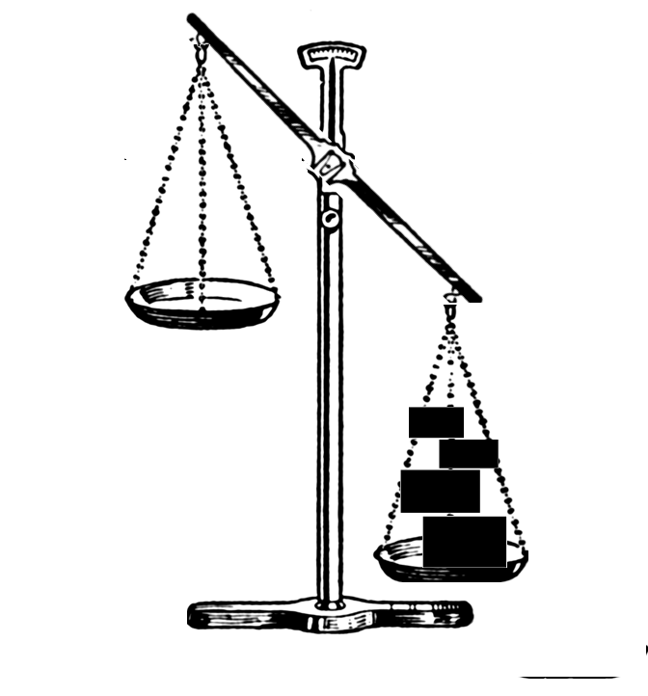
What we would like to see: (?)
Evolution
Creation

Slide 11
…or this:
Evolution
Creation
Evolution
Creation

Slide 12
What we See:
Evolution
Creation

Slide 13
Conclusion:
A = B
A = B
Therefore:
For those who know the science, the decision about origins is always going to be based upon something other than science.

Slide 14
