Slide 1
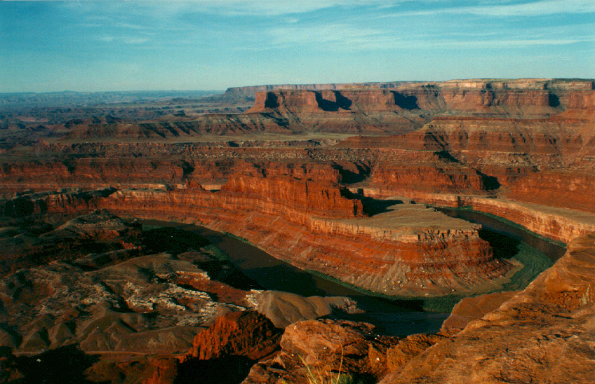
Looking for time in all the wrong places

Slide 2
What science cannot do:

Slide 3
Deciding about origins:
Challenges to the concept of a fiat creation
Radiometric dating
Other dating methods
Fossil record
  Orderly fossil record
  Hominid record
  Etc.

Slide 4
Deciding about origins: challenges to the concept of evolution
Origin of life
Fossil record
  Sudden appearances
  General absence of intermediate forms
Sedimentology and Catastrophism
  Evidence of extraordinary events.
  General lack of evidence for time.
Molecular biology

Slide 5

What we see:
Evolution
Creation

Slide 6
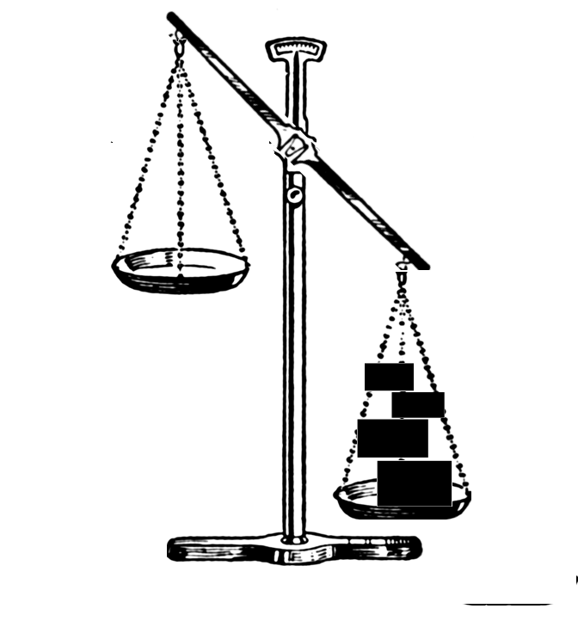
What we would like to see: (?)
Evolution
Creation

Slide 7
…or this:
Evolution
Creation
Evolution
Creation

Slide 8
What we see:
Evolution
Creation

Slide 9
Conclusion:
A = B
A = B
Therefore:
For those who know the science, the decision about origins is always going to be based upon something other than science.

Slide 10
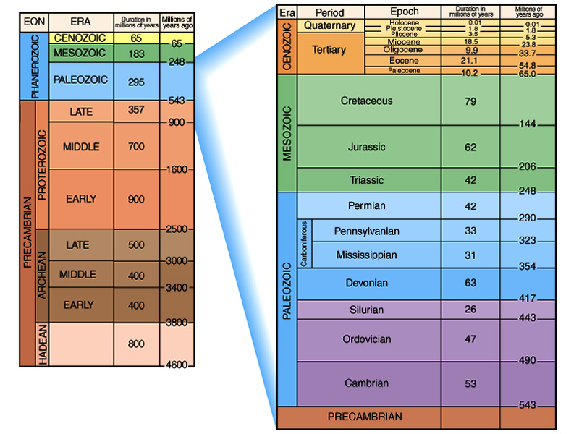
Simple Geologic Time Scale

Slide 11
“The present is The Key to the Past”
“Relative” Time
Principles Used to Determine “Relative Age”
  Principles of stratigraphy
  Unconformities
  Correlation
  The Standard Geologic Time Scale
“Absolute” Time
Principles of radioactive decay
  Instruments
  Assumptions
The age of the Earth

Slide 12
Radioactive Decay
Nucleus of an atom spontaneously changes
Independent of normal pressures and temperatures
In some cases nucleus gets smaller
In all cases, the kind of atom is changed
Happens at a known, measurable rate at present.

Slide 13
Alpha Decay
Alpha particle (helium nucleus) = composed of 2 neutrons and 2 protons
Alpha Particle is ejected from the nucleus, along with some gamma radiation
Atomic number goes down by 2
Atomic mass goes down by 4.

Slide 14
Beta Decay
An electron is ejected from the nucleus
Essentially a neutron becomes a proton
Atomic number increases by 1
Atomic mass remains the same.

Slide 15
Electron Capture
A proton becomes a neutron in the nucleus
Atomic number decreases by one
Atomic mass does not change.

Slide 16
Useful Isotope Systems
ISOTOPE | HALF LIFE | RANGE
¹⁴C -> ¹⁴N | 5730 yrs | < 60,000 yrs
⁴⁰K -> ⁴⁰Ar | 1.25 x 10⁹ yrs | > 100,000 yrs
⁸⁷Rb -> ⁸⁷Sr | 48.8 x 10⁹ yrs | > 1,000,000 yrs
²³⁸U -> ²⁰⁶Pb | 4.5 x 10⁹ yrs | > 1,000,000 yrs
²³⁵U -> ²⁰⁷Pb | 0.7 x 10⁹ yrs | > 100 x 10⁶ yrs
¹⁴⁷Sm -> ¹⁴³Nd | 106 x 10⁹ yrs | > 100 x 10⁶ yrs
²³²Th -> ²⁰⁸Pb | 14 x 10⁹ yrs | > 200 x 10⁶ yrs

Slide 17
The Radiocarbon System
Carbon has 6 protons in the nucleus
The most common isotope is ¹²C
  Has 6 protons and 6 neutrons in the nucleus
  Stable isotope
Some Carbon is ¹³C
  Has 6 protons and 7 neutrons in the nucleus
  Nonradioactive isotope.
Some Carbon is ¹⁴C
  Has 6 protons and 8 neutrons in the nucleus
  Radioactive isotope.

Slide 18
Radioactive Decay of 14C
e⁻
¹⁴C Nucleus
¹⁴N Nucleus
6 Protons
8 Neutrons
7 Protons
7 Neutrons

Slide 19
¹⁴C - ¹⁴N Isotope System
¹⁴C spontaneously decays to ¹⁴N at a constant rate (beta decay).
In a closed system the proportion of ¹⁴C (parent) to ¹⁴N (daughter) will change over time.
The amount of time it takes half of the parent isotope to decay is called the half-life.
We can graph this on a decay curve.

Slide 20
Radioactive Decay Curve
Percent Parent Isotope
Time (half-lives)

Slide 21
2 Half-lives

Slide 22
3 Half-lives

Slide 23
4 Half-lives

Slide 24
5 Half-lives

Slide 25
6 Half-lives

Slide 26
7 Half-lives

Slide 27
RADIOACTIVE DECAY CURVE
Daughter Isotope
% Atoms
Parent Isotope
# Half-Lives

Slide 28
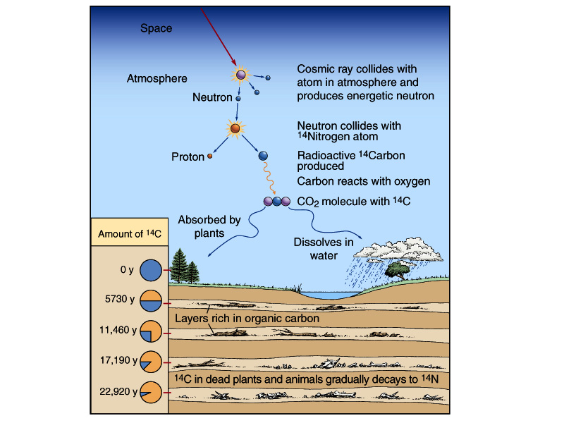
Carbon-14 radiometric clock

Slide 29
What Assumptions Have We Made?
Decay rate constant over time
Decay is unaffected by pressure and temperature
Single daughter product is involved
No parent or daughter atoms have escaped or been added
Starting amount of daughter = Zero
Starting amount of parent is known
Other assumptions, some of which may not be known to us yet …

Slide 30
Useful Isotope Systems
ISOTOPE | HALF LIFE | RANGE
¹⁴C -> ¹⁴N | 5730 yrs | < 60,000 yrs
⁴⁰K -> ⁴⁰Ar | 1.25 x 10⁹ yrs | > 100,000 yrs
⁸⁷Rb -> ⁸⁷Sr | 48.8 x 10⁹ yrs | > 1,000,000 yrs
²³⁸U -> ²⁰⁶Pb | 4.5 x 10⁹ yrs | > 1,000,000 yrs
²³⁵U -> ²⁰⁷Pb | 0.7 x 10⁹ yrs | > 100 x 10⁶ yrs
¹⁴⁷Sm -> ¹⁴³Nd | 106 x 10⁹ yrs | > 100 x 10⁶ yrs
²³²Th -> ²⁰⁸Pb | 14 x 10⁹ yrs | > 200 x 10⁶ yrs

Slide 31
Potassium - Argon
Another important isotope system
Potassium is very abundant in rocks
Lots of isotope to measure
⁴⁰K Beta decays to ⁴⁰Ca most of the time
BUT, ~11% of the time electron capture occurs, causing ⁴⁰K to decay to ⁴⁰Ar
Can also be used to study thermal history of rocks.

Slide 32
What Assumptions Have We Made?
Decay rate constant over time
Decay is unaffected by pressure and temperature
Single daughter product is involved
No parent or daughter atoms have escaped or been added
Starting amount of daughter = Zero
Starting amount of parent is known
Other assumptions, some of which may not be known to us yet …

Slide 33
Summary & Conclusions
Several ways to calculate “absolute ages”
Most involve radioactive decay
All have specialized applications
All have certain limitations
No numerical age is truly “absolute”.
“At present, physical dates do not stand on their own. They must be compatible with stratigraphy. Stratigraphy has also served to highlight flaws and the relevance of unexpected factors in some physical procedures. So-called absolute dating is a misnomer, for physical dates provide numerical approximations, preferably considered within and constrained by a stratigraphic framework”
''Canons'' revisited and reviewed: Lester King's views of landscape evolution considered 50 years later. C. R. Twidale. Geological Society of America Bulletin 2003;115, no. 10;1155-1172

Slide 34
What science can do:
Investigate the natural world
Test ideas about the natural world to see if they work
Your success as a scientist may attract others, who then may become interested in your other ideas.
Science is fun.

Slide 35
Time and the Fossil Record
The most common interpretation of radiometric data would take life on the earth far beyond Biblical timeframe.
Although progress is being made, efforts to resolve the discrepancy head-on have not thus far been fruitful.
Certain features of the geologic record seem to contradict conclusions based on radiometric dates:

Slide 36
How can we detect time in the rocks?
If the deposition of sediments that constitutes the rocks around us occurred over millions of years, what features in the rocks should confirm that?
If the sedimentary processes were occurring much more rapidly, how would we know that?
More than ten years ago, Dr. Brand and others set out to examine the rocks of the Colorado Plateau to see what they could tell us about the time required for their deposition.
Colorado Plateau was chosen because it is nearby, has a dry climate, and the rocks are well exposed.

Slide 37
Issues in dating
Sediments appear to have accumulated rapidly
Sediments do not appear in equilibrium with the environment.
There is a general lack of erosion in the geologic record
Where radiometric dates are available, the events occurring between dated horizons rarely comport with the radiometric time.
Surviving biomolecules are found far out of possibility for radiometric time.

Slide 38
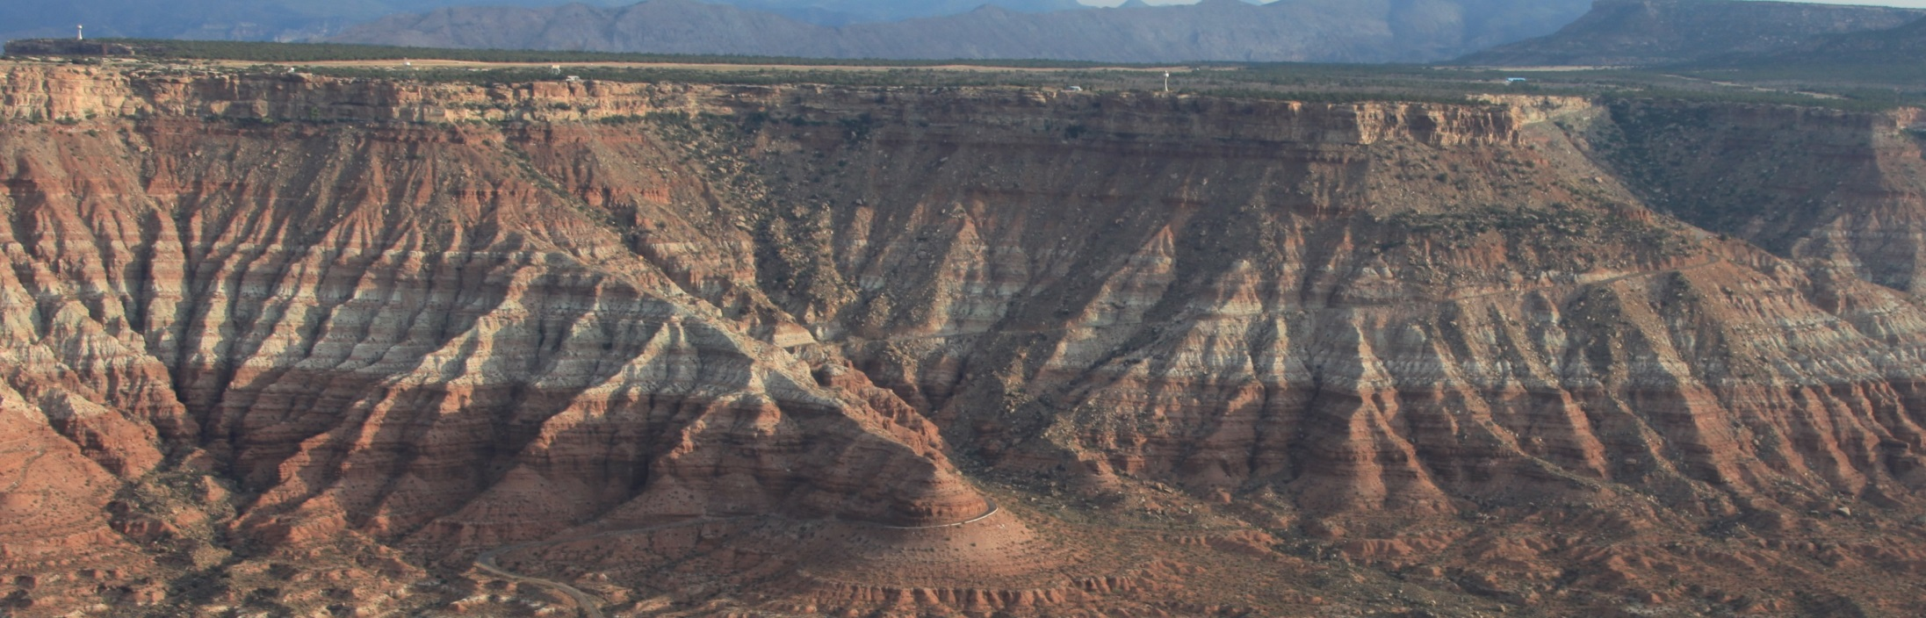
Sediment Accumulation Rates
When examining sedimentary layers, one important question we would like to answer is “How fast do sedimentary layers accumulate?”
10 million yrs?
Few days?

Slide 39
Sediment Accumulation Rates
How can we determine the answer?
  1. Measure rates in modern depositional environments. Assume rates in past were similar. Determine a rate based on these assumptions or…
  2. Refer to some external information about past time and apply that to the sedimentary layers.
    Use radiometric dating methods to get time and measure thickness of sediments and determine a rate based on these assumptions, or…
    Use Biblical time framework and measure thickness of sediments and determine a rate based on these assumptions, or...
  3. Use calculations based on the behavior of sedimentary particles
What kinds of answers do we get?

Slide 40
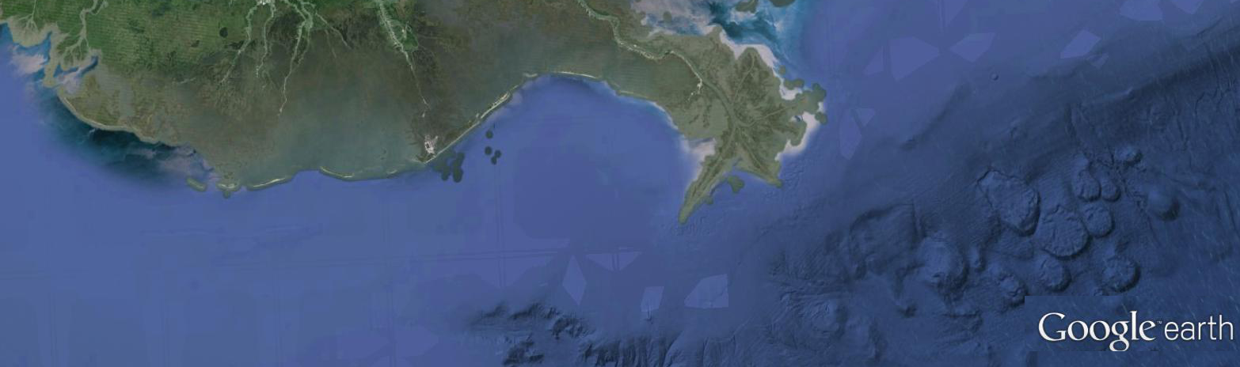
Sedimentation Rates based on actual measurements
Modern rates for sediment accumulation in depositional environments are determined by actual measurements.
Rates in cm/yr determined in a variety of environments where sediment is actively accumulating vary from less than 0.1 to more than 2, most often closer to 0.5-1.0 cm/yr.*
*Modern accumulation rates and a sediment budget for the Eel shelf: a flood-dominated depositional environment . Marine Geology 54, 227–241
.
10⁻⁴
10⁻³
10⁻²
0.1
0
1
10
10²
10³
10⁴
10⁵
10⁶
10⁷
Rate in cm/yr (log scale)

Slide 41

Sediment rates based on interpretation of radioisotope ratios
Sediment accumulation rates for past sedimentary layers are often based upon interpretations of radioisotope measurements. Such calculations give rates in meters/my. Rates (in cm/yr) vary from less than 0.0001 to more than 0.01, most often 0.001cm/yr.
10 million yrs
10⁻⁴
10⁻³
10⁻²
0.1
0
1
10
10²
10³
10⁴
10⁵
10⁶
10⁷
Rate in cm/yr (log scale)

Slide 42

Sedimentation Rates based upon biblical chronology
Sedimentary rates can take into account the Biblical narrative, (one year of extremely high rates followed by gradual reductions to present). Rates in cm/yr could vary from less than 100,000 to more than 200,000, perhaps averaging ~150,000cm/yr.
Few days?
10⁻⁴
10⁻³
10⁻²
0.1
0
1
10
10²
10³
10⁴
10⁵
10⁶
10⁷
Rate in cm/yr (log scale)

Slide 43
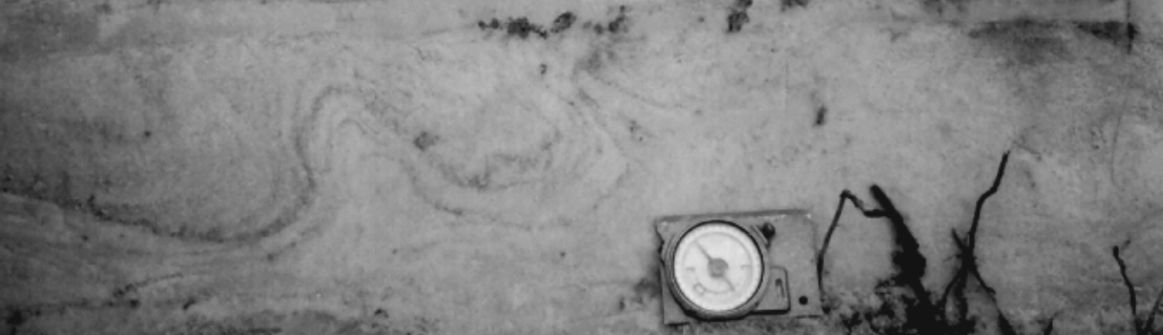

Sedimentation Rates based upon sedimentary studies
Sedimentation based upon the behavior of sedimentary particles gives rates of accumulation that are from 2000 to 10 million times faster than the rates based on radiometric time.*
  *G. Berthault, A.V. Lalomov, and M.A. Tugarova Reconstruction of Paleolithodynamic Formation Conditions of Cambrian-Ordovician Sandstones in the Northwestern Russian Platform. Lithology and Mineral Resources. 46:60-70. 2011
10⁻⁴
10⁻³
10⁻²
0.1
0
1
10
10²
10³
10⁴
10⁵
10⁶
10⁷
Rate in cm/yr (log scale)

Slide 44
Summary Sediment Accumulation Rates
Modern depositional rates are ~1000 times faster than fossil rates calculated from radiometric isotope data.
Biblical time frame gives depositional rates that are 10,000 times faster than modern rates and ~10,000,000 times faster than fossil rates based on radiometric isotope data.
Experimental sedimentation studies suggest rates 2000 to 10,000,000 times faster than fossil rates calculated from radiometric dates.
Radiometriccalculations
Modern measurements
Sediment behavior
Biblical chronology
10⁻⁴
10⁻³
10⁻²
0.1
0
1
10
10²
10³
10⁴
10⁵
10⁶
10⁷
Rate in cm/yr (log scale)

Slide 45
Conclusions: Past Sediment Accumulation Rates
Attempts have been made to explain this discrepancy between modern and fossil rates, largely by invoking erosion and redeposition of sediment many times prior to burial.* This model has fatal problems.
Rapid rates of sediment accumulation are required for certain classes of clastic rock (rock made up of particles of other rocks, like sandstone).
The accumulation of sedimentary layers can be rapid enough to be accommodated in the Biblical time frame. They cannot be slow enough to be explained adequately in a radiometric-imposed time frame.
Therefore consideration should be given to alternative explanations of radiometric isotope ratios.
  *cf. Sadler, P. Sediment Accumulation Rates and the Completeness of Stratigraphic Sections The Journal of Geology, 89 , 569-584.1981.

Slide 46
Issues in dating
Sediments appear to have accumulated rapidly
Sediments do not appear in equilibrium with the environment.
There is a general lack of erosion in the geologic record
Where radiometric dates are available, the events occurring between dated horizons rarely comport with the radiometric time.
Surviving biomolecules are found far out of possibility for radiometric time.

Slide 47
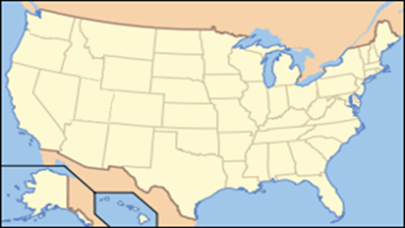
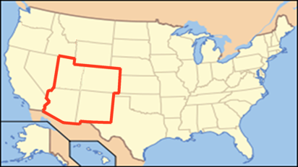
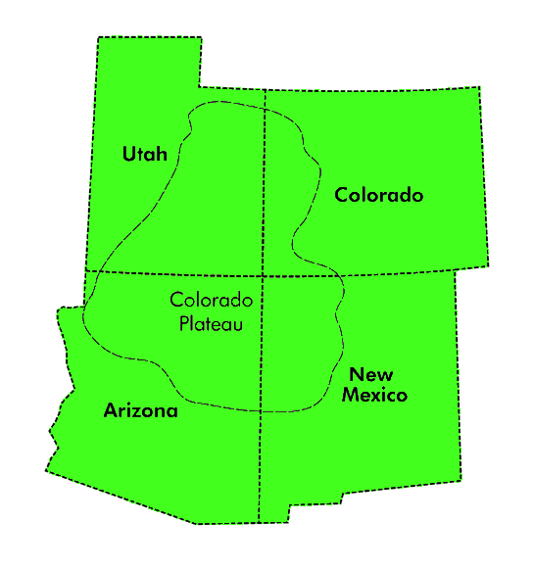
Colorado Plateau

Slide 48
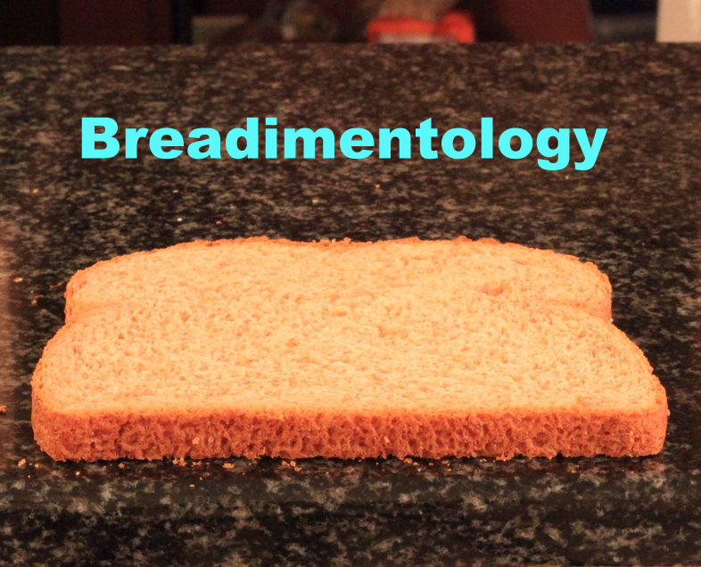

Slide 49
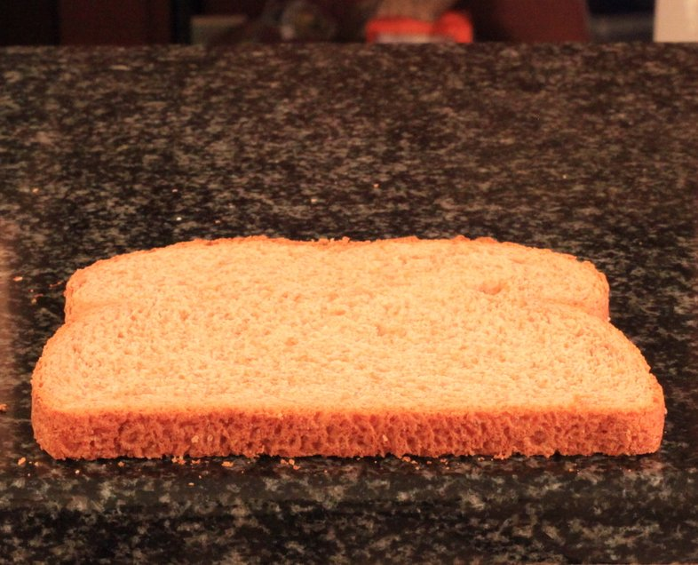

Slide 50
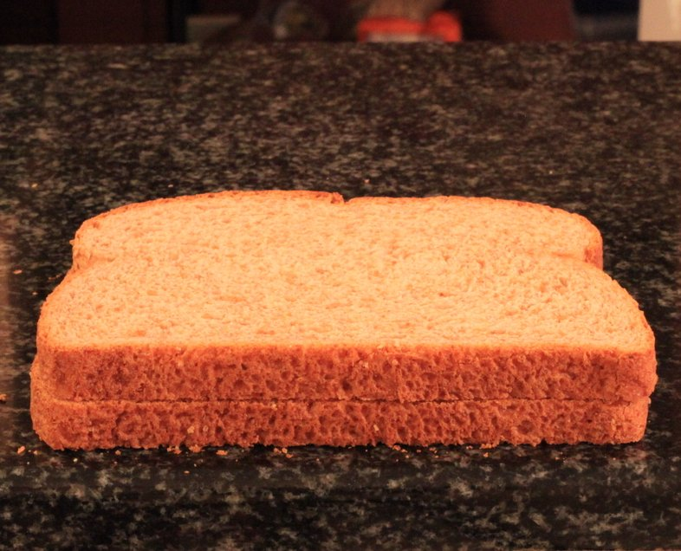

Slide 51
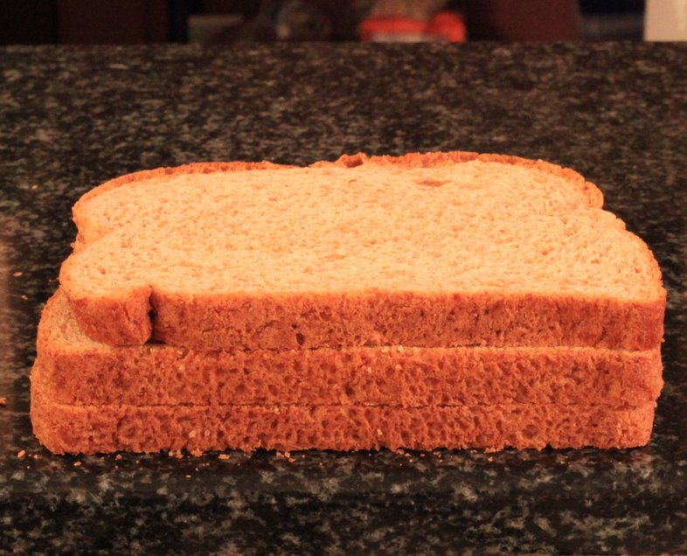

Slide 52
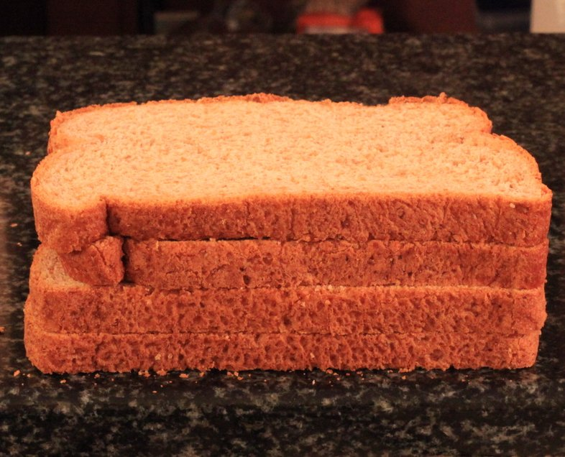

Slide 53
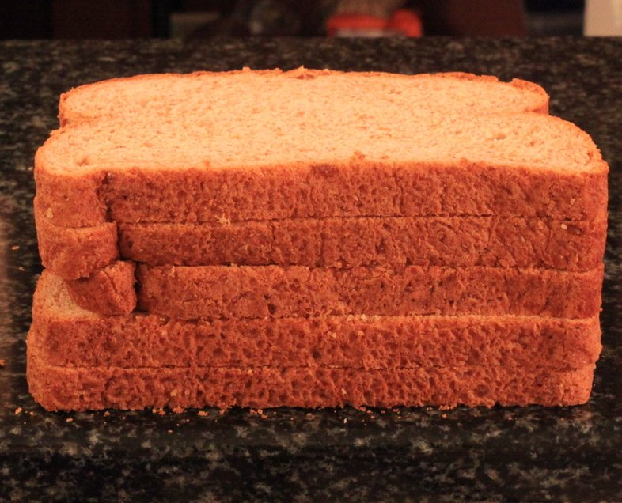

Slide 54
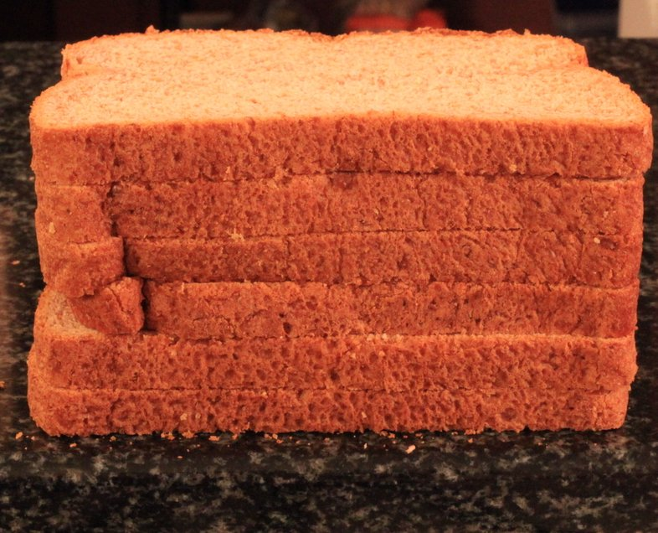

Slide 56
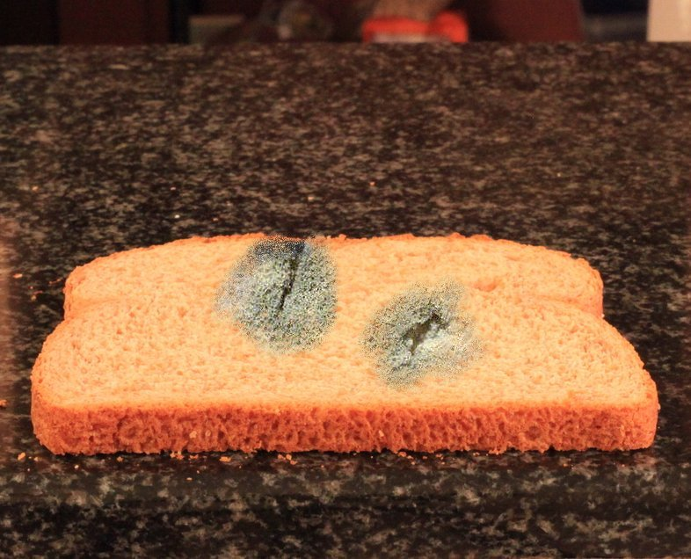

Slide 57
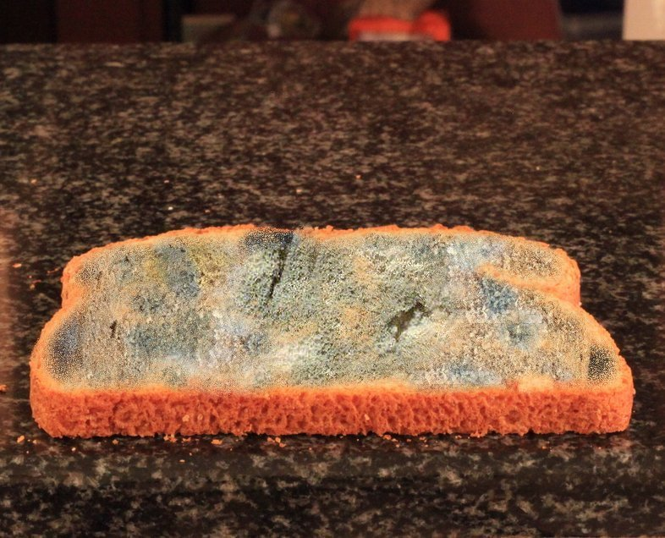

Slide 58
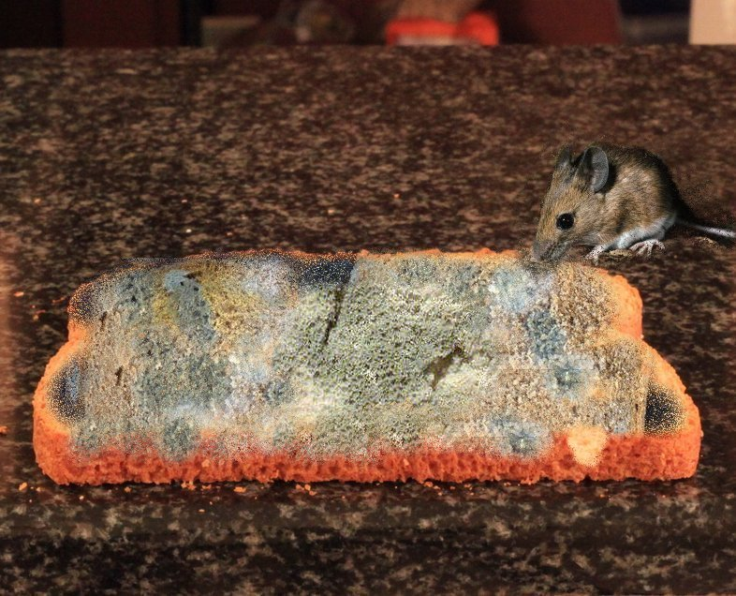

Slide 59
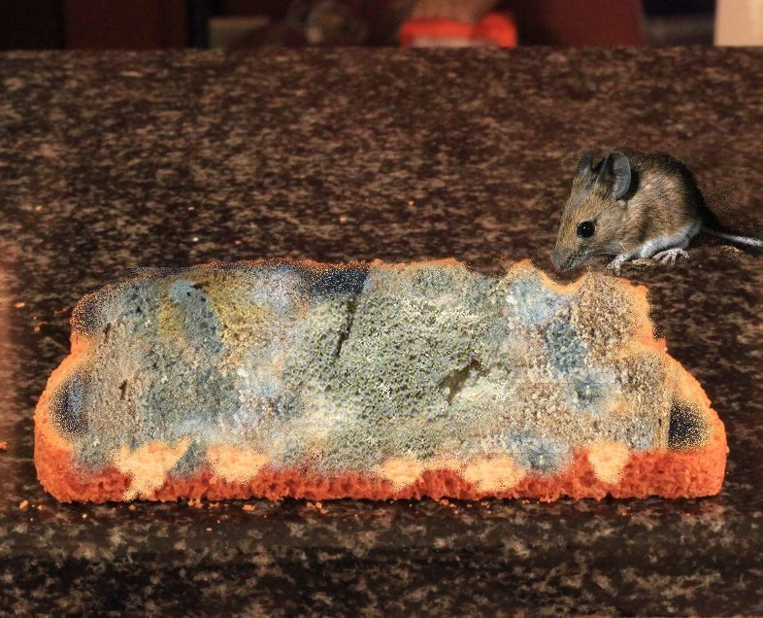

Slide 60
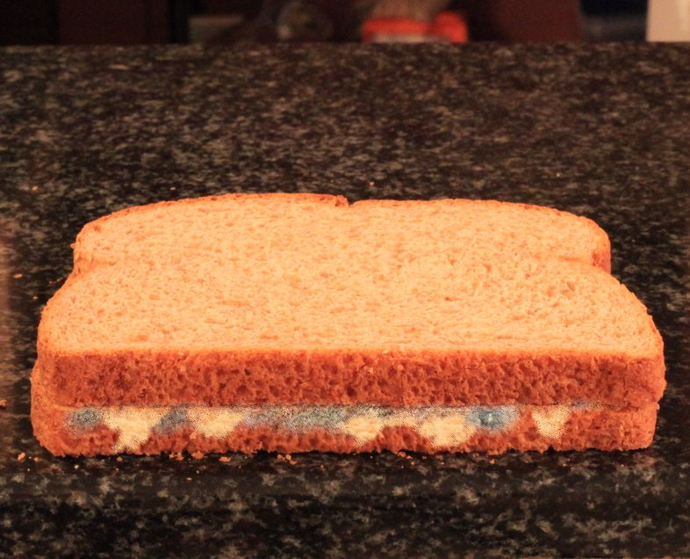

Slide 61
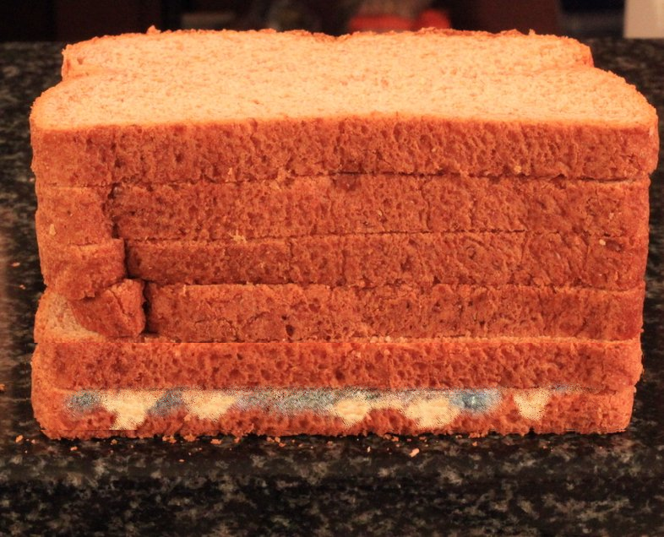

Slide 63
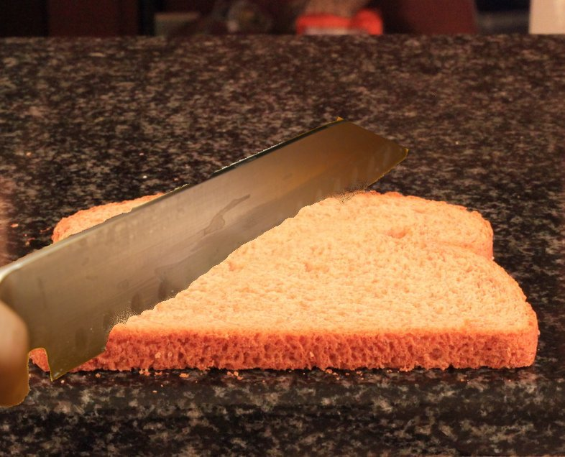

Slide 64
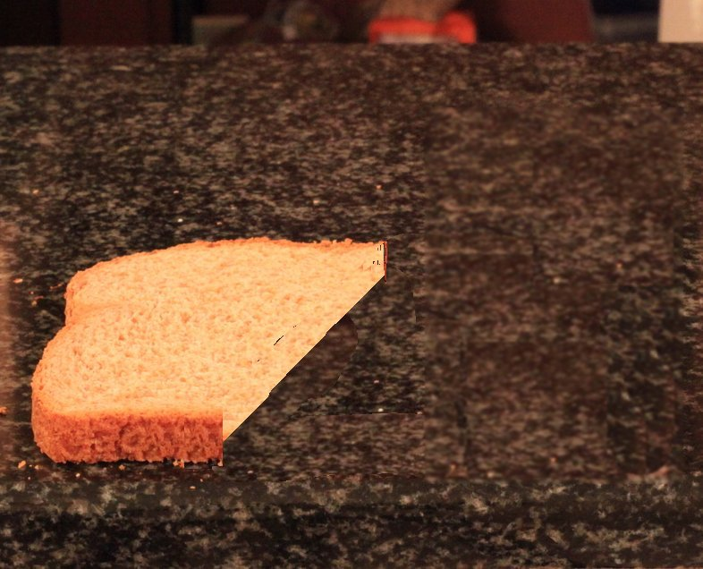

Slide 65
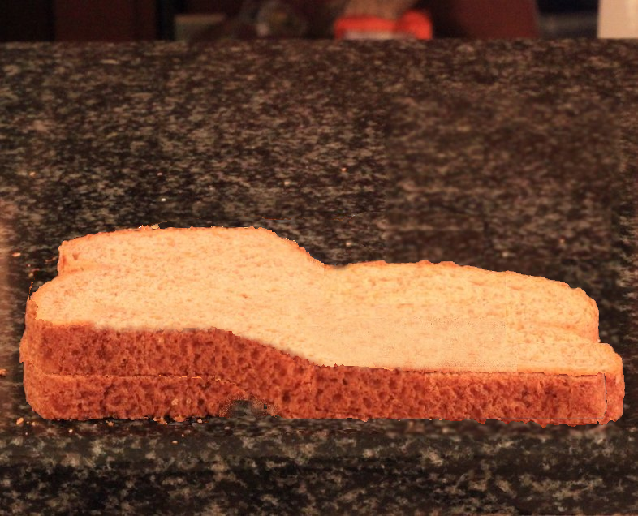

Slide 66
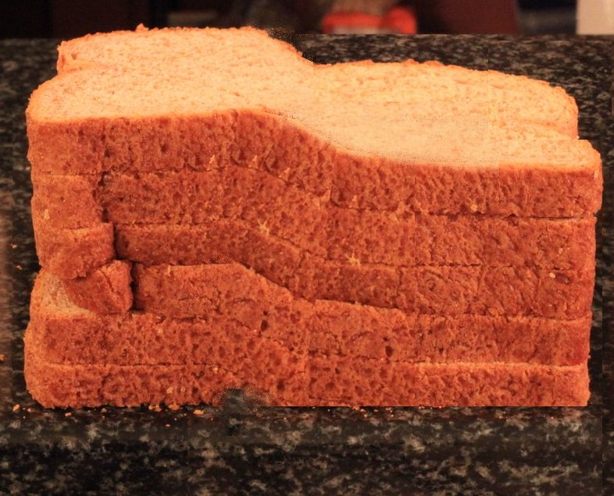

Slide 67
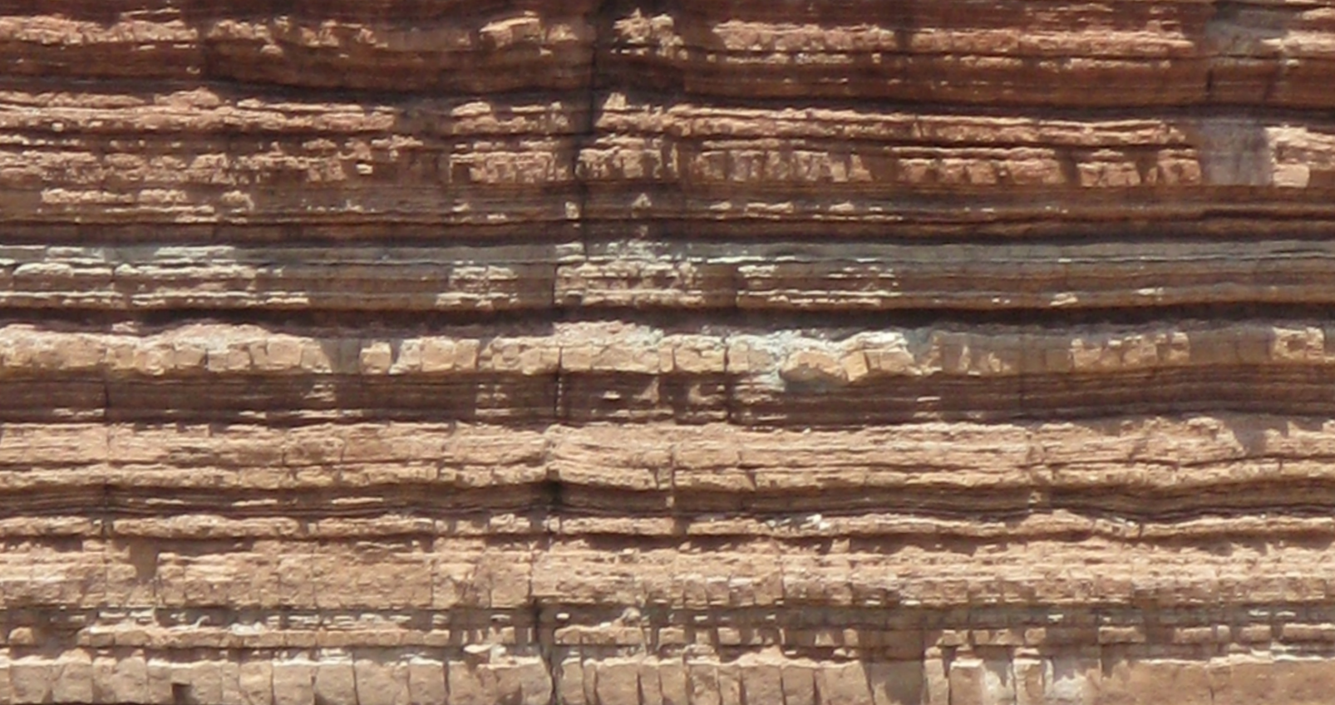
What do we see?

Slide 68
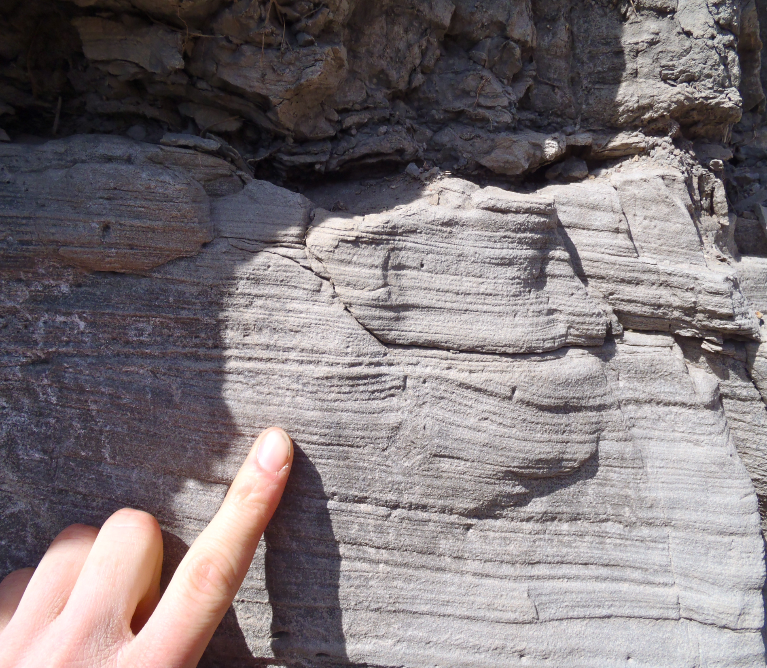

Slide 69
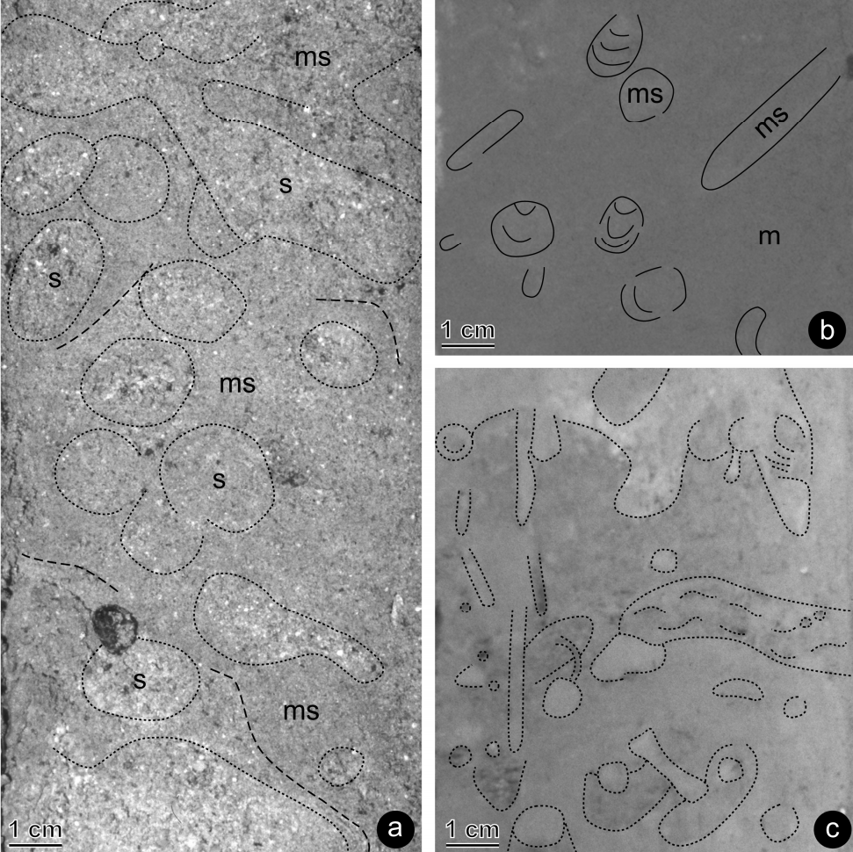
What would time do?
  Homogenized sediments
  All internal structure is gone.
  Only most recent episode of burrowing is preserved.

Slide 70
Bioturbation (burrowing)
  Typical rates given for sediment accumulation in rock layers based upon radiometric dates are 10 cm/1,000 years
How fast do marine invertebrates burrow?
Modern observed rates for homogenization of 10 cm depth are 1 year or less in marine setting.
  Experimental rates indicate complete homogenization of sediments to a depth of 10 cm (about 4 inches) can be achieved in less than an hour under some conditions (10,000 deposit feeders per square meter).*
  Unrealistic numbers? “…densities of 2 of these species of spionid [burrowing marine worms] may reach 16,000-60,000 per square meter.”**
    *M.K. Gingras, S.G. Pemberton, S. Dashtgard, and L. Dafoe. Paleo, Paleo, Paleo. 270:280-286. 2008.
    **Wilson 1981 J Mar Res 39: 735; Brenchley 1981 J Mar Res 39: 767.

Slide 71
Bioturbation
At those rates, all sediments deposited on a radiometrically determined time scale should be thoroughly homogenized and there should be no sedimentary structure anywhere.
Instead, we find homogenized sediments are exceedingly rare in the geologic column.
Richard Bromley has stated:
  “One hundred per cent bioturbation of the substrate is the natural end product of the activity of the endobenthos [burrowers]. Failure to reach 100 per cent, or the failure of that state to be preserved in the rock record, are conditions that require explanation.”
  Bromley, Richard G. 1990. Trace Fossils: Biology and Taphonomy. London: Unwin Hyman. P. 200

Slide 72
Colorado Plateau

Slide 73
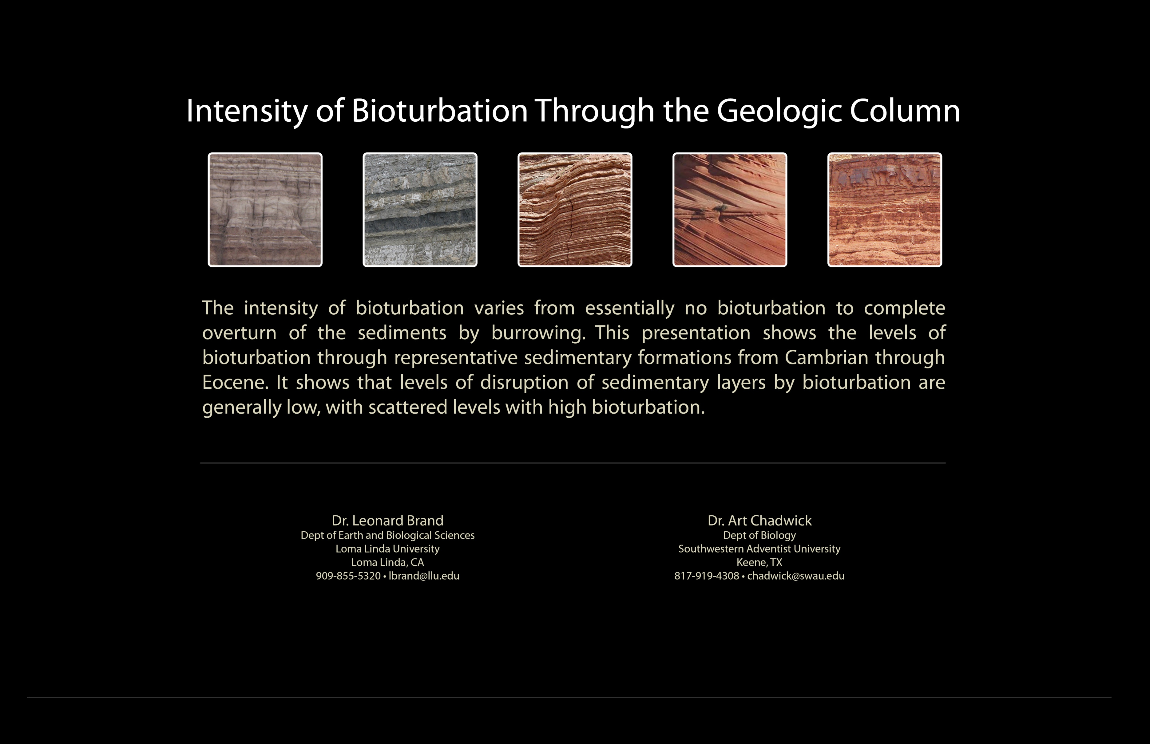
MAIN
A
B
C
D
E
F
G
H
I
J
K
L
M

Slide 74
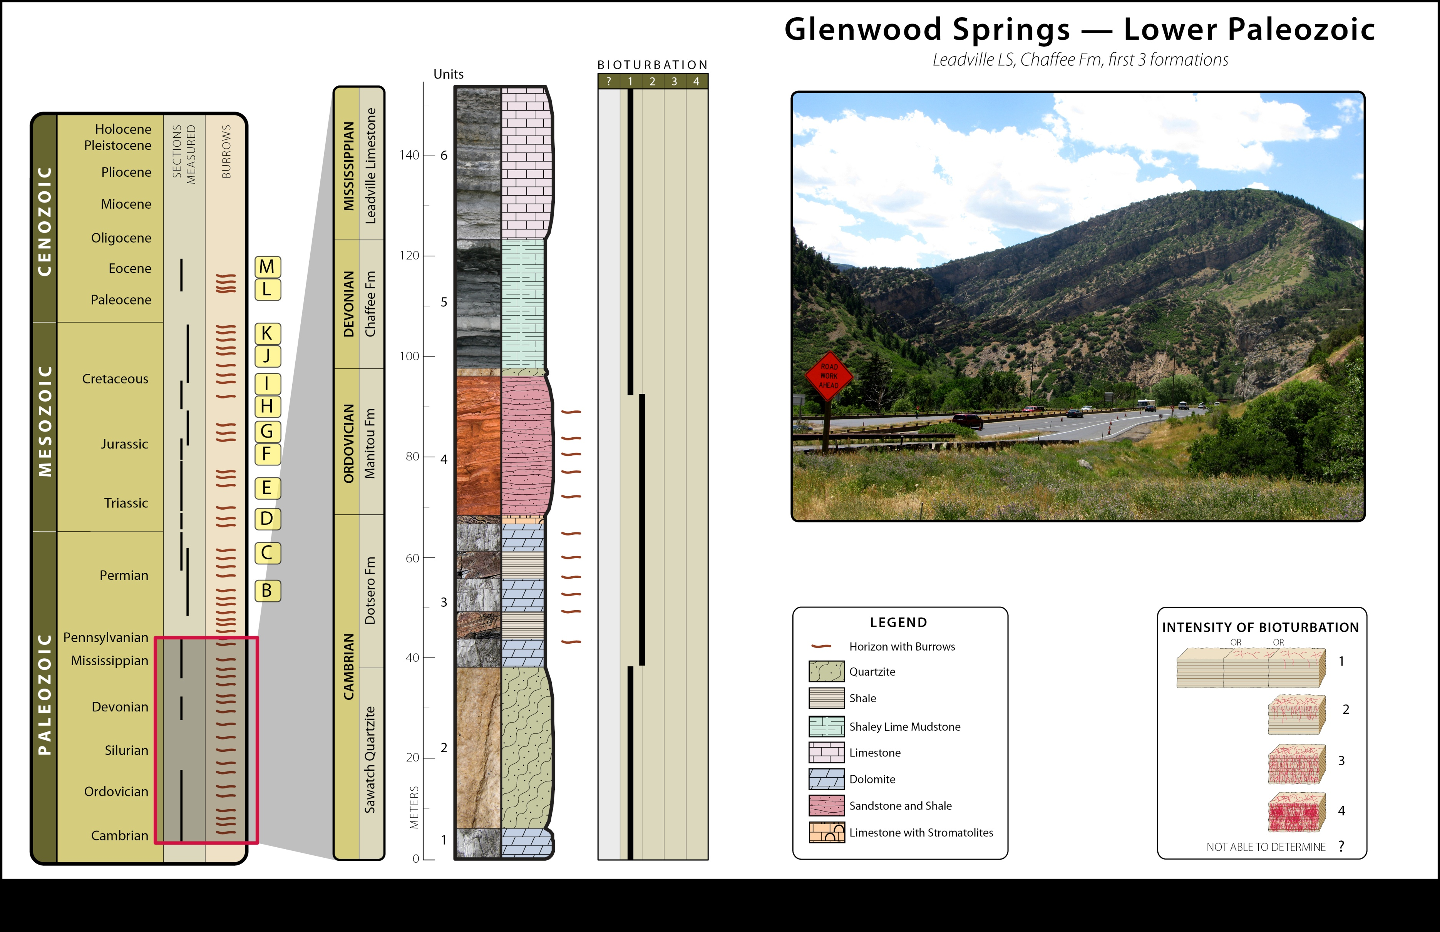
MAIN
A
B
C
D
E
F
G
H
I
J
K
L
M

Slide 75
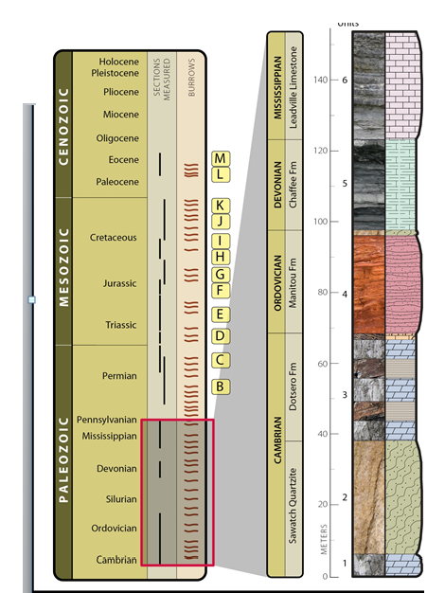
Bioturbation – Left half of image
Leftmost column is geologic column with indicators of what section this image will cover and summaries of all the coverage and where bioturbation was seen.
Middle column expands portion of column covered by this image
Right column shows thickness of measured section and rock types pictorially and symbolically.

Slide 76

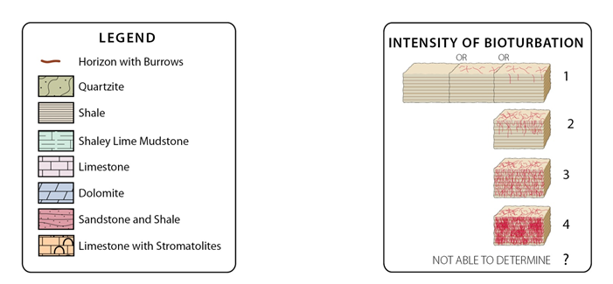
Bioturbation-right half of image
Right hand table gives scale of bioturbation.
Middle table is figure legend for rock types and other symbols.
The column on the left shows the results of our research scored by the scale in the right hand table.
The photograph (not shown here) typifies the outcrop

Slide 77
MAIN
A
B
C
D
E
F
G
H
I
J
K
L
M

Slide 78
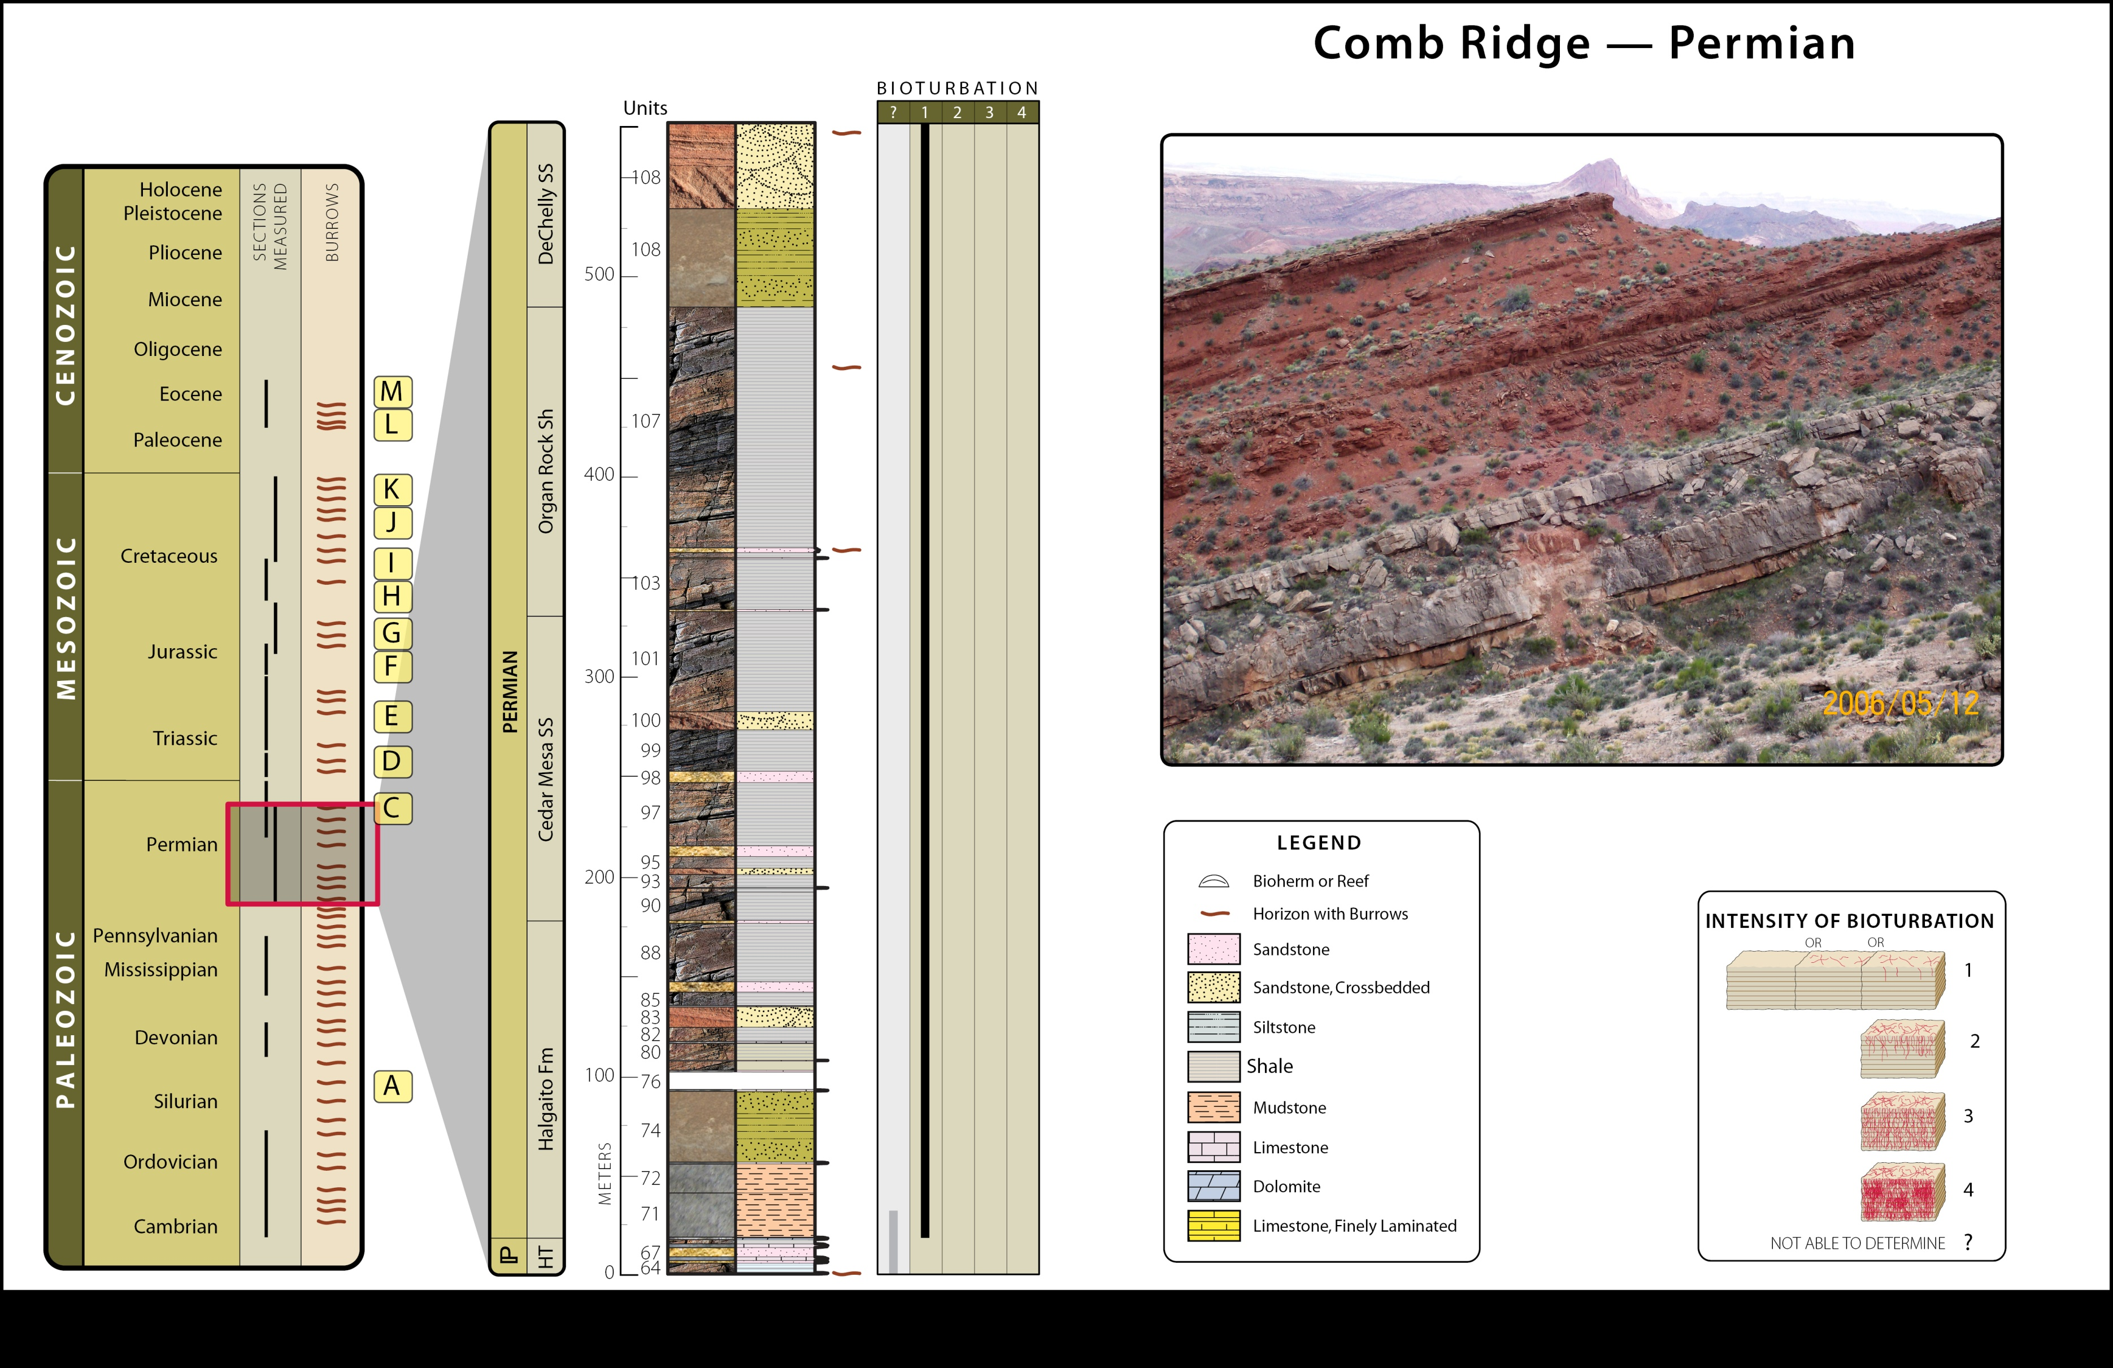
MAIN
A
B
C
D
E
F
G
H
I
J
K
L
M

Slide 79
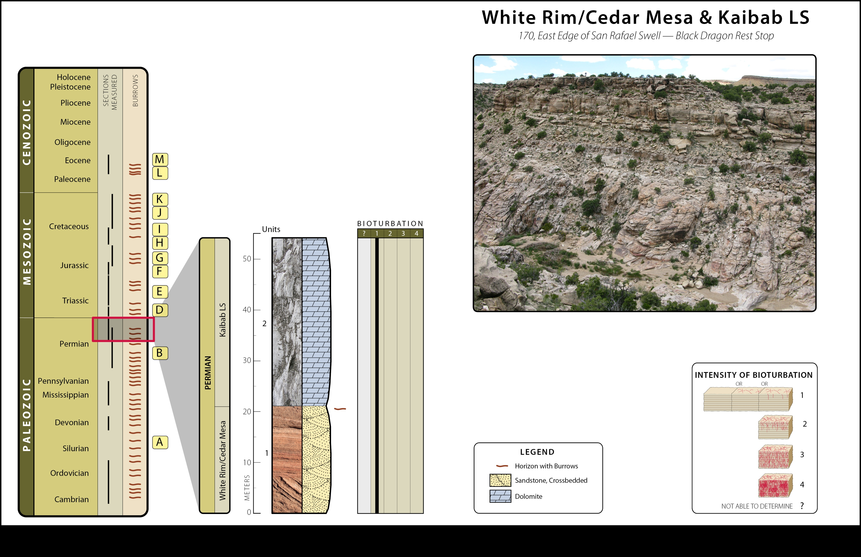
MAIN
A
B
C
D
E
F
G
H
I
J
K
L
M

Slide 80
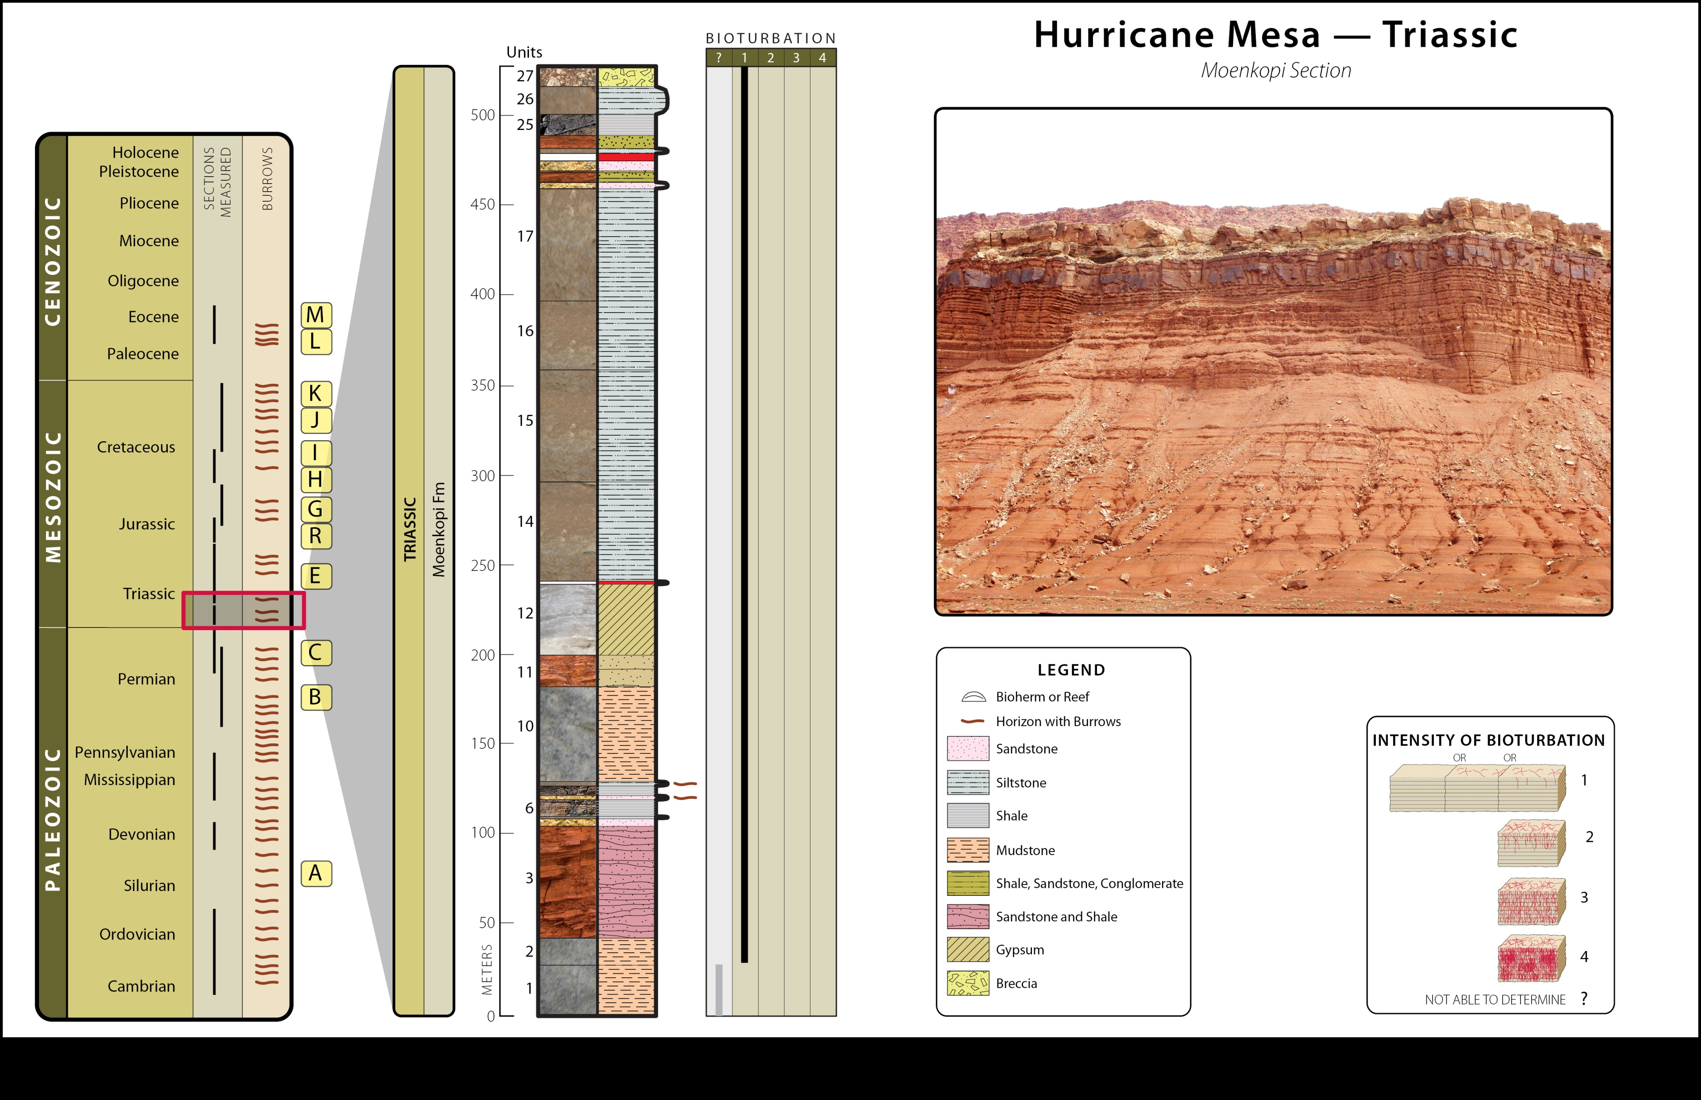
MAIN
A
B
C
D
E
F
G
H
I
J
K
L
M

Slide 81
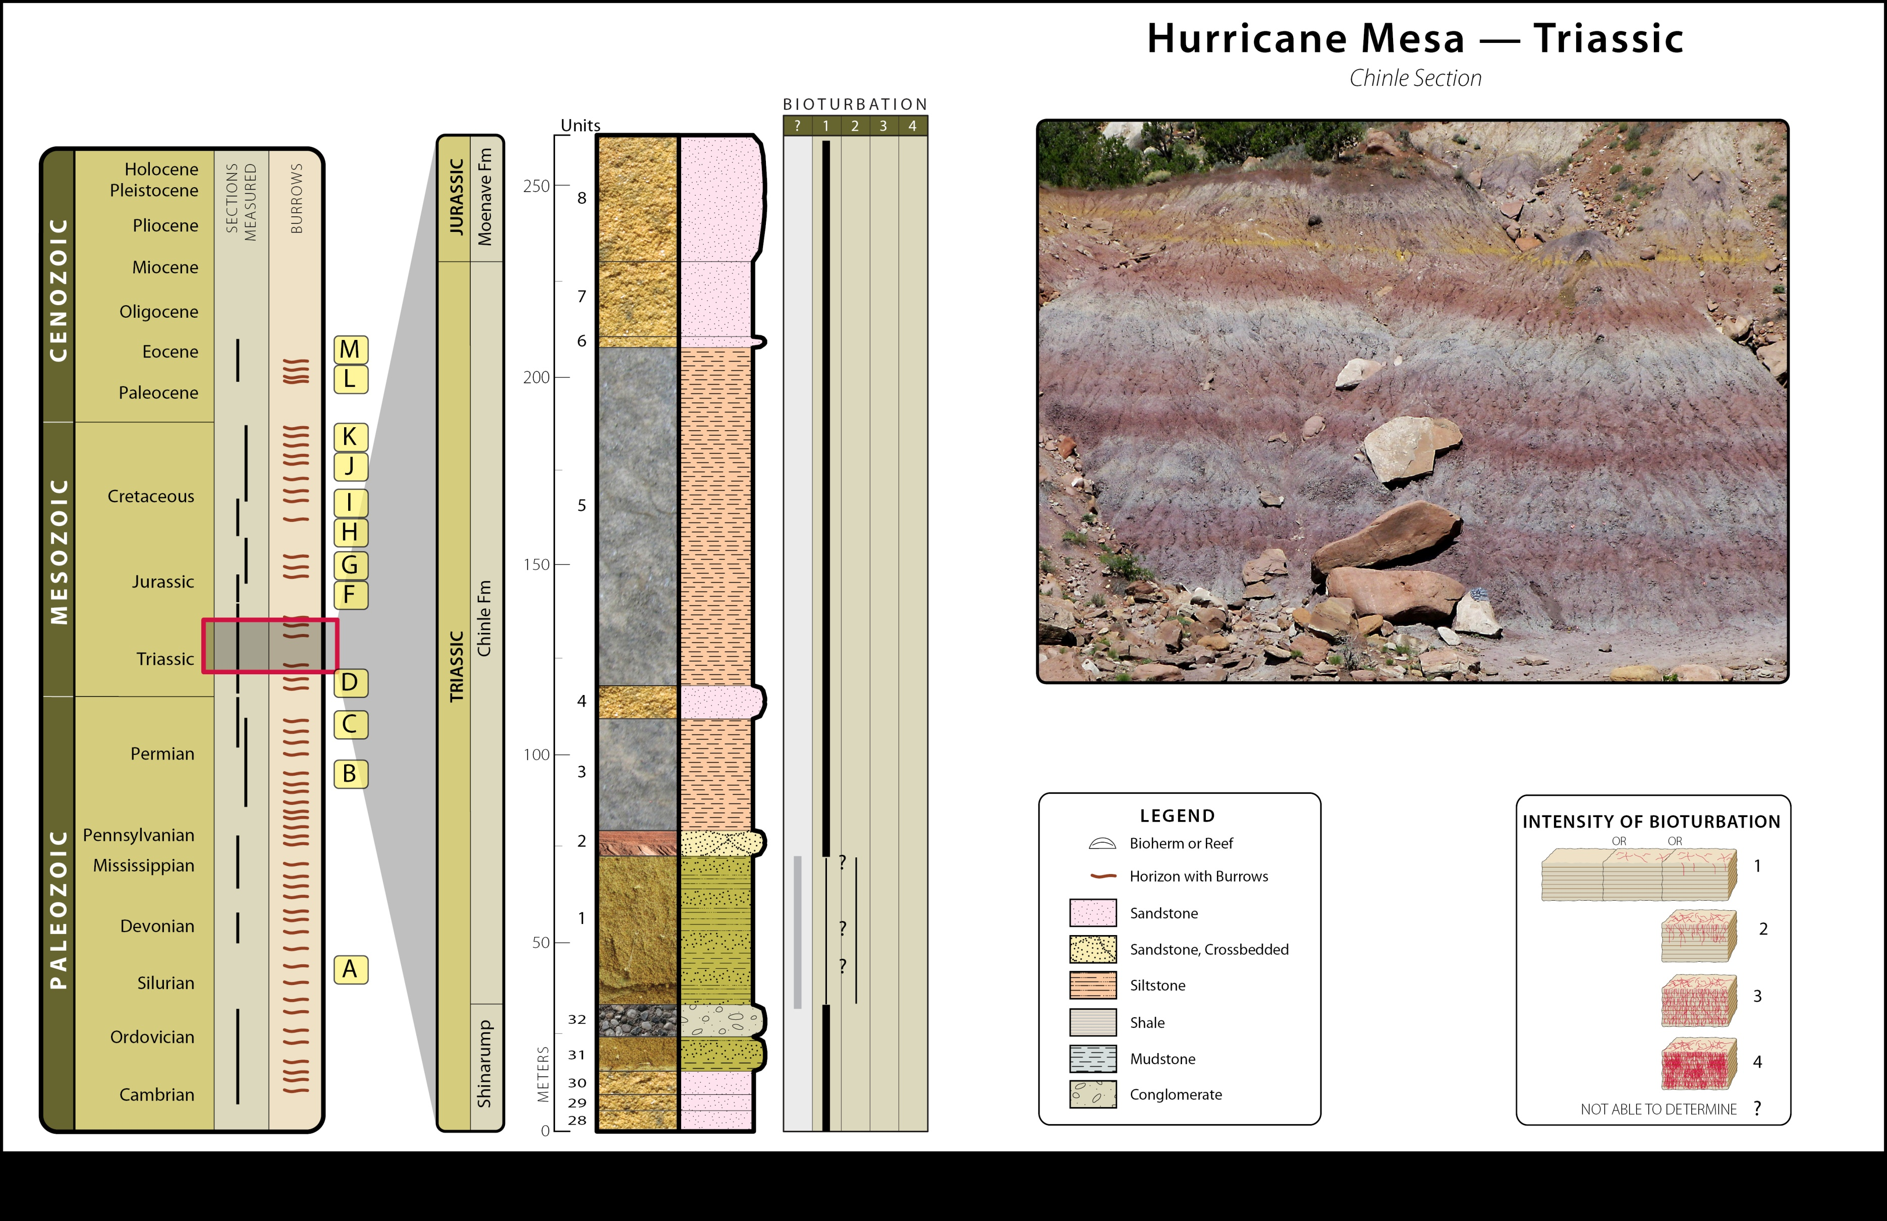
MAIN
A
B
C
D
E
F
G
H
I
J
K
L
M

Slide 82
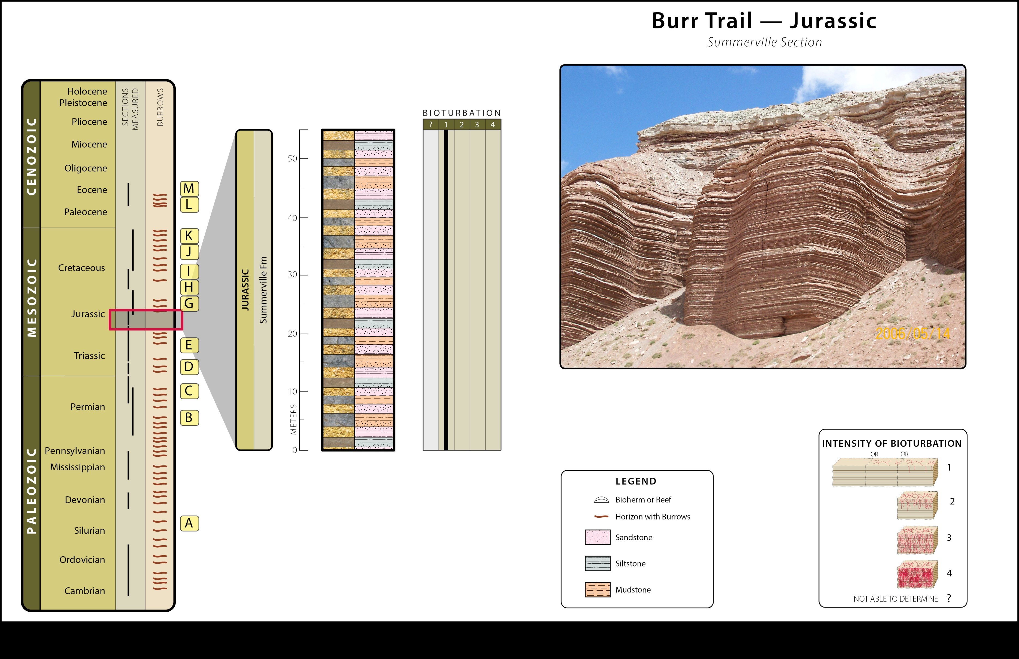
MAIN
A
B
C
D
E
F
G
H
I
J
K
L
M

Slide 83
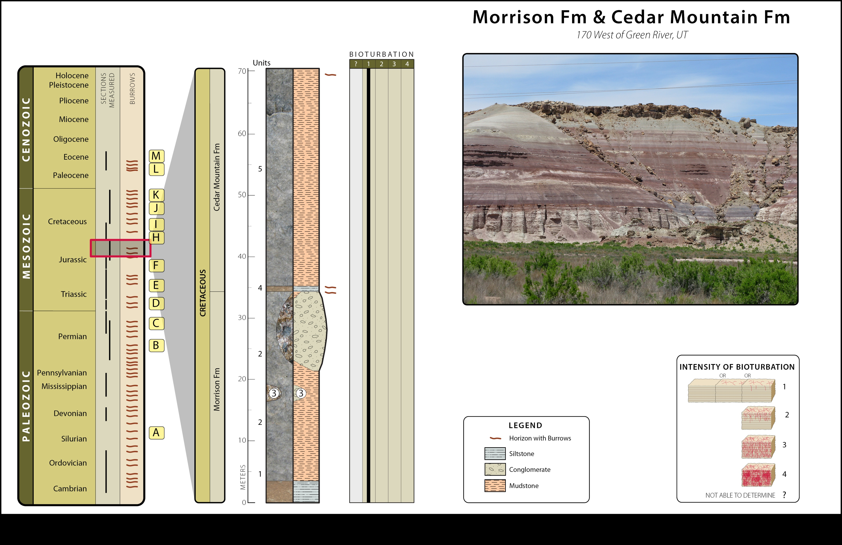
MAIN
A
B
C
D
E
F
G
H
I
J
K
L
M

Slide 84
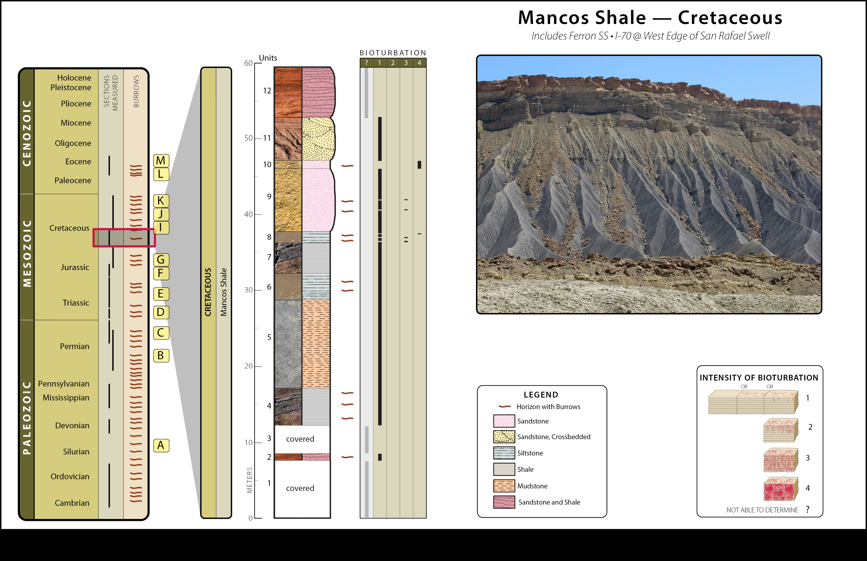
MAIN
A
B
C
D
E
F
G
H
I
J
K
L
M

Slide 85
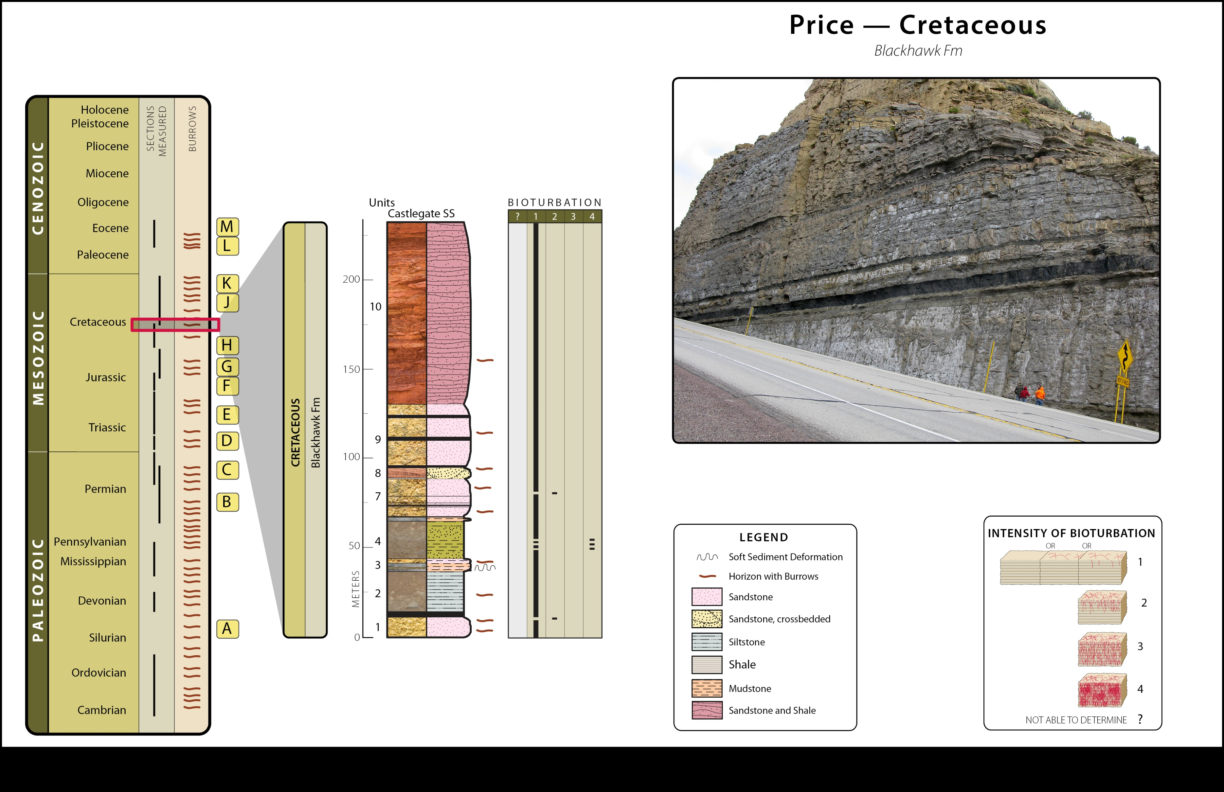
MAIN
A
B
C
D
E
F
G
H
I
J
K
L
M

Slide 86
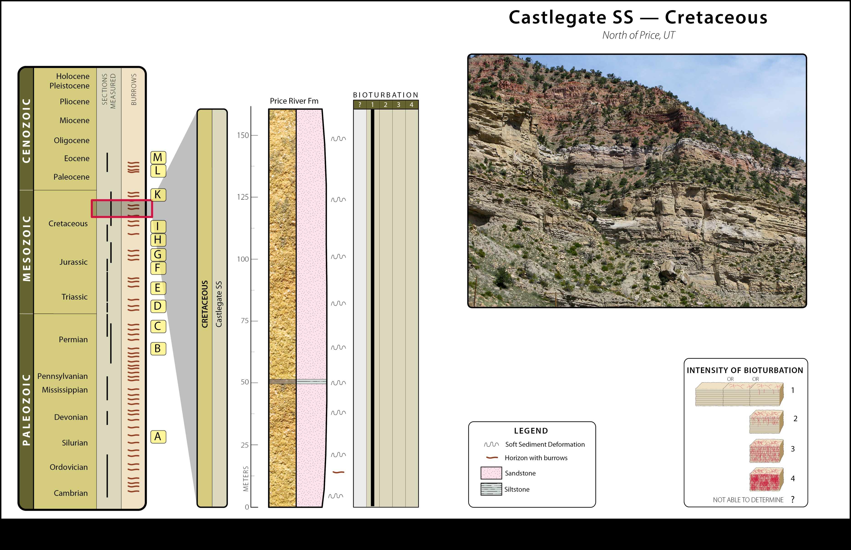
MAIN
A
B
C
D
E
F
G
H
I
J
K
L
M

Slide 87
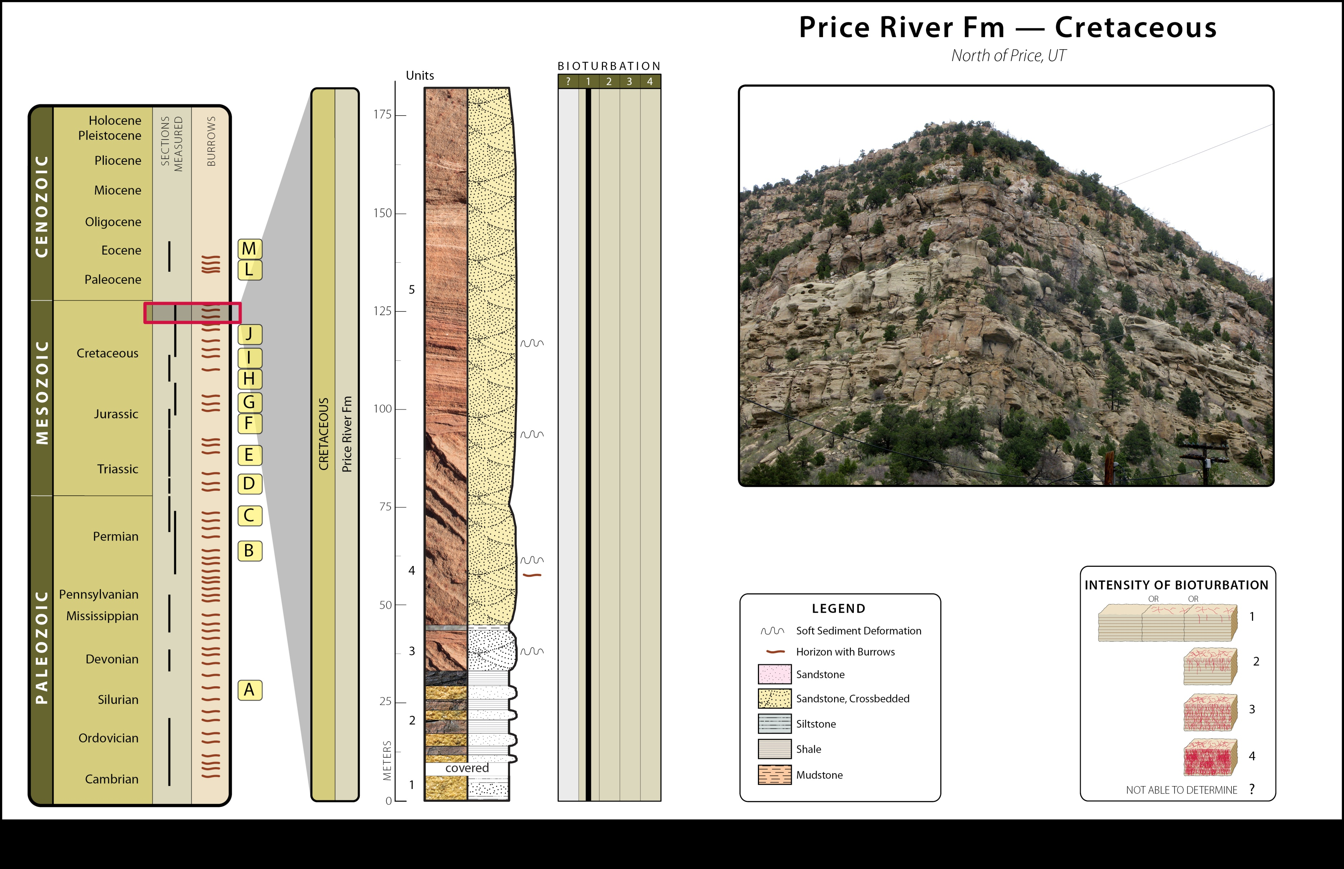
MAIN
A
B
C
D
E
F
G
H
I
J
K
L
M

Slide 88
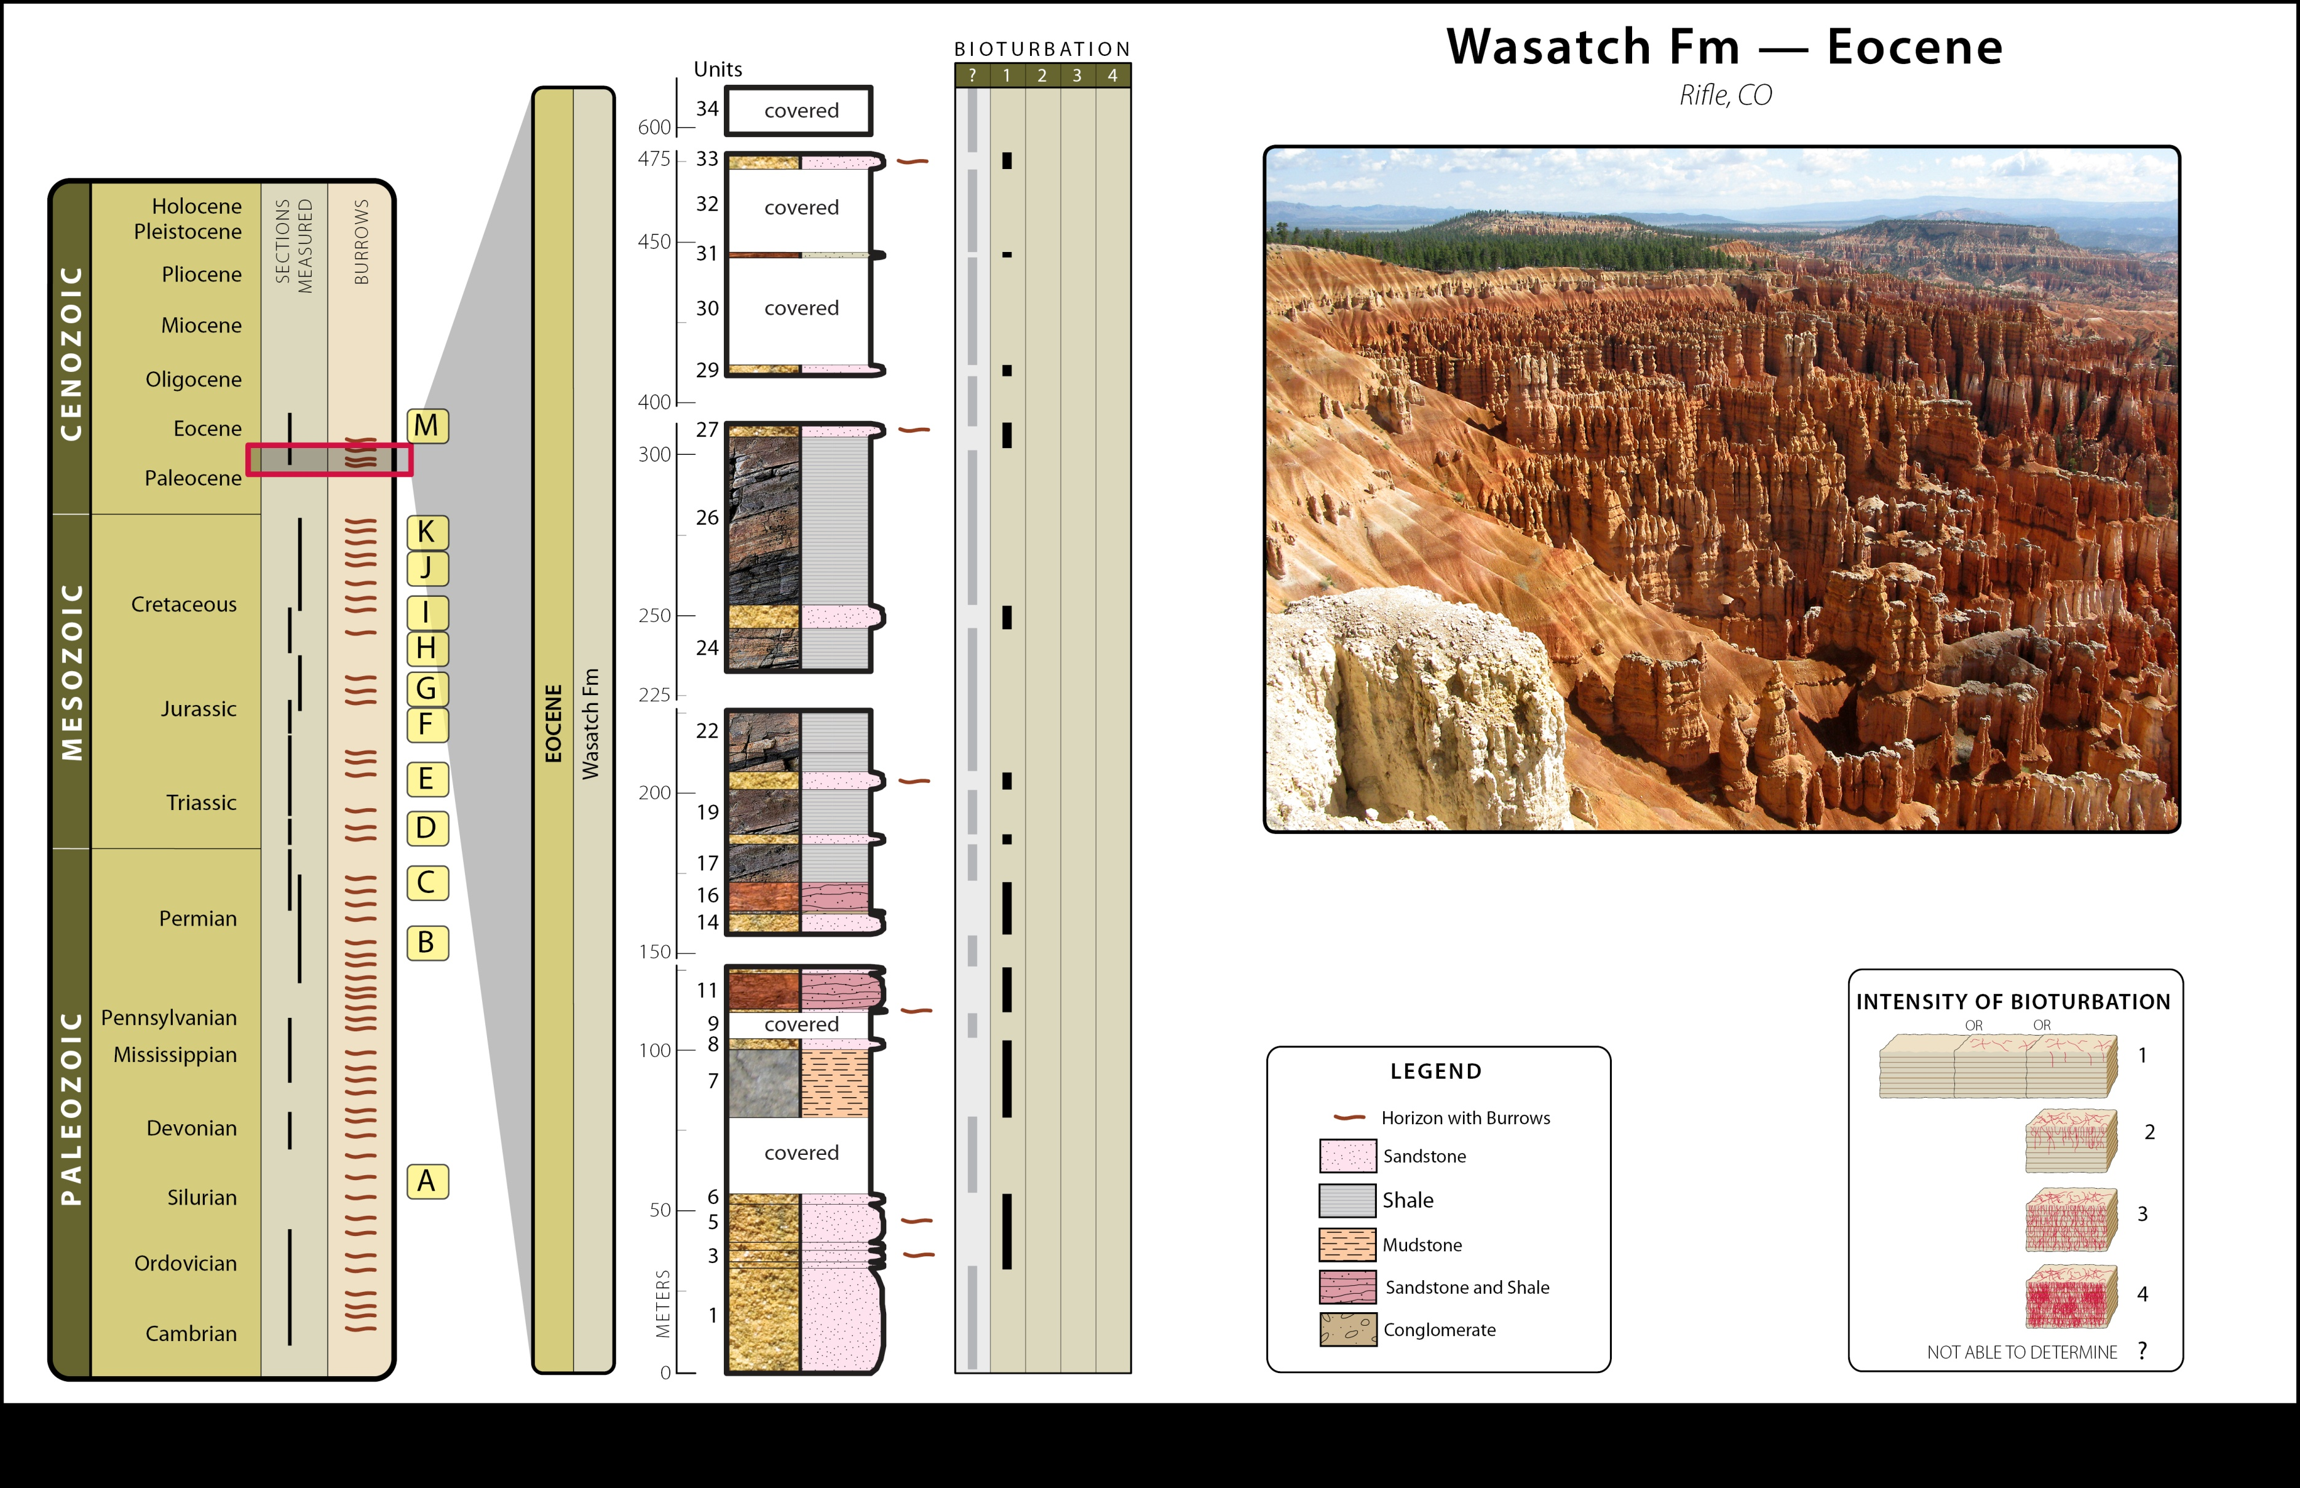
MAIN
A
B
C
D
E
F
G
H
I
J
K
L
M

Slide 89
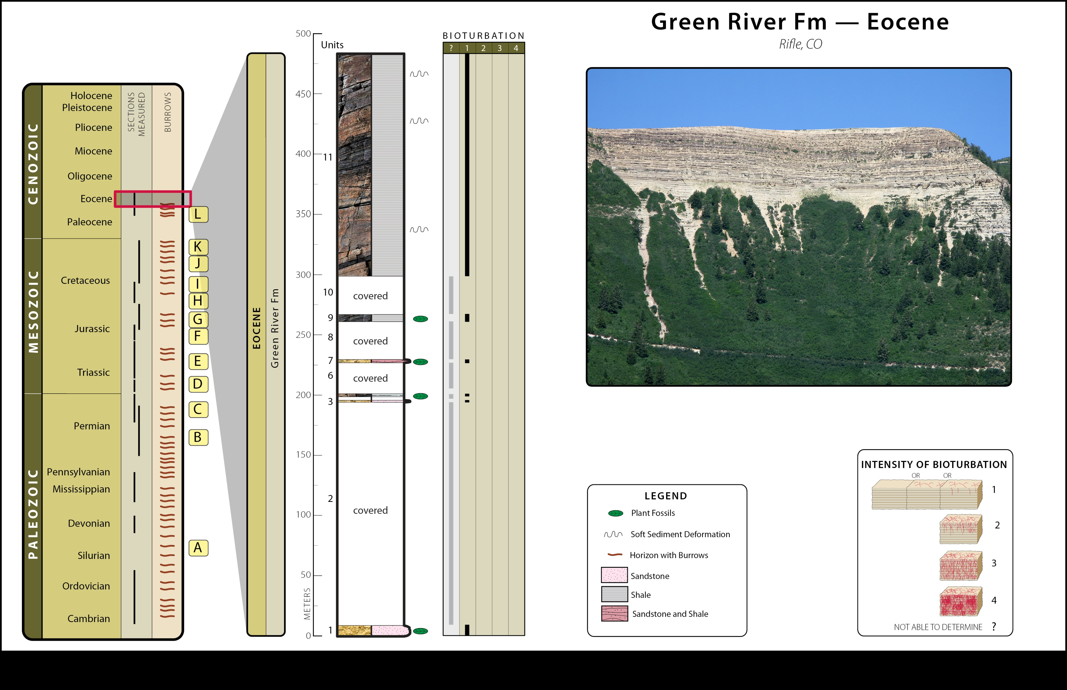
MAIN
A
B
C
D
E
F
G
H
I
J
K
L
M

Slide 90
Bioturbation: Summary and Conclusions
Careful, centimeter by centimeter analysis of thousands of meters of sedimentary deposits across the Colorado Plateau (Southwestern United States) shows a systematic and profound absence of features giving evidence for time.
Only reasonable way to preserve sedimentary features is by rapid deposition and burial, consistent with short time.
Consideration should be given to other interpretations of radioisotope ratios.

Slide 91
Issues in dating
Sediments appear to have accumulated rapidly
Sediments do not appear in equilibrium with the environment.
There is a general lack of erosion in the geologic record
Where radiometric dates are available, the events occurring between dated horizons rarely comport with the radiometric time.
Surviving biomolecules are found far out of possibility for radiometric time.

Slide 92
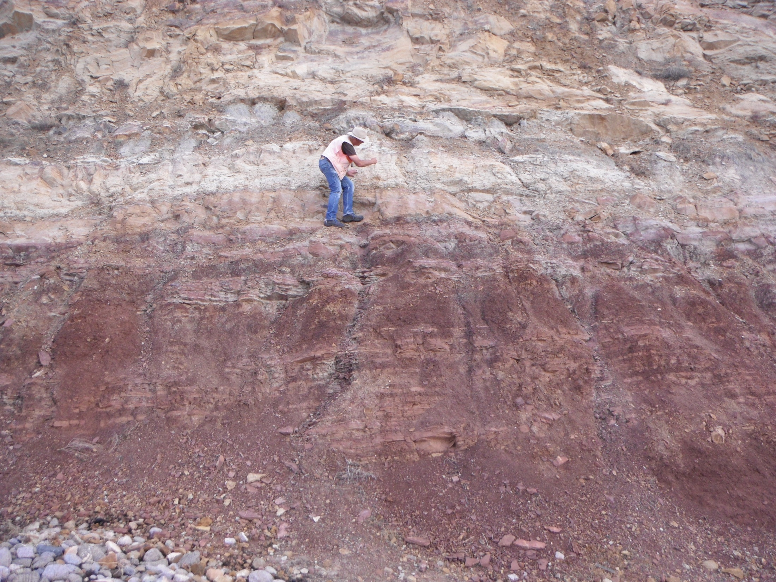
Does the Shinarump/Moenkopi contact represent a 10 MY depositional hiatus on the Colorado Plateau?
Radiometric dating
Other dating methods
Fossil record
  Orderly fossil record
  Hominid record
  Etc.
Art Chadwick and Leonard Brand

Slide 93
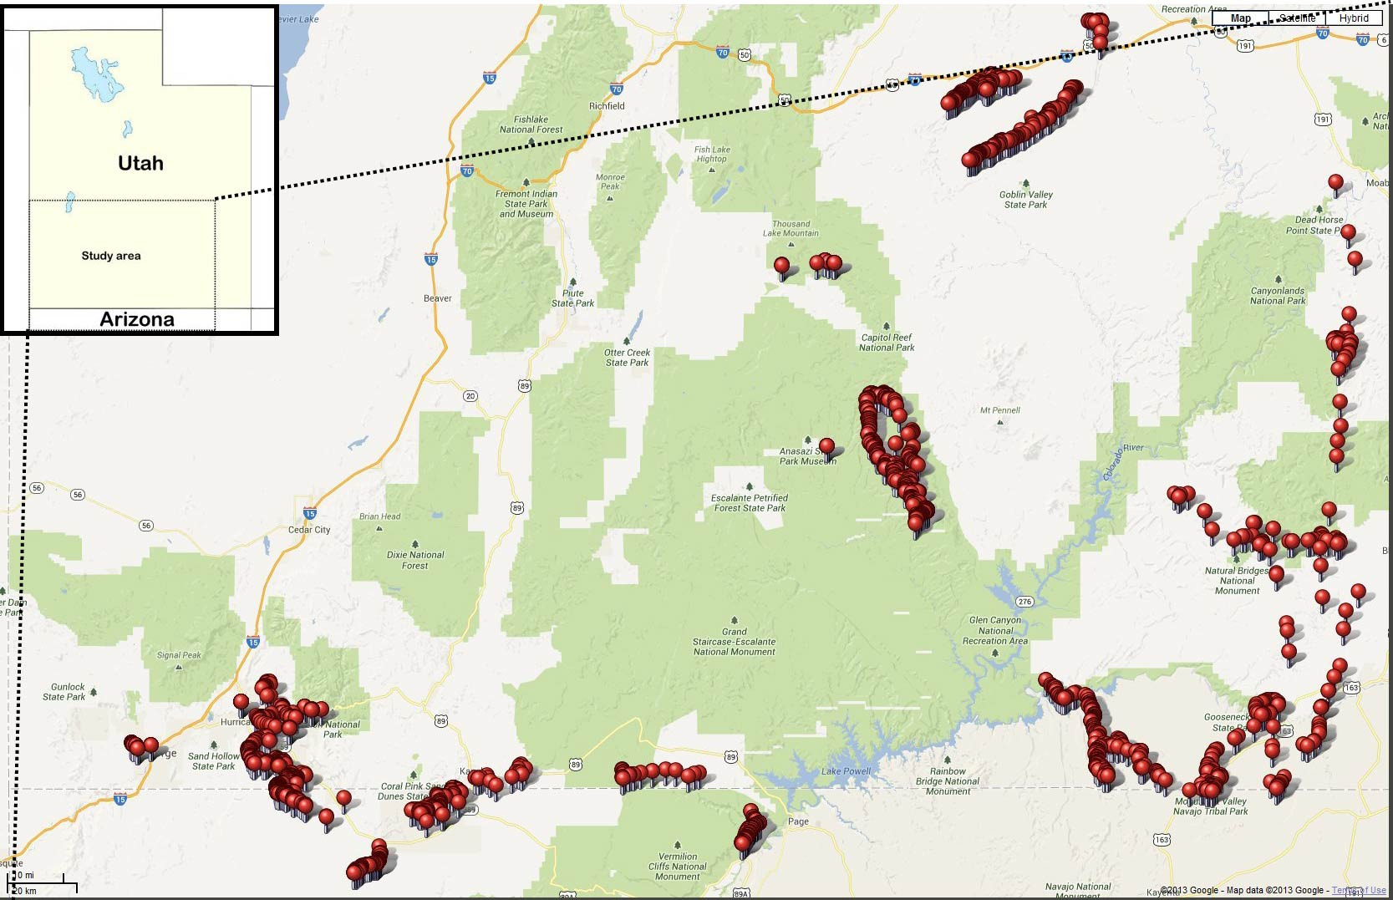

Slide 94
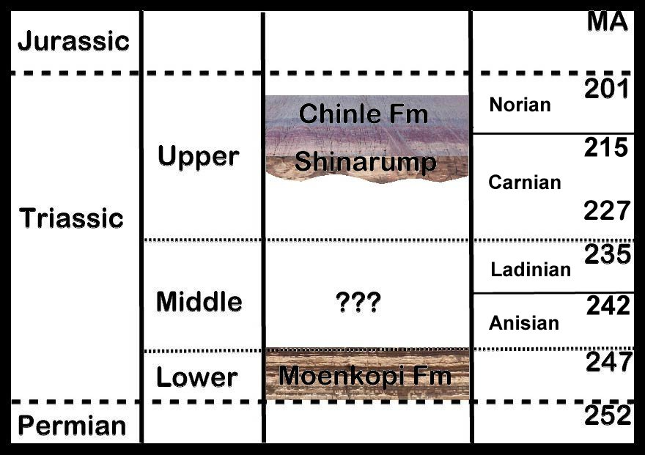
Stratigraphy

Slide 95
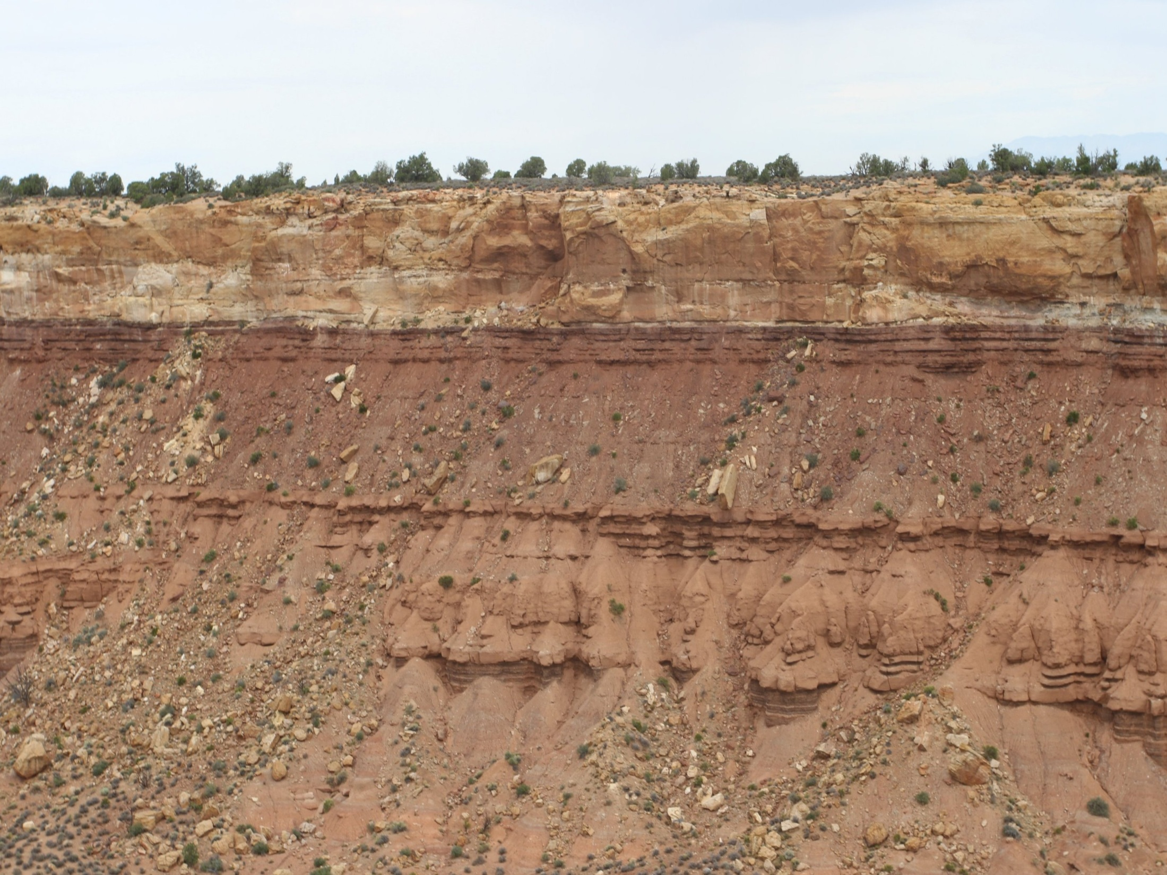
Shinarump/Moenkopi Contact

Slide 97


Slide 98


Shinarump
Moenkopi

Slide 99

Load cast
Moenkopi – Shinarump Contact

Slide 100

Shinarump
Load casts
Contact
Moenkopi

Slide 101

Moenkopi – Shinarump Contact
Porcellanous layer

Slide 102

Porcellanous layer

Slide 103


Slide 104


Slide 105
Episodes of non-deposition
Clearly the Moenkopi did not sit for 10-35 million years without erosion, or deposition, or lithification.
This is not an isolated example. Frequently, periods of non-deposition are invoked to explain radiometric discrepancies or fossil gaps in the geologic column. The example just considered is minor compared to some such as the Cambrian to Mississippian hiatus in Grand Canyon presumed to represent 140 million years.
These episodes of non-deposition are most readily explained by a model of rapid deposition and burial, consistent with short time.

Slide 106
Erosion – Continents are still here
Erosional Rates
  Modern erosion rates on active margins (California coastline, etc) are .75 to 1.5 ft eastward per year. Similar rates apply elsewhere.
  At this rate, California beaches will be in Florida in less than 15 million years.
  Conservative and realistic rates of continental erosion based on modern erosion rates, suggest all of North America will be eroded to sea level in 10 to 33 million years (latter allowing for isostatic rebound)*.
  *Gilluly, James, 1955, Geologic contrasts between continents and ocean basins : Geol. Soc. America Special Paper 62, p. 7-18.

Slide 107
Erosion – Continents are still here
  Current erosion rates determined by a wide variety of indicators would have North America eroded to sea level 20-60 times in 600 million radiometric years that life is supposed to have been on the earth
  Has not happened even once – the presence of the geologic column in many places in North America and around the world evidences this.
  Most easily explained in short time

Slide 108
Survival of biomolecules
Current status based on work of Mary Schweitzer
Documented existence of tissues, proteins, blood cells in bones supposed to be 65 million years old.
Many other examples of biomolecules lasting far beyond their physical chemical determined limits.

Slide 109



T. rex Tissue Examples
Notes:
Top right picture shows bifurcated vascular canals in partially demineralized cortical bone.
Bottom right picture shows branched transparent vessels with “cells” inside.

Slide 110



T. rex Tissue Examples
Notes:
Left image: Comparison of isolated T. rex “osteocyte” (left sides) with modern ostrich osteocyte images (top = light microscope, bottom = scanning electrom microscope).
Top right image: Hollow blood vessel with possible red blood cell inside.
Bottom right image: Vessels showing endothelial cell nuclei.

Slide 111
Survival of biomolecules
These discoveries make the conventional interpretation of the meaning of radioisotope ratios untenable.
Continuing discoveries of biomolecules not only make conventional scientists uncomfortable, but require them to fight vigorously against their acceptance.
The best understanding of this evidence is that current interpretations of the meaning of radioisotope ratios are wrong, and new explanations should be sought.

Slide 112
Conclusion
Sedimentology indicates by rates of deposition, general absence of bioturbation or interstratal erosion, absence of evidence for time between units and by other features that radiometrically determined time is not giving us correct values for real time. The survival of biomolecules far beyond experimental values likewise challenges the radiometrically-determined dates.
The meaning of radioisotope distributions should be reevaluated.

Slide 114
“Absolute” dating
“At present, physical dates do not stand on their own. They must be compatible with stratigraphy. Stratigraphy has also served to highlight flaws and the relevance of unexpected factors in some physical procedures. So-called absolute dating is a misnomer, for physical dates provide numerical approximations, preferably considered within and constrained by a stratigraphic framework”
''Canons'' revisited and reviewed: Lester King's views of landscape evolution considered 50 years later. C. R. Twidale. Geological Society of America Bulletin 2003;115, no. 10;1155-1172

Slide 115
New finding affects understanding of formation of the solar system
March 29, 2012
A global collaboration including five University of Notre Dame researchers has revised the half-life of samarium-146 (146Sm), reducing it to 68 million years from 103 million years. Their finding is published in the journal Science today

Slide 116
Richard Dawkins on “Designed”
“Its terribly terribly tempting to use the word designed, time and again I have to bite my tongue, and stop myself. [...] when talking to other biologists, we none of us bother to bite our tongues, we just use the word designed.“
Richard Dawkins, Waking up in the Universe, 1991 Royal Institution Christmas Lecture; 2nd lecture - Designed and designoid objects.

Slide 117
Gee on meaning of fossil record
“No fossil is buried with its birth certificate. That, and the scarcity of fossils, means that it is effectively impossible to link fossils into chains of cause and effect in any valid way.”
According to Gee, senior editor for Nature and a paleontologist by training, we call new fossil discoveries missing links.
“as if the chain of ancestry and descent were a real object for our contemplation, and not what it really is: a completely human invention created after the fact, shaped to accord with human prejudices.”
He concludes:
“To take a line of fossils and claim that they represent a lineage is not a scientific hypothesis that can be tested, but an assertion that carries the same validity as a bedtime story—amusing, perhaps even instructive, but not scientific.” – Henry Gee, In Search of Deep Time: Beyond the Fossil Record to a New History of Life (New York: The Free Press, 1999), pp. 32, 113-117.

Slide 118

Whale evolution
Mesonychid: Robert Carroll - “[i]t is not possible to identify a sequence of mesonychids leading directly to whales,” This statement understates the problem.[10] It is not even possible to identify a single ancestral species. All known mesonychids are excluded from the actual chain of descent by the paleontologists’ own criteria.
Pachycetus: Gingerich - ‘In time and in its morphology, Pakicetus is perfectly intermediate, a missing link between earlier land mammals and later, full-fledged whales.’
de Muizon - ‘All the postcranial bones indicate that pakicetids were land mammals, and … indicate that the animals were runners, with only their feet touching the ground.’
Robert L. Carroll, Patterns and Processes of Vertebrate Evolution (Cambridge: University Press, 1997), 329.
Gingerich, P.D., The whales of Tethys, Natural History, p. 86, April 1994.
de Muizon, C., Walking with whales, Nature 413(6853):259–260, 20 Sep. 2001.

Slide 119
Richard Dawkins on “Junk DNA”
Before ENCODE: “Pseudogenes are genes that once did something useful but have now been sidelined and are never transcribed or translated. They might as well not exist, as far as the animal's welfare is concerned. But as far as the scientist is concerned they very much exist, and they are exactly what we need for an evolutionary clock. .. . . What pseudogenes are useful for is embarrassing creationists. It stretches even their creative ingenuity to make up a convincing reason why an intelligent designer should have created a pseudogene --a gene that does absolutely nothing and gives every appearance of being a superannuated version of a gene that used to do something, unless he was deliberately setting out to fool us."
Dawkins then continues: "Leaving pseudogenes aside, it is a remarkable fact that the greater part (95 percent in the case of humans) of the genome might as well not be there, for all the difference it makes." The Greatest Show on Earth, 2009, pp 332-333.
After ENCODE: "I know there are some creationists who have jumped on it because they think it is awkward for Darwinism. Quite the contrary, of course. It is exactly what a Darwinist would hope for -- is to find usefulness in the living world."

Slide 120
“Pseudogenes are not pseudo any more
“The study of functional pseudogenes is just at the beginning. There remain many questions to be addressed, such as the regulatory elements controlling the cell or tissue specific expression of pseudogenes. But, definitely, the so-called pseudogenes are really functional, not to be considered any more as just “junk” or “fossil” DNA. Surely, many functional pseudogenes and novel regulatory mechanisms remain to be discovered and explored in diverse organisms.”
Wen et al, RNA Biology 9:27-32. Jan 2012

Slide 121
Prothero on stasis
The first major discovery was that stasis was much more prevalent in the fossil record than had been previously supposed. […]. If species didn’t appear suddenly in the fossil record and remain relatively unchanged, then biostratigraphy would never work—and yet almost two centuries of successful biostratigraphic correlations was evidence of just this kind of pattern. As Gould put it, it was the “dirty little secret” hidden in the paleontological closet. Most paleontologists were trained to focus on gradual evolution as the only pattern of interest, and ignored stasis as “not evolutionary change” and therefore uninteresting, to be overlooked or minimized. Once Eldredge and Gould had pointed out that stasis was equally important (“stasis is data[sic]” in Gould’s words), paleontologists all over the world saw that stasis was the general pattern, and that gradualism was rare—and that is still the consensus 40 years later.

Slide 122
Prothero on stasis
In my dissertation on […]fossil mammals […], I had over 160 well-dated, well-sampled lineages of mammals, so I could evaluate the relative frequency of gradualism versus stasis in an entire regional fauna. I also had a wide geographic spread […]. I had large fossil samples of many species, with dozens at each level, and excellent stratigraphic data. When I finally plunged in and plotted and analyzed my data carefully, it was clear that nearly every lineage showed stasis, with one minor example of gradual size reduction in the little oreodont Miniochoerus. I could point to this data set and make the case for the prevalence of stasis without any criticism of bias in my sampling. More importantly, the fossil mammals showed no sign of responding to the biggest climate change of the past 50 million years […]. In North America, dense forests gave way to open scrublands, crocodiles and pond turtles were replaced by land tortoises, and the snails changed from those typical of Nicaragua to those of Baja California. Yet out of all the 160 lineages of mammals in this time interval, there was virtually no response.

Slide 123
Prothero on stasis
After six years of work and publication, the conclusion is clear: none of the common Ice Age mammals and birds responded to any of the climate changes at La Brea in the last 35,000 years, even though the region went from dry chaparral to snowy piñon-juniper forests during the peak glacial 20,000 years ago, and then back to the modern chaparral again.
In four of the biggest climatic-vegetational events of the last 50 million years, the mammals and birds show no noticeable change in response to changing climates. No matter how many presentations I give where I show these data, no one (including myself) has a good explanation yet for such widespread stasis despite the obvious selective pressures of changing climate. Rather than answers, we have more questions—and that’s a good thing! Science advances when we discover what we don’t know, or we discover that simple answers we’d been following for years no longer work.

Slide 124
evolutionary relationships priapulids (group of marine worms)
See http://www.sciencedaily.com/releases/2012/10/121009092533.htm.
Excerpt: He explained: "The fossils from the Cambrian period can cause a real headache for evolutionary biologists. Instinct tells us to expect simple organisms evolving over time to become increasingly more complex. However during the Cambrian period there was an apparent explosion of different major groups of animals, all appearing simultaneously in the fossil record. We looked at priapulid worms, which were among the first ever predators. What's remarkable is that they had already evolved into a diverse array of forms -- comparable to the morphological variety of their living cousins -- when we first encounter them in the Cambrian fossil record. It's precisely this apparent explosion of anatomical diversity that vexed Darwin and famously attracted the attention of Harvard biologist Stephen Jay Gould."
Dr Ruta, from the School of Life Sciences at the University of Lincoln, continued: "Our work has shown that despite many new fossil finds, including many from China in the last decade, the picture remains largely unchanged.

Slide 125
New Fossils Suggest Ancient Origins of Modern-Day Deep-Sea Animals
A collection of fossil animals discovered off the coast of Florida suggests that present day deep-sea fauna like sea urchins, starfish and sea cucumbers may have evolved earlier than previously believed and survived periods of mass extinctions similar to those that wiped out the dinosaurs.
Previously, researchers believed that these present-day animals evolved in the relatively recent past, following at least two periods of mass extinction caused by changes in their oceanic environment. The new fossil collection described in this study predates the oldest known records of the present-day fauna. "We were amazed to see that a 114 million year old deep-sea assemblage was so strikingly similar to the modern equivalents," says lead author Ben Thuy.
According to the authors, this evidence shows that the ancestors of modern deep-sea animals have lived in these deep waters for much longer than previously thought. That this collection of fossils appears to have survived several drastic changes in oceanic climates also suggests that deep-sea biodiversity may be more resilient than shallow-water life forms, and more resistant to extinction events than previously thought.
Thuy B, Gale AS, Kroh A, Kucera M, Numberger-Thuy LD, et al.. Ancient Origin of the Modern Deep-Sea Fauna. PLoS ONE, 2012 DOI: 10.1371/journal.pone.0046913

Slide 126
The half-life of DNA in bone: measuring decay kinetics in 158 dated fossils
Claims of extreme survival of DNA have emphasized the need for reliable models of DNA degradation through time. By analysing mitochondrial DNA (mtDNA) from 158 radiocarbon-dated bones of the extinct New Zealand moa, we confirm empirically a long-hypothesized exponential decay relationship. The average DNA half-life within this geographically constrained fossil assemblage was estimated to be 521 years for a 242 bp mtDNA sequence, corresponding to a per nucleotide fragmentation rate (k) of 5.50 ! 10–6 per year. With an effective burial temperature of 13.1°C, the rate is almost 400 times slower than predicted from published kinetic data of in vitro DNA depurination at pH 5. Although best described by an exponential model (R2 = 0.39), considerable sample-to-sample variance in DNA preservation could not be accounted for by geologic age. This variation likely derives from differences in taphonomy and bone diagenesis, which have confounded previous, less spatially constrained attempts to study DNA decay kinetics. Lastly, by calculating DNA fragmentation rates on Illumina HiSeq data, we show that nuclear DNA has degraded at least twice as fast as mtDNA. These results provide a baseline for predicting long-term DNA survival in bone.
Proceedings of the Royal Society B: Biological Sciences (2012). Published online before print October 10, 2012, doi:10.1098/rspb.2012.1745.

Slide 127

Correlations between age and DNA preservation

